Slide 1

Steve

Slide 2
Current Problems
A need to standardize neuroimaging data from different formats.
An economical method to store images.
A way to cooperate with different institution while following federal guidelines.
A simple procedure to implement and understand modules and workflows without coding in scripting languages.

Slide 3
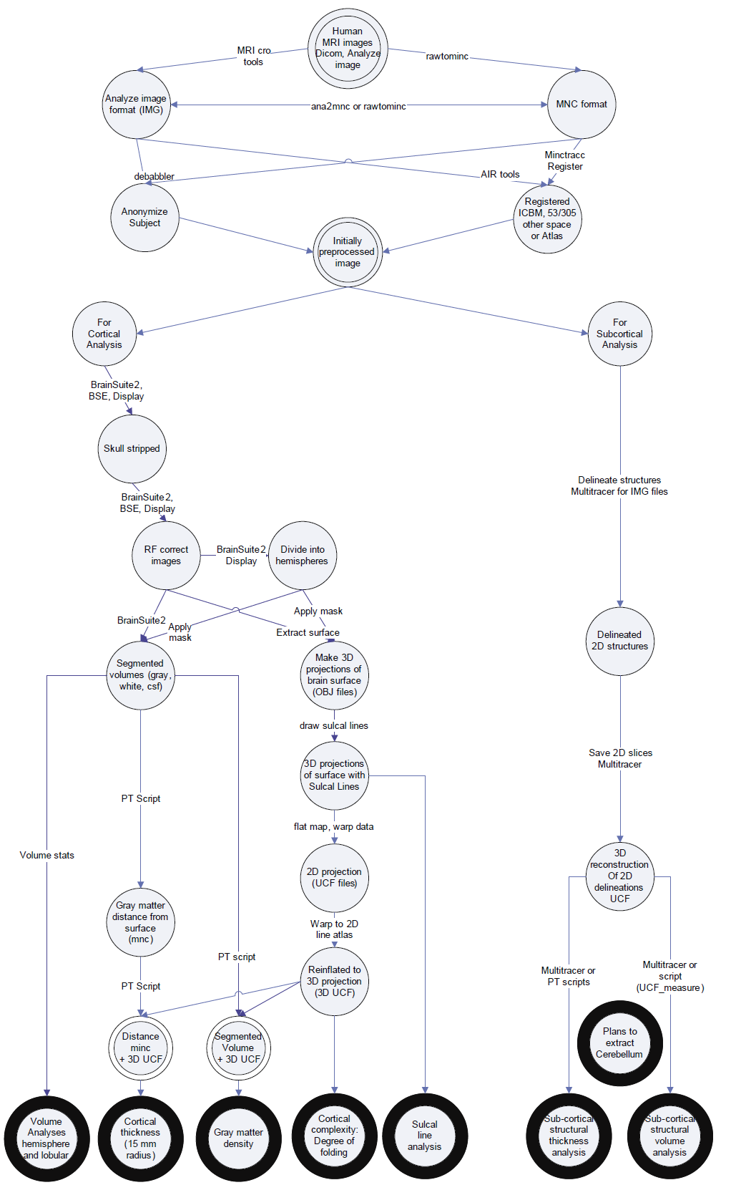
LONI Pipeline Processing and Analysis Workflow
Key:
Circle: data state
Arrows: data process
Dark circle: end analysis

Slide 4
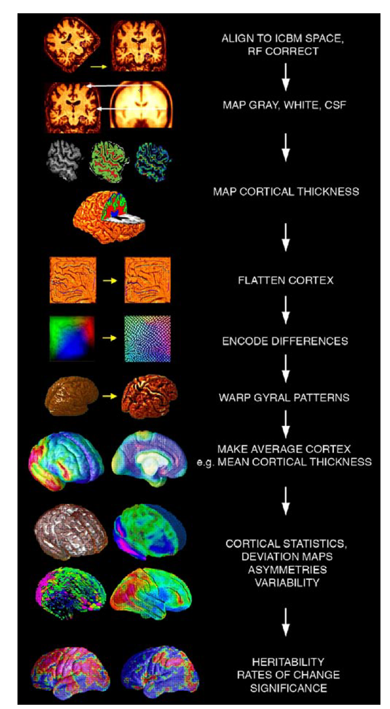
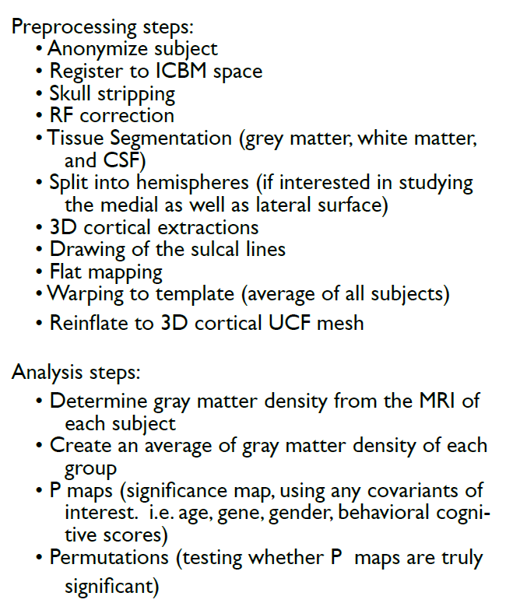

Slide 5
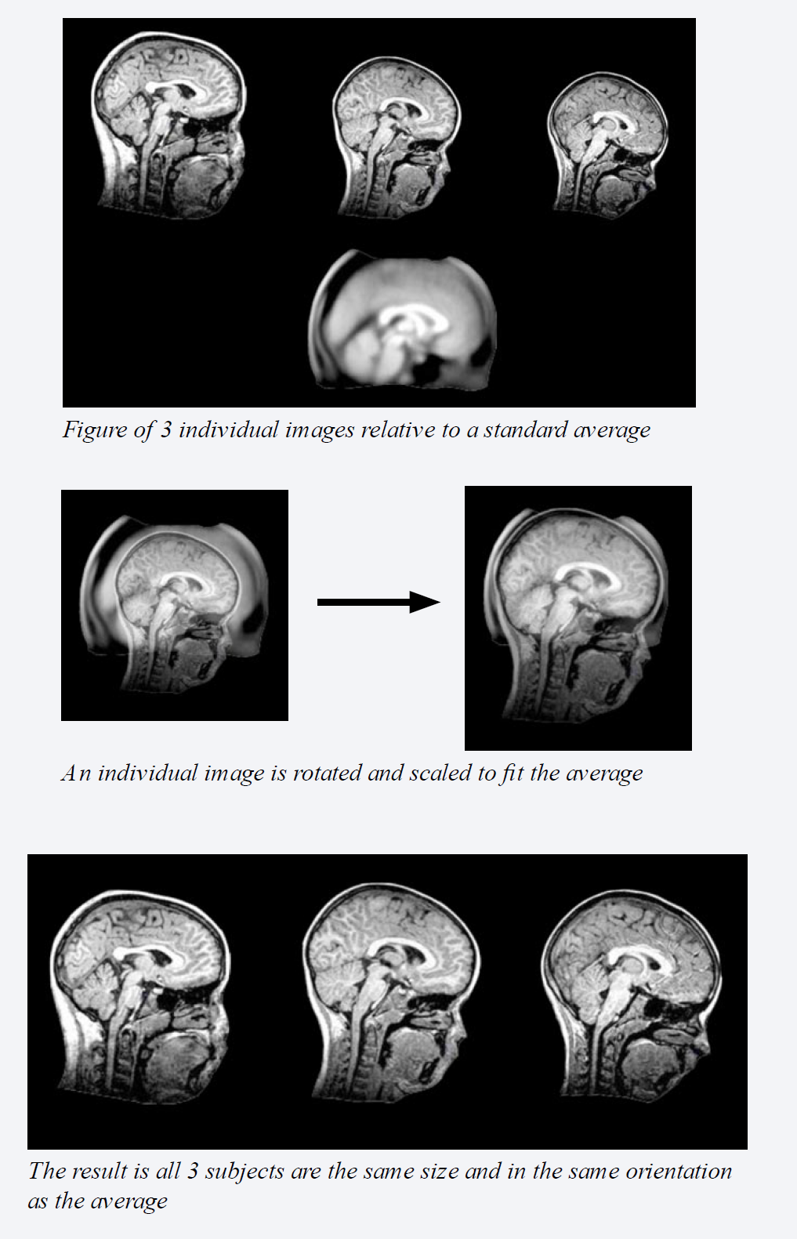
Register to Brain Atlas and Image
Positioning image into (average) standard position and space
Different standardize methods:
*Standard Pipeline workflow: Skull strip BEFORE image registration
Minctracc: Skull strip AFTER image registration (minctracc estimates the spatial transformation required to register two volumes together)

Slide 6
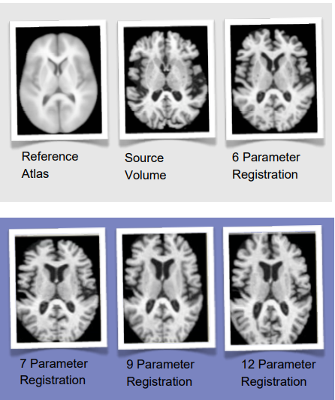
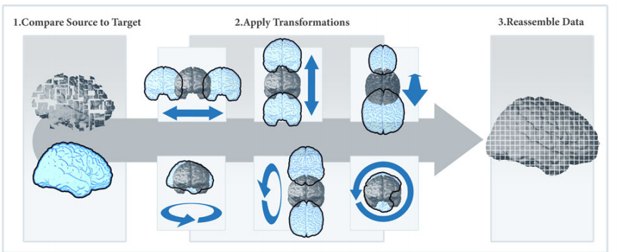
AIR (Automated Image Registration) Registration Workflow *DEMO
A registration algorithm generates a transformation matrix to align MRI images into standard space.

Slide 7
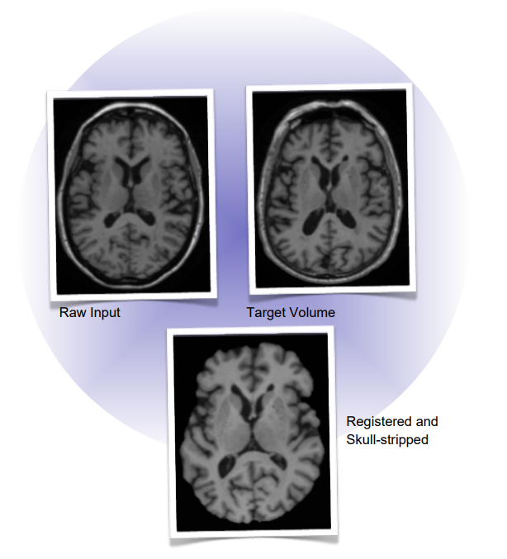
Automated Image Registration (AIR) & BrainSuite *DEMO
Heterogeneity of image analysis tools using parts of the two workflows and aggregate the function into a new workflow.
Results: The raw input is aligned to the target volume and skull-stripped.

Slide 8
Image Data Archive (IDA)
An environment for archiving, searching, sharing, tracking, and disseminating neuroimaging and related clinical data.
Multiple studies that open to the public, request access, and private
Largest open database: ADNI (Alzheimer’s Disease Neuroimaging Initiative)

Slide 9
Health Information Exchange and HIPPA
California
California Office of Health Information Integrity, California’s Statewide Health Information Policy Manual 193 (2016) - California's statewide health information policy manual requires that an agreement between an HIO and the entities it provides HIE services for must require that participating organizations obtain the appropriate authorization from the patient to allow the exchange of health information. The policy manual defines "authorization" as "a detailed document signed and dated by the patient that grants permission for the covered entity to use or disclose health information, for specified purposes."
Illinois
740 Ill. Comp. Stat. 110/9.6 - Illinois law requires that all HIEs require that participating healthcare providers give patients whose mental health information is on the HIE the opportunity to prohibit further disclosure of the record by the HIE to third parties, except in cases where such disclosure is permitted by law such as for purposes of public health reporting.

Slide 10
HIPPA continue
LONI Data Ownership
Neuroimaging and workflow can be stored locally.
However in order to use LONI modules and workflow. A connection to LONI server must be made. On connection local files are automatically transferred and stored on LONI server.
Potential patient identifiers
Facial muscles and tattoos

Slide 11
Future
Workflow Design?
Correlational Explanation (CorEx) Unsupervised learning workflow
Cooperate with Greg Ver Steeg
Potential Datawarehouse?
Potential tool to cooperate with outside institution?
Alternative transparent drag and drop UI workflow tool?

Slide 12
Conclusion
Pros:
Multiple pre- and processing workflow pipeline
Great basic analysis workflow
Well established brain atlas and databases
Cons:
USC LONI owns the data
Poor error feedback
Design docs are not regularly updated

