Slide 1

A formal verifier for the Diem blockchain Move language
David Dill, Lead Researcher, Blockchain, Novi September 29, 2021
Notes:
Thank you for inviting me to speak today.
I am a blockchain researcher for Novi, a Facebook company that develops applications for the Diem blockchain.
The research I am presenting today is one of Novi’s contributions to the Blockchain
You may have heard of the “Libra blockchain”. The association announced a name change from “Libra” to “Diem” in December.
The work I’ll describe today is the result of efforts from many people, including the Prover team, the Move platform team, and numerous interns.

Slide 2
Outline of the talk
Background
Move Prover
Using the Prover
Memory Model
Concluding Remarks

Slide 3
The Need for High Assurance
A high-assurance system is one designed to have have low likelihood of major failure
Blockchains should be high assurance systems
Large assets are at stake
Transactions are irreversible(-ish)
May be targeted by highly motivated, well-resourced adversaries
Already: hundreds of millions of dollars in losses from bugs on other blockchains

Slide 4
The Move Prover
The Move Prover is a formal verification tool for “smart contracts” on the Diem blockchain
It’s a “work in progress”
I will treat as an engineering project, not focus on research results
100% open-source: https://github.com/diem/move, https://github.com/diem/diem
Aspirations:
Allow complete specification of functional properties of smart contracts
Enable fully automatic verification that implementations meet specifications
Run only a little slower than a compiler
Can re-verify after every change (interactively and in continuous integration).

Slide 5
Keys to success
We’re starting with a clean slate
Trying to avoid problems with verifying traditional software
Programming languages are too complex and ill-defined
After-the-fact verification
Lack of concern about bugs (even when they should).
We are co-designing tools, programming style, verification methodology

Slide 6
Our view of a blockchain
_{Genesis}
_{State}
Transaction
Transaction
Transaction
Transaction
Transaction
At this level of abstraction, don’t care about multiple validators
Transactions update one blockchain state to create the next one
“Smart contract” is code that implements a transaction
Transactions are atomic – run to completion, or don’t change state

Slide 7
Diem blockchain state
addresses
0x0
0x1
0x2
...
0x11BA
...
...
...
DiemAccount
Balance<XDX>
Balance<XUS>
...
authentication_key: Vector<u8>
balance: Diem<XDX>
balance: Diem<XUS>
Sequence_number: u64
value: u64
value: u64

Slide 8
Move programming language
Move is a programming language for implementing smart contracts on the Diem blockchain.
Move is designed for safety (these are not specifically to enable formal verification)
Module can only call modules that already exist
No "re-entrancy" issues
"Resource" types model physical assets (can't be lost or duplicated)
Move has limited expressive power
References cannot be stored in state
No aliasing (enforce staticallly by borrow analysis)
No first-class procedures
No dynamic dispatch

Slide 9
Resources in Move
This struct is a “resource”, meaning it cannot be copied or deleted except in code in the module that defines it:
struct Diem<phantom CoinType> has store { value: u64 }
Resources can be used to implement “coins as values” – they can be stored anywhere, passed as arguments, etc. And they are “conserved”.
In contrast, Solidity/Ethereum contracts keep account balances in tables. Transferring currency updates the table.

Slide 10
Move compilation
Move program
_{Compiler}
_{Bytecode}
Bytecode verifier does semantic checks on the bytecode
Don't trust compiler to do these checks

Slide 11
Every change in blockchain state goes through the Move VM
Library
Modules in Move
Transaction
Scripts in Move
Virtual Machine
Store
Basic functionality is implemented in smart contracts, e.g.:
Currency
Accounts
Etc.

Slide 12
Outline of the talk
Background
Move Prover
Using the Prover
Memory Model
Concluding Remarks

Slide 13
Formal specification and verification of Move programs
Uses a classical (Floyd/Hoare) approach with explicit specifications
Specifications are mathematically precise
Specifications are separate from implementations
Specifications explicitly capture user intent
Formal verification proves that Move program satisfies specification for all inputs, in all states
Goal is to prove correctness, not to hunt for bugs
… although we expect it will be good for finding bugs.

Slide 14
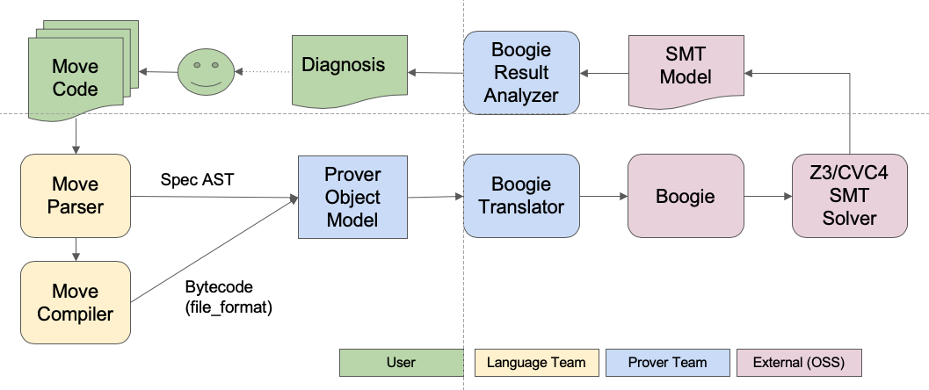
Lifetime of a verification task

Slide 15
Boogie code
Boogie (developed at Microsoft Research) is a intermediate language for verification -- between program and SMT solver
Looks approximately like a simple imperative language
Procedures
Assignment
Data structures based on theories in SMT solvers
Problem: Translate bytecode program to Boogie
Our approach
Implement each bytecode instruction as a Boogie procedure
Bytecode program -> a sequence of procedure calls
Specifications translate into a Boogie code + Boogie assumptions and assertions

Slide 16
Outline of the talk
Background
Move Prover
Using the Prover
Memory Model
Concluding Remarks

Slide 17
Move specification language
addresses
0x0
0x1
0x2
...
0x11BA
...
...
...
DiemAccount
RoleId
...
role_id: u64
Does a resource exist at the top level?
E.g. exists<DiemAccount>(0x2)
Access a value
E.g. global<RoleId>(0x2).role_id

Slide 18
Post-conditions
public fun publish_parent_vasp_credential(… addr: Address …) { … }
All specifications are enclosed in special blocks:
spec publish_parent_vasp_credential { // ParentVASP resource is published ensures exists<ParentVASP>(addr); // Field value of ParentVASP resource ensures global<ParentVASP>(addr).num_children == 0; }
Function name
repeated in spec

Slide 19
Aborts_if
Instead of run-time errors or exceptions, Move programs abort
(e.g., U64 overflow, out-of-bounds vector access)
Abort – no state change, except for consuming a bit of “gas” to pay for the computation
Programs are supposed to abort under some conditions
Verifier should not report an expected abort as an error
But unexpected abort is an error
Expected abort that does not occur is also an error
aborts_if specification capture programmer’s expectations about aborting.

Slide 20
Access control and aborts_if
Access control rule: Parent VASP can only be created by account with treasury compliance role.
spec create_parent_vasp_account { // RoleId has required value aborts_if global<RoleId>(creator_addr).role_id != TREASURY_COMPLIANCE_ROLE_ID with Errors::REQUIRES_ROLE; }
addresses
0x0
0x1
0x2
...
0x11BA
...
...
...
DiemAccount
RoleId
...
Role_id: u64

Slide 21
Global specifications
The most important properties are often "global"
Involve multiple functions
Involve properties of global state
Involve change (or no change) over time (limited "temporal properties")
Kinds of global properties:
Global invariants – properties guaranteed to be true for all time
Two-state invariants – properties comparing previous and current state

Slide 22
Example global invariant
Every address that has a DiemAccount also has a RoleId:
spec module { invariant [global] forall addr: address where exists<DiemAccount>(addr): exists<RoleId>(addr); }
addresses
0x0
0x1
0x2
...
0x11BA
...
...
...
DiemAccount
RoleId
...
Role_id: u64

Slide 23
Example two-state invariant
Two-state invariants can refer to pre- and post-states of state changes
We use them to specify simple ”temporal” properties
Example: Once a RoleId is stored at an address, it never changes
invariant update [global] forall addr: address where old(exists<RoleId>(addr)): exists<RoleId>(addr) && global<RoleId>(addr).role_id == old(global<RoleId>(addr).role_id)
addresses
0x0
0x1
0x2
...
0x11BA
...
...
...
DiemAccount
RoleId
...
Role_id: u64

Slide 24
Outline of the talk
Background
Move Prover
Using the Prover
Memory Model
Concluding Remarks

Slide 25
Aliasing and memory model
Aliasing of memory references creates major efficiency challenges
Reasoning about memory updates requires considering whether runtime memory locations are the same or distinct
There is often a combinatorial explosion of possible aliasing relationships
E.g., if memories are modeled as arrays, deeply nested array store expressions expand out to massive if-then-else trees covering all possibilities of location pairs equal and distinct

Slide 26
Move avoids aliasing!
Memory is tree-structured (records of records of records …)
References into memory (pointers to subtrees) can only be stored on the stack (local variables or parameters)
Static borrow-checker strictly forbids combinations of references that result in aliasing
Essentially, copy semantics

Slide 27
Move reference as copy-in/copy-out
f(&mut r, …)
t₁
Copy in referenced subtree
t₂
Reference &mut t₂
Modify subtree
Copy modified subtree out of f
t₂
t₂’

Slide 28
Move Prover Memory Model
Advantages
Eliminates combinatorial explosion of aliasing possibilities
Greatly simplifies “framing” – avoids need to specify memory that functions do not change
Convenience of imperative programming with (some of) the advantages of functional programming

Slide 29
Outline of the talk
Background
Move Prover
Using the Prover
Memory Model
Concluding Remarks

Slide 30
Similar projects
Similarities:
Smart contracts/blockchain
SMT-based
VeriSol – Microsoft Research
Solc-Verify – SRI
Certora – startup with proprietary technology
Difference: Based on Solidity and Ethereum (Issues in Solidity are very different from Move)

Slide 31
Current status
Extensive specifications for the Move standard library
Specified and verified all of the access control requirements documented in the “DIP-2” document (in github)
Specifications refer back to specific DIP-2 requirements
Specified and verified documented abort conditions in transaction scripts
Many other properties
All specifications verify automatically
30 secs or less per module
Formal verification is automatically run in continuous integration
Diem Framework, standard library + specifications in github.com/diem/diem
Move prover source code & documentation github.com/diem/move
Not yet supported for general use (maybe next year)
Rapidly evolving

Slide 32
Next
Next challenge: minimize cost, maximize benefit
Reduce need for “boilerplate” specifications
Better debugging
Tools for specification correctness & completeness
Many other improvements

Slide 33
Summary
Move programs (smart contracts) hit the sweet spot for formal verification
Impacts of bugs can be bad
Move programs are relatively simple
Starting with a clean slate makes the problem easier
Approach is highly automated Floyd/Hoare verification
Move and the Diem blockchain create some unique issues & opportunities

Slide 34
Thank you

