Slide 1

blockchain as a trusted Third Party
Craig Gentry
Berkeley Course on Decentralized Systems

Slide 2
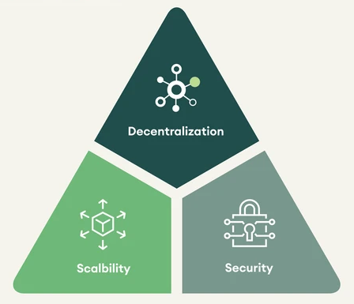

What is a blockchain good for?
Common answer: blockchain buzzword bonanza!
Decentralized
Scalable
Secure
Immutable
Censorship-resistant
Trustless
Blockchain’s special sauce
Blockchain Trilemma
Essential
So what? Why should I want these things?

Slide 3
So what? Why should I want these things?
Decentralization: No single party has undue influence.
But centralized solutions (like Visa) work fine.
Immutability: Transactions are irreversible.
But what if I make a mistake and want to reverse a transaction?
Censorship-resistance: Nobody can silence you or anyone else.
But what if we want to remove content that is criminal or harmful?
Trustlessness: Blockchain uses cryptography to eliminate the need for trust
Then why so many scams? And how do we check integrity of data entered into the blockchain?

Slide 4
Suggestion: Maybe using buzzwords – some ambiguous, and some that sound questionable or even scary – is not the best way to make your case?
Fair point.
Let’s give a more formal and fundamental answer.

Slide 5
What is blockchain good for?
Blockchain is our most efficient & robust construction of the ideal “trusted third party” (TTP) from cryptography
The TTP is decentralized
Decentralization makes trust more robust to corruption by distributing it
Harder to corrupt a big group
The TTP is cryptographic
Trusted to run cryptographic protocols correctly
Not trusted to walk your dog, or provide good legal advice
A decentralized cryptographic TTP is very useful!

Slide 6
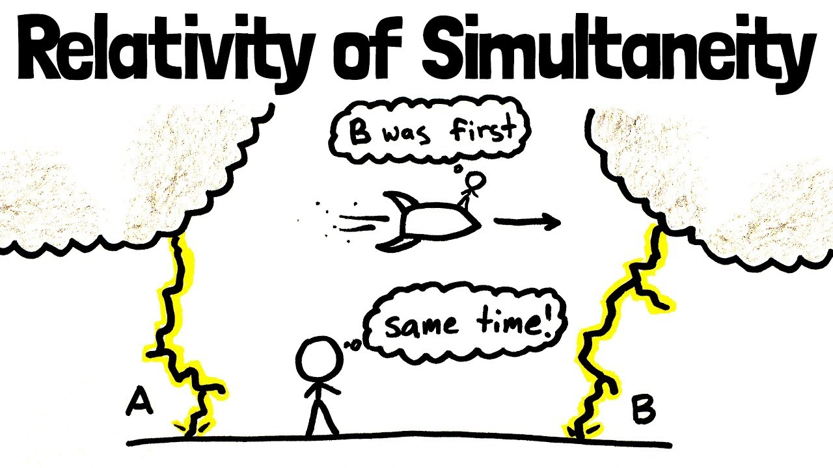
Current blockchains as cryptographic TTPs
TTP functionality of current blockchains:
Validate state (e.g. of a ledger or SCs) as it comes in (append only)
This functionality→ immutability, censorship-res., “consensus”
Decentralized consensus is surprisingly difficult and powerful!

Slide 7
Current blockchains as cryptographic TTPs
TTP functionality of current blockchains:
Validate state (e.g. of a ledger or SCs) as it comes in (append only)
This functionality→ immutability, censorship-res., “consensus”
Decentralized consensus is surprisingly difficult and powerful!
Get usual buzzword properties at transaction level
Emergent properties at network level
Agreed-upon state and rules allow ecosystems to thrive
Lifting local consensus (e.g., about assets) to global consensus has value by making those assets more visible/usable
Example by economist Hernando de Soto Polar on capitalism:
Capital formation thrives when there is broad consensus on property laws and assets. “What owners can do with their assets benefits from the collective imagination of a larger network of people.”

Slide 8



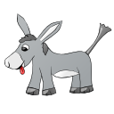




Future Blockchains as Cryptographic TTPs
Empower the TTP to do other cryptographic functionalities!
For many functionalities, the TTP needs to keep a secret
$$x_{1}$$
$${f(x}_{1}, x_{2}, x_{3})$$
$$x_{2}$$
$$x_{3}$$
This Photo by Unknown Author is licensed under CC BY-NC-ND

Slide 9
The Power of a Secret
Basic security setting: Client deposits secret at blockchain
To be “revealed only when the time is right”
More generally “used only in the prescribed manner”
Blockchain can keep a secret → Anyone can keep a secret at the blockchain to be opened conditioned on some event

Slide 10
Information Bazaar
Example: Information marketplace of user-controlled data
User deposits secret (e.g., genomic) data, and specifies policy of how the data can be shared (e.g., to medical researchers)
Researchers collect encrypted data with permissive policies, use homomorphic encryption to process the encrypted data, and use a SNARK to prove correct evaluation
After verifying SNARK, blockchain decrypts the final result
User surgically controls and monetizes its data in a way that is basically impossible without cryptography
Huge! Opens up economies that might not exist otherwise

Slide 11
Can a Blockchain Keep a Secret?
Fabrice Benhamouda, Craig Gentry, Sergey Gorbunov, Shai Halevi, Hugo Krawczyk, Chengyu Lin, Tal Rabin, Leonid Reyzin
eprint.iacr.org/2020/464

Slide 12
The Challenge
Secrecy: the secret must remain a secret
Unknown to the adversary, but still recoverable
As long as we have “honest majority” of stake
Even when the adversary is mobile
Efficiency: want a scalable solution
Communication/work does not increase as time goes by, or as more nodes are joining the network
Plausible practicality: No obfuscation/witness-encryption
Want solutions based on proactive secret-sharing

Slide 13




Proactive Secret-Sharing [OY91,CH93,…]
Periodic runs of a share-refresh protocol
The secret remains a secret as long as each committee separately has honest majority
Even if different parties are corrupted in different times
reshare
reshare
reshare
reshare
$$C_{1}$$
$$C_{2}$$
$$C_{3}$$
$$C_{4}$$

Slide 14
Why is it Hard on a Public Blockchain?
For scalability, communication only by a small committee
But then a mobile adversary can corrupt them all
Previous work assumed that committees have honest majority
We provide a mechanism to ensure it
Solution: keep committee members anonymous
So adversary cannot target them
Player replaceability: a committee member sends a single message, revealing its identity only after completing its job
How to (re)share a secret among an unknown committee?

Slide 15

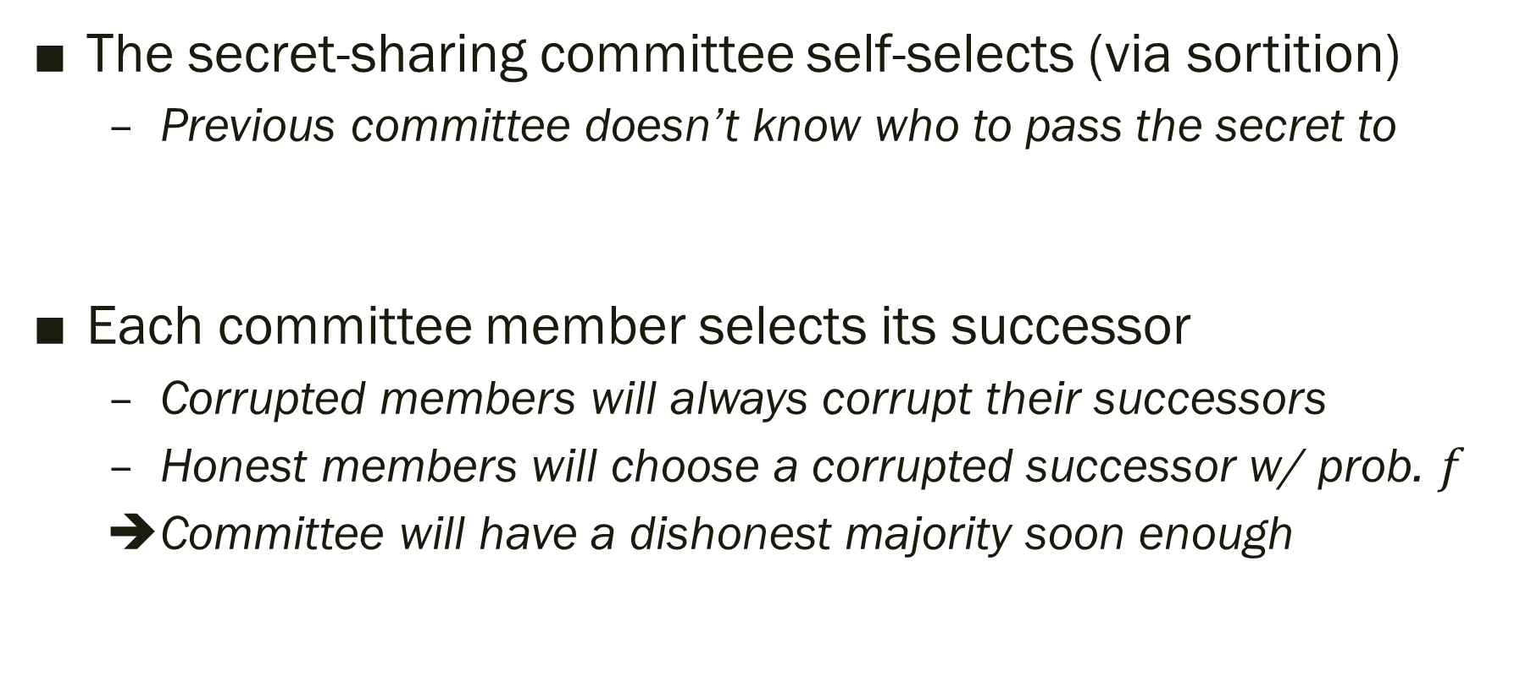



Some Directions that do not Work
The secret-sharing committee self-selects (via sortition)
Previous committee doesn’t know who to pass the secret to
Each committee member selects its successor
Corrupted members will always corrupt their successors
Honest members will choose a corrupted successor w/ prob. $f$
Committee will have a dishonest majority soon enough
?
reshare
reshare
reshare
reshare
reshare
$$C_{1}$$
$$C_{2}$$
$$C_{3}$$
$$C_{4}$$

Slide 16












Wouldn’t it be great if we had…
A target-anonymous channel functionality
$m$ visible input ports, $m$ hidden output ports
Random assignment of the output ports to an $m$-subset of the $N$ users
$$P_{1}$$
$$P_{2}$$
$$I_{1}$$
$$P_{3}$$
$$I_{2}$$
$$P_{4}$$
$$I_{3}$$
$$P_{5}$$
…
$$P_{6}$$
…
$$I_{m}$$
$$P_{N}$$

Slide 17
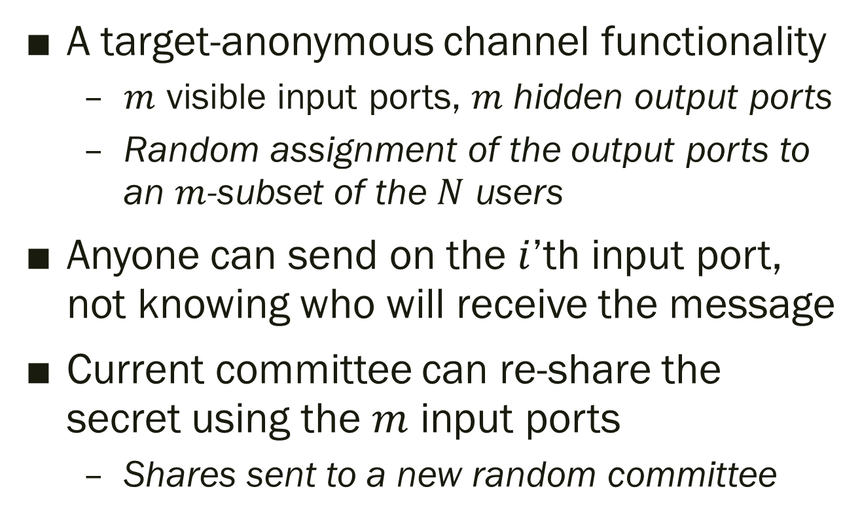
Wouldn’t it be great if we had…
A target-anonymous channel functionality
$m$ visible input ports, $m$ hidden output ports
Random assignment of the output ports to an $m$-subset of the $N$ users
Anyone can send on the $i$’th input port, not knowing who will receive the message
Current committee can re-share the secret using the $m$ input ports
Shares sent to a new random committee
$$P_{1}$$
$$P_{2}$$
$$I_{1}$$
$$P_{3}$$
$$I_{2}$$
$$P_{4}$$
$$I_{3}$$
$$P_{5}$$
…
$$P_{6}$$
…
$$I_{m}$$
$$P_{N}$$

Slide 18
Wouldn’t it be great if we had…
A target-anonymous channel functionality
$m$ visible input ports, $m$ hidden output ports
Random assignment of the output ports to an $m$-subset of the $N$ users
Anyone can send on the $i$’th input port, not knowing who will receive the message
Current committee can re-share the secret using the $m$ input ports
Shares sent to a new random committee
$$P_{1}$$
$$P_{2}$$
$$I_{1}$$
$$P_{3}$$
$$I_{2}$$
$$P_{4}$$
Doesn’t solve everything, but helps a lot
$$I_{3}$$
$$P_{5}$$
…
$$P_{6}$$
…
$$I_{m}$$
$$P_{N}$$

Slide 19
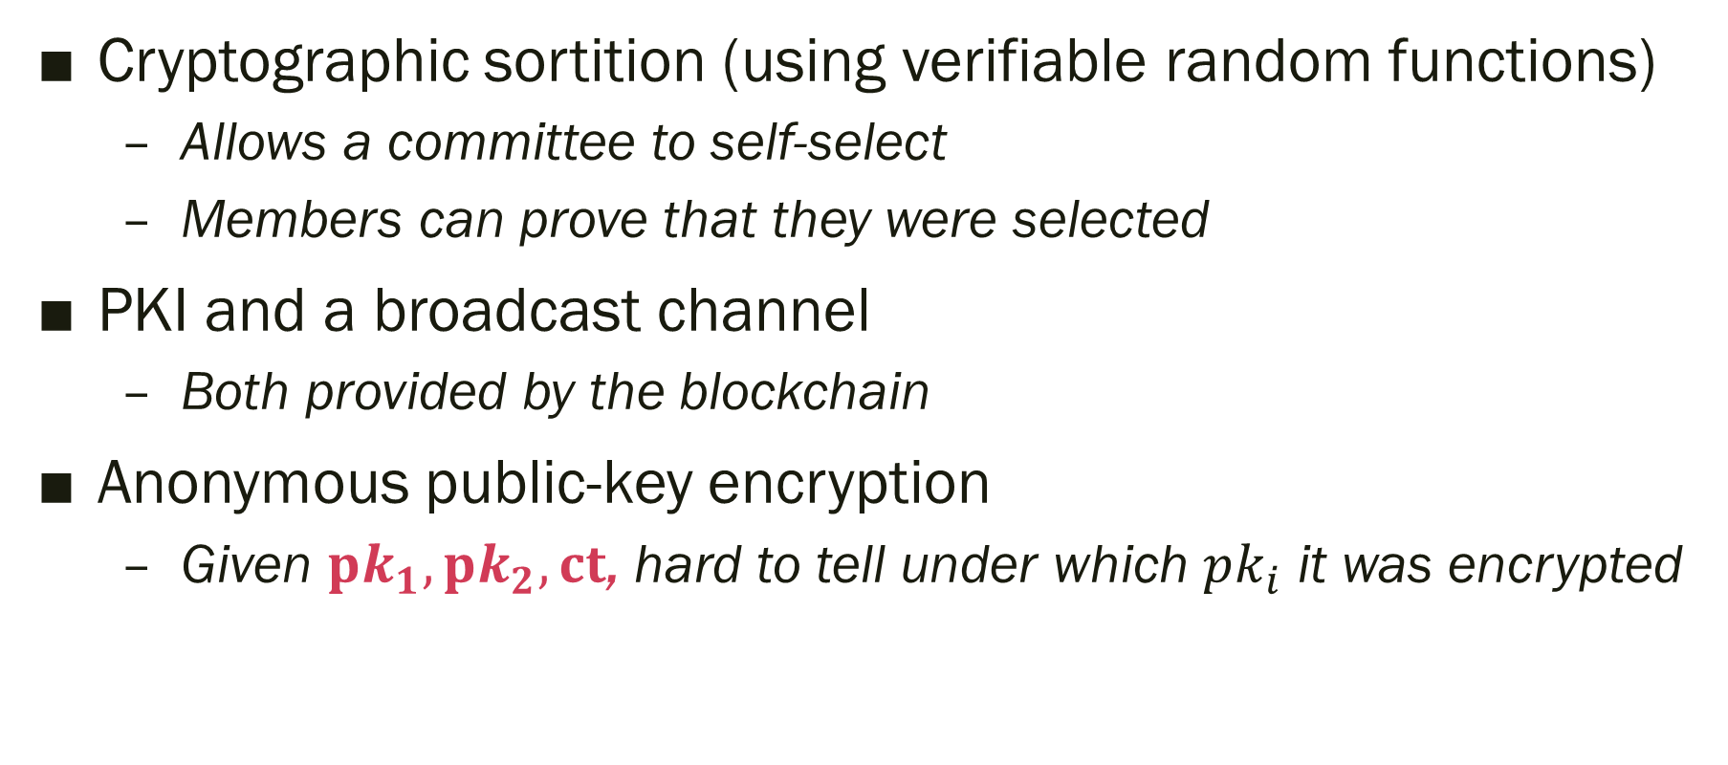
Tools
Cryptographic sortition (using verifiable random functions)
Allows a committee to self-select
Members can prove that they were selected
PKI and a broadcast channel
Both provided by the blockchain
Anonymous public-key encryption
Given $pk_{1}, pk_{2}, ct$, hard to tell under which $pk_{i}$ it was encrypted

Slide 20
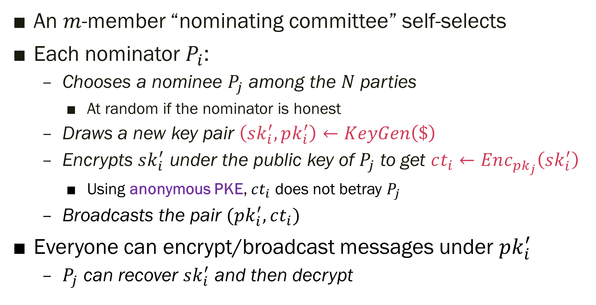
Approximating Target-Anonymous Channels
An $m$-member “nominating committee” self-selects
Each nominator $P_{i}$:
Chooses a nominee $P_{j}$ among the $N$ parties
At random if the nominator is honest
Draws a new key pair $\left(sk_{i}^{′}, pk_{i}^{′}\right)←KeyGen\left(\$\right)$
Encrypts $sk_{i}^{′}$ under the public key of $P_{j}$ to get $ct_{i}←Enc_{pk_{j}}\left(sk_{i}^{′}\right)$
Using anonymous PKE, $ct_{i}$ does not betray $P_{j}$
Broadcasts the pair $(pk_{i}^{′}, ct_{i})$
Everyone can encrypt/broadcast messages under $pk_{i}^{′}$
$P_{j}$ can recover $sk_{i}^{′}$ and then decrypt

Slide 21
Nominators Need Not Prove Anything
➔Corrupted nominators can (e.g.) nominate their friends
Proofs wouldn’t have worked anyways:
Even if forced to behave honestly, a corrupted nominator could turn around and corrupt its randomly-chosen nominee
Also: such proofs have “long statements”
Statements that include everyone’s public keys
So producing the proof is not scalable

Slide 22
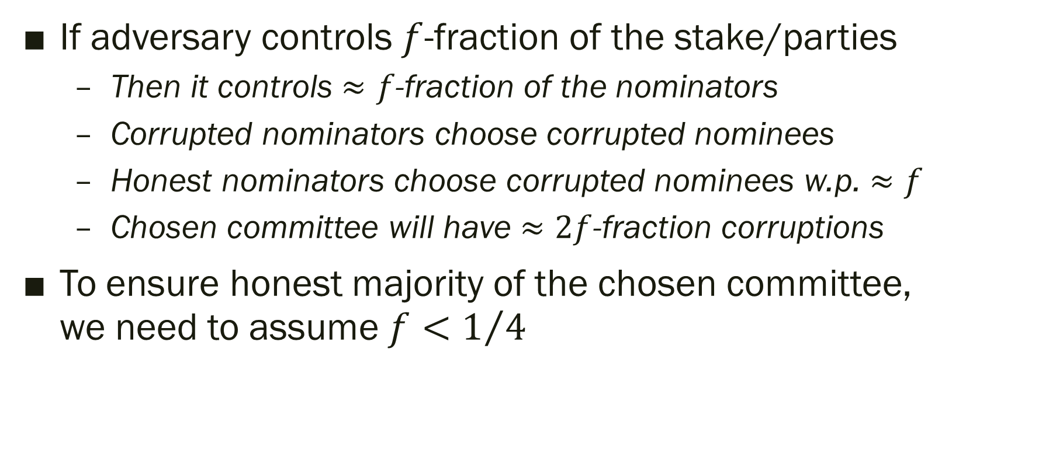
Resilience of Our Target-Anonymous Channels
If adversary controls $f$-fraction of the stake/parties
Then it controls $≈f$-fraction of the nominators
Corrupted nominators choose corrupted nominees
Honest nominators choose corrupted nominees w.p. $≈f$
Chosen committee will have $≈2f$-fraction corruptions
To ensure honest majority of the chosen committee, we need to assume $f<1/4$

Slide 23








The Overall Solution
$$C_{1}^{′}$$
$$C_{2}^{′}$$
$$C_{3}^{′}$$
$$C_{4}^{′}$$
Nominating committees
…
reshare
reshare
reshare
reshare
Secret-sharing committees
$$C_{1}$$
$$C_{2}$$
$$C_{3}$$
$$C_{4}$$
Re-sharing requires NIZK
Only for short statements with short witnesses
Depends only on the committee size
Hence solution is scalable

Slide 24
The End Result
A scalable proactive secret-sharing protocol
With “player replaceability”
Assuming that the adversary controls < ¼ of the stake
Room for improvement here
Can be implemented under DDH, DCR, LWE, …
Requires anonymous encryption under selective opening attacks
Can conceivably be made practical
Involves only proving “short statements” with “short witnesses”, independent of total stake or the blockchain history

Slide 25
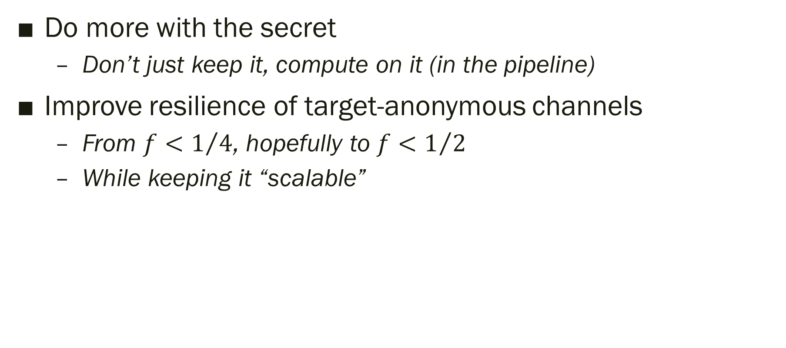
Problems Left Open
Do more with the secret
Don’t just keep it, compute on it (in the pipeline)
Improve resilience of target-anonymous channels
From $f<1/4$, hopefully to ${f<1}/2$
While keeping it “scalable”

Slide 26
Some Follow-up Work

Slide 27
Better committee selection and f ≈ ½ resilience
“Random-Index PIR and Applications”, Craig Gentry, Shai Halevi, Bernardo Magri, Jesper Buus Nielsen, and Sophia Yakoubov. eprint.iacr.org/2020/1248
Recall double-dipping attack: dishonest nominators pick dishonest nominees
Countermeasure: Use MPC on blockchain to emulate honest nominators
Don’t need general MPC: just a simple primitive (RPIR) to sample a random key together with its index

Slide 28
Practical NIZKs for resharing of secrets using lattice-based encryption
“Practical Non-interactive Publicly Verifiable Secret Sharing with Thousands of Parties”, Craig Gentry, Shai Halevi, Vadim Lyubashevsky. eprint.iacr.org/2021/1397
Efficient encryption for the shares
Regev encryption with “packing” many messages per ciphertext
Efficient proofs of correct sharing
Bulletproof for proving linear/quadratic relations
Various “proofs of smallness”

Slide 29
Exploration of the You-Only-Speak-Once (YOSO) Model (relating to player replaceability)
“YOSO: You Only Speak Once: Secure MPC with Stateless Ephemeral Roles”, Craig Gentry, Shai Halevi, Hugo Krawczyk, Bernardo Magri, Jesper Buus Nielsen, Tal Rabin, and Sophia Yakoubov. eprint.iacr.org/2021/210
YOSO is useful in other contexts (not just blockchain)
To defeat DDoS attacks
In computing with stateless components
The paper defines, explores and constructs YOSO MPC

Slide 30


