Slide 1
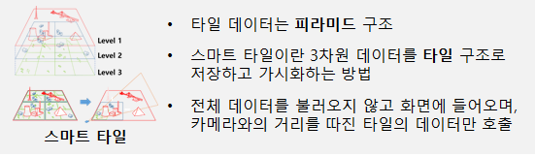
Tile data has the pyramid structure.
Smart tiles are how to save and visualize 3D data as tile structure.
It does not load full data in the display; only requests and renders data with consideration for visibilities and distances from the camera's viewpoint.
Smart Tiles

