Slide 1
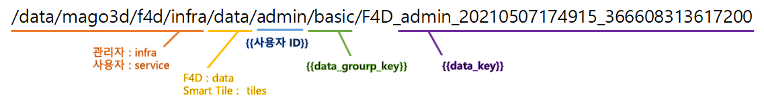
{{User ID}}
Admin : infra
User : service

