Slide 1
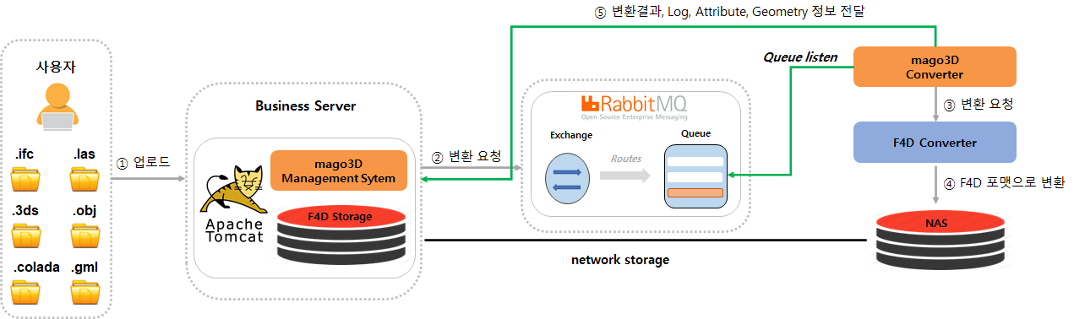
⑤ Pass the conversion results, logs, attributes, geometry information
User
③ Conversion request
② Conversion request
① Upload
④ Conversion to F4D format

