Slide 1
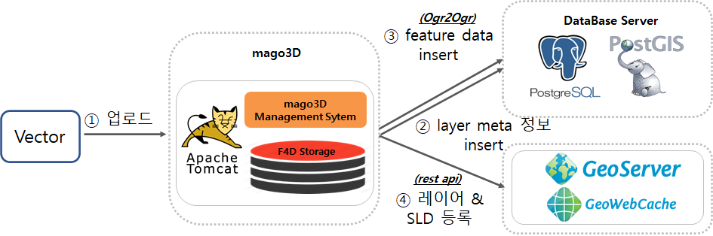
upload
layer meta info insert
layer & SLD registration

