Slide 1

padna
YOUR GRA CONNECT
ARTEFACT PRESENTATION
Continuance Intention Toward the GRA Padna App
A data-collection artefact: a conceptual model and questionnaire instrument for assessing why taxpayers keep using Padna.
Grounded in ECM, UTAUT2 and e-government trust literature.
BASE
EXTENSION
LENS
INSTRUMENT
ECM
UTAUT2
E-Gov Trust
One Questionnaire
Gaianand Ramnarace
1045370
BSc Information Technology
University of Guyana

Slide 2
01 · THE PROBLEM
Brief overview of the problem
CORE PROBLEM
STEP 2
STEP 3
Padna's long-term value depends on taxpayers returning to the app after first use — but the factors shaping continued use in Guyana have not been empirically tested.
STEP 1
→
Actual experience
→
Continue when needed?
Initial use
The artefact must measure post-use experience — not general awareness or first-time adoption.
Tax apps are periodic, so "not using it every month" is not automatically discontinuance. This study defines continuance as the intention to use Padna again when a relevant tax need or filing period arises .
Grounding: ECM explains post-adoption continuance (Bhattacherjee, 2001); trust matters in e-government (Carter & Bélanger, 2005; Bélanger & Carter, 2008).
PADNA · ARTEFACT
02

Slide 3
02 · RESEARCH QUESTION & OBJECTIVES
Research question and objectives
RESEARCH QUESTION
What factors influence Guyanese taxpayers' intention to continue using the GRA Padna App?
OBJECTIVES THE ARTEFACT MUST SUPPORT
1
Identify key determinants using ECM extended with selected UTAUT2 and trust constructs.
2
Measure confirmation, usefulness, satisfaction, trust/security, habit, social influence, facilitating conditions and continuance intention.
ARTEFACT ROLE
A deployable questionnaire and conceptual model that collect the exact evidence needed to answer the research question.
3
Collect analysis-ready data from prior Padna users through one structured questionnaire.
4
Test construct relationships and provide recommendations for sustained digital tax engagement.
ALIGNMENT CHECK
Every construct, item and analysis step is traceable to an objective or hypothesis.
PADNA · ARTEFACT
03

Slide 4
03 · RESEARCH DESIGN
Brief description of research design
DESIGN
PARTICIPANTS
INSTRUMENT
ANALYSIS
Quantitative, cross-sectional, explanatory.
Guyanese taxpayers who used Padna at least once.
One online questionnaire; no interview or demo.
Descriptive stats, reliability, validity and PLS-SEM where sample permits.
DESIGN JUSTIFICATION
ECM and UTAUT2 are theory-driven behavioural models commonly tested with survey data and SEM; therefore the instrument must generate reliable numeric indicators for each construct.
Sources: Bhattacherjee (2001); Venkatesh et al. (2012); Hair et al. PLS-SEM guidance used for measurement / structural model evaluation.
PADNA · ARTEFACT
04

Slide 5
04 · LITERATURE → MODEL RATIONALE
Literature review summary
ECM BASE
UTAUT2 EXTENSION
E-GOVERNMENT TRUST
GUYANA-SPECIFIC GAP
Confirmation, perceived usefulness and satisfaction explain why experienced users continue or discontinue.
Habit, social influence and facilitating conditions add behavioural, social and resource-access explanations.
Taxpayers share sensitive information, so agency trust and security perception are central.
Existing literature does not empirically test Padna continuance in Guyana; local digital access issues require contextual controls.
Carter & Bélanger, 2005; Bélanger & Carter, 2008; Gefen et al., 2003
Bhattacherjee, 2001; Roca et al., 2006
Venkatesh et al., 2012; Limayem et al., 2007
UNDP, 2023; GRIF, 2022; project proposal
LITERATURE GAP
Prior models explain adoption and continuance generally — but not Padna-specific continuance under Guyana's tax-season and digital-readiness context.
PADNA · ARTEFACT
05

Slide 6
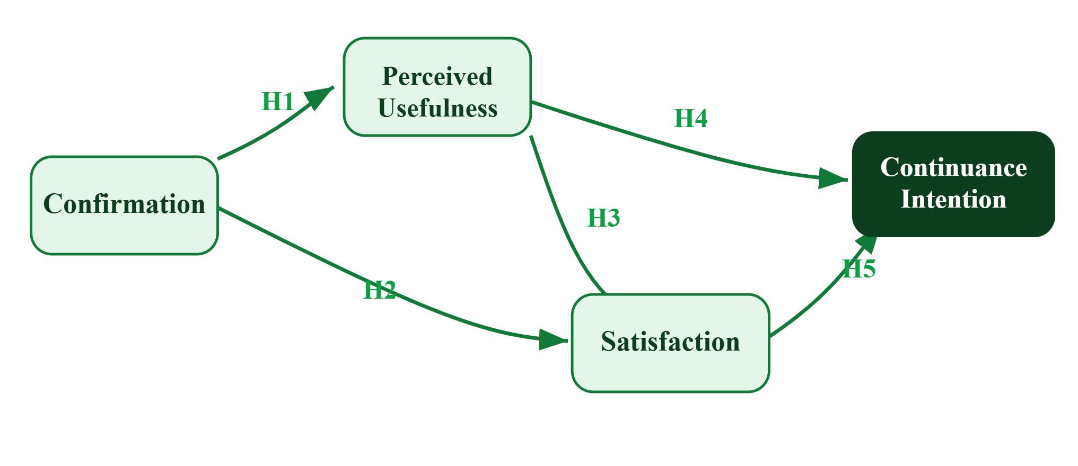
05A · ARTEFACT MODEL STRUCTURE
Base model: Expectation–Confirmation Model
WHY ECM?
It is built for post-adoption continuance — after users have actual experience with a system.
BASE PATHS (H1–H5)
Confirmation → usefulness & satisfaction; usefulness → satisfaction & continuance; satisfaction → continuance.
Bhattacherjee (2001); Davis (1989); Roca et al. (2006).
PADNA · ARTEFACT
06

Slide 7
05B · ARTEFACT MODEL STRUCTURE
Extended model
The base ECM is extended only where the literature and Padna context justify additional explanatory factors.
HABIT
SOCIAL INFLUENCE
FACILITATING CONDITIONS
TRUST & SECURITY PERCEPTION
Whether using Padna becomes the normal option for tax tasks.
Whether important others or work networks support use.
Whether users have resources, access and support.
Whether the system and agency are perceived as reliable with tax data.
E-government trust literature
UTAUT2; Limayem et al.
UTAUT / UTAUT2
UTAUT / UTAUT2
ECM core
UTAUT2 extension
Trust & security
PADNA · ARTEFACT
07

Slide 8
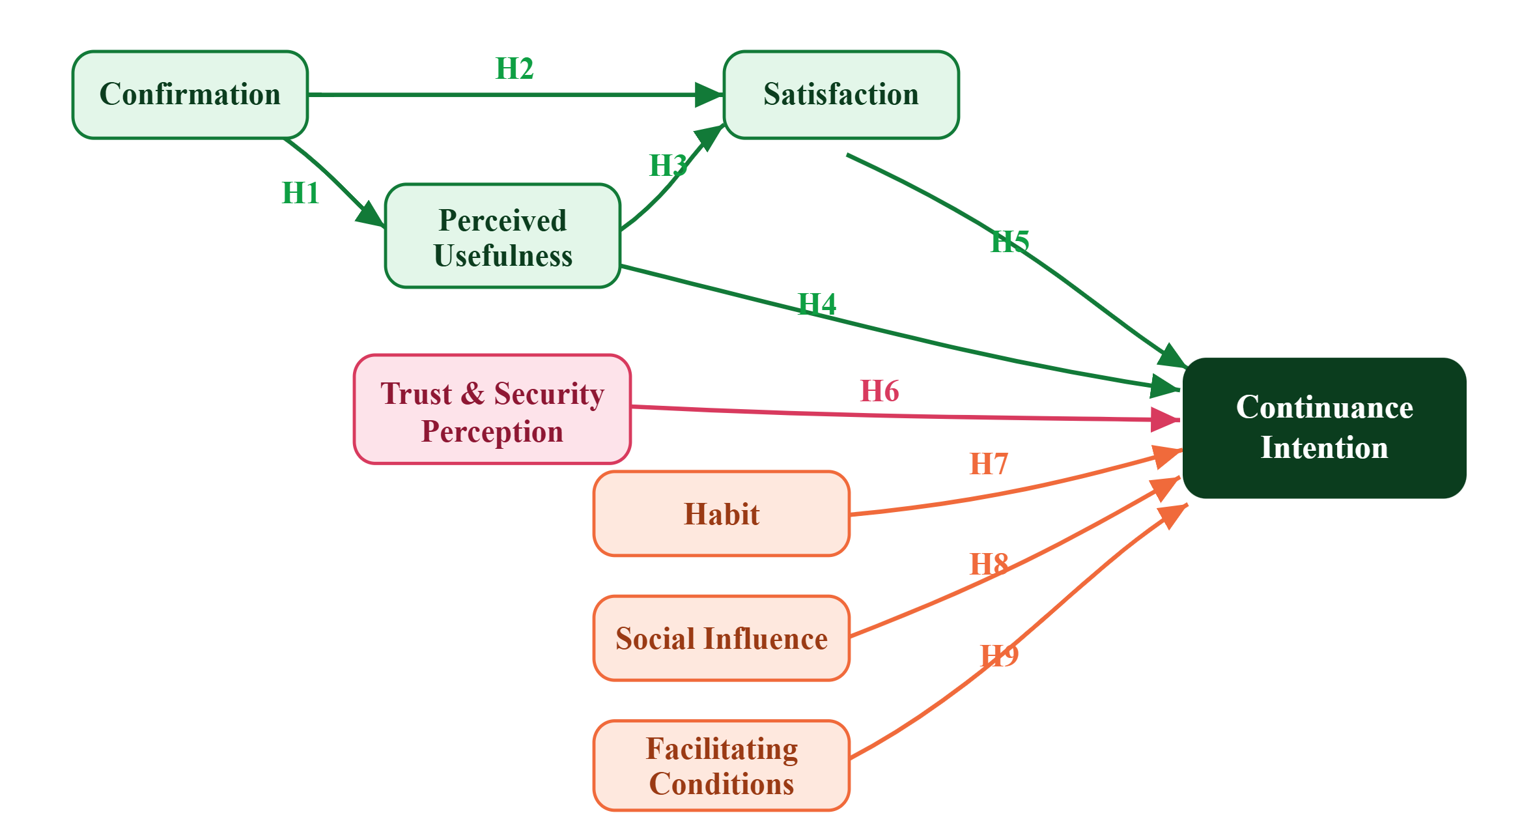
05C · FINAL CONCEPTUAL FRAMEWORK
Final conceptual framework and hypotheses
ECM core — H1–H5
UTAUT2 — H7–H9
Trust & security — H6
Continuance intention
CONTROLS
User type · Main tax task · Last use · Seasonal use pattern · Region / access
H1–H5 test ECM paths; H6–H9 test the extension paths to continuance intention. Controls support interpretation — especially tax-season usage.
PADNA · ARTEFACT
08

Slide 9
05D · ARTEFACT PACKAGE & ALIGNMENT
Artefact package and objective alignment
WHAT THE ARTEFACT CONTAINS
Conceptual framework
Questionnaire
Screening logic
Seasonality control
Analysis plan
Testable model and hypotheses
20–30 core questions, one instrument only
Prior Padna use required
Use again when tax need arises
Reliability, validity and SEM-ready data
OBJECTIVE 1
OBJECTIVES 2–5
OBJECTIVE 6
Model development → slides 6–8.
Each determinant becomes a construct scale → questionnaire sections.
Results identify evidence-based recommendations for GRA service continuity.
The artefact turns the theory into a deployable instrument that measures the exact evidence needed for Padna continuance.
PADNA · ARTEFACT
09

Slide 10
06A · EVALUATION INSTRUMENT
Construct-to-question mapping
One questionnaire · 5-point Likert scale · ~28 core items (24 construct items + 4 screening / context items).
CONSTRUCT
EXAMPLE ITEM
SOURCE
Confirmation
My experience with Padna matched what I expected.
Bhattacherjee (2001)
Perceived usefulness
Padna helps me complete tax-related tasks more efficiently.
Davis (1989); Bhattacherjee (2001)
Satisfaction
Overall, I am satisfied with my experience using Padna.
Bhattacherjee (2001)
Trust & security perception
I believe Padna protects my tax-related information.
Carter & Bélanger (2005); Bélanger & Carter (2008)
Facilitating conditions
I have the device, internet access and support needed to use Padna.
Venkatesh et al. (2012)
Continuance intention
I intend to use Padna again when I have a relevant tax task.
Bhattacherjee (2001); Roca et al. (2006), adapted
PADNA · ARTEFACT
10

Slide 11
06B · EVALUATION, ETHICS & ANALYSIS
Instrument evaluation, ethics and analysis
PILOT & RELIABILITY
VALIDITY & ANALYSIS
ETHICS
Pilot with 20–30 prior users
Revise unclear wording only
Cronbach's alpha ≥ .70
Descriptive statistics and cross-tabs
CR ≥ .70, AVE ≥ .50, HTMT check
PLS-SEM / path testing if sample permits
Informed consent
Anonymous and confidential responses
No unnecessary sensitive data such as race or exact TIN
EVALUATION CLAIM
The instrument is reliable if items consistently measure their constructs, and valid if the measurement model supports the construct structure.
PADNA · ARTEFACT
11

Slide 12
07 · CONSTRAINTS & RESPONSIBLE CLAIMS
Constraints and responsible claims
1
Seasonal use
2
Sampling and access
Tax-related use may be periodic, so findings speak to intention to reuse when needed.
Online sampling may overrepresent connected and digitally literate users.
3
Instrument limits
4
Model limits
Questionnaires provide broad, self-reported evidence but limited depth.
ECM–UTAUT2–trust explains behavioural intention, not all operational or policy causes.
RESPONSIBLE CLAIM
The study can identify statistically supported determinants of Padna continuance intention among surveyed prior users.
PADNA · ARTEFACT
12

Slide 13
APPENDIX · NOT PART OF 7 MINS
References
Bélanger, F., & Carter, L. (2008). Trust and risk in e-government adoption. Journal of Strategic Information Systems, 17(2), 165–176.
Hair, J. F., Hult, G. T. M., Ringle, C. M., & Sarstedt, M. (2022). A Primer on Partial Least Squares Structural Equation Modeling (PLS-SEM) (3rd ed.). Sage.
Bhattacherjee, A. (2001). Understanding information systems continuance: An expectation-confirmation model. MIS Quarterly, 25 (3), 351–370.
Limayem, M., Hirt, S. G., & Cheung, C. M. K. (2007). How habit limits the predictive power of intention. MIS Quarterly, 31(4), 705–737.
Carter, L., & Bélanger, F. (2005). The utilization of e-government services. Information Systems Journal, 15(1), 5–25.
Rana, N. P., Dwivedi, Y. K., & Williams, M. D. (2015). Citizen adoption of e-government: meta-analysis. Information Systems Frontiers, 17 (3), 547–563.
Davis, F. D. (1989). Perceived usefulness, perceived ease of use, and user acceptance of IT. MIS Quarterly, 13(3), 319–340.
Roca, J. C., Chiu, C. M., & Martínez, F. J. (2006). Understanding e-learning continuance intention. IJHCS, 64(8), 683–696.
Dwivedi, Y. K., et al. (2017). Electronic government research: review and future research agenda. Government Information Quarterly, 34 (3), 346–361.
UNDP. (2023). Digital Readiness Assessment: Guyana.
United Nations DESA. (2024). UN E-Government Survey 2024: Accelerating Digital Transformation for Sustainable Development.
Gefen, D., Karahanna, E., & Straub, D. W. (2003). Trust and TAM in online shopping. MIS Quarterly, 27(1), 51–90.
Venkatesh, V., Morris, M. G., Davis, G. B., & Davis, F. D. (2003). User acceptance of IT: Toward a unified view. MIS Quarterly, 27 (3), 425–478.
GRIF. (2022). ICT Access and E-Services for Hinterland, Poor and Remote Communities: Final Project Report.
Venkatesh, V., Thong, J. Y. L., & Xu, X. (2012). Consumer acceptance and use of IT: Extending UTAUT. MIS Quarterly, 36(1), 157–178.
PADNA · ARTEFACT
13

