Slide 1

Performance Comparison of MPI Broadcast Algorithms
Gaia Alessio

Slide 2

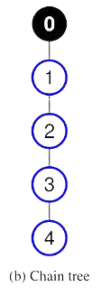
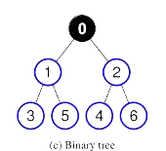
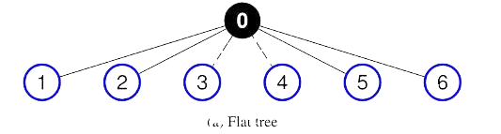
Algorithms

Slide 3
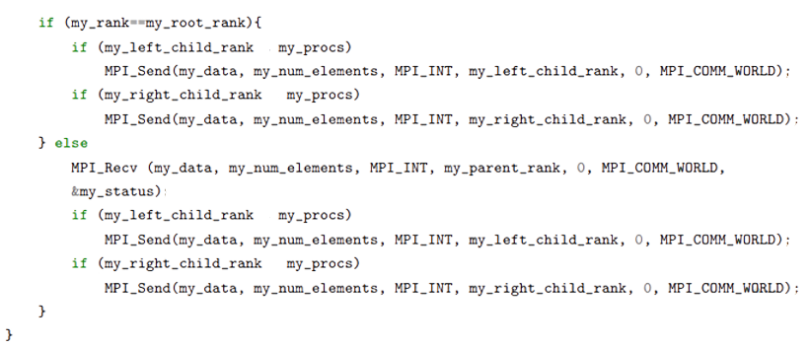
Binary tree

Slide 4
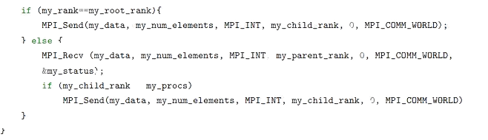
Chain

Slide 5
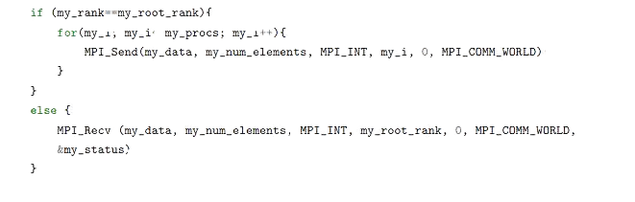
Flat

Slide 6
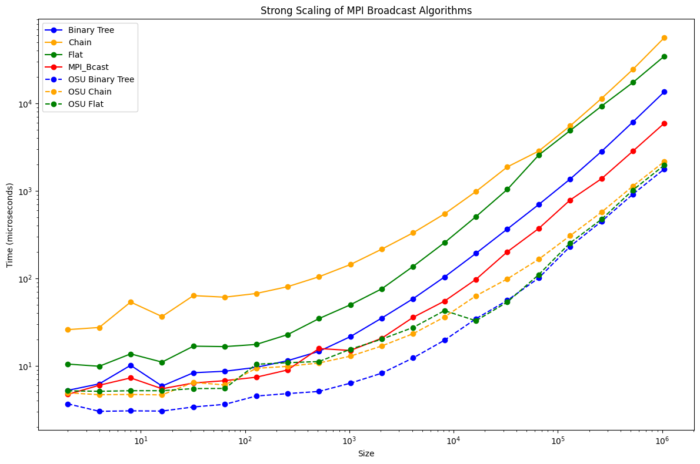
Strong scalability

Slide 7
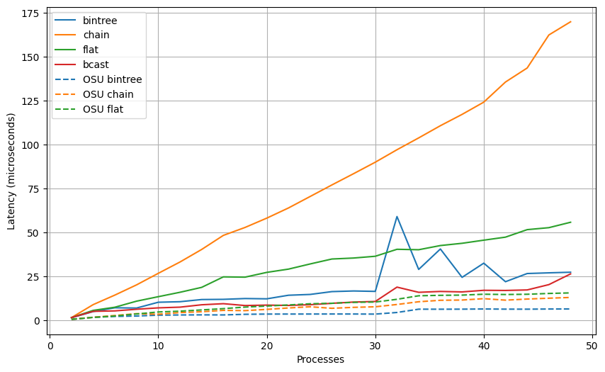
Weak scalability

Slide 8
The Mandelbrot set

Slide 9
Introduction
Develop an efficient and scalable code for generating the Mandelbrot set using OpenMP.
Complex geometric structure defined by the iterative function 𝑓_{𝑐}(𝑧)=𝑧²+c in the complex plane.
A point 𝑐 is in the Mandelbrot set if the series does not diverge.

Slide 10
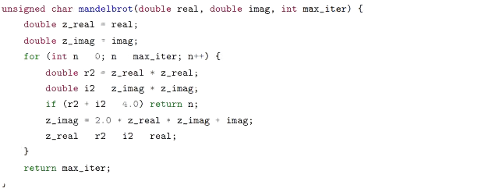
Implementation

Slide 11
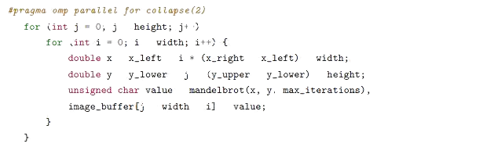
Implementation

Slide 12
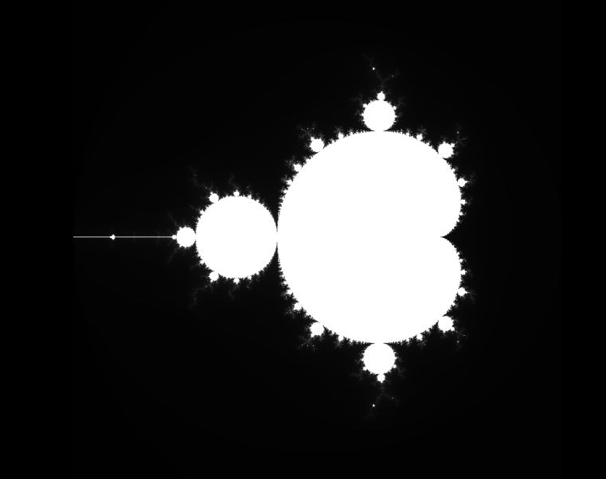

Slide 13
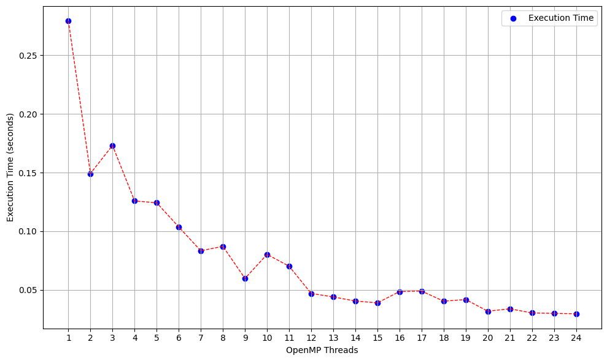
Strong scalability

Slide 14
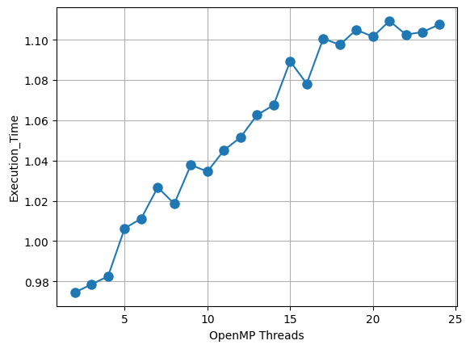
Weak scalability

