Slide 1
IPL Team Selection
BY-:
Garima Kundnani

Slide 2
Introduce the Topic
In this project we have to suggest players to a sports management company for a new IPL Team.
We have to suggest such players who can maximise the chances of winning the match in IPL-2024.

Slide 3
Introduction To Data
The dataset provided by the team is of previous IPL years(2016-2022).
In this dataset two different datasets are provided one of bowlers and other of batsman.

Slide 4
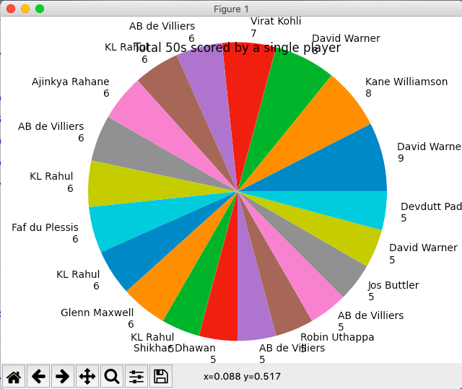
EDA

Slide 5
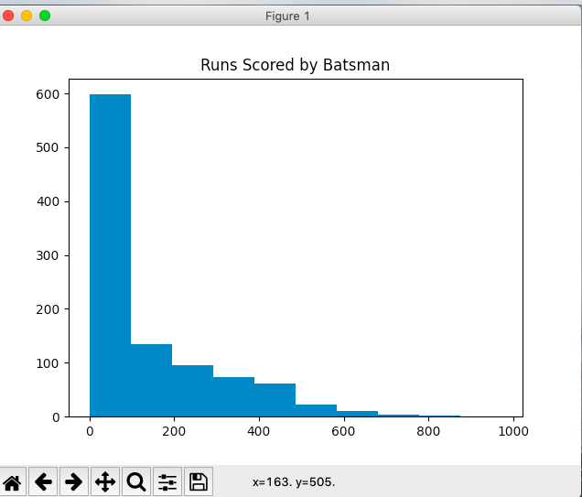

Slide 6
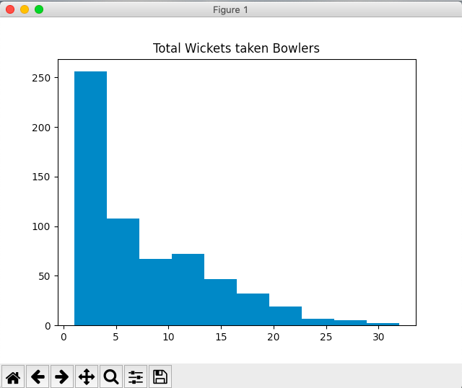

Slide 7
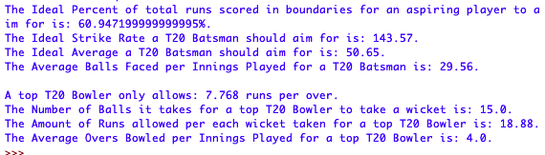
Final Model

Slide 8
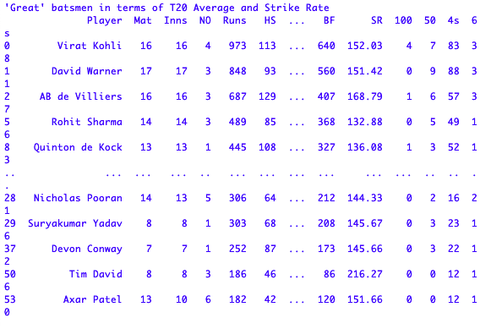
Interesting Finding

Slide 9
Conclusion
Our rating system is definitely not the best out there but it does a good job of displaying the players that are dominant across all metrics.
Also the goals/targets section is very helpful and I hope that it does benefit an aspiring cricketer out there looking to replicate their favourite players.

