Slide 1
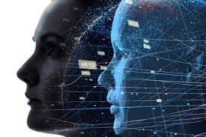

Slide 2
contents
INTRODUCTION
HISTORY
WHY DIGITAL TWIN
TYPES OF DIGITAL TWIN
ARCHITECTURE
WORKING OF DIGITAL TWIN
ADVANTAGES
DISADVANTAGES
APPLICATIONS
FUTURE SCOPE
CONCLUSION

Slide 3
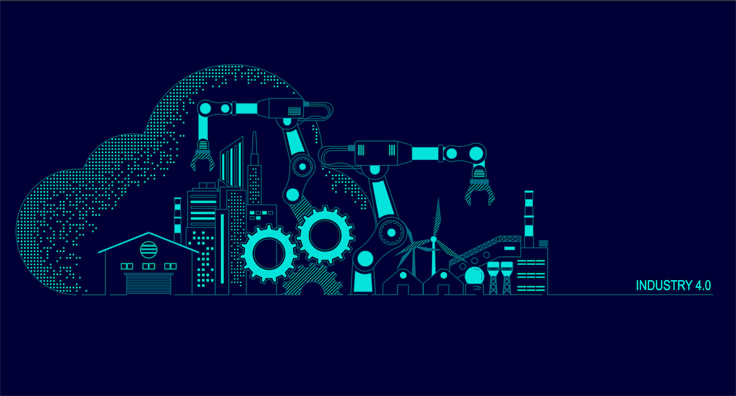
INTRODUCTION
Digital Twins integrate internet of things, artificial intelligence, machine learning and software analytics to create spatial network graph, living digital simulation models that update and change as their physical counterpart change. They are used for enhancing performance and reducing operating cost, offer the business including increased reliability of equipment and production lines.

Slide 4
HISTORY
The concept and model of the digital twin was publicly introduced in 2002 by Grieves, then of the university of Michigan, at a society of manufacturing engineers conference in Troy, Michigan. Grieves proposed the digital twin as the conceptual model underlying product lifecycle management (PLM).

Slide 5

Why digital twin?
With the help of digital twin, companies can test and validate a product before it even exits in the real world. By creating a replica of the planned production process, a digital twin enables engineers to identify any process failures before the product goes into production.

Slide 6
DIGITAL TWIN
Digital twins are virtual replica of physical devices .
Digital twin technology can be used to replicate processes in order to collect data to predict how they will perform.

Slide 7
Product life cycle management
Challenging conventions through Digital twins concepts and transform manufacturing.
6 step process being introduced to this concept.

Slide 8
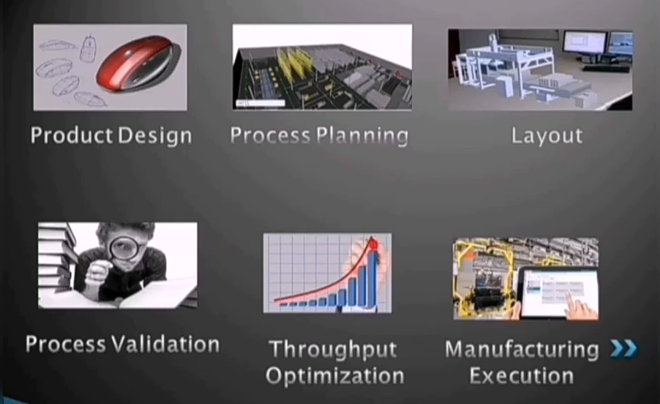
Steps

Slide 9
TYPES
Digital Twin Prototype (DTP)
Digital Twin Instance (DTI)
Digital Twin Aggregate (DTA)
DT’s are operated on in a digital twin environment (DTE)

Slide 10
Purpose
Purpose Digital Twin Environment (DTE)- this is an integrated, multi-domain physics application space for operating on Digital Twins for a variety of purposes
Predictive
interrogative

Slide 11
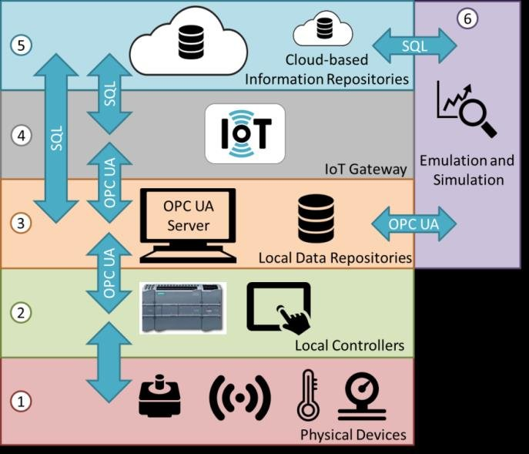
Architecture

Slide 12
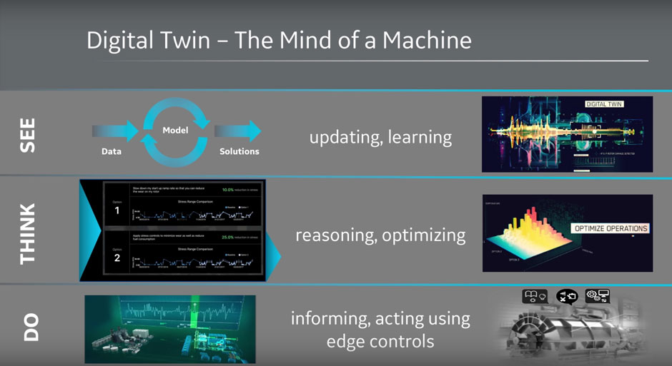
WORKING

Slide 13
Underlying technologies
Internet of Things
Cloud Computing
API and Open Standards
Artificial Intelligence
Augmented, Mixed and Virtual Reality

Slide 14
ADVANTAGES
Performance monitoring
Improved productivity
Increased reliability
Performance tuning
Customer support

Slide 15
DISADVANTAGES
Handling data
Compatibility challenges
Inconsistencies
Security

Slide 16
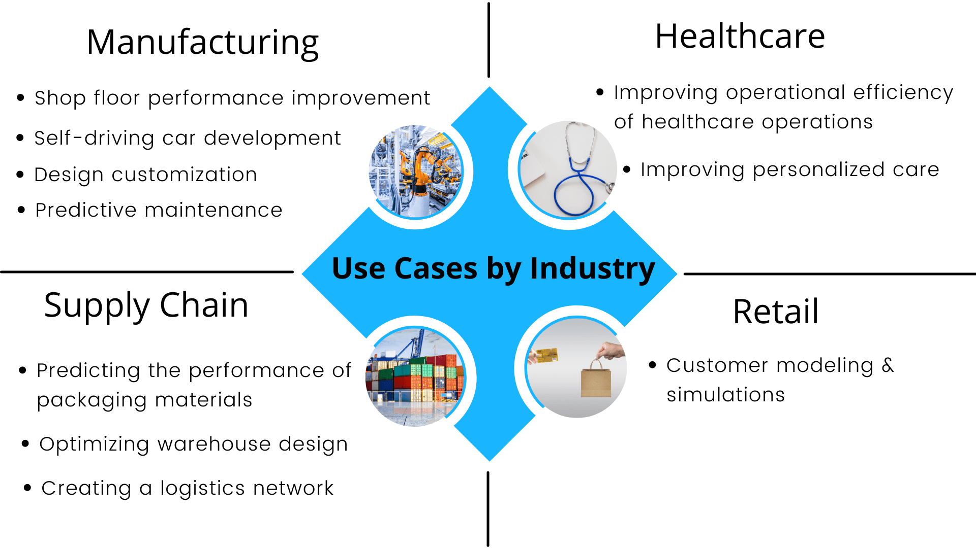
APPLICATIONS

Slide 17
Conclusion
In recent years, there has been an unexpected progress in the technologies and capabilities of both the physical product and virtual product, the Digital Twin. Digital twins will evolve from concept to reality for nearly everything everyone, every service, and every network.
Digital twin usage is being driven through the rise of loT designed sensors with the future of both going hands in hand. Sensors are able to deliver the data on how an object is operated and its reaction to the environment while implementing digital twins can improve analysis, condition simulation, operations, and value.

Slide 18
Future scope
As per estimates, the market for digital twin is set to grow at a rate of more than 30% per year from 2020 till 2025. An increase in demand for IIoT and cloud-based platforms like Thing Worx and a desire to be globally competitive are set to propel the demand for digital twin technology. India and other countries are already investing into IoT; digital twin is one more step in the right direction.

Slide 19
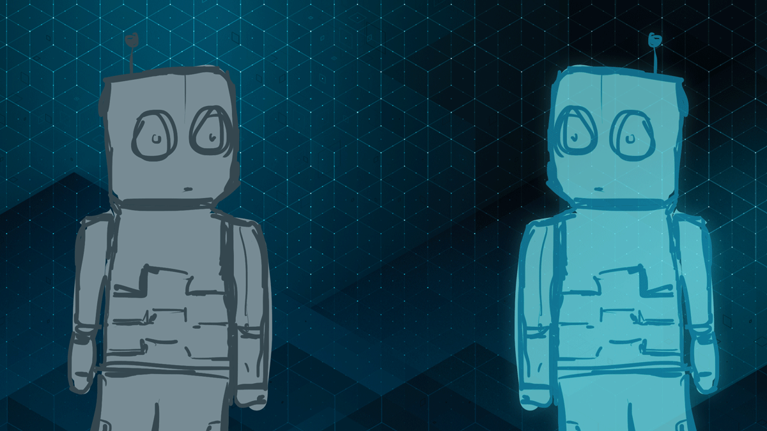

Slide 20
