Slide 1

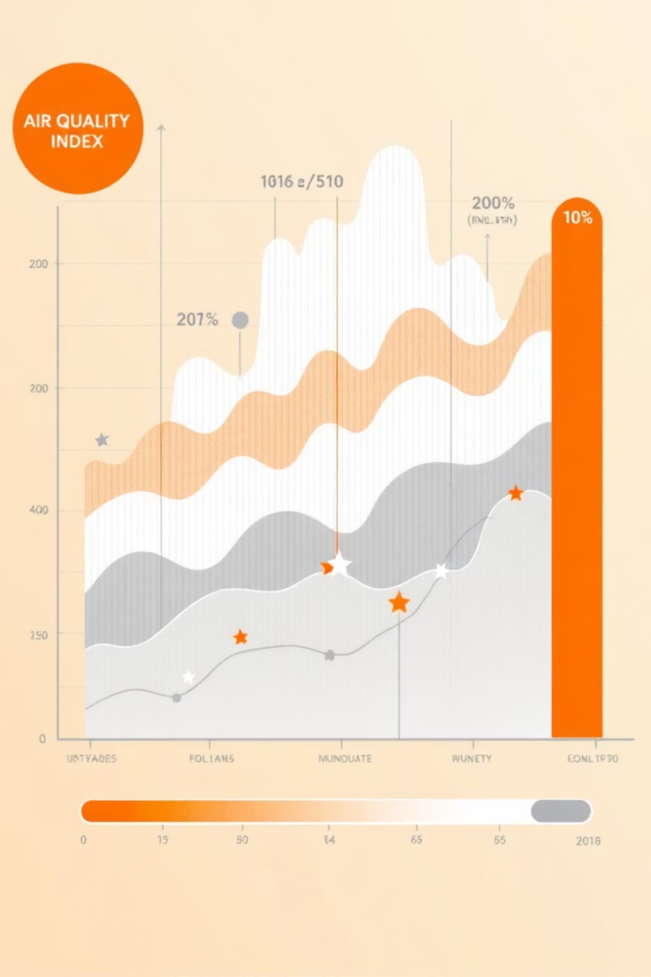

Exploratory Data Analysis of Air Quality Index (AQI) Pollutant , Spatial, and Seasonal Factors
Presented by: Gajala Parween
Domain:- Environmental Data Analytics
Organization:- Innomatics Research Labs
Dataset Source:- Public Air Quality Dataset kaggle

Slide 2

Problem Statements :-
To Analyze historical Air Quality data and Identify Pollutant-based ,
Spatial,and Seasonal factors influencing the AQI .
Dataset Description :-
Publicly available air quality dataset
Collected from air quality monitoring stations
Contains pollutant concentration measurements across multiple citie
Key Pollutant Parameters:-
PM2.5, PM10
NO₂, SO₂
CO, O₃

Slide 3

Data Foundation
Our Air Quality Dataset at a Glance
Our analysis leverages a comprehensive historical air quality dataset, meticulously compiled to capture a wide array of environmental parameters and their impact on the Air Quality Index.
Key Pollutant Parameters
Additional Attributes
PM2.5: Fine Particulate Matter
City: Geographic location of data collection
PM10: Coarse Particulate Matter
NO₂: Nitrogen Dioxide
Datetime: Timestamp for each observation
SO₂: Sulfur Dioxide
CO: Carbon Monoxide
AQI_Bucket: Categorical AQI classification
O₃: Ozone
Target Variable
AQI: The Air Quality Index (numerical value)

Slide 4
Ensuring Data Integrity
Data Cleaning & Preprocessing Workflow
Rigorous data cleaning and preprocessing steps were undertaken to guarantee the quality, consistency, and reliability of the dataset, preparing it for insightful analysis.
01
02
03
Datetime Conversion
Feature Extraction
Missing Value Handling
Converted the 'Datetime' column to a proper datetime format, enabling robust time-series analysis.
Extracted 'Year', 'Month', and 'Day' from the datetime object for temporal and seasonal analysis.
Thoroughly checked for and addressed all missing values, ensuring a complete and coherent dataset.
04
05
Outlier Visualization
Final Dataset Readiness
Used boxplots to visualize outliers in pollutant concentrations and AQI, retaining them as crucial indicators of real-world extreme pollution events.
The dataset is now clean, consistent, and fully prepared for exploratory data analysis (EDA).

Slide 5

Introduction
Understanding the What is AQI..?
AQI stand for AIR QUALITY INDEX .This is a single number that are reperesent overall air pollution by combining multiple the polluant concentration . Higher AQI means worse air quality and higher health risk .
Health Impacts
Poor air quality is directly linked to severe health consequences, including respiratory diseases, cardiovascular problems, and a notable reduction in life expectancy.
Monitoring is Key
Effective monitoring and comprehensive understanding of air pollution patterns are essential for robust public health protection and informed environmental management strategies.

Slide 6
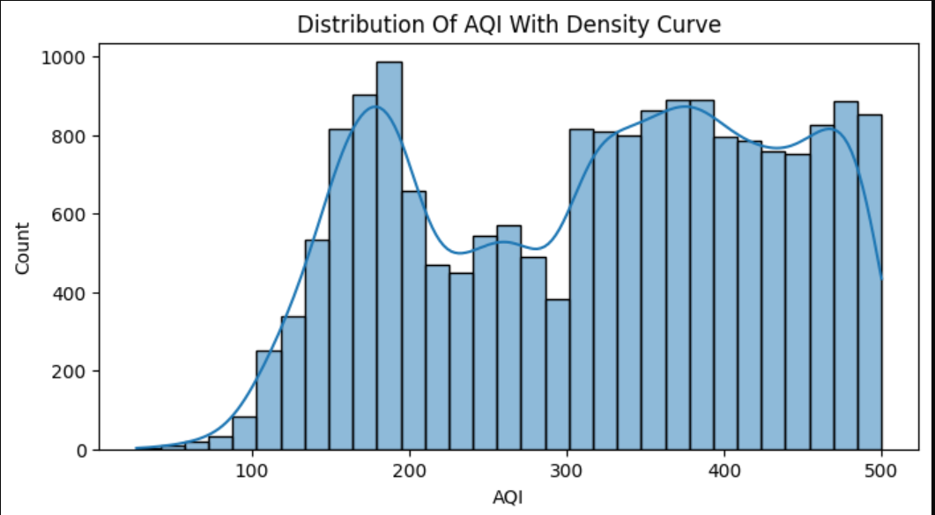
AQI Distribution – Target Variable Behavior
What This Plot Shows
Overall distribution of AQI across all time periods
Focuses on general pollution severity, not city-level differences
Key Observations (Data Analyst View)
AQI values show a right-skewed distribution
Moderate pollution levels occur frequently
High and extreme AQI values appear regularly
Distribution is non-normal and multi-modal

Slide 7
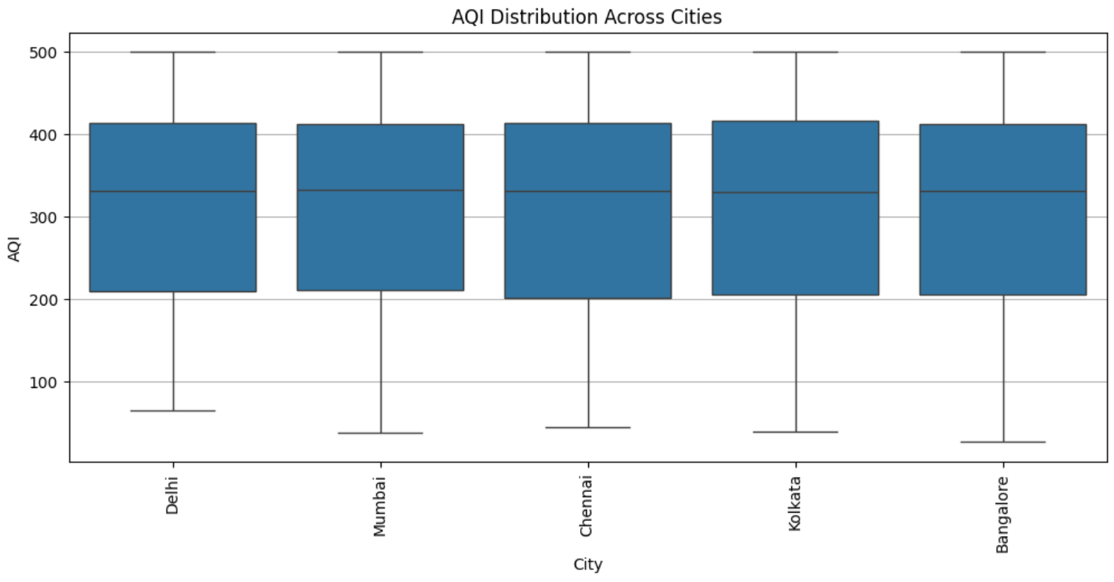
AQI Distribution Across Cities (Spatial Analysis
What This Plot Shows :-
Comparison of AQI distribution across major cities
Highlights city-wise differences in air quality
Key Observations:-
Some cities show higher median AQI, indicating consistently worse air quality
Several cities exhibit wide AQI variation, reflecting unstable pollution levels
Extreme AQI values are present across multiple cities

Slide 8
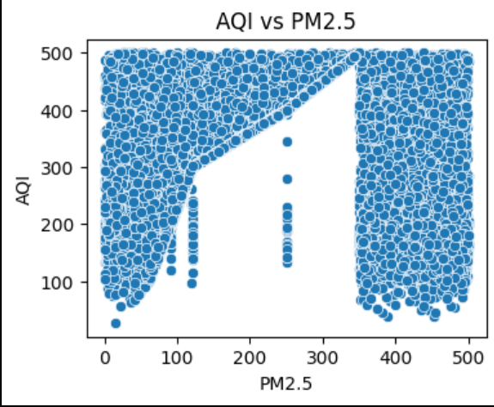
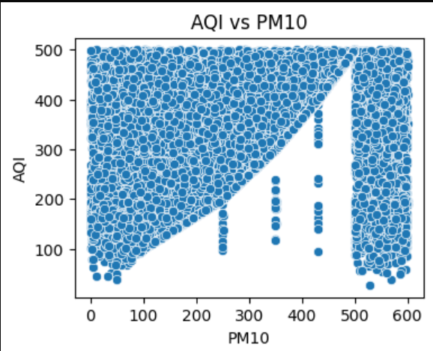
Particulate Matter Impact on AQI (AQI vs PM2.5 & AQI vs PM10)
What This Slide Shows :-
Relationship between AQI and particulate matter
Comparison of fine and coarse particles
Key Observations :-
Strong positive relationship between AQI and PM2.5
AQI increases sharply as PM2.5 levels rise
PM10 also shows a strong upward trend with AQI
Insights :-
Particulate matter is the primary driver of AQI
High AQI events are closely linked to increased dust and fine particles

Slide 9
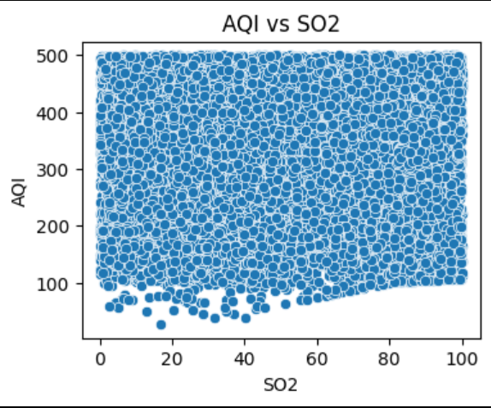
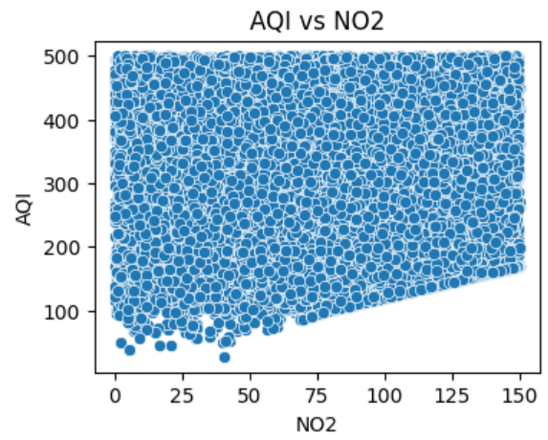
Gaseous Pollutants: Moderate Impact (AQI vs NO₂ & AQI vs SO₂)
What This Slide Shows :-
Relationship between AQI and nitrogen & sulfur gases
Key Observations :-
NO₂ shows a moderate positive relationship with AQI
SO₂ contributes to AQI but with less intensity than particulate matter
Insights:-
Gaseous pollutants influence AQI, but are secondary contributors
Often linked to traffic and industrial emissions

Slide 10
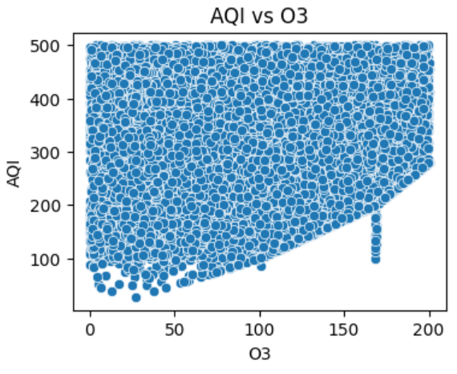
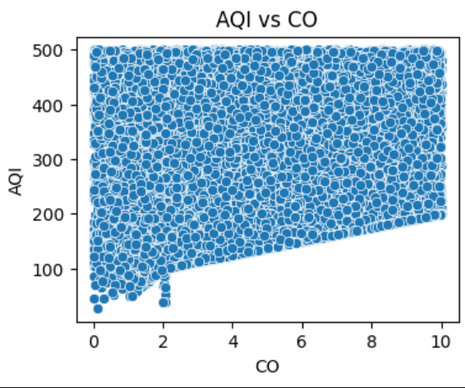
Low & Seasonal Influence Pollutants (AQI vs CO & AQI vs O₃)
What This Slide Shows:-
Relationship between AQI and CO, O₃
Key Observations:-
CO shows a weak relationship with AQI
O₃ exhibits seasonal influence rather than consistent impact
Insights:-
CO and O₃ are not dominant AQI drivers
Their impact varies based on season and weather

Slide 11
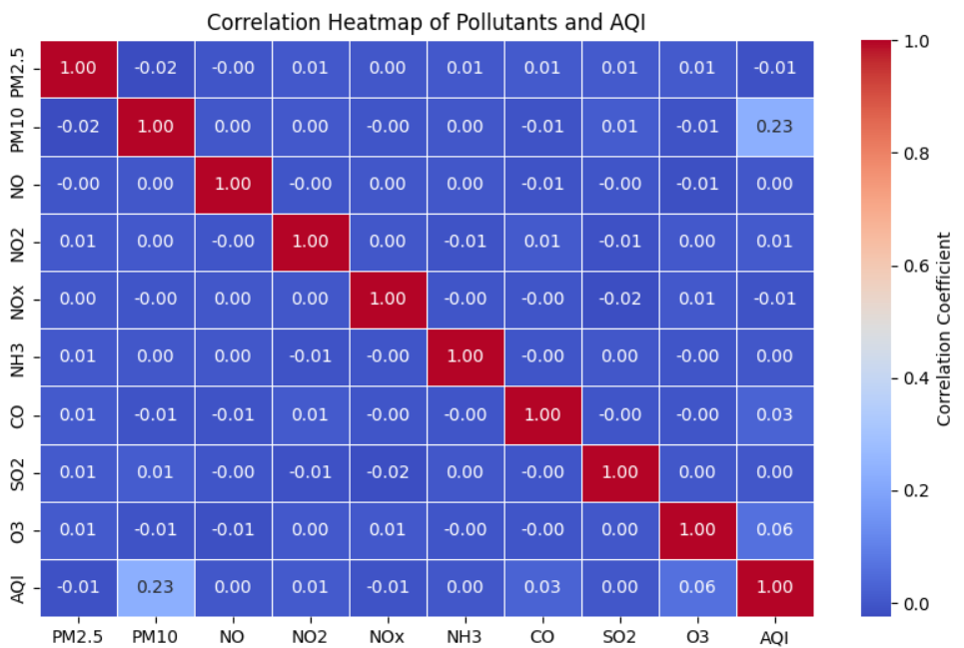
Pollutant-Based Analysis and Their Impact on AQI
This analysis focused on individual air pollutants to discern their influence on the overall Air Quality Index (AQI), revealing strong correlations with particulate matter.
PM2.5 & PM10 Dominance
Scatter plots confirm that fine and coarse particulate matter (PM2.5 and PM10) are the most significant contributors to elevated AQI levels.
Gaseous Pollutant Influence
NO2, SO2, CO, and O3 also exhibit varying degrees of correlation with AQI, contributing to overall air quality degradation.
Correlation Heatmap
NO2, SO2, CO, and O3 also exhibit varying degrees of correlation with AQI, contributing to overall air quality degradation.
The heatmap quantifies these relationships, identifying the most influential pollutants for targeted mitigation strategies.

Slide 12

Project Focus
Deconstructing Air Pollution: A Data-Driven Approach
This project aims to unravel the complex factors influencing air quality by analyzing historical data, providing a foundation for future prediction models and targeted interventions.
Pollutant Factors
Spatial Variations
Seasonal Patterns
Identify individual pollutant contributions to overall AQI levels.
Examine how air quality differs across various urban centers and regions.
Uncover temporal and seasonal trends in pollution severity throughout the year.

Slide 13
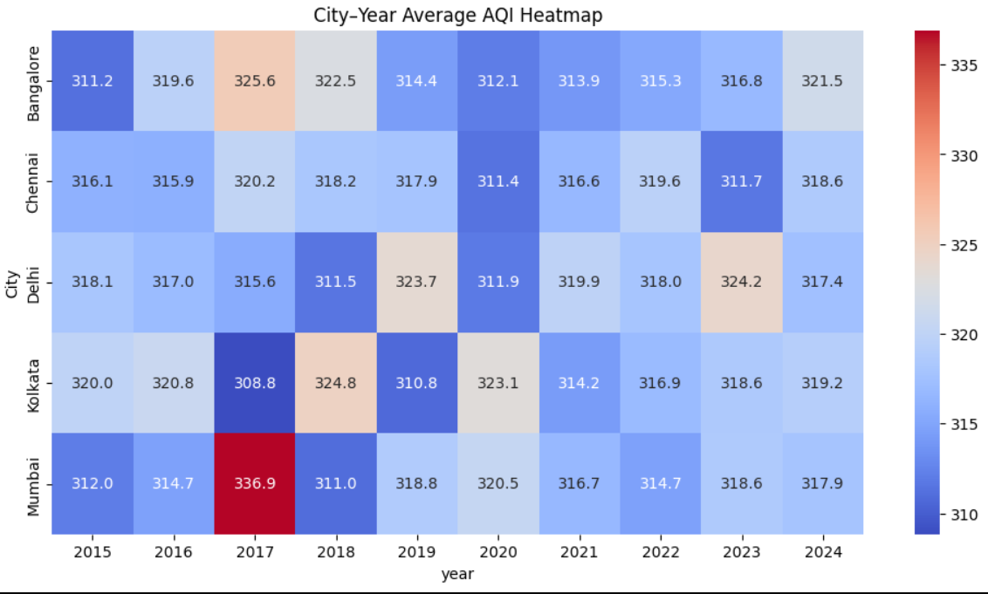
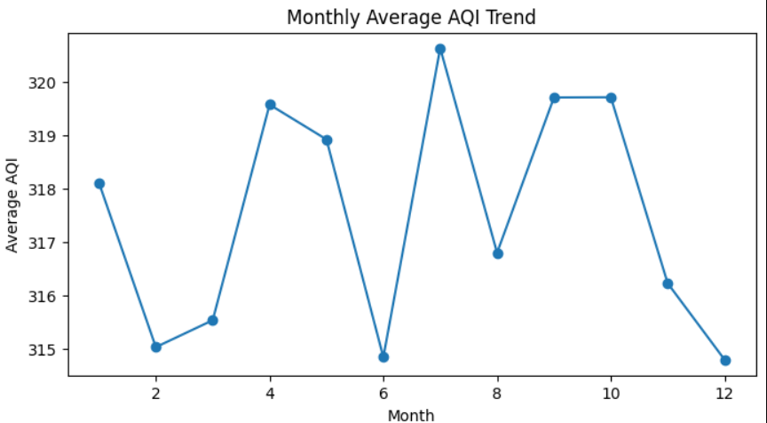
City-wise and Seasonal AQI Trends (Spatio-Temporal Analysis)

Slide 14
City–Year Heatmap :-
Some cities show consistently high AQI across multiple years
Certain cities experience persistent pollution, not isolated events
AQI levels vary significantly between cities over time
Monthly AQI Trend :-
AQI levels are higher during winter months
AQI decreases during summer and monsoon periods
Seasonal pattern is clearly visible and recurring
Insights:-
Air pollution is influenced by both location and time
High-AQI cities require long-term, city-specific interventions
Seasonal trends explain repeated pollution spikes each year
Analyst Recommendations :-
Prioritize pollution control in consistently high-AQI cities
Implement season-specific measures, especially before winter
Use city–year trends to track effectiveness of policies

Slide 15
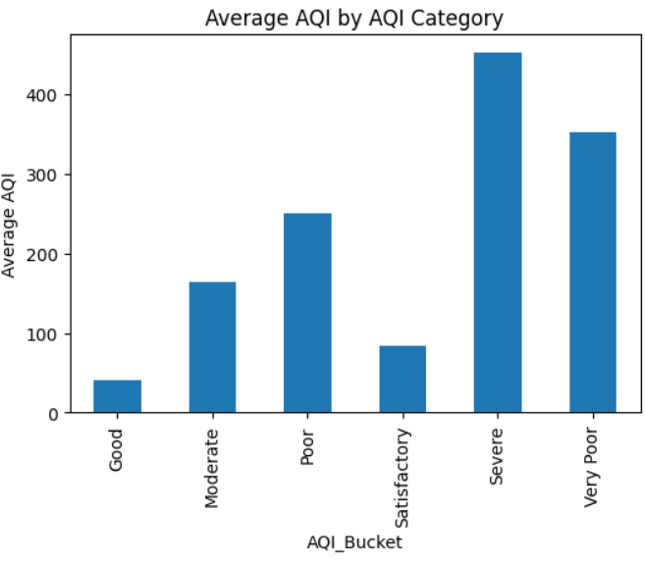
What This Plot Shows :-
Average AQI values across different AQI categories
Relationship between AQI categories and pollution severity
Key Observations (Data Analyst View) :-
AQI categories follow a clear increasing severity pattern
“Good” and “Satisfactory” categories have low average AQI values
“Moderate” and “Poor” categories show significant pollution levels
“Very Poor” and “Severe” categories have extremely high AQI, indicating serious health risk
Insights :-
AQI categories effectively translate numeric AQI into pollution severity
Higher AQI categories represent disproportionately higher health impact
Majority of high AQI values fall into Poor, Very Poor, and Severe ranges
AQI Categories and Pollution Severity

Slide 16


Actionable Intelligence
Key Insights & Conclusion
This comprehensive exploratory data analysis has illuminated critical factors influencing the Air Quality Index, providing a robust foundation for proactive environmental management and public health initiatives.
Pollutant Drivers
Seasonal Peaks
PM2.5 and PM10 are confirmed as the primary pollutants driving AQI fluctuations.
Winter months consistently exhibit the worst air quality, necessitating seasonal interventions.
Urban Hotspots
Dynamic Variability
Urban and industrial cities bear the brunt of higher AQI levels, requiring localized strategies.
The non-normal and variable nature of AQI indicates frequent extreme pollution events.
These findings provide invaluable insights into air pollution behavior, paving the way for advanced air quality monitoring and predictive modeling.

