Slide 1
CLUSTERING
ADBVANTAGES AND DIS ADVANTAGES

Slide 2
CLUSTERING:
Clustering is an unsupervised machine learning technique used to group similar data points into clusters based on their features. The goal is to organize data into meaningful structures, where points within a cluster are more similar to each other than to points in other clusters. Clustering is commonly used in exploratory data analysis, image segmentation, anomaly detection, and other areas where pattern recognition is important.
DBSCAN:
DBSCAN (Density-Based Spatial Clustering of Applications with Noise)
- Groups data points that are closely packed together, while marking points in low- density regions as outliers.
- Does not require the number of clusters to be specified.
- Effective for data with varying densities but may struggle with varying cluster sizes.

Slide 3
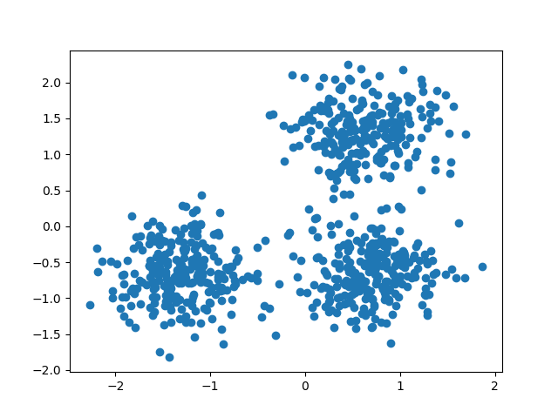
Advantages:
Handles noise:DBSCAN automatically determines the number of clusters based on the data density. There is no need to predefine the number of clusters, which is required by algorithms like K-Means.
Unlike algorithms that assume spherical shape clusters,
DBSCAN can handle noise and outilers by making points
Disadvantage:
While DBSCAN is scalable, its performance can degrade with very large datasets.
Poor choices can lead to poor clustering results.

Slide 4
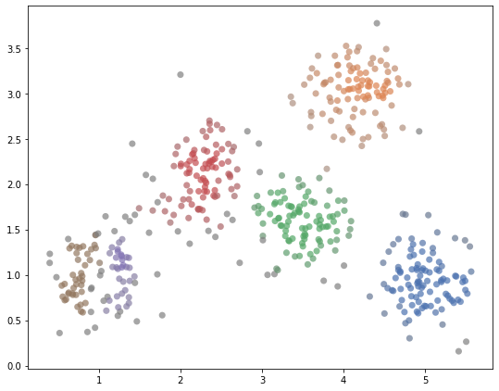
HDBSCAN (Hierarchical DBSCAN)
- An extension of DBSCAN that produces a hierarchy of clusters.
- Allows for varying densities and automatically finds the optimal number of clusters.
- Suitable for noisy and complex datasets.

Slide 5
Advantages:
Automatic Cluster Selection: No need to specify the number of clusters.
Handles Varying Densities: Better suited for datasets with clusters of varying densities.
Robust to Noise: Effectively detects and labels outliers.
Disadvantages:
Complexity: More complex and computationally intensive than DBSCAN.
Sensitive to Hyperparameters: Although more robust, the choice of min_cluster_size and min_samples
still impacts performance.

Slide 6
OPTICS
OPTICS (Ordering Points To Identify the Clustering Structure) is a density-based clustering algorithm that is similar to DBSCAN but provides more flexibility. It works well with datasets containing clusters of varying densities and sizes.
How OPTICS Works
Ordering: OPTICS creates an ordering of the data points based on their density-reachability. Points that are close to each other and in high-density regions are clustered together.
Reachability Distance: This is a measure of how close a point is to another point, given the density. It helps determine whether points belong to the same cluster or different clusters.
Core Distance: For each point, OPTICS calculates a core distance, which is the smallest distance required for the point to be considered dense.
Cluster Extraction: Clusters are extracted by analyzing the reachability plot, which shows the reachability distances of points in the order they were processed.

Slide 7
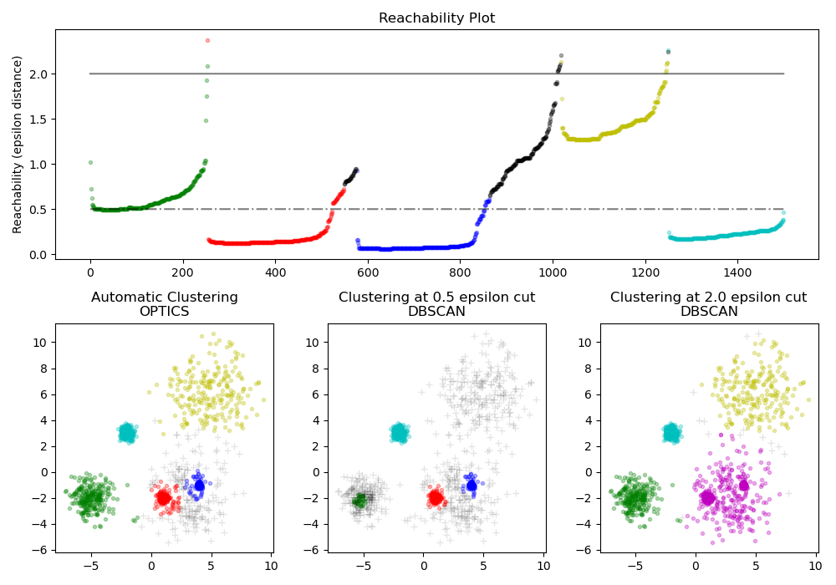

Slide 8
Advantage:
Extracts a Hierarchical Structure: OPTICS provides a reachability plot that can be used to visualize the hierarchical structure of the clusters.
Handles Varying Densities: Unlike DBSCAN, OPTICS can identify clusters of varying densities in the same dataset.
Disadvantage:
Computationally Intensive: OPTICS is more computationally expensive than DBSCAN, especially for large datasets.
No Clear-Cut Clusters: Unlike DBSCAN, OPTICS does not always produce a clear-cut assignment of points to clusters, which can make interpretation more complex.

Slide 9
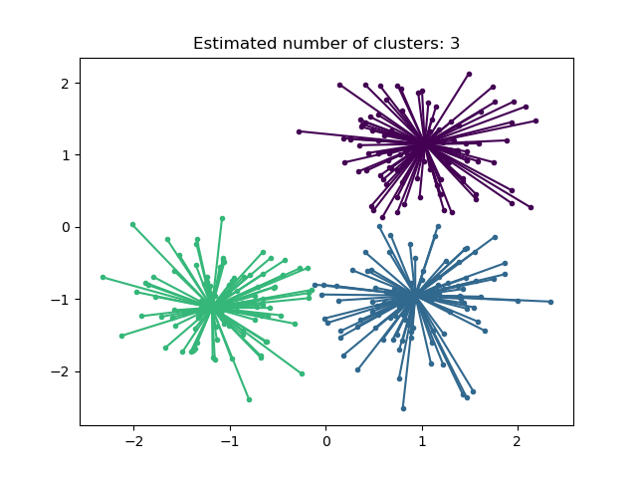
Affinity propagation
Affinity Propagation is a clustering algorithm that identifies exemplars (data points that are representative of clusters) and forms clusters based on the similarities between data points.
Advantages
No Need to Specify Number of Clusters: The algorithm automatically determines the number of clusters.
Identifies Exemplars: Provides representative points (exemplars) for each cluster, which can be useful for interpretability.
Works Well with Non-Spherical Clusters: Can identify arbitrarily shaped clusters, unlike K-Means.
Disadvantage:
Memory intensive: storing and preprocessing the similarity matrix

Slide 10
Advantage:
No Need to Specify the Number of Clusters
Robust to Outliers:
DBSCAN can effectively handle noise and outliers by marking points that do not belong to any cluster as
Works Well with Varying Cluster Sizes:
DBSCAN is capable of identifying clusters with varying sizes and densities, which is a limitation for many clustering algorithms.
Disadvantage:

Slide 11
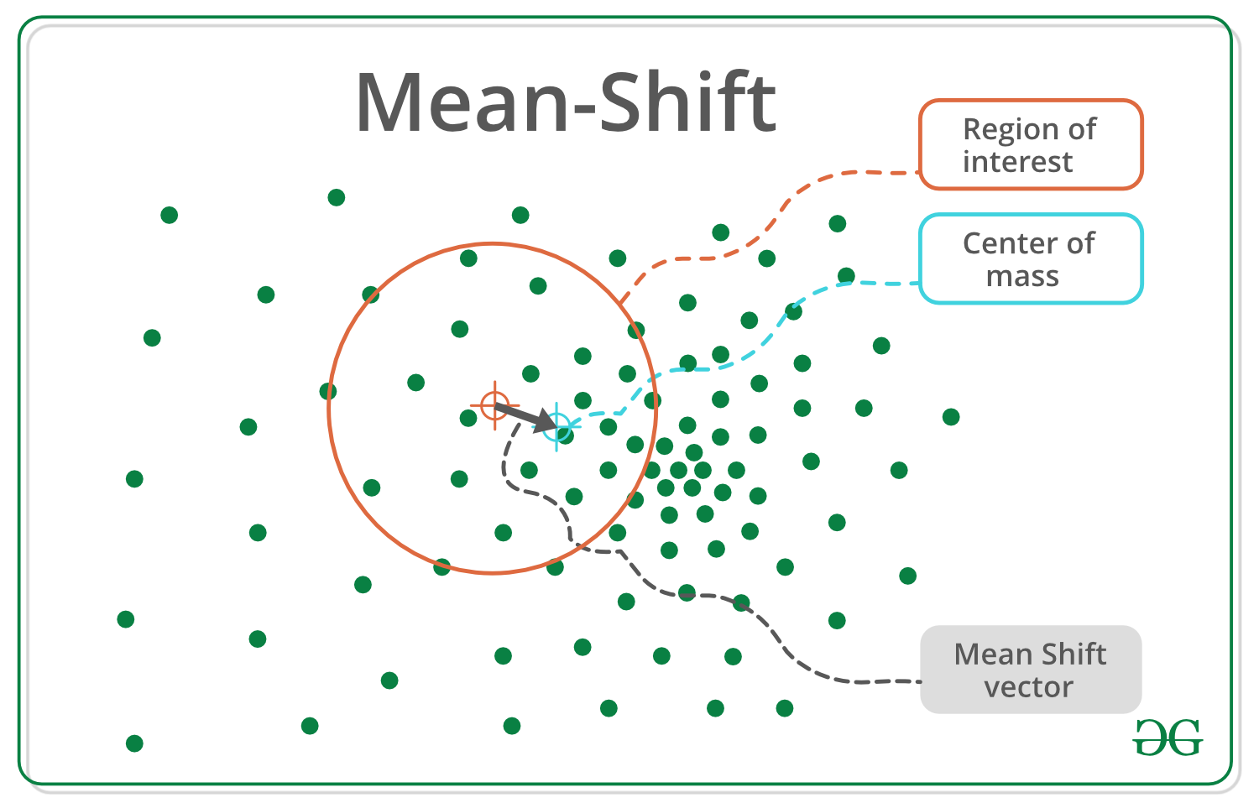
Mean Shift:
- Shifts data points towards the mode of a density distribution iteratively until convergence.
- Does not require specifying the number of clusters.
- Works well with clusters of various shapes and sizes but can be computationally expensive.

Slide 12
Advantange
Finds variable number of modes
Robust to outliers
General, application-independent tool
Model-free, doesn’t assume any prior shape like spherical, elliptical, etc. on data clusters
Just a single parameter (window size h) where h has a physical meaning (unlike k-means)
Disadvantage
Output depends on window size
Window size (bandwidth) selecHon is not trivial
Computationally (relatively) expensive (approx 2s/image)
Doesn’t scale well with dimension of feature space.

Slide 13
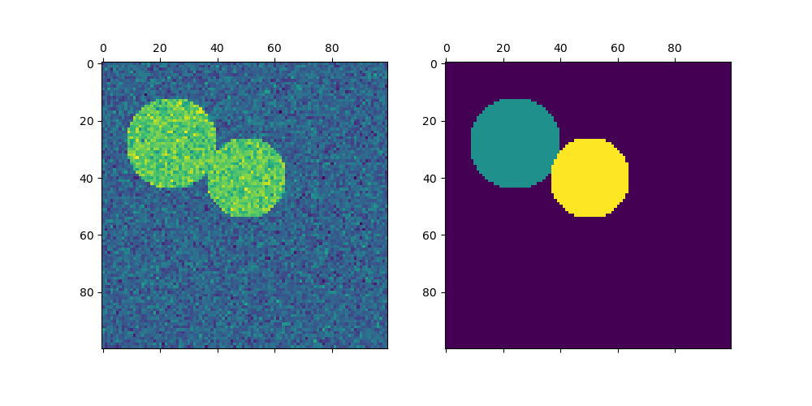
Spectral Clustering
- Uses eigenvalues of a similarity matrix to reduce dimensionality before clustering.
- Effective for non-convex clusters and when the data has complex relationships.
- Computationally expensive for large datasets.

Slide 14
Advantages:
Effective for Non-Convex Clusters: Can capture complex, non-linear relationships in data.
Good for Graph-Based Data: Useful for problems involving graph-like structures or relationships.
No Need to Assume Cluster Shapes: Can identify arbitrarily shaped clusters.
Disadvantages:
Computationally Expensive: Can be slow, especially for large datasets due to eigenvalue decomposition.
Requires Similarity Matrix: Performance depends on constructing a good similarity (affinity) matrix.
Not Scalable: Typically not suitable for very large datasets.

Slide 15
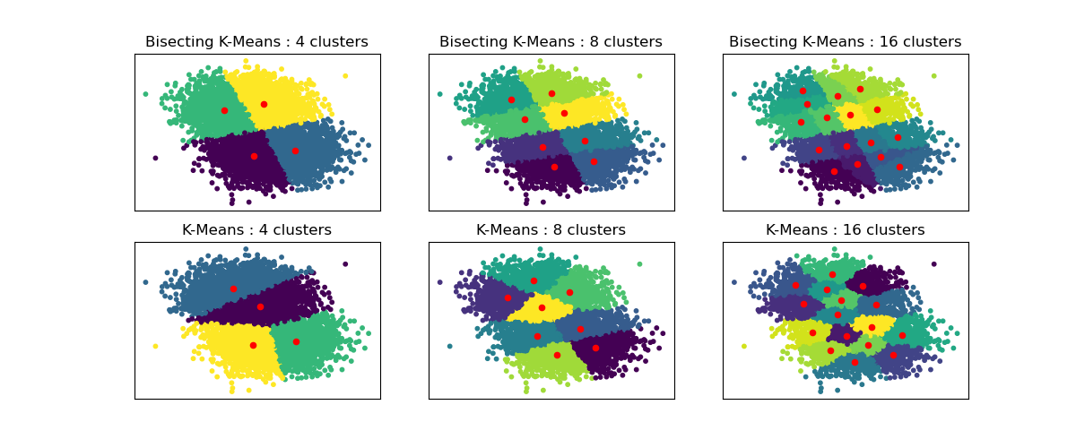
Bisecting K-Means
- A variant of K-Means that recursively splits clusters into two until the desired number of clusters is achieved.
- Often yields better results than standard K-Means.
visually.

Slide 16
Advantages:
Hierarchical Approach: Combines the benefits of both K-Means and hierarchical clustering.
Better Accuracy than K-Means: Often yields better clustering results than standard K-Means.
Scalable: Maintains the scalability of K-Means while improving performance.
Disadvantages:
Requires Pre-Specification of k: Still needs the number of clusters to be specified.
Sensitive to Initial Split: The first split can heavily influence the final clusters.
When to Use Clustering
- **Exploratory Data Analysis**: Discover natural groupings within your data.
- **Market Segmentation**: Group customers based on purchasing behavior or demographics.
- **Anomaly Detection**: Identify unusual patterns or outliers in data.
- **Image Segmentation**: Partition images into regions based on pixel similarity.
### Visualization of Clustering
When working with clustering, it’s often useful to visualize the results to understand the quality and characteristics of the clusters. Scatter plots, dendrograms (for hierarchical clustering), and heatmaps are commonly used to represent clusters

Slide 17
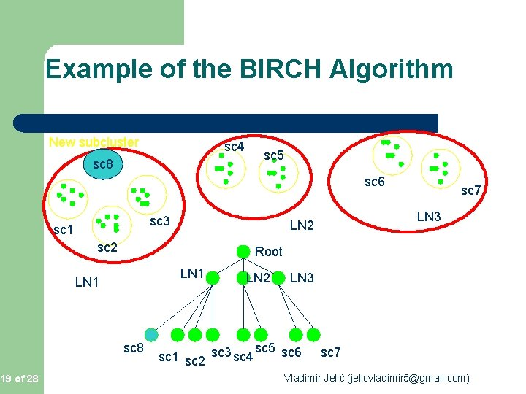
BIRTCH
Birch (Balanced Iterative Reducing and Clustering using Hierarchies) is a hierarchical clustering algorithm designed to handle large datasets efficiently. It incrementally and dynamically clusters incoming data points, making it particularly well-suited for very large datasets.

Slide 18
Advantage:
Scalability
Low memory usage
Handle noiseless
Incremental clustering
Disadvantage:
Sensitive to input order
Parameter sensitivity

