Slide 1

Car Market Analysis
AICTE STU ID-STU6a4b6f5ea97291783329606
Gajanan Harinarayan Raje

Slide 2

PROBLEM STATEMENT
The used-car market has vehicles with varying prices, fuel types, and usage levels, making it hard to know which factors most affect selling price.
This project analyzes historical Car Dekho data to identify key market trends and pricing patterns.
The goal is to provide data-driven insights that support better buying, selling, and pricing decisions.

Slide 3
Project Description This project focuses on analyzing Car Dekho used-car data using data analysis and visualization techniques. The dataset contains information such as car name, manufacturing year, selling price, present price, kilometers driven, fuel type, seller type, transmission, and number of previous owners. The analysis explores relationships between these variables and identifies the major factors influencing used-car prices, helping stakeholders understand market trends and make informed decisions.

Slide 4

WHO ARE THE END USERS?
Car Buyers – to compare cars and identify reasonable prices.
Car Sellers – to estimate competitive selling prices.
Car Dealers – to understand demand and pricing trends.
Used-Car Businesses – to support inventory and pricing decisions.
Data Analysts/Business Teams – to derive insights from automobile market data.

Slide 5

Technology Used
Python, Pandas, Matplotlib, Seaborn, NumPy

Slide 6
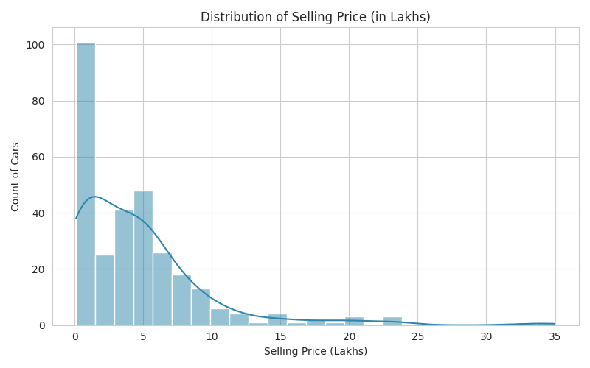
RESULTS
Demo Link

Slide 7
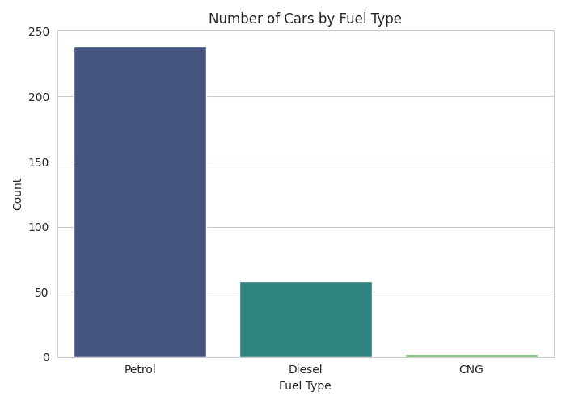
RESULTS
Demo Link

Slide 8
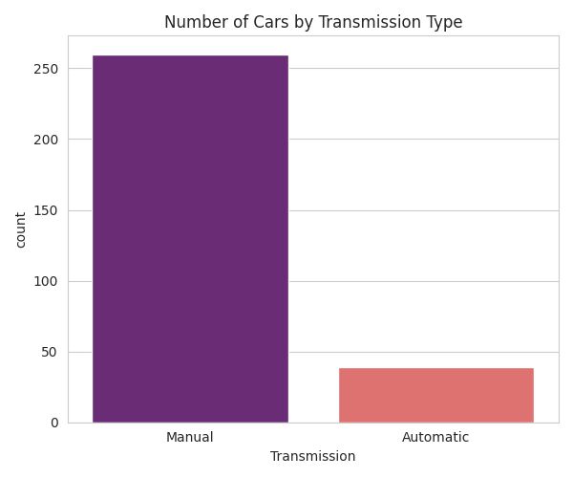
RESULTS
Demo Link

Slide 9
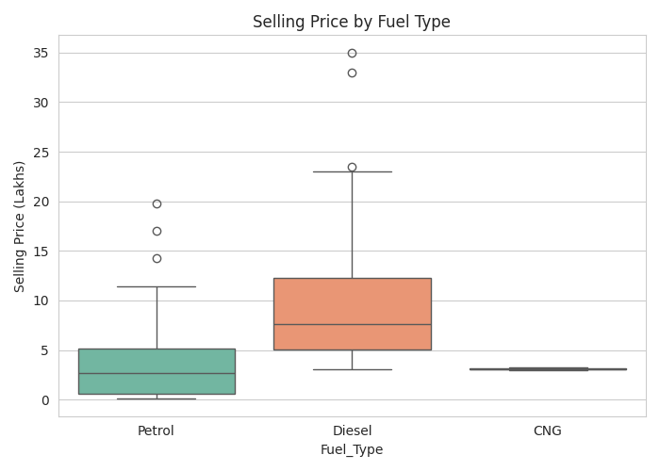
RESULTS
Demo Link

Slide 10
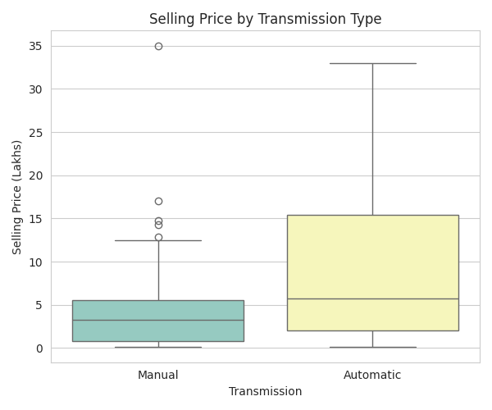
RESULTS
Demo Link

Slide 11
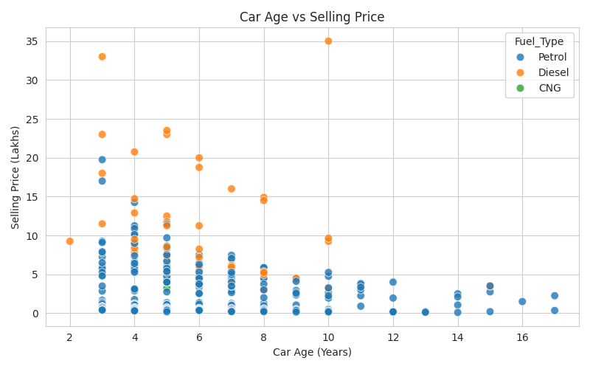
RESULTS
Demo Link

Slide 12
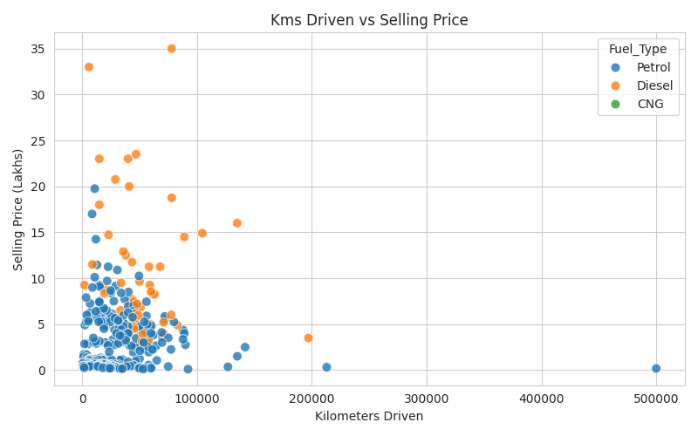
RESULTS
Demo Link

Slide 13
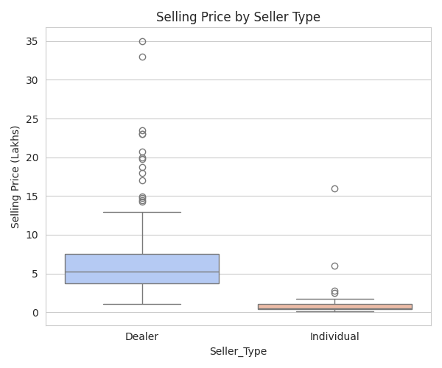
RESULTS
Demo Link

Slide 14
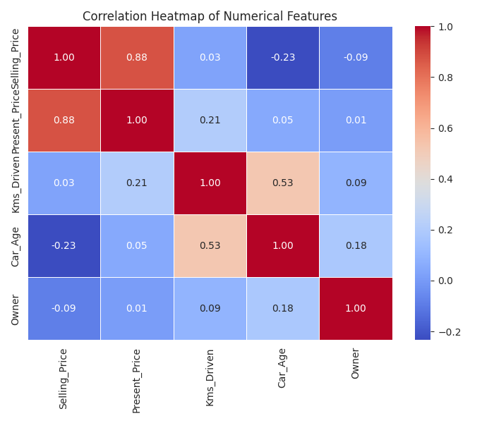
RESULTS
Demo Link

Slide 15
Thank you
Thank you for your attention!
Gajanan | Car Market Analysis Project
.
.

