Slide 1

Project Title – Seasonal Agricultural Performance Analysis
Student Name- Gajanan Harinarayan Raje
College Name- MGM’s College of Coumputer Science & IT
AICTE STU ID : STU6a4b6f5ea97291783329606

Slide 2

PROBLEM STATEMENT
Agricultural performance is influenced by seasonal variations in environmental conditions, farming practices, resource availability, and market conditions.
Raw agricultural data does not clearly reveal:
How performance changes across seasons
What patterns exist in different seasonal conditions
The problem: Analyze the seasonal agriculture dataset to identify meaningful patterns, trends, relationships, and variations in agricultural performance across Kharif, Rabi, and Zaid seasons.

Slide 3
Project Description This project analyzes seasonal agricultural performance using a dataset of 4000 farm records across Kharif, Rabi, and Zaid seasons, covering environmental, farming input, and economic factors. Approach: Cleaned missing data (season-wise median imputation) Performed EDA and seasonal comparison (yield, profit, water usage, disease risk) Created 9 visualizations (boxplots, heatmaps, bar charts) Applied ANOVA statistical test to validate seasonal differences Tools: Python, Pandas, Matplotlib, Seaborn, SciPy (Google Colab) Key Finding: Kharif shows highest yield & profit; Zaid runs at a loss on average.

Slide 4

WHO ARE THE END USERS?
Farmers — Season-wise crop and resource planning based on data insights
Agricultural Officers / Extension Workers — Advising farmers with evidence-based recommendations
Government Agriculture Departments — Policy-making for seasonal support schemes and subsidies
Agri-business & Supply Chain Companies — Forecasting production and market planning
Researchers / Data Analysts — Further study on seasonal agricultural trends
Banks / Insurance Providers (Agri-loans) — Risk assessment based on seasonal profit/loss patterns

Slide 5

Technology Used
Programming Language: Python
Platform: Google Colab (Jupyter Notebook environment)
Libraries:
Pandas, NumPy — Data cleaning & manipulation
Matplotlib, Seaborn — Data visualization
SciPy — Statistical testing (ANOVA)
Data Source: CSV (Seasonal Agriculture Performance Dataset)
Presentation: Microsoft PowerPoint

Slide 6
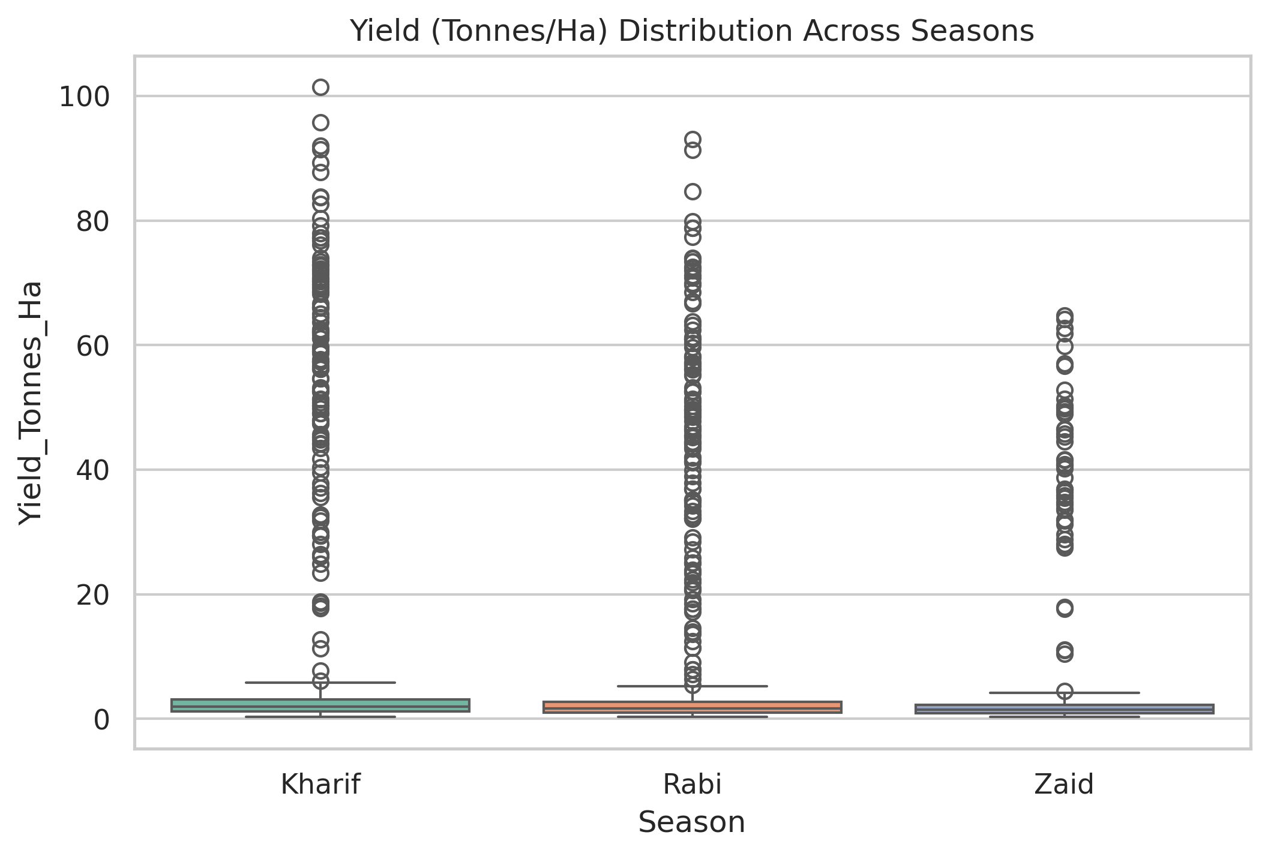
RESULTS

Slide 7
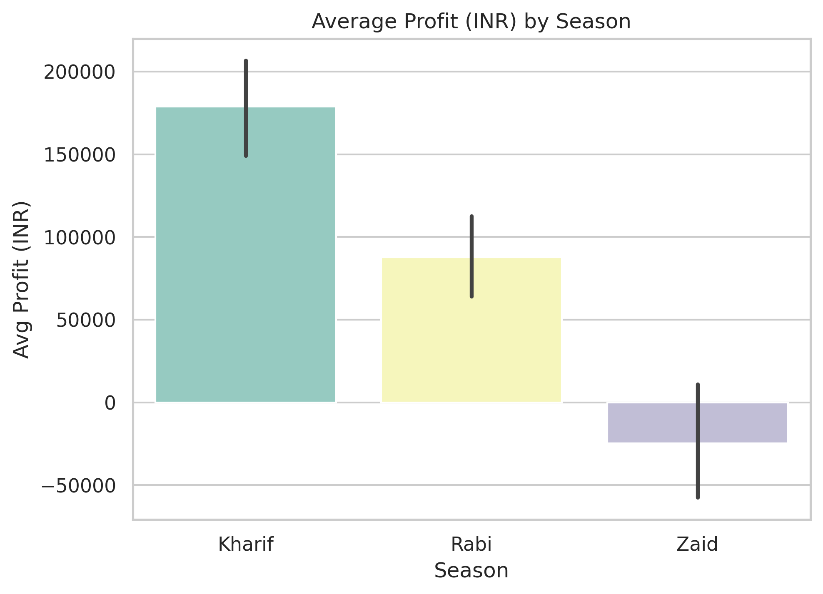
RESULTS

Slide 8
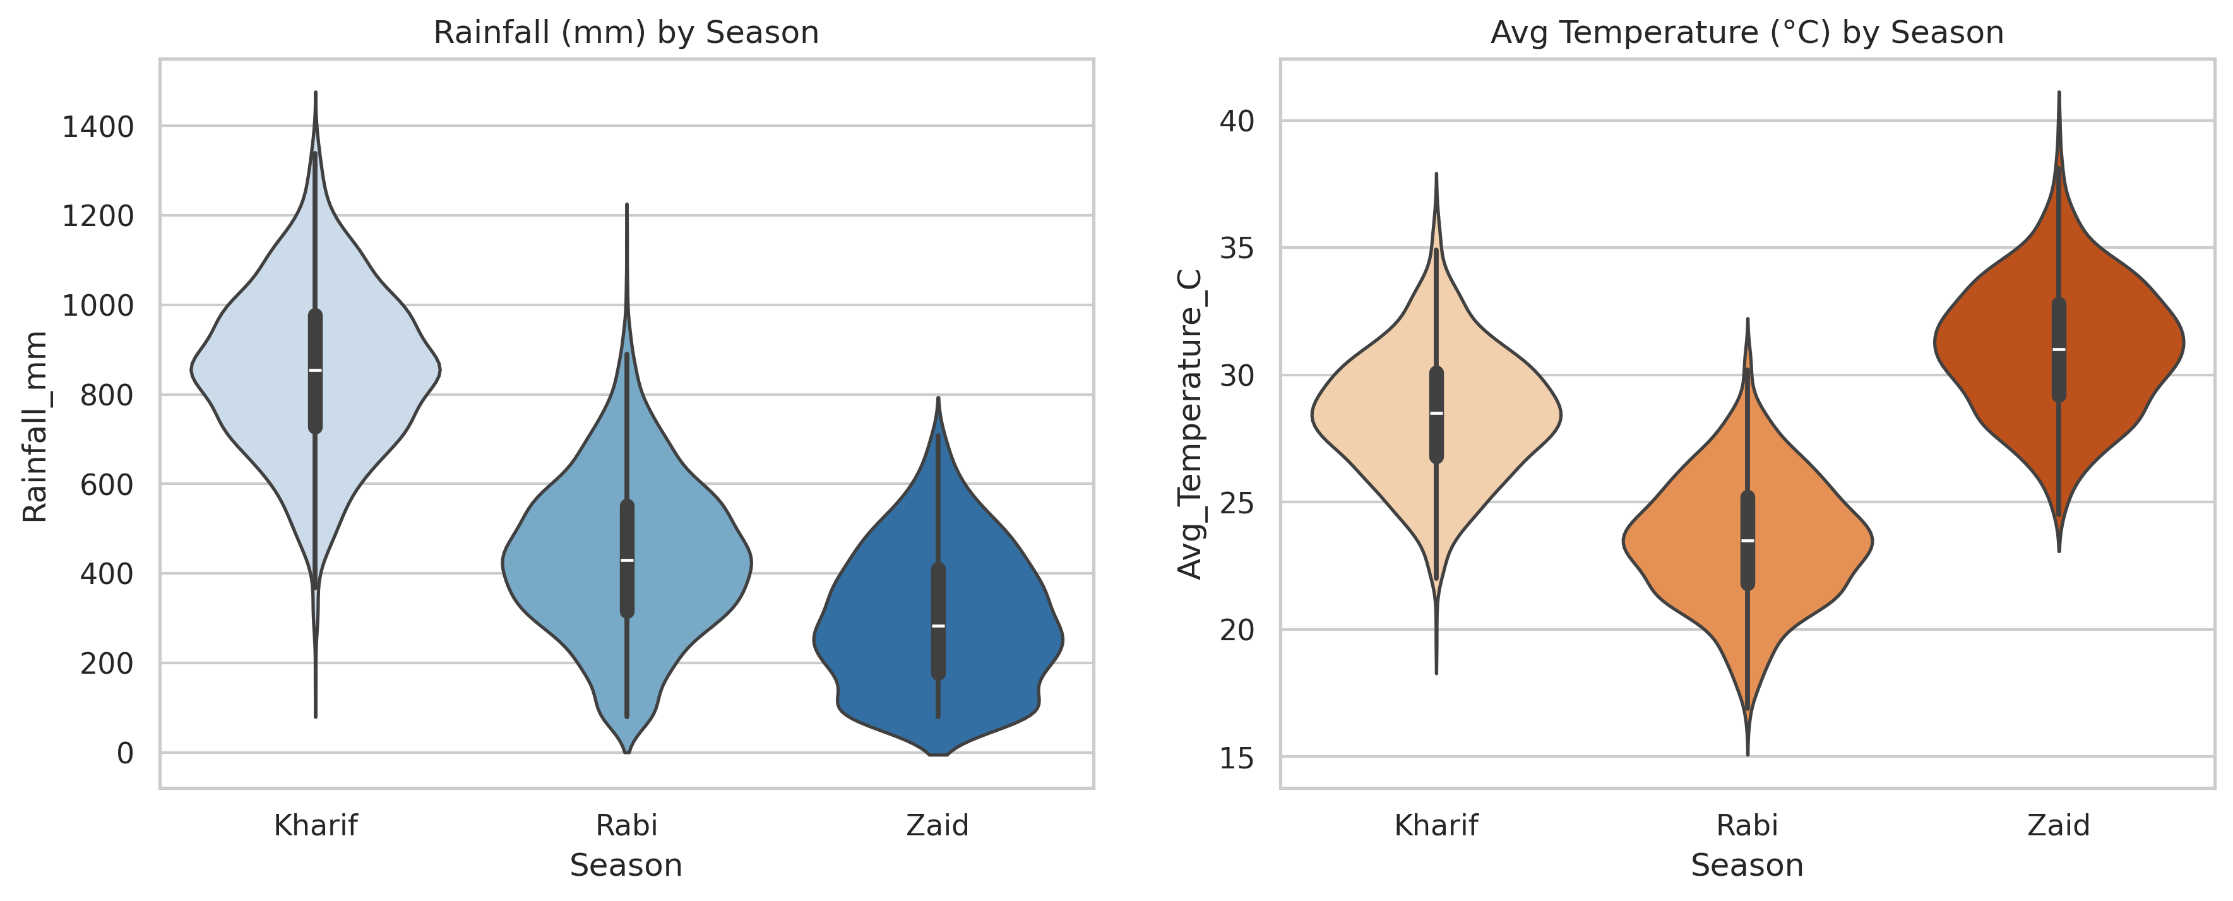
RESULTS

Slide 9
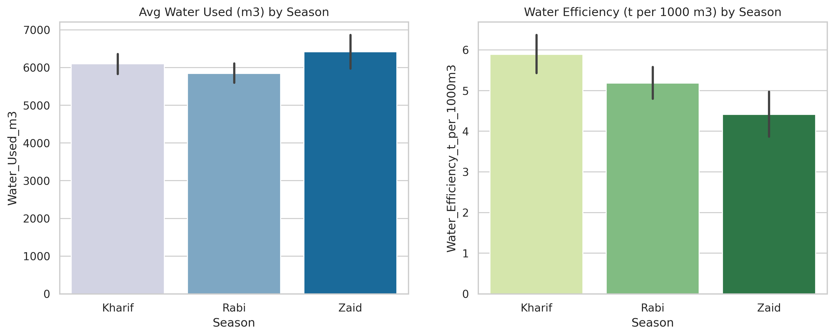
RESULTS

Slide 10
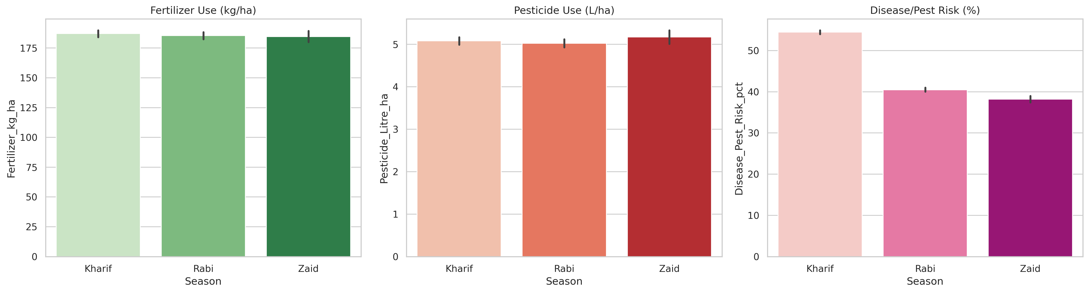
RESULTS

Slide 11
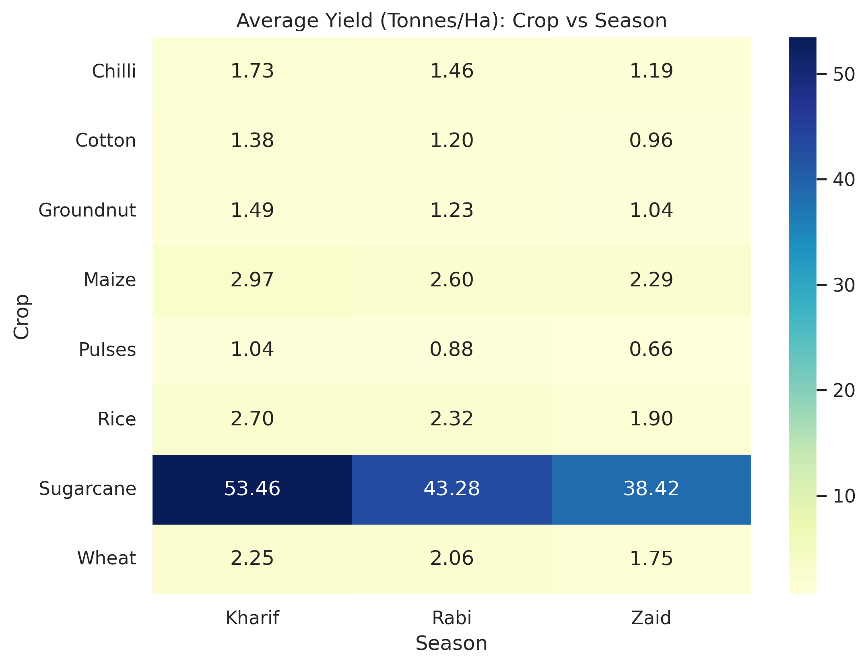
RESULTS

Slide 12
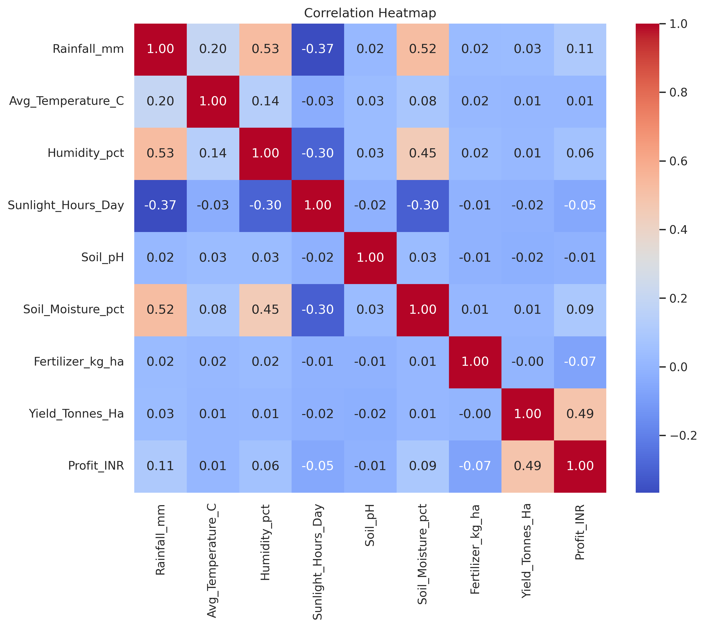
RESULTS

Slide 13
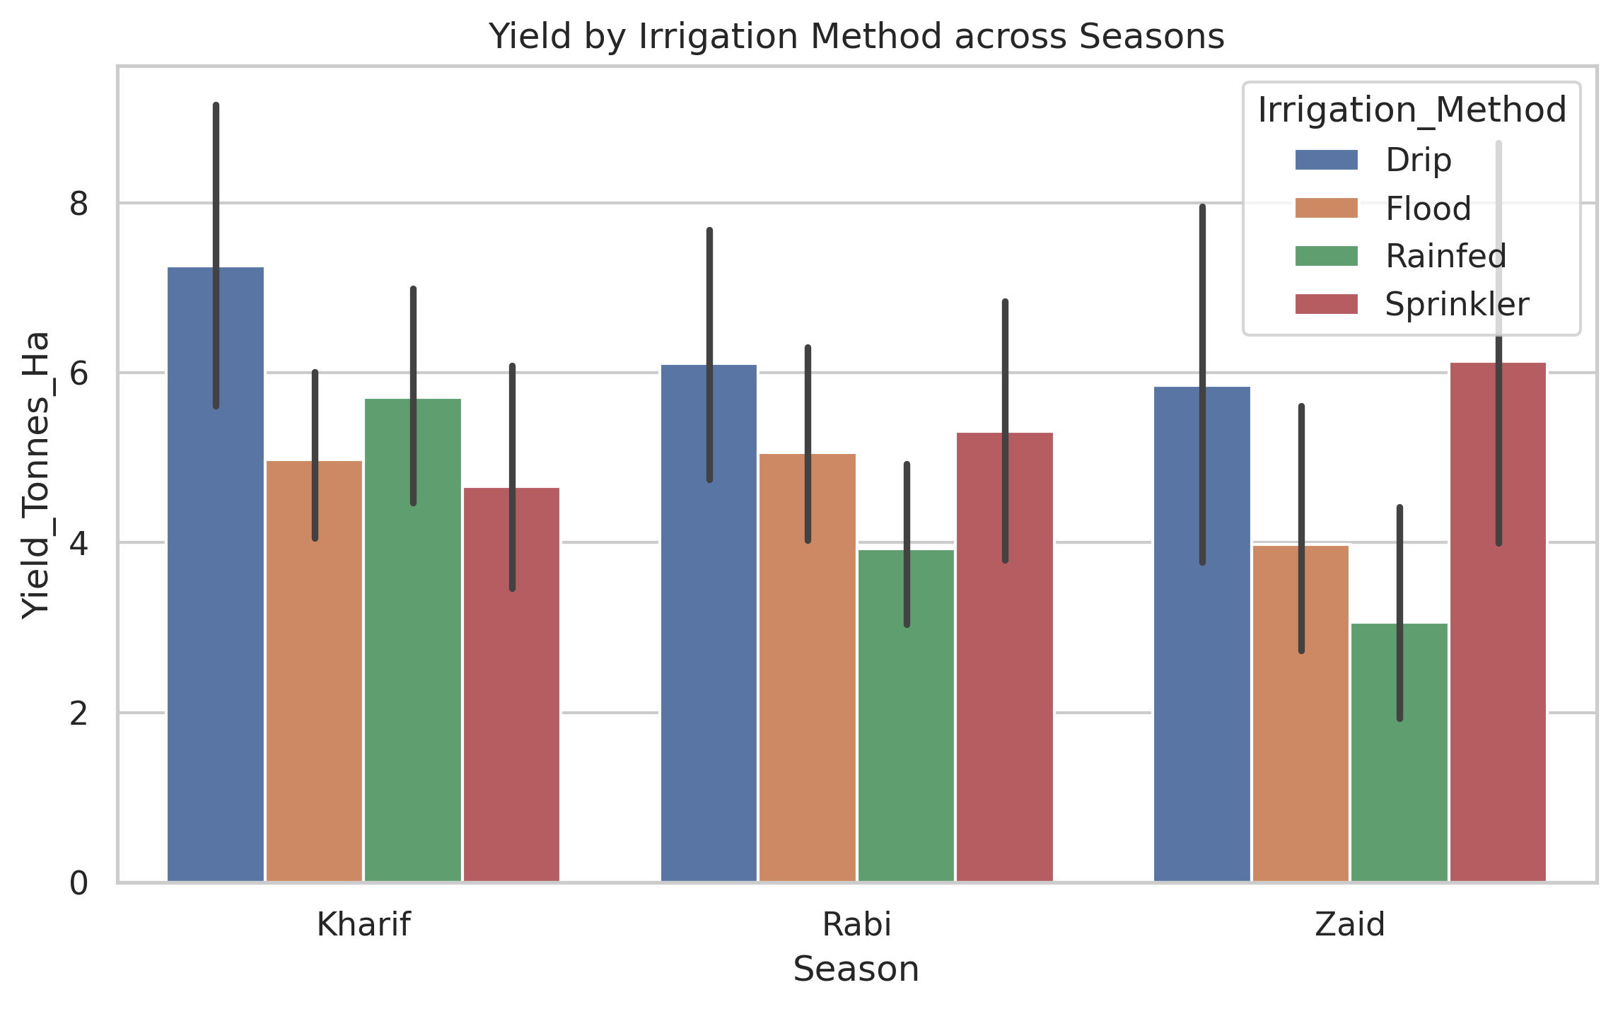
RESULTS

Slide 14
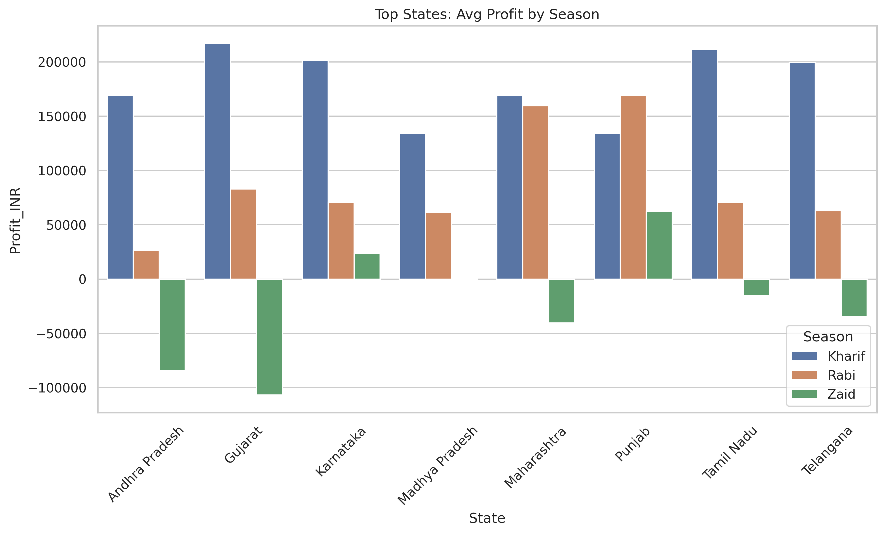
RESULTS

Slide 15
Future scope
Apply Machine Learning models to predict yield/profit based on season and environmental factors
Include more seasons/years of historical data for deeper trend analysis
Build an interactive dashboard (Power BI / Tableau) for real-time seasonal monitoring
Incorporate weather forecasting data to give farmers proactive seasonal recommendations
Extend analysis to region-wise soil health mapping for precision agriculture
Develop a mobile app to deliver seasonal insights directly to farmers

Slide 16
GitHub Link
https://github.com/Gajanan-raje/Seasonal-Agriculture-Performance-Analysis

Slide 17

VOIS Course completion certificate - Course name- Data Visualization

Slide 18
Thank you
.
.

