Slide 1
Superstore Sales Analysis
Final Data Analytics Project: Python, EDA and Power BI
Gajanan Raje
AICTE | IBM SkillsBuild Data Analytics with AI Internship, Week 6

Slide 2
Problem and Dataset
Problem
The store sells 2.30M but keeps only a 12.47% margin. Where is profit made and where is it lost?
Goals
Find top and weak areas, understand the effect of discounts, and recommend actions.
Dataset (2014 to 2017)
9,994 order lines
5,009 orders
793 customers
1,862 products
3 tables: Orders, Products, Customers

Slide 3
Data Cleaning and EDA
Cleaning
No missing values, no duplicates
Dates converted to datetime
6 corrupted customer names fixed
3 tables merged (28 columns)
New columns: Year, Month, Delivery Days, Margin %
EDA
Profit vs Sales correlation: 0.48
Profit vs Discount: -0.22
11.7% sales outliers kept (real big orders)
18.7% of order lines lose money

Slide 4
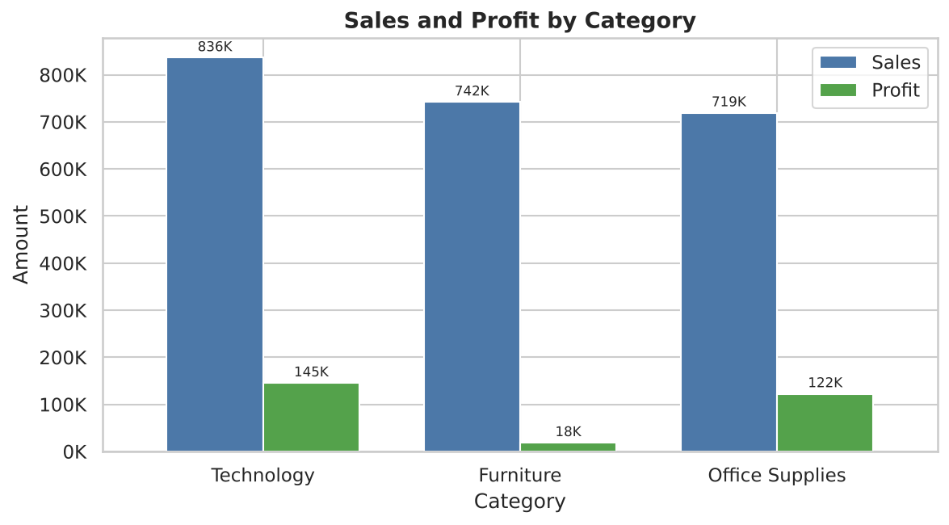
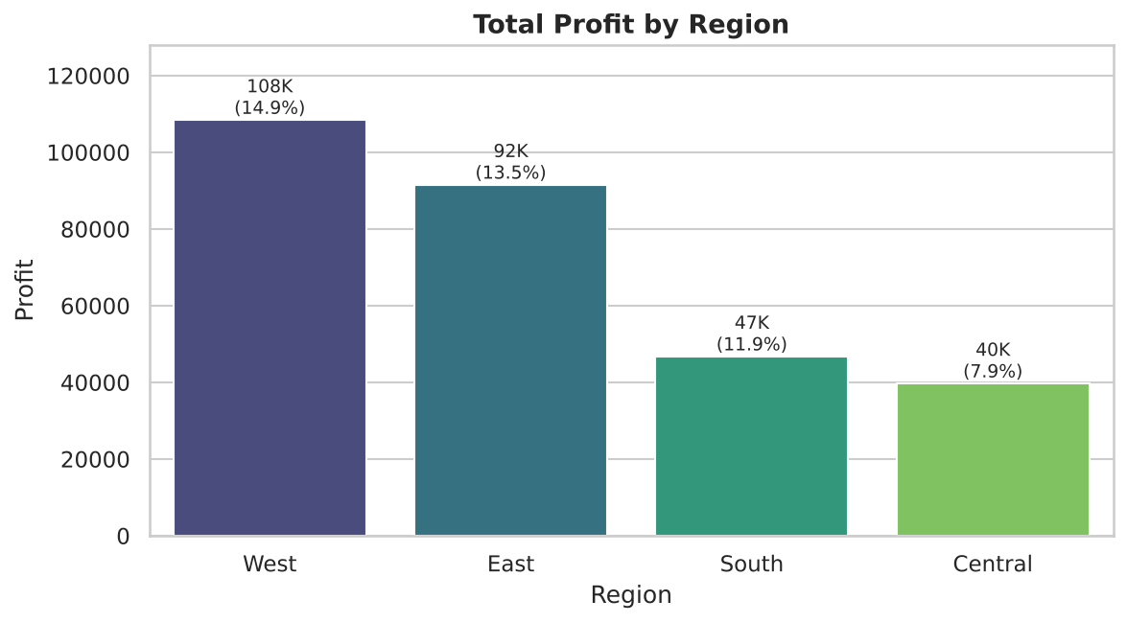
Category and Region
Furniture: 742K sales but only 2.5% margin. Central region has the lowest margin (7.9%).

Slide 5
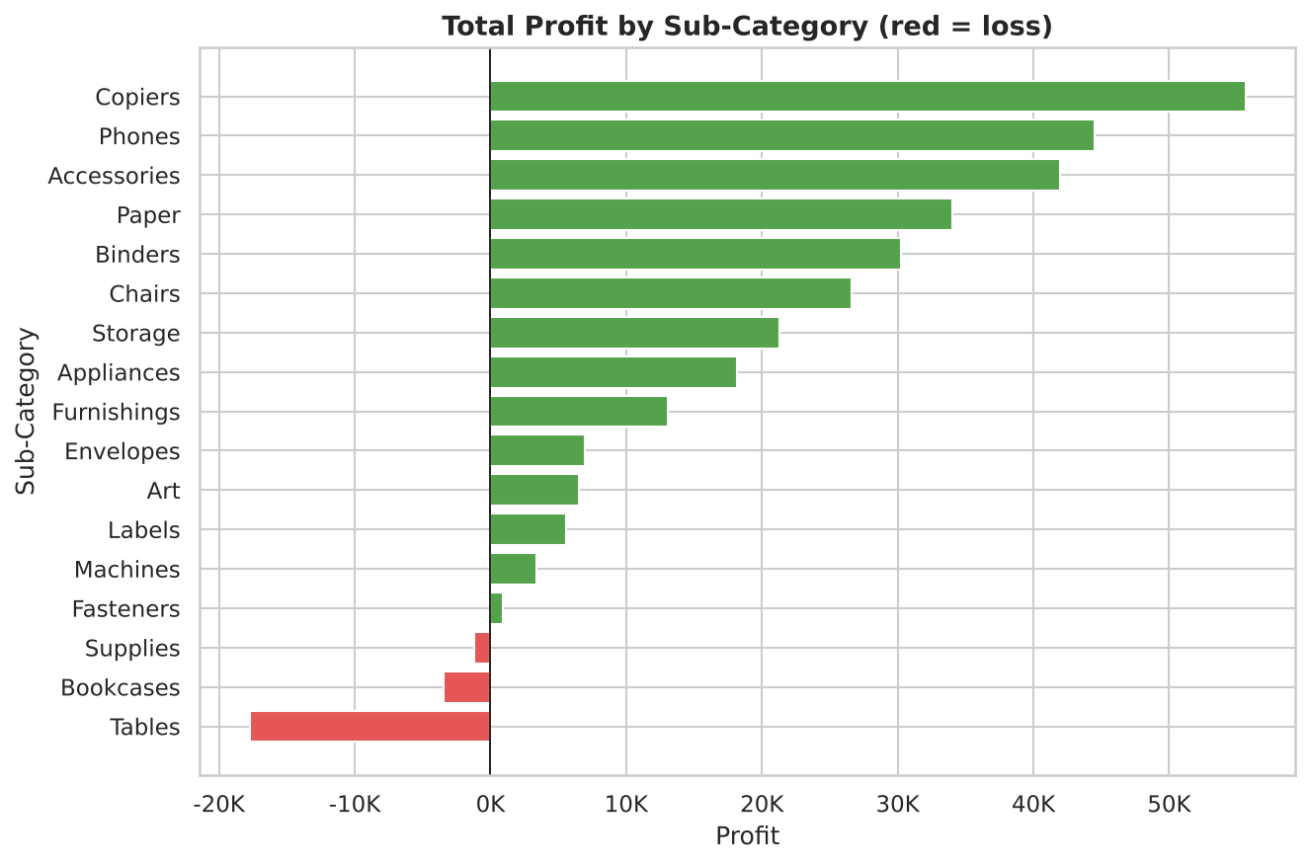
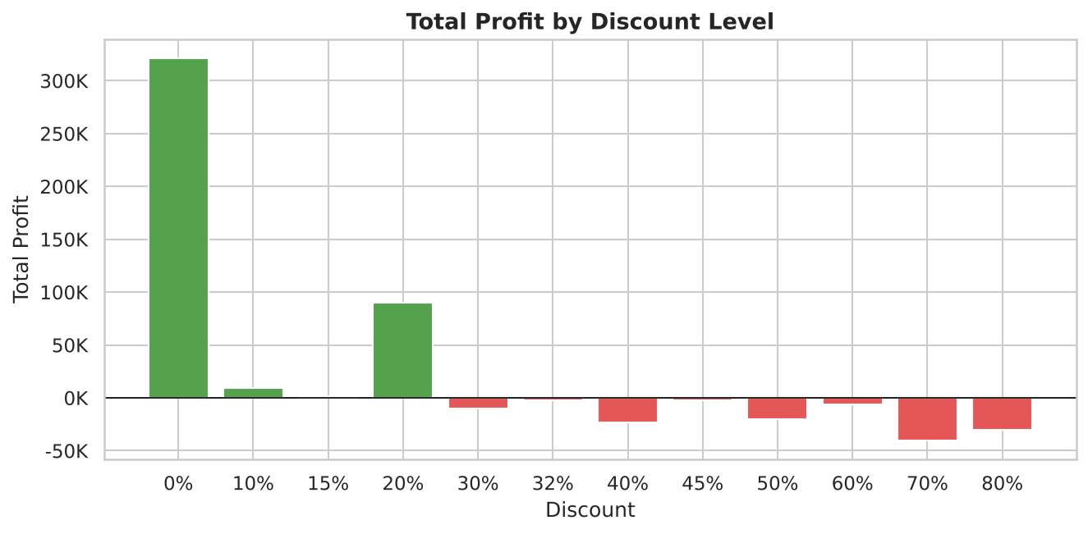
Sub-Category and Discount
Tables, Bookcases and Supplies lose money. Discounts above 20% lose 135K.

Slide 6
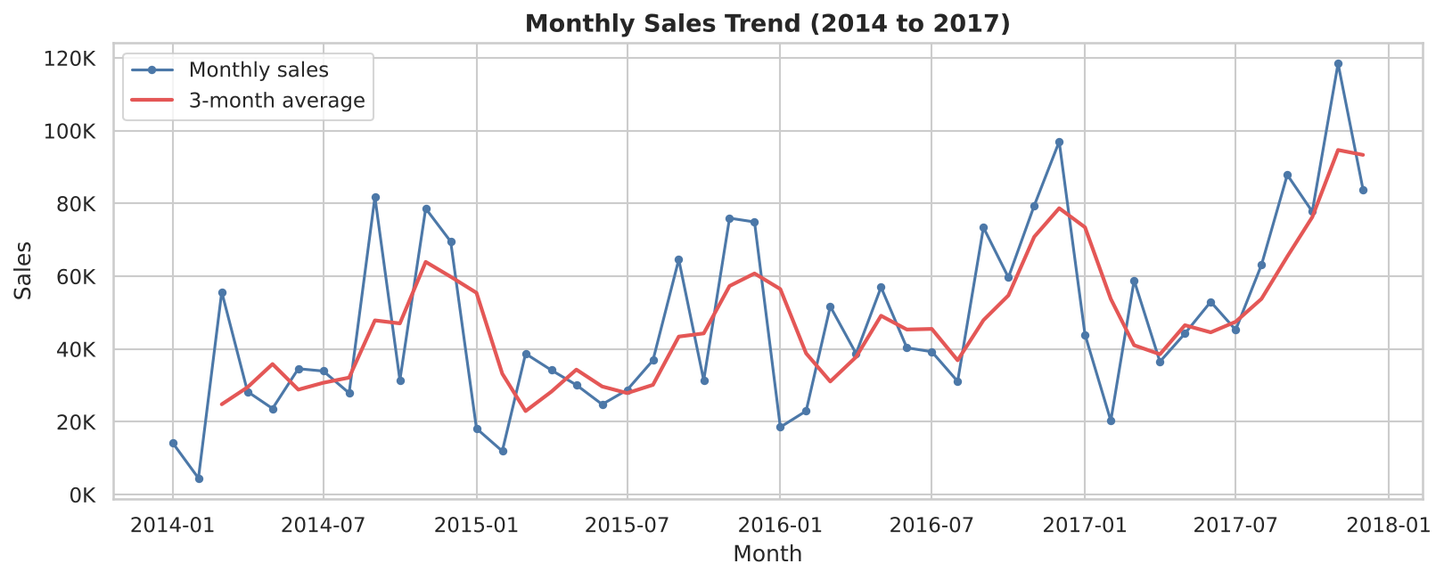
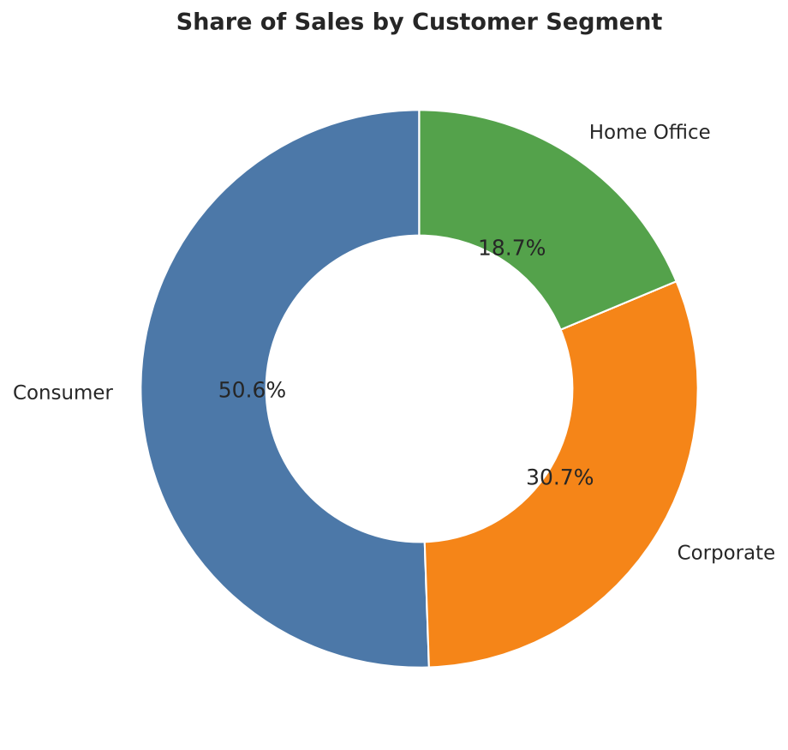
Trend and Segment
Sales up 51% since 2014. Nov, Dec and Sep are the strongest months.

Slide 7
Power BI Dashboard
4 KPI cards: Sales 2.30M, Profit 286.40K, Profit % 12.47%, Orders 5.009K
5 visuals: category, monthly trend, customer segment, sub-category profit, product table
Slicers: Year and Region
File: Week5_PowerBI_Gajanan__Raje.pbix (in the GitHub repo)

Slide 8
Key Insights
1. Technology gives 145K profit (17.4%); Furniture only 18K (2.5%).
2. Tables (-17.7K), Bookcases (-3.5K) and Supplies (-1.2K) lose money.
3. Discounts above 20%: 1,393 lines, 135K loss. At 20% or less: 422K profit.
4. Central margin is 7.9% (West 14.9%). Texas, Ohio, Pennsylvania and Illinois lose the most.
5. Sales grew 51% (2014 to 2017); Consumers bring 50.6% of sales.

Slide 9
Recommendations and Conclusion
Recommendations
1. Cap discounts at 20%; high discounts need approval.
2. Re-price or drop Tables and Bookcases; push Copiers, Phones, Accessories, Paper.
Conclusion
The business is growing, but heavy discounts and weak Furniture lines leak profit. Fixing them is the fastest way to raise the 12.47% margin.

