Slide 1

Healthcare Analytics for Doctor Visits
DIY Project | VOIS For Tech
Gajanan Harinarayan Raje
TYBCA | MGM's College of CS & IT, Nanded

Slide 2

PROBLEM STATEMENT
Hospitals and clinics need to know which patient factors decide how often people visit a doctor.
Raw patient records (5,190 rows) do not show these patterns on their own.
This project cleans the data and analyses it to find which factors matter most, so care can be planned better.

Slide 3
Project Description
Dataset: 5,190 patient records with 12 variables (age, gender, income, illness, insurance type, health score and more).
Target: number of doctor visits per patient.
Steps: load data, clean it (encode yes/no and gender, check nulls and duplicates), draw 10 charts, find correlations, write insights.
Work done in Python on Google Colab, in the same style as a market analysis.
Output: 10 charts, cleaned CSV, report (PDF) and this presentation.

Slide 4

WHO ARE THE END USERS?
Hospital and clinic managers: plan staff and appointments
Doctors and care teams: spot patients who need regular follow-up
Health insurance providers: see which groups use more care
Public health planners: target chronic-condition programs
Students and analysts: example of an end-to-end analytics project

Slide 5

Technology Used
Python 3: programming language
Google Colab: cloud notebook to run the code
Pandas and NumPy: load, clean and calculate
Matplotlib and Seaborn: 10 charts and heatmap
GitHub: project code and files
MS Word and PowerPoint: report and presentation

Slide 6
RESULTS: KEY FINDINGS
79.8% of patients had no doctor visits; the average is 0.30 visits per person.
Reduced activity days is the strongest factor (correlation +0.42).
Long-term chronic patients average 0.60 visits vs 0.26 without (about 2.3x).
Illness type 5 averages 0.81 visits; type 0 only 0.08.
Females average 0.36 visits vs 0.24 for males.
Age and income have a weak effect.
GitHub link: paste your repository link here

Slide 7
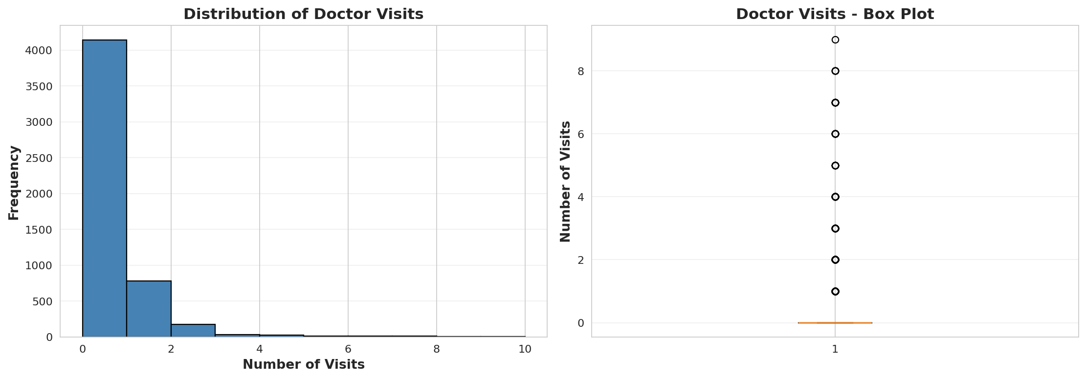
Chart 1: Doctor Visits Distribution
79.8% of patients had 0 visits; only 20.2% visited at least once (maximum 9). Most patients rarely see a doctor.

Slide 8
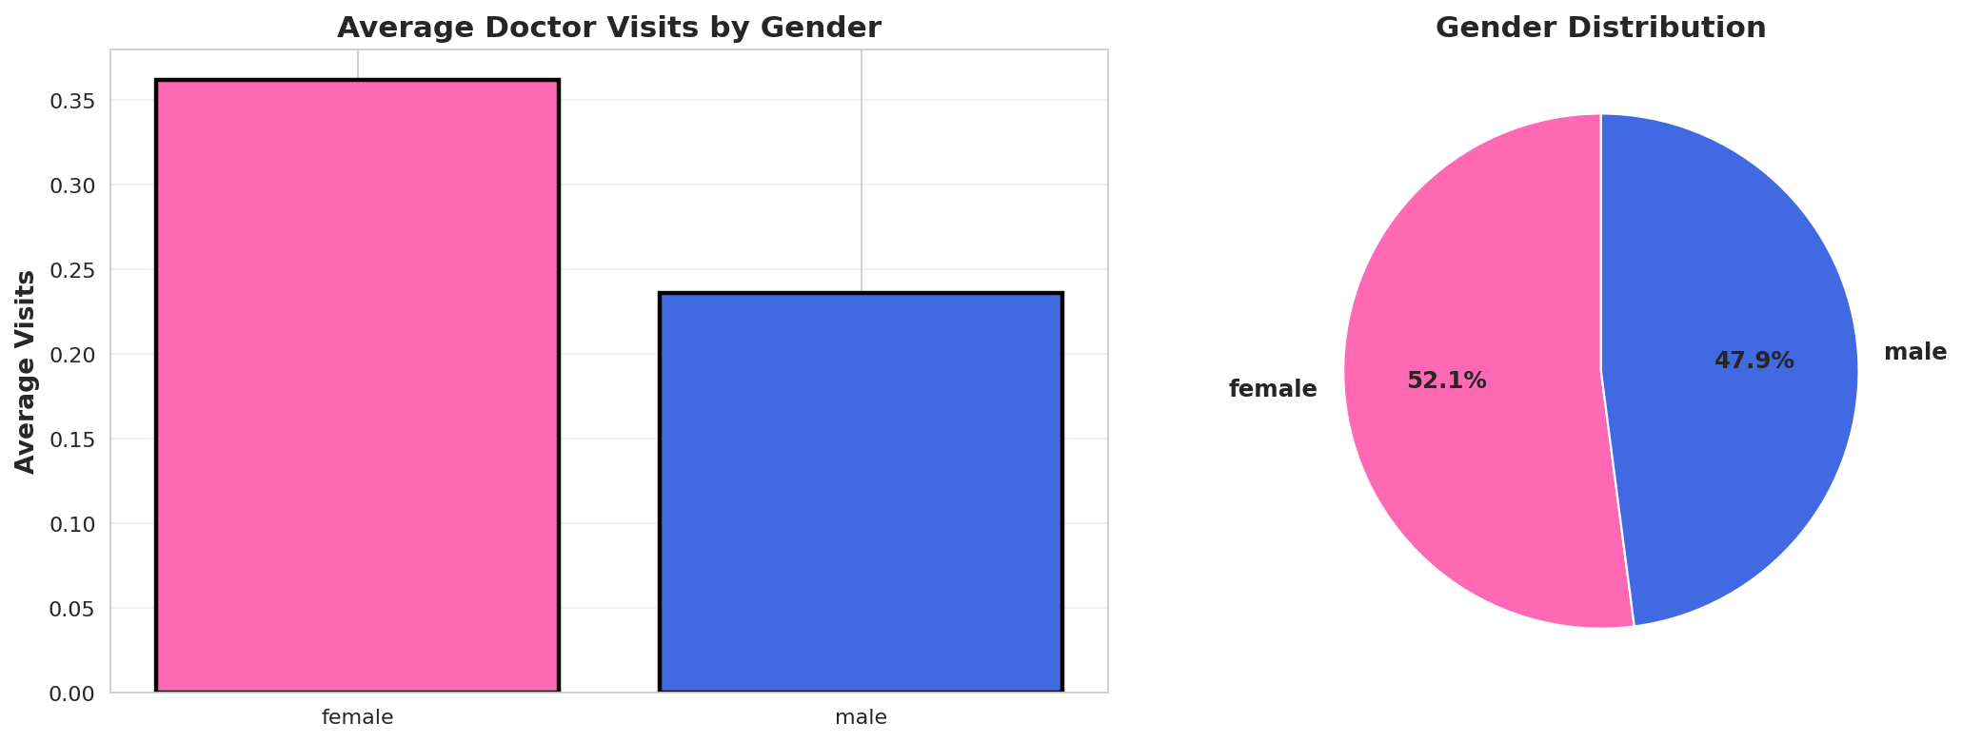
Chart 2: Visits by Gender
Female patients average 0.36 visits vs 0.24 for males. The sample is 52% female (2,702 of 5,190).

Slide 9
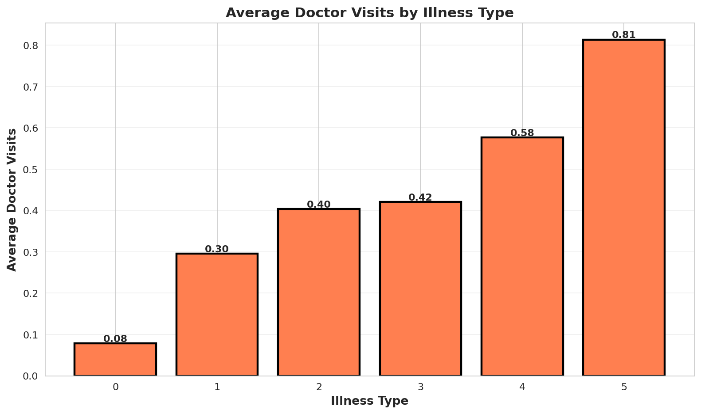
Chart 3: Illness Type vs Visits
Average visits rise with illness type, from 0.08 (type 0) to 0.81 (type 5).

Slide 10
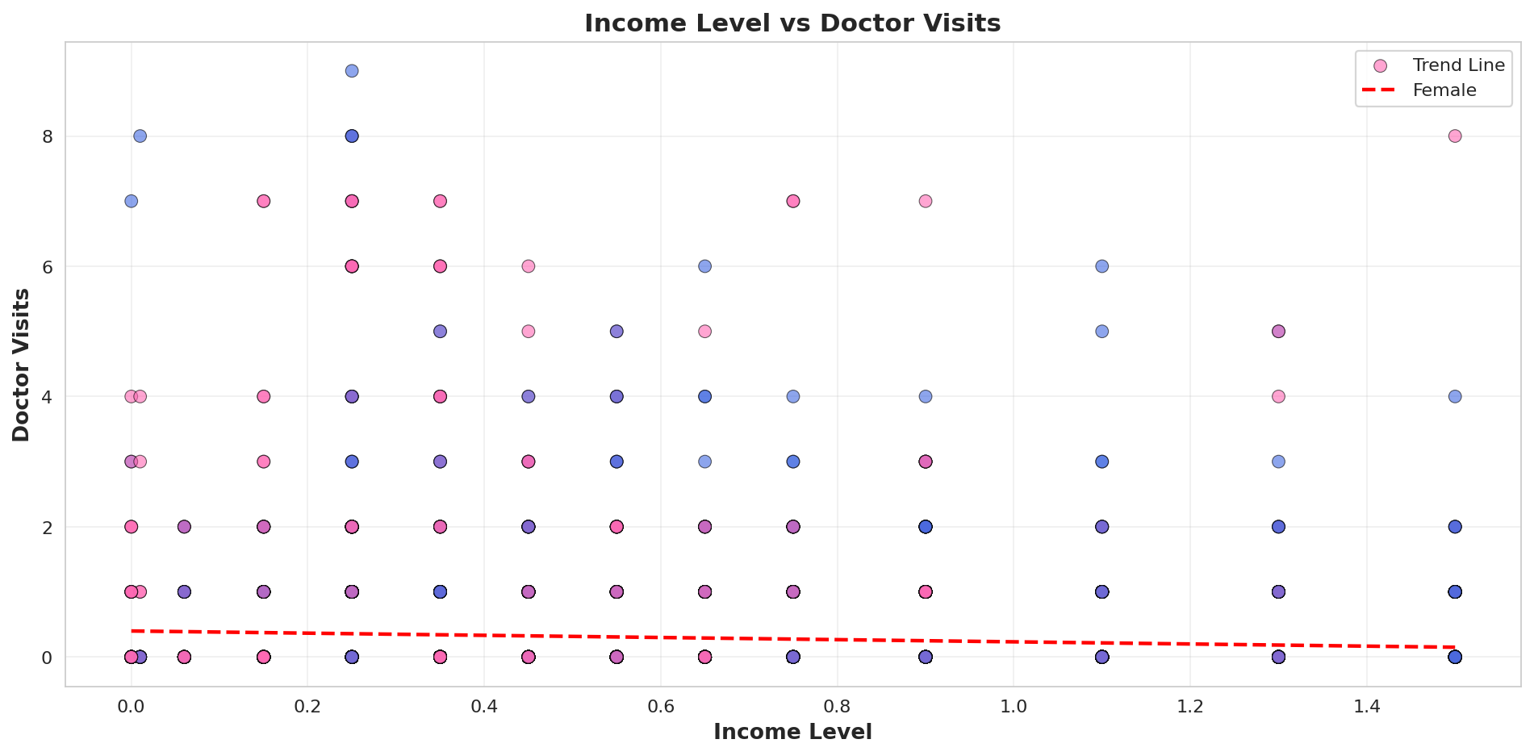
Chart 4: Income vs Visits
Income has a weak negative link with visits (correlation -0.08). Income alone does not explain visits.

Slide 11
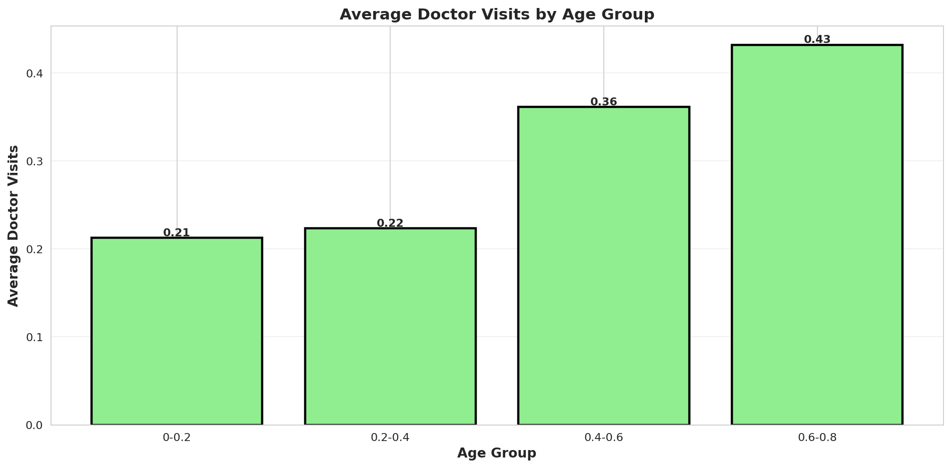
Chart 5: Age Groups vs Visits
Visits rise with age, from 0.21 in the youngest group to 0.43 in the oldest. Age is a scaled value in this dataset.

Slide 12
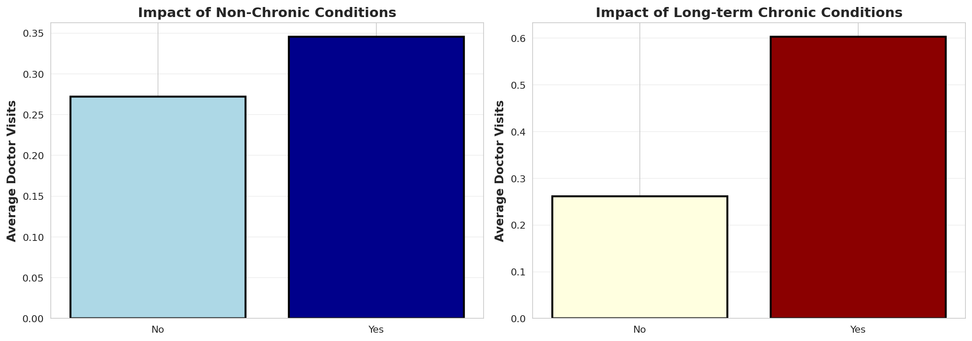
Chart 6: Chronic Conditions
Long-term chronic patients average 0.60 visits vs 0.26 without (about 2.3x). Non-chronic: 0.35 vs 0.27.

Slide 13
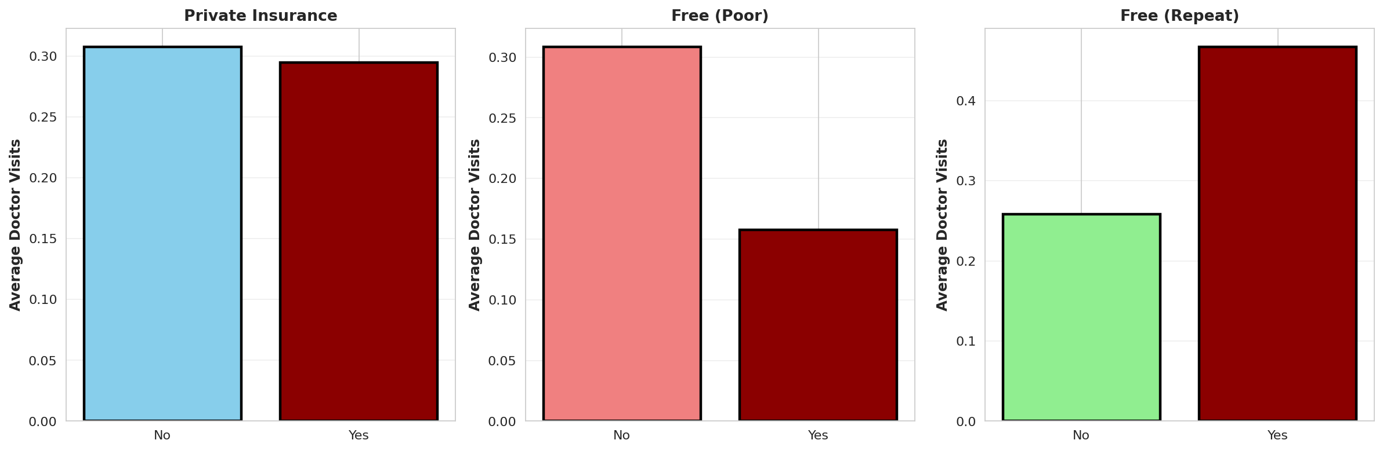
Chart 7: Insurance Type
Free (repatriate) patients average 0.47 visits vs 0.26; free (poor) patients 0.16 vs 0.31. Private insurance: 0.30 vs 0.31.

Slide 14
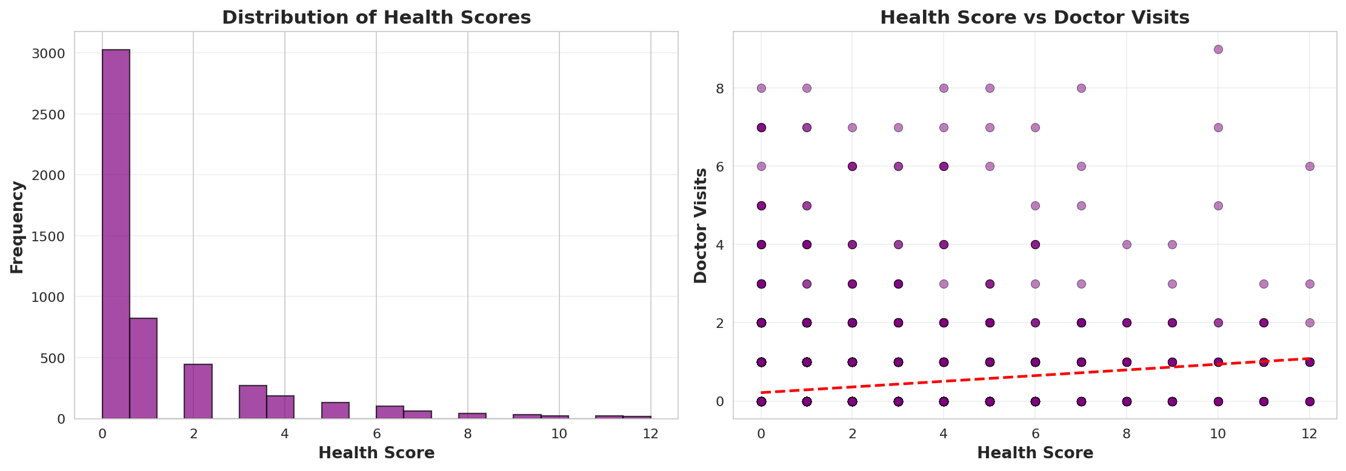
Chart 8: Health Score
Health score and visits are positively related (correlation +0.19): a higher score goes with more visits. The median score is 0.

Slide 15
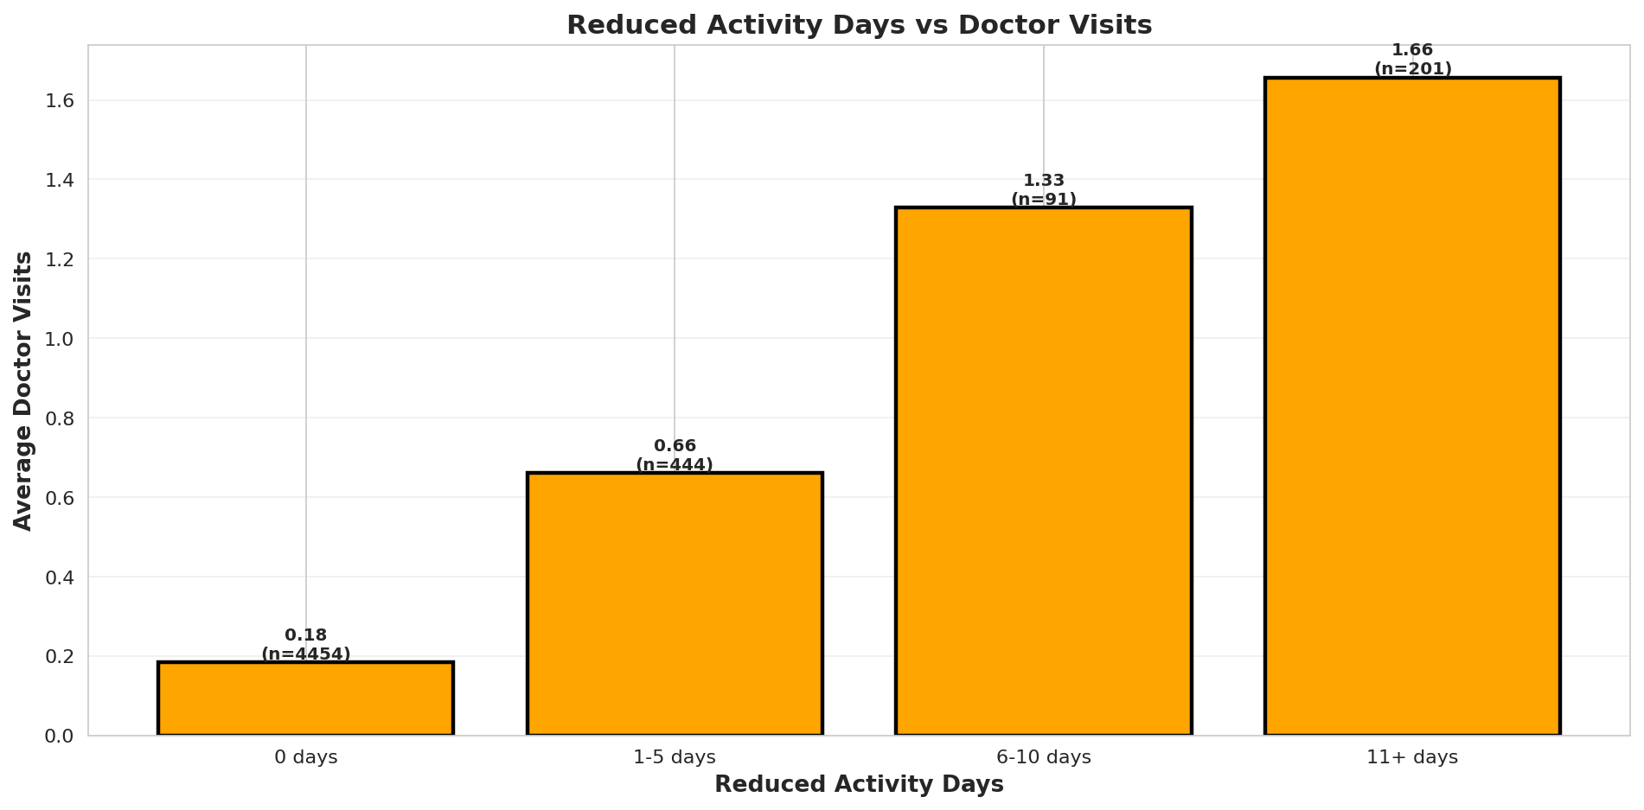
Chart 9: Reduced Activity Days
Visits rise sharply with reduced activity days: 0.18 (0 days) to 1.66 (11+ days), about 9 times higher.

Slide 16
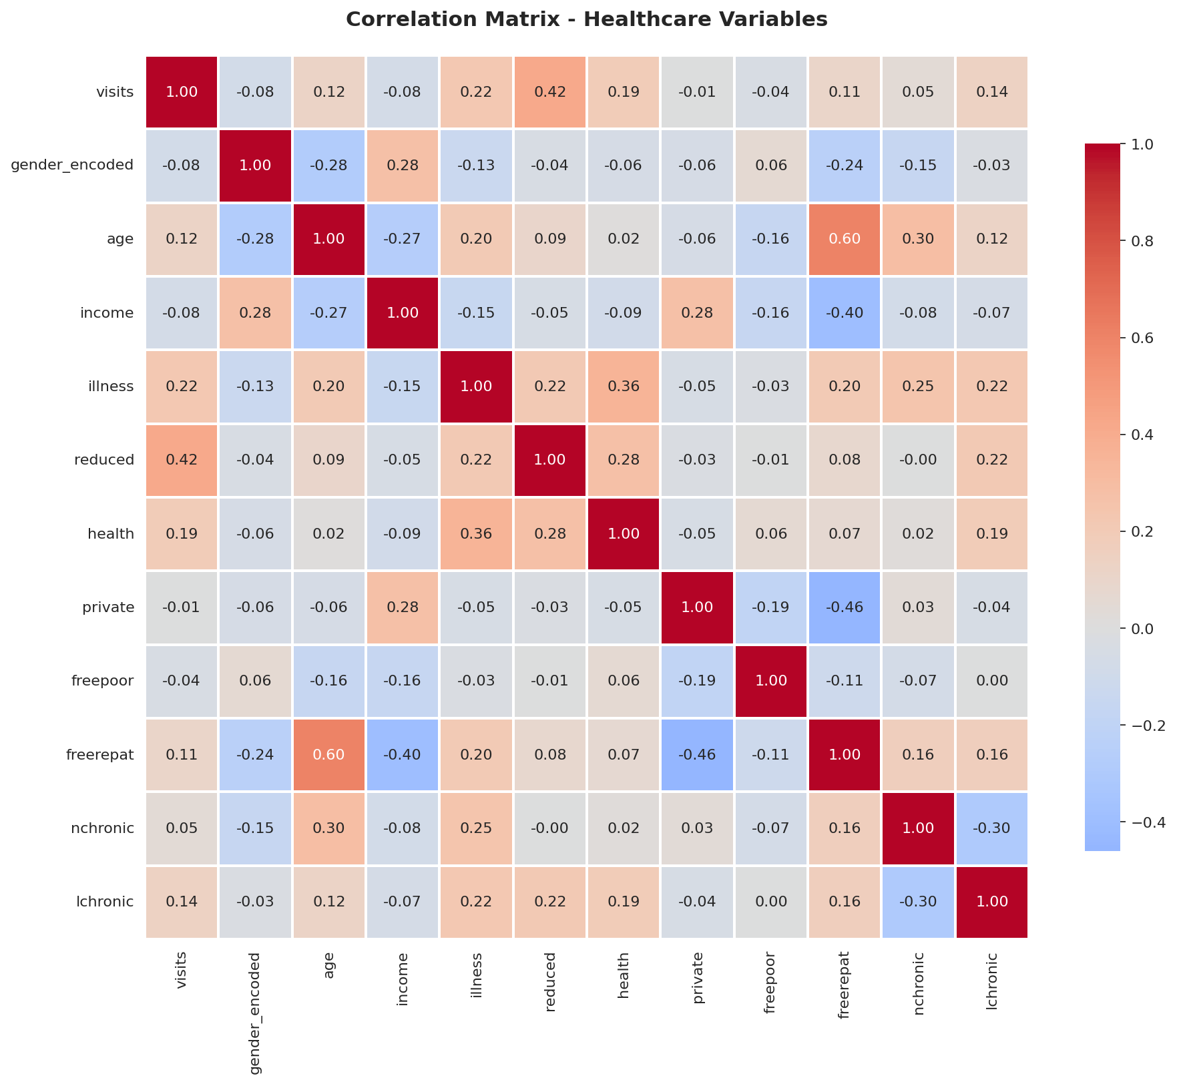
Chart 10: Correlation Heatmap
Reduced activity days has the strongest link with visits (+0.42), then illness type (+0.22) and health score (+0.19). Age and income are weak.

Slide 17
Thank you
Gajanan Harinarayan Raje
TYBCA | MGM's College of CS & IT, Nanded
Healthcare Analytics for Doctor Visits

