Slide 1
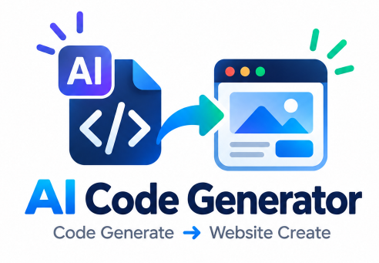
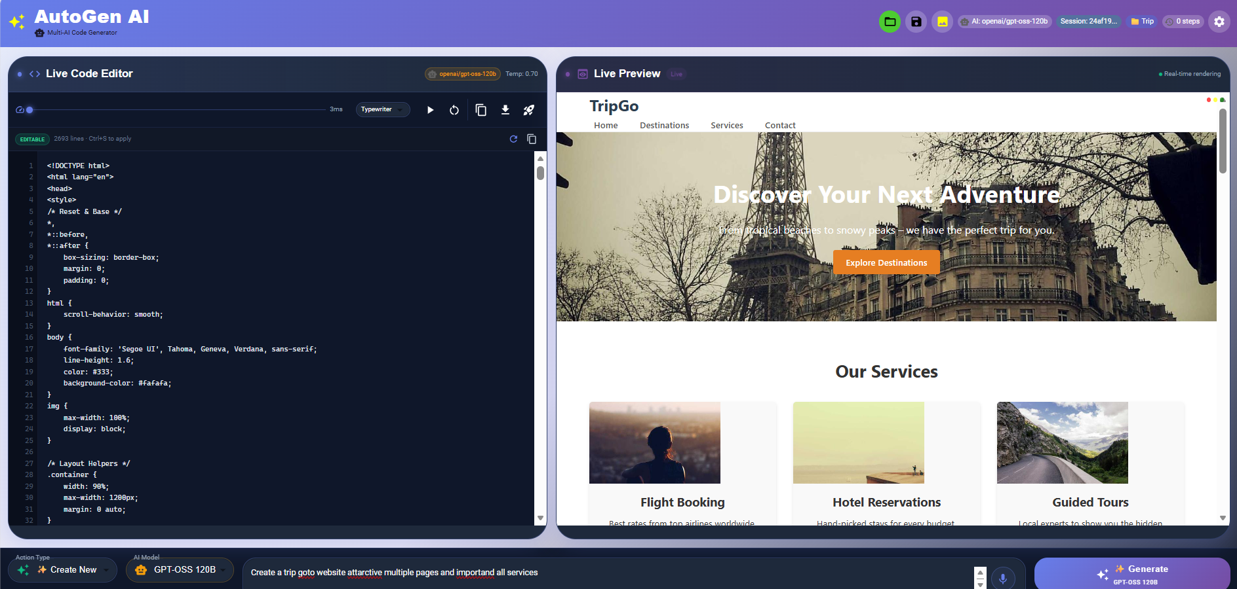

AutoGen AI
Multi-AI Code Generator
Create • Edit • Preview • Debug • Deploy
websites using natural language, voice and images.
GENAI
FASTAPI
REACT
GROQ
Presented by
Gajanan Deshmukh
AI / GenAI Developer
LIVE CODE + LIVE PREVIEW
AUTOGEN AI • GAJANAN DESHMUKH • 01

Slide 2
01 | Project Overview
1
A single AI-assisted workspace for turning ideas into functional websites
What is AutoGen AI?
Natural Language → Code
Describe the website you want.
AutoGen AI is an AI-powered web development platform
that lets users create, inspect and refine websites without
manually writing every part of the frontend.
The platform combines natural-language prompting,
voice input, image-to-website generation, a live code editor,
real-time preview, project management and Vercel
deployment.
Voice → Code
Speak the requirement instead of typing.
Image → Website
Use a UI screenshot as visual input.
AI Code Assistant
Modify, debug, refactor and optimize.
AUTOGEN AI • GAJANAN DESHMUKH • 02

Slide 3
02 | Problem Statement
2
Traditional website development creates friction across coding, iteration, debugging and deployment
Repetitive coding
Idea → UI gap
Manual iteration
HTML, CSS and JavaScript need to be
written and updated manually.
Turning a requirement or screenshot
into a working interface takes effort.
Frequent design changes require
repeated code edits and testing.
01
02
03
Debugging overhead
Disconnected tools
Frontend issues can require context
switching between files and tools.
Coding, preview, AI assistance and
deployment are often separate steps.
04
05
AUTOGEN AI • GAJANAN DESHMUKH • 03

Slide 4
03 | Proposed Solution
3
Bring generation, editing, preview, assistance and deployment into one workflow
INPUT
AI
CODE
PREVIEW
DEPLOY
Prompt / Voice / Image
Understand + Generate
HTML + CSS + JS
Render in real time
Vercel
One continuous loop: describe → generate → inspect → improve → publish.
AI-ASSISTED DEVELOPMENT WORKFLOW
AUTOGEN AI • GAJANAN DESHMUKH • 04

Slide 5
04 | Project Objectives
4
Core goals of the platform
Generate
Assist
Visualize
Create complete website layouts from
natural-language instructions.
Use AI to modify, debug, analyze,
refactor and optimize code.
Show generated output immediately
through live preview.
Translate
Manage
Deploy
Convert voice instructions and
screenshots into web development
inputs.
Save and load projects and
maintain session-based work.
Provide a direct path from generated
project to Vercel hosting.
AUTOGEN AI • GAJANAN DESHMUKH • 05

Slide 6
05 | Core Features
5
Capabilities implemented in the current project
AI Website Generation
Voice-to-Code
Image-to-Website
Live Code Editor
Generate modern web /components from natural-language
prompts.
Use browser speech input to
describe requirements.
Analyze screenshots and
generate a website starting
point.
Edit generated HTML/CSS/JS
directly.
Real-Time Preview
AI Code Assistant
Project Management
Vercel Deployment
See the current website output
while editing.
Modify • Debug • Refactor •
Analyze • Optimize.
Save, load and manage
generated projects.
Deploy generated websites
and receive hosted output.
AUTOGEN AI • GAJANAN DESHMUKH • 06

Slide 7
06 | AI Engine & Model Flow
6
Current implementation separates text/code generation from visual understanding
Text / Code Generation
Groq API Primary configured model: openai/gpt-oss-120b
Used for website generation, modification and code-assistance
workflows.
Prompt / Code
Request
Groq
GPT-OSS 120B
Generated Code
Vision / Screenshot Analysis
Mistral Vision
Used for screenshot analysis and image-to-website workflows.
UI Screenshot
Mistral
Vision
UI Spec / Code
AUTOGEN AI • GAJANAN DESHMUKH • 07

Slide 8
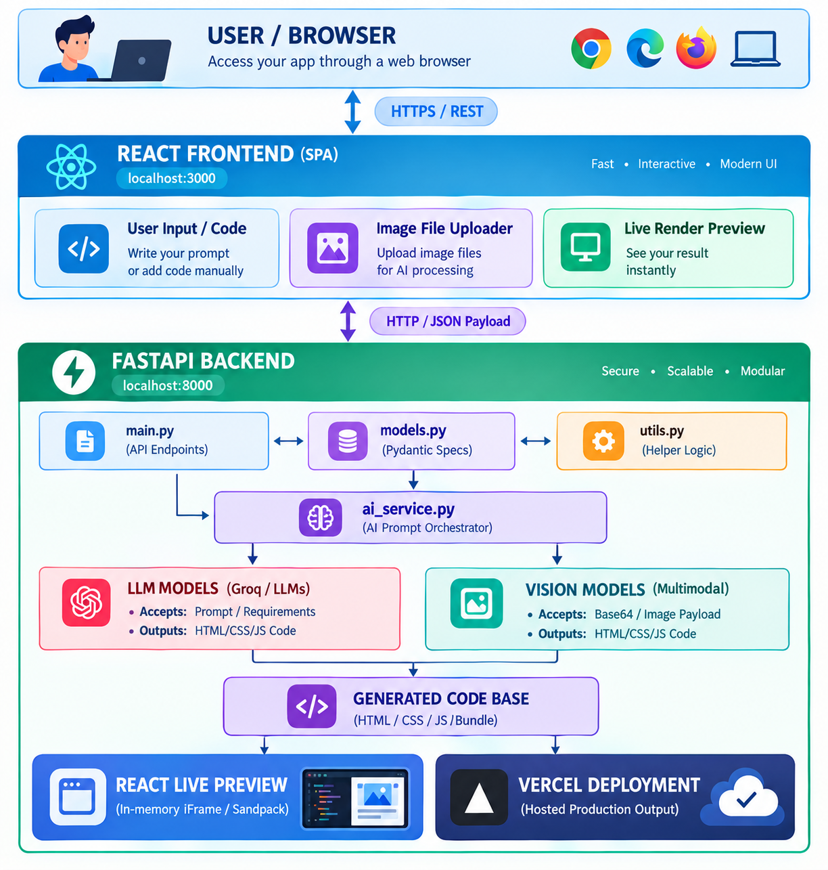
07 | System Architecture
7
Frontend → API → AI → code processing → deployment
Frontend
React • Monaco Editor • Voice/Image input
Backend & API
FastAPI • Pydantic • REST APIs
AI Engine
Groq • GPT-OSS 120B • Mistral Vision
Code Processing
HTML/CSS/JS extraction, validation & preview
Deployment
Vercel deployment integration
AUTOGEN AI • GAJANAN DESHMUKH • 08

Slide 9
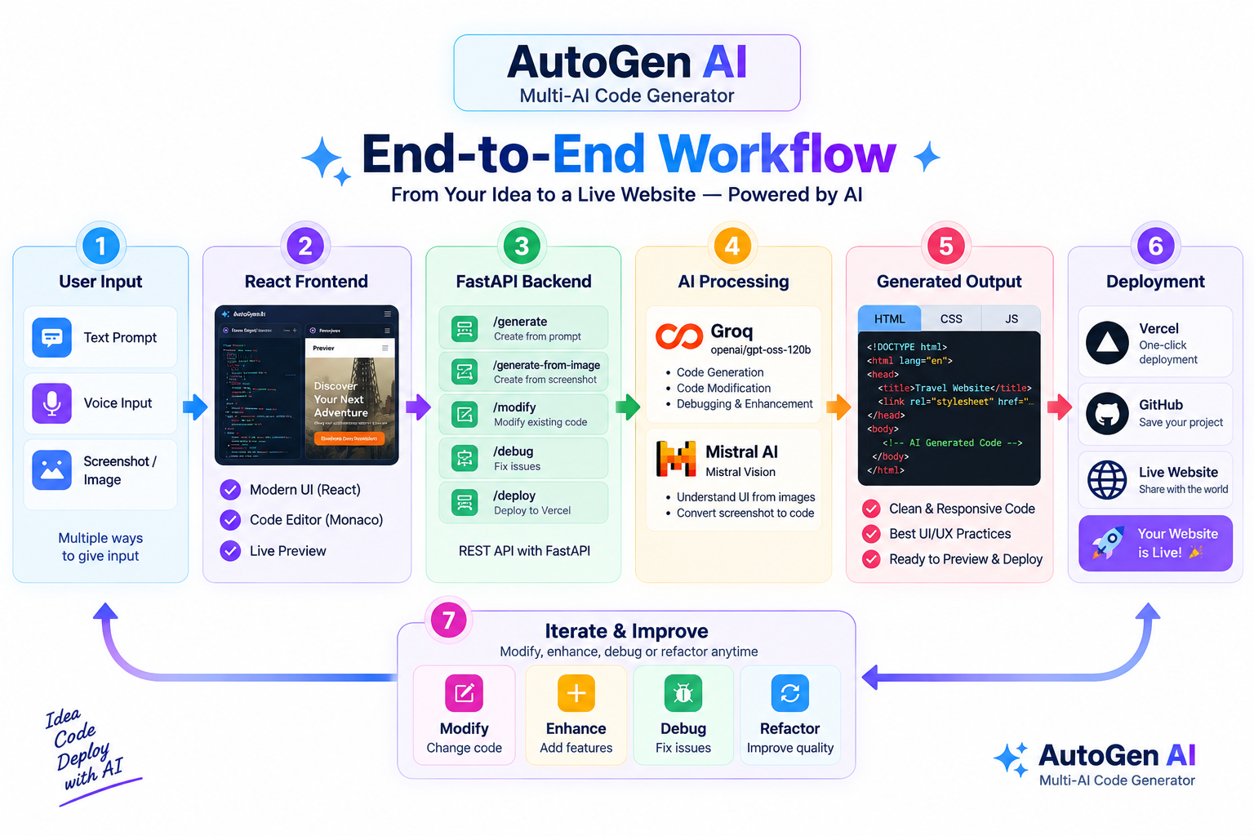
09 | End-to-End Workflow
9
Typical user journey inside AutoGen AI
01
Describe
“Create a modern travel we
“Create a modern travel website…”
02
Generate
AI model creates the website code.
03
Preview
The generated site appears inside the editor.
04
Improve
Ask AI to modify, debug or refactor.
05
Save
Keep the project for later editing.
06
Deploy
Send the generated website to Vercel.
AUTOGEN AI • GAJANAN DESHMUKH • 10

Slide 10
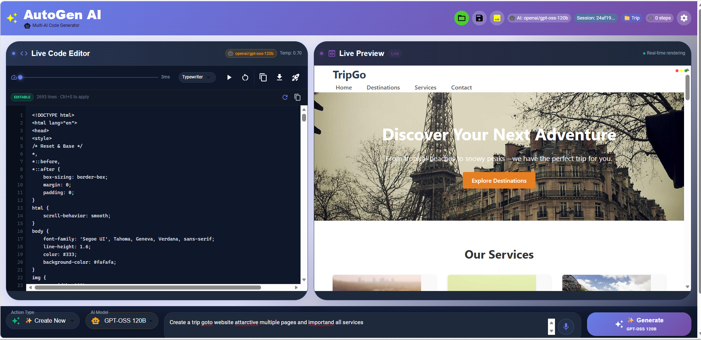
10 | Product Demo
10
Code editor + real-time preview + AI controls in one screen
Live Code Editor
Generated HTML/CSS/JS
can be viewed and edited.
Live Preview
Real-time website rendering.
AI Prompt Bar
Natural-language input +
model selection.
AUTOGEN AI • GAJANAN DESHMUKH • 11

Slide 11
11 | Use Cases
11
Where the platform can be applied
Rapid Prototyping
Portfolio & Landing Pages
Create a working UI concept before full implementation.
Generate structured multi-section websites quickly.
Business Websites
UI Reconstruction
Create service, product and informational sites.
Use screenshots as references for web implementation.
Developer Assistance
Learning & Experimentation
Modify, debug and refactor existing generated code.
Explore frontend concepts through conversational coding.
AUTOGEN AI • GAJANAN DESHMUKH • 12

Slide 12
12 | Advantages
12
Value of combining the workflow in one platform
Faster iteration
Conversational development
Multimodal input
Less context switching between coding,
preview and AI assistance.
Requirements and changes can be
expressed in natural language.4
Prompt, voice and screenshot-based
workflows.
Immediate feedback
Reusable projects
Deployment path
Live preview exposes UI changes
during development.
Generated work can be saved and revisited.
The workflow continues from generation
to hosted output.
AUTOGEN AI • GAJANAN DESHMUKH • 13

Slide 13
13 | Future Scope
13
Natural next steps for making the platform more production-ready
Future Enhancements
Engineering Focus
• Persistent cloud project storage
• GitHub / repository integration
• Automated testing and code validation
• More framework and language targets
• Stronger deployment controls
• Team collaboration and sharing
• Better generated-code consistency
• Safer execution and validation of generated code
• Improved responsive UI generation
• More robust error recovery
• Usage / cost observability
• Version history for generated projects
The direction: from AI-assisted frontend generation toward an end-to-end AI development workspace.
AUTOGEN AI • GAJANAN DESHMUKH • 14

Slide 14
14 | Conclusion
14
AutoGen AI demonstrates a practical GenAI workflow for web development
IDEA
AI
OUTPUT
Natural-language intent
Generation + assistance
Live site
Key Takeaway
AutoGen AI unifies AI generation, code editing, live preview, multimodal input, project management
and deployment into one development experience.
AUTOGEN AI • GAJANAN DESHMUKH • 15

Slide 15
Thank You
AutoGen AI — Multi-AI Code Generator
Presented by Gajanan Deshmukh
AI • CODE • PREVIEW • DEPLOY
Questions & Discussion
Mobile.No:-9359458009
AUTOGEN AI • GAJANAN DESHMUKH • 16

