Slide 1

PUNE INSTITUTE OF COMPUTER TECHNOLOGY PUNE
PIC MICROCONTROLLER UNIT-V Real Word Interfacing With 18FXXXX
Department of Electronics and Telecommunication Engineering
Ass.Prof. P.B.Tathe
Email Id: pbtathe@pict.edu

Slide 2
SYLLABUS
Port structure with programming,
Interfacing of LED, LCD and Keyboard,
DAC for generation of waveform,
Design of PIC test Board and debugging,
Home protection System: All programs in embedded C.

Slide 3
Port structure
40 pins of PIC18Fxx are divided into 5 ports. Out of which, 34 pins are Input-Output pins which can be configured for general Input or Output by setting registers associated with them.
Ports Number of pins Pin Name
PORTA 7 RA0-RA6
PORTB 8 RB0-RB7
PORTC 8 RC0-RC7
PORTD 8 RD0-RD7
PORTE 3 RE0-RE2
Registers Associated with Ports in PIC18F4550
Each port in pic18f4450 is associated with three 8 bit registers for IO operations.
TRISX (8 bit)
LATx (8 bit)
PORTx (8 bit)

Slide 4
Port structure
TRISx : where X is the name of the ports either of A, B, C, D, E. For example TRISA, TRISB etc. This register assigns the direction of the pins (Input or Output). For example, “TRISB = 0xF0”, will set all the pins in port B to Output.
LATX: The latch registers reds and modifies the write operation on the value of I/O pin and stored the output data that is to be passed on to the external hardware.
PORTX: Reads the device level, stores the Input level of the pins and reads and registers the input signal from the external device if the pin is configured as Input.

Slide 5
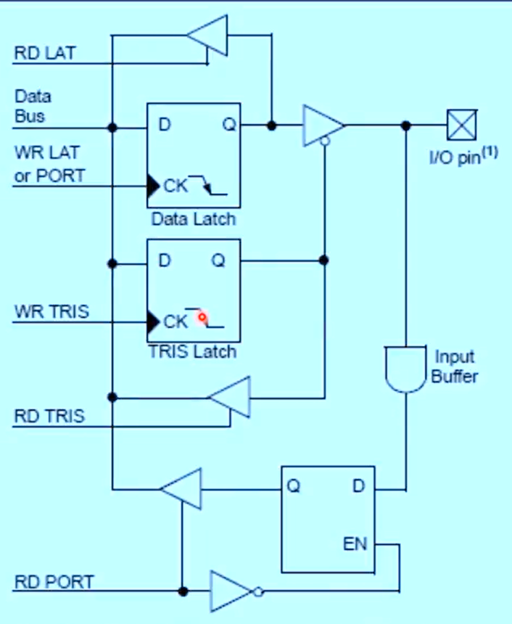
Port structure:

Slide 6
TRSID=0x00
TRSID=0xFF
TRISDbits.TRISD0=1;
TRISDbits.TRISD1=0;

Slide 7
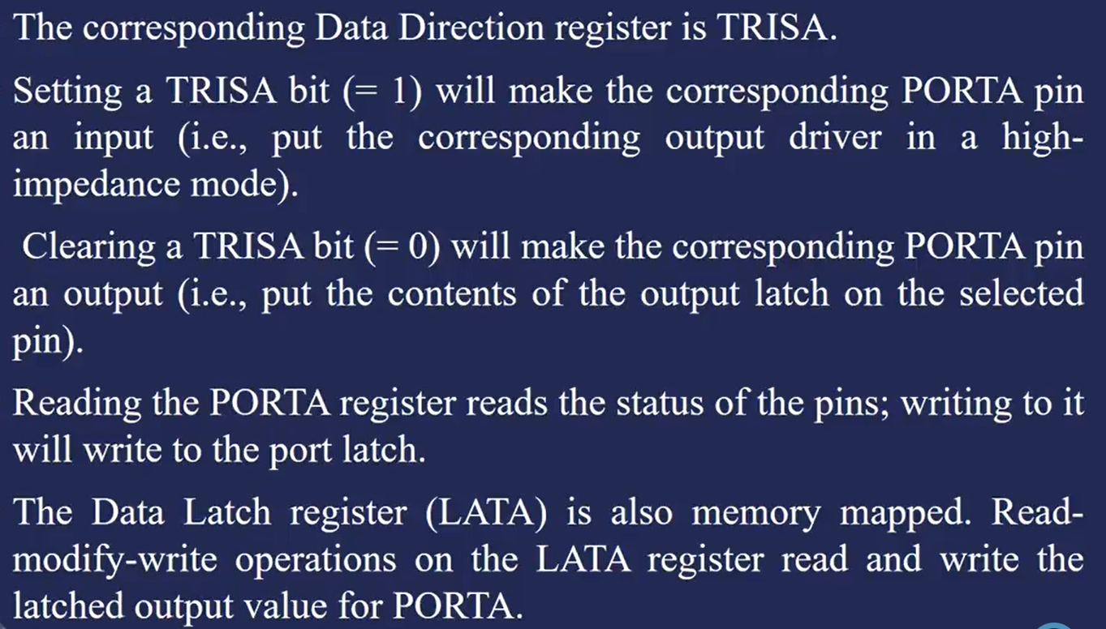

Slide 9
1.LED Interfacing

Slide 10
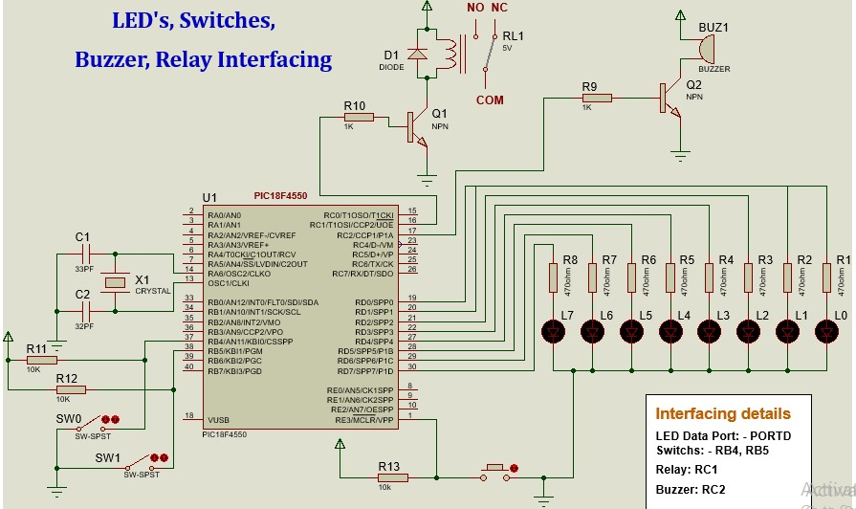
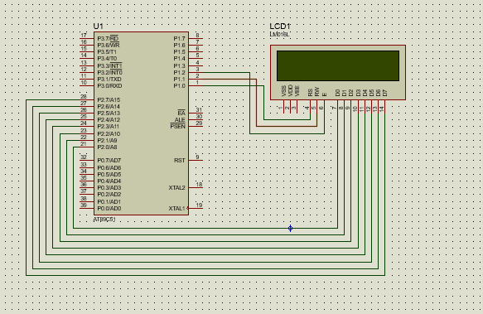
LED ,RELAY,S/W, Buzzer Interfacing with PIC18F4550

Slide 11
Algorithm for LED ,RELAY,S/W,Buzzer Interfacing with PIC18F4550
Activate the internal Pullup on PORTB.
Disable the all-analog inputs.
Configured RB0 and RB1 as input for sensing Sw0 and Sw1 respectively.
Configured:
RC1 (Relay) as Output.
RC2(Buzzer) as Output.
PORTD (LED) as Output.
Initialize the value for LED’s, Buzzer & Relay.
Keep them off on Power-on or on Reset.

Slide 12
Algorithm for LED ,RELAY,S/W,Buzzer Interfacing with PIC18F4550
Check the status of RB0 for switch (SW0) press. Chase the LEDs from left to right on PORTD, turn on the Buzzer and Relay.
Check the status of RB1 for switch (SW1) press. Chase the LEDs from right to left on PORTD, turn off the Buzzer and Relay.

Slide 13
Code for LED ,RELAY,S/W,Buzzer Interfacing with PIC18F4550
#include<p18f4550.h>
#include “vector_relocate.h”
void msdelay (unsigned int time)
Void main( ) {
unsigned int i; unsigned char va l= 0;
INTCON2bits.RPBU=0;
ADCON1=0x0F;
TRSID=0x00;
TRISBbits.TRISB0=1;
TRISBbits.TRISB1=1;
TRISCbits.TRISC1=0;
TRISCbits.TRISC2=0;
PORTCbits.RC1=0;
PORTCbits.RC2=0;
while(1) {
If(PORTBbits.RB0==0)
{
Val=1; }
If(PORTBbits.RB1==0)
{
Val=2;
}

Slide 14
Code for LED ,RELAY,S/W,Buzzer Interfacing with PIC18F4550
If(val==1)
{
PORTCbits.RC1=1;
PORTCbits.RC2=1;
PORTD=0x80;
msdelay(100);
For(i=0;i<8;i++)
{
PORTD=PORTD>>1;
Msdelay(100) }
}
If(val==2)
{
PORTCbits.RC1=0;
PORTCbits.RC2=0;
PORTD=0x01;
msdelay(100);
For(i=0;i<8;i++)
{
PORTD=PORTD<<1;
Msdelay(100) }
}
}

Slide 15
2.LCD Interfacing

Slide 16
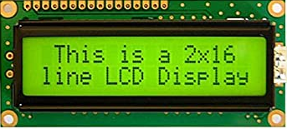
Basics of LCD
16×2 LCD
Line 1
80H | 81H | 82H | 83H
C0H | C1H | C2H | C3H
Line 2
Notes:
In 16×2 LCD, have two rows or lines, In Each row we can display 16 character
The address of the first character of line1/ row1 or is start at 80H,next one is 81H and so on
The address of the first character of line 2/row2 is start at c0H,next one is c1H and so on
For e.g. I want to display PICT on first row & starting to display from character address 81H,so at 81H address character P is display ,and 82h address character I is display and so on

Slide 17
Structures of LCD
Command Register
Data Register
D0-D7
RS
R / W
E
Notes:
LCD have two internal register ,The first register is command register and second register is data register
LCD have three control signal RS-Register select,R/W bar and E Enable
In command register, user can stored the command such as clear the display, display on cursor blinking etc.
In Data register, user has stored the ASCII value of the character we want to display
The selection of command reg.or data register depends on status of RS control signal
If RS is zero ,The command register is selected;If RS is one,The Data register is selected.
So whenever we want to write command or data ,first we have to select an appropriate register.
The second control signal of LCD that is R/W bar;When it is zero ,we can write the data on the LCD module
When it is one , we can read the data from LCD module
The third control signal is latch enable;Whenever we want to latch a data i.e. first we will place data or command on data bus d0-d7 ;
after that we we have to send enable signal.The enable signal for the write operation is high to low pulse ;
so we have to make this terminal high for some delay or immediately we can send logic zero pulse on this enable signal

Slide 18
Commands for LCD
Command to LCD | Code (Hex)
To Select LCD of 16 ×2 lines and 5x7 matrix | 38
Display on cursor blinking | 0E
Clear the display | 01
The address of first character of line 1 | 80
The address of first character of line 2 | C0
Notes:
The no.of commands are available for LCD,but generally we used four commands
First command is 38H which is used to select LCD of 16×2,5×7 matrix display,i.e. to display each character on LCd dot matrix pattern 5×7 is used
Second command 0EH which is used to display on,cursor blinking
Third command is 01H which is used to clear the display;before displaying any data on LCD we can sent this command to clear the previous data on LCD
Important command to the LCD is relating to the addressing of the character ;In 16×2 LCD,in each line there are 16 character .
The address of the first character is 80H
The address of the first character is C0H

Slide 19
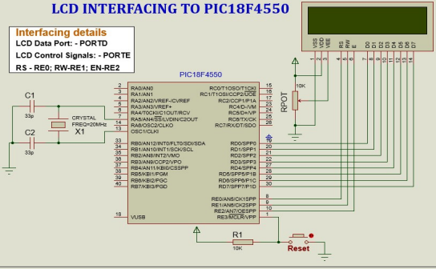
LCD Interfacing with PIC18F4550

Slide 20
Algorithm for LCD Interfacing with PIC18F4550
Configure PORTE as control port for LCD and PORTD as 8 bit data lines for the LCD.
Define the required function prototypes.
Declare the message/s to be displayed on LCD.
Initialize the LCD using suitable commands.
Display the message “Welcome” on line1 and “PICT” on line2.

Slide 21
Code for LCD Interfacing with PIC18F4550
#include<p18f4550.h>
#include “vector_relocate.h”
#define LCD_DATA PORTD;
#define ctrl PORTE;
#define rs PORTEbits.RE0;
#define rw PORTEbits.RE1;
#define en PORTEbits.RE2;
void init_LCD(void);
void LCD_command(unsigned char cmd);
void LCD_data(unsigned char data);
void LCD_write_string(static char *str);
void msdelay (unsigned int time)
Void main( void ) {
char var1[] = "Wel-Come";
char var2[ ] = "PICT";
INTCON2bits.RPBU=0;
ADCON1=0x0F; TRSID=0x00;TRISE=0x00;
init_LCD();
msdelay(15);
LCD_write_string(var1); msdelay(15);
LCD_command(0xC0);
LCD_write_string(var2);
while(1) {
void init_LCD(void)
{
LCD_command(0x38); msdelay(15); LCD_command(0x01); msdelay(15); LCD_command(0x0E); msdelay(15); LCD_command(0x80); msdelay(15);
}

Slide 22
Code LCD Interfacing with PIC18F4550
void LCD_command(unsigned char cmd)
{
LCD_DATA = cmd;
rs = 0;
rw = 0;
en = 1;
msdelay(15);
en = 0;
}
void LCD_data(unsigned char data)
{
LCD_DATA = data;
rs = 1;
rw = 0;
en = 1;
msdelay(15);
en = 0;
}
void LCD_write_string(unsigned char *str)
{
int i = 0;
while (str[i] != '\0')
{
LCD_data(str[i]);
msdelay(15);
i++;
}
}

Slide 23
3.Keyboard Interfacing

Slide 24
Keyboard
PIC
1
2
3
RC0
RC1
RC2
RC3
4
5
6
7
8
9
*
0
#
RC4
RC5
RC6

Slide 25
#include <PIC18F4550.h> // Include the XC8 compiler header file
#include <vector relocate.h> // Include the standard integer library
#define R1 PORTCbits.RC0 // Define ROW1 pin connected to RC0
#define R2 PORTCbits.RC1 // Define ROW2 pin connected to RC1
#define R3 PORTCbits.RC2 // Define ROW3 pin connected to RC2
#define R4 PORTCbits.RC3 // Define ROW4 pin connected to RC3
#define C1 PORTCbits.RC4 // Define COL1 pin connected to RC4
#define C2 PORTCbits.RC5 // Define COL2 pin connected to RC5
#define C3 PORTCbits.RC6 // Define COL3 pin connected to RC6
char keypad[4][3] = { // Define the keypad matrix
{'1', '2', '3', },
{'4', '5', '6', },
{'7', '8', '9', },
{'*', '0', '#', }
};

Slide 26
Void main(void)
{
ADCON1=0x0F;
INTCON2bits.RPBU=0;
TRISCbits.TRISC0=1
TRISCbits.TRISC1=1
TRISCbits.TRISC2=1
TRISCbits.TRISC3=1
TRISCbits.TRISC4=0
TRISCbits.TRISC5=0
TRISCbits.TRISC6=0
While(1)
{
C1=0; C2=C3=C4=1;
If(R1==0){returnkeypad[0][0];}
If(R2==0){returnkeypad[1][0];}
If(R3==0){returnkeypad[2][0];}
If(R4==0){returnkeypad[3][0]; }
C3=0; C1=C2=C4=1;
If(R1==0){returnkeypad[0][2];}
If(R2==0){returnkeypad[1][2];}
If(R3==0){returnkeypad[2][2];}
If(R4==0){returnkeypad[3][2]; }
C2=0; C1=C3=C4=1;
If(R1==0){returnkeypad[0][1];}
If(R2==0){returnkeypad[1][1];}
If(R3==0){returnkeypad[2][1];}
If(R4==0){returnkeypad[3][1]; }
C4=0; C1=C2=C3=1;
If(R1==0){returnkeypad[0][3];}
If(R2==0){returnkeypad[1][3];}
If(R3==0){returnkeypad[2][3];}
If(R4==0){returnkeypad[3][3];}

Slide 27
Keyboard
LCD
PIC
1
2
3
RC0
RC1
RC2
RC3
RB3
RB4
RB5
4
5
6
7
8
9
*
0
#
PORTD
RC4
RC5
RC6

Slide 28
4.DAC Interfacing

Slide 29
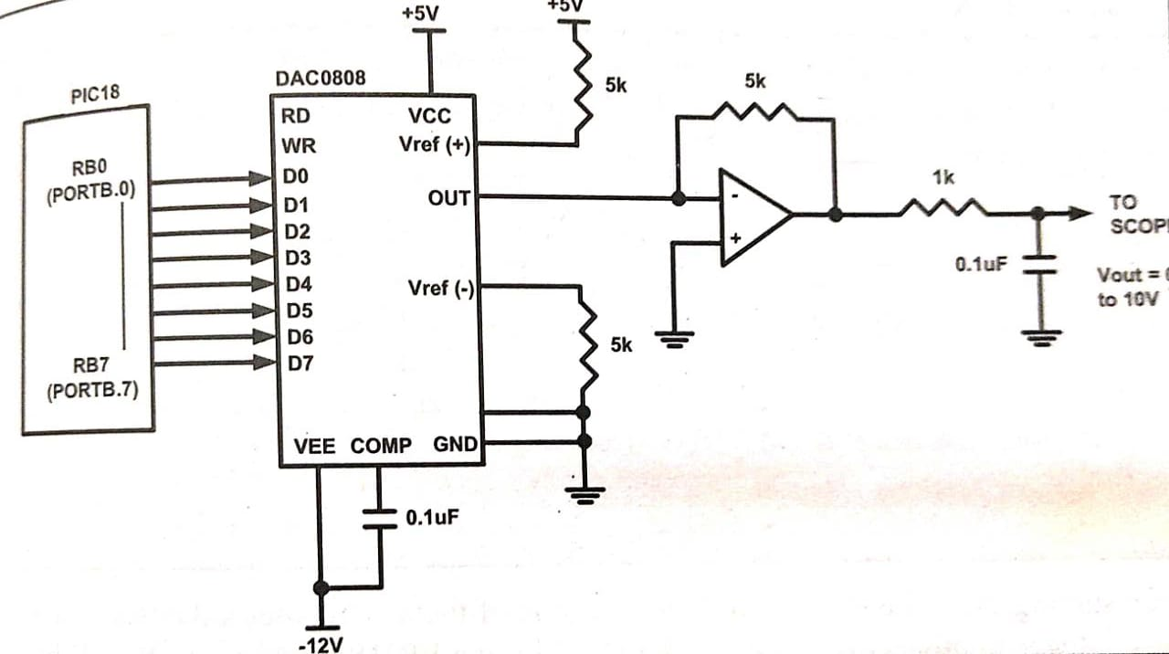
PIC 18F4550 connection diagram to DAC 0808

Slide 30

Generating Sine wave
For generating sine wave, we need a look-up table to represent the magnitude of the sine value of angles between 0° to 360°.
The sine function varies from -1 to +1.
In the table only integer values are applicable for DAC input.
In this example we will consider 30° increments and calculate the values from degree to DAC input.
We are assuming full-scale voltage of 10V for DAC output.
formula to get the voltage ranges.

Slide 31
Generating Sine wave
Angle (in θ ) | sinθ | V out (Voltage Magnitude)= 5V+(5V*sin θ) | Values sent to DAC (decimal) (voltage mag*25.6)
0 | 0 | 5 | 128
30 | 0.5 | 7.5 | 192
60 | 0.866 | 9.33 | 238
90 | 1 | 10 | 255
120 | 0.866 | 9.33 | 238
150 | 0.5 | 7.5 | 192
180 | 0 | 5 | 128
210 | -0.5 | 2.5 | 64
240 | -0.866 | 0.669 | 17
270 | -1 | 0 | 0
300 | -0.866 | 0.669 | 17
330 | -0.5 | 2.5 | 64
360 | 0 | 5 | 128

Slide 32
Programming DAC in C (8051)
#include<reg51.h>
void main()
{
unsigned char
sinvalue[12] ={128,192,238,255,238,92,128,64,17,0,17,64};
unsigned char i;
while(1)
{
for(i = 0; i<12; i++)
{
P0 = sinvalue[i];
} } }

Slide 33
Programming For PIC-DAC in C
#include<pic18f4550.h>
void main()
{
unsigned char
sinvalue[12] ={128,192,238,255,238,192,128,64,17,0,17,64};
unsigned char i;
TRISB=0x00;
while(1)
{
for(i = 0; i<12; i++)
{
PORT B = sinvalue[i];
} } }

Slide 34
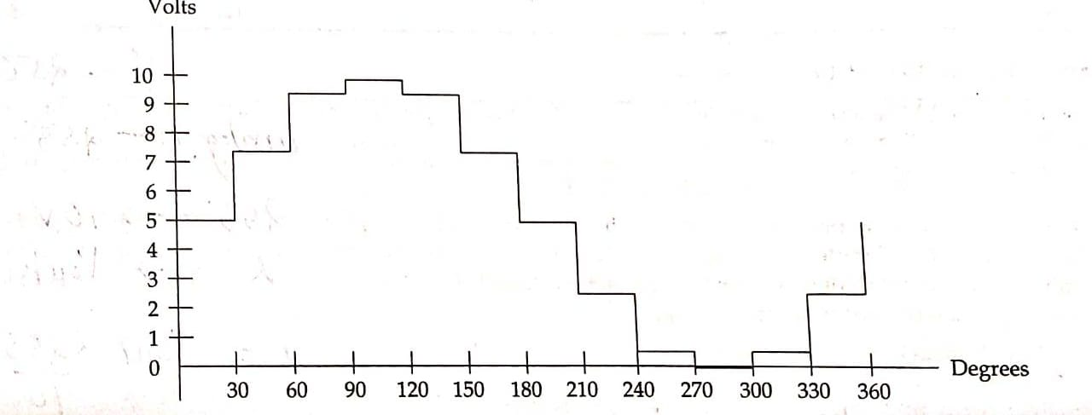
Output

Slide 35
DAC 0808 Assignment
Write a C program to generate following waves using interfacing of DAC0808 and PIC 18F4550 microcontroller:
Square wave
Triangular wave
Saw tooth wave

Slide 36
1.Programming For PIC-DAC in C (Square)
#include<pic18f4550.h>
Void MSDELAY (unsigned int time);
void main()
{
unsigned char i;
TRISB=0x00;
while(1)
{
PORT B = 0x00;
MSDELAY(100);
PORT B = 0x0FF;
MSDELAY(100);
}
}

Slide 37
2. Programming For PIC-DAC in C (Triangular)
#include<pic18f4550.h>
void main()
{
unsigned char i;
TRISB=0x00;
while(1)
{
for(i = 0; i<255; i++)
{
PORT B = i;
} for(j = 255; j>0; j--)
{
PORT B = j; } } }

Slide 38
3.Programming For PIC-DAC in C (SAWTOOTH)
#include<pic18f4550.h>
void main()
{
unsigned char i;
TRISB=0x00;
while(1)
{
for(i = 0; i<255; i++)
{
PORT B = i;
} } }

Slide 39
Design of PIC test Board and debugging
By following steps, one can design and debug a PIC test board effectively.
1.PCB fabrication: Once the PCB layout is complete, generate the necessary files for PCB fabrication.
2.Assembly: After receiving the fabricated PCB, assemble the components onto the board. This can be done manually or by using automated assembly services. Ensure that all components are properly soldered and secured, and check for any manufacturing defects or shorts.
3.Power supply and programming: Connect a suitable power supply to the test board and verify that the power is distributed correctly..
4.Testing and debugging: Begin testing the functionality of the test board by running the programmed firmware. Use appropriate tools, such as an oscilloscope, logic analyzer, or multimeter, to verify the signals and behavior of the board. Debug any issues or errors that arise during testing, such as incorrect output signals, communication failures, or unexpected behavior. Use debugging techniques, such as breakpoints, watchpoints, and serial output, to identify and resolve issues.
5.Iterative improvements: Iterate on the design and debugging process as needed. Make any necessary changes to the hardware or firmware to improve functionality or address any identified issues. Test and verify the changes before finalizing the design.
6.Documentation: Document the design, including the schematic, PCB layout, bill of materials, and any design notes or instructions. This documentation will be useful for future reference or if modifications or repairs are needed.

Slide 40
Thank you!

