Slide 1
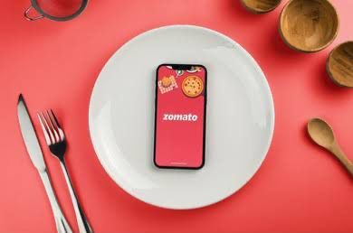
Zomato Analysis
PRESENTER
1)Shruthi .G
2)Shruthi shree
3) Bhagya
4)Chethan
5)Deraj
6) Pavan
7)jaideep

Slide 2

Zomato analysis
Zomato, one of the biggest players in the food delivery and restaurant discovery game, has transformed how people eat, explore, and experience food. From its beginnings as a simple restaurant directory to becoming a global leader in online food delivery, Zomato’s growth is a case study in innovation, adaptability, and customer obsession.

Slide 3
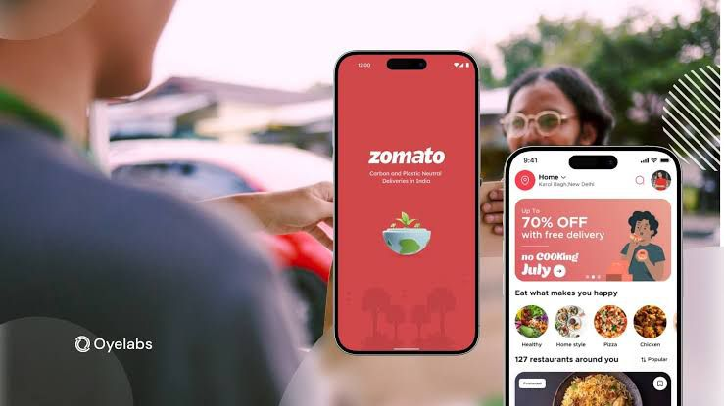
Analysis Factors of Project
1. Market Position
2. Customer Insights
3. Revenue Streams
4. Technology
5. Operations
6. Challenges
7. Growth Opportunities

Slide 4

Challenges Faced In Data Analysis
During Dashboard Creation
Data Integration
Data Quality
Complex Visualization
Performance Optimizations
User Experience
Dynamic Filtering
Scalability
During Data Transformation
Data Availability
Data Quality
Metrics
Dynamic in nature

Slide 5

DASHBOARD
ANALYSIS

Slide 6
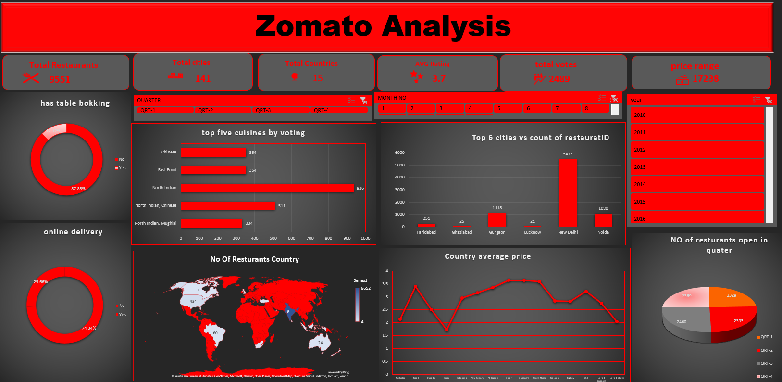
EXCEL DASHBOARD

Slide 7
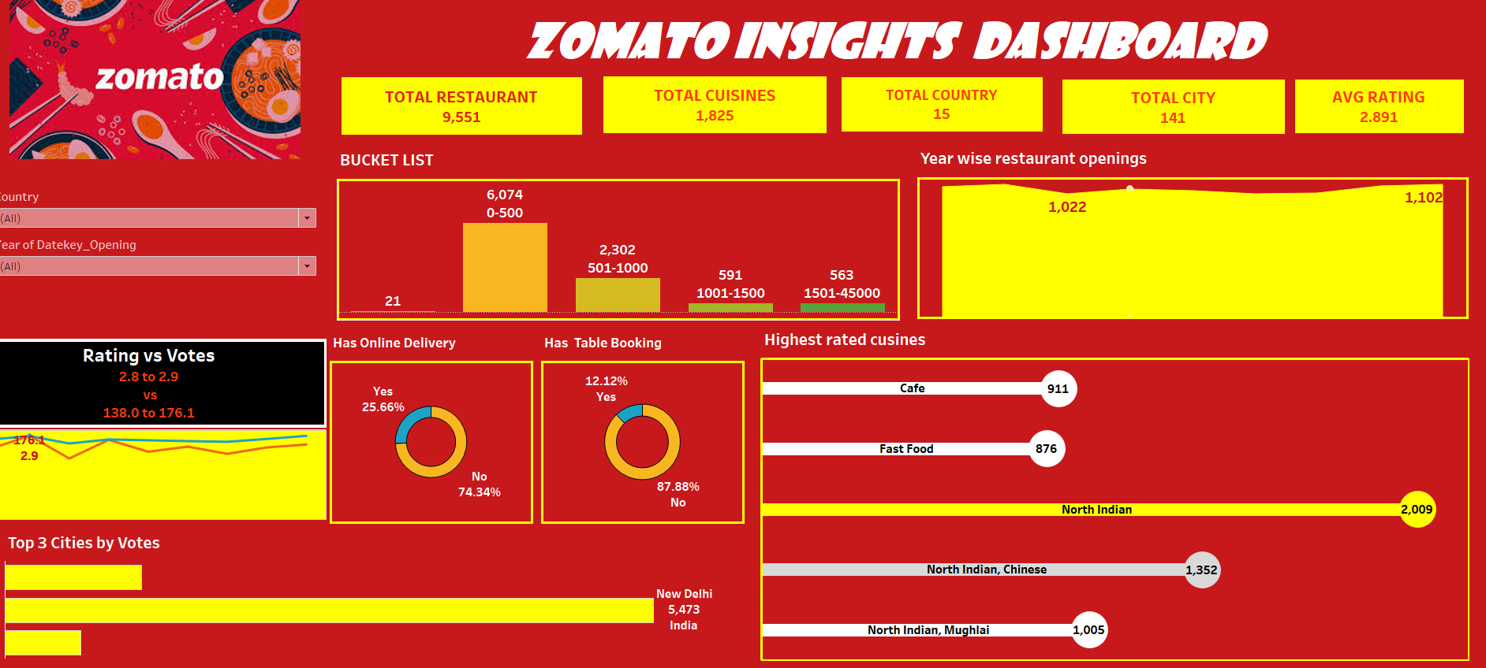
TABLEAU DASHBOARD

Slide 8
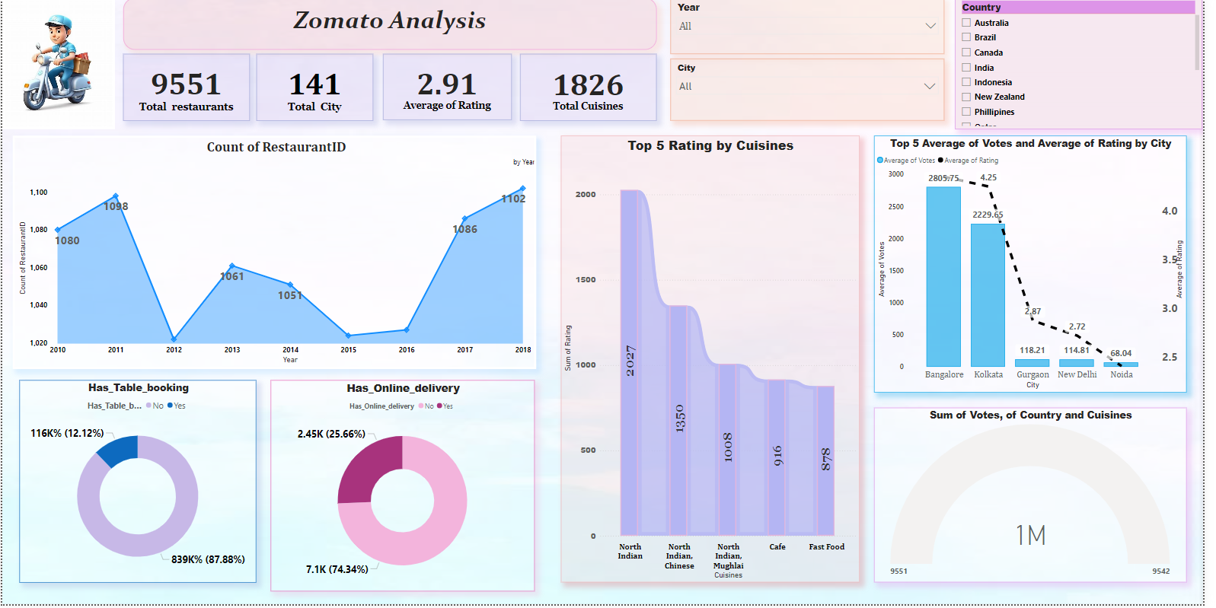
POWER BI DASHBOARD

Slide 9
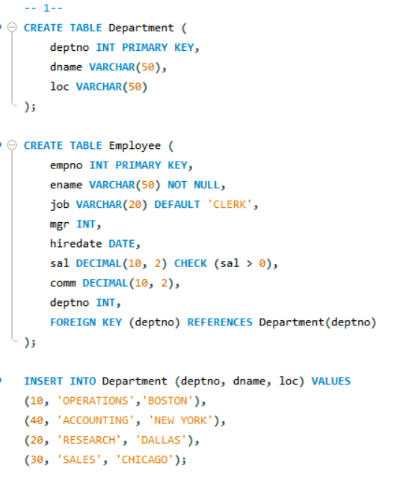
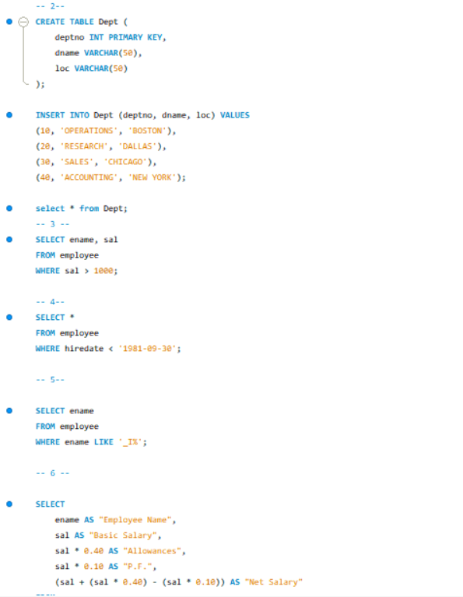
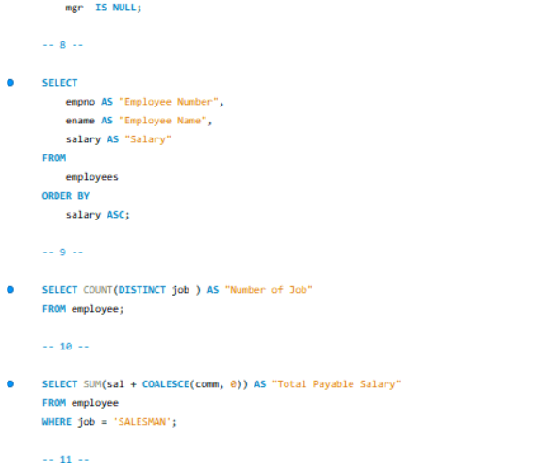
SQL Query

Slide 10
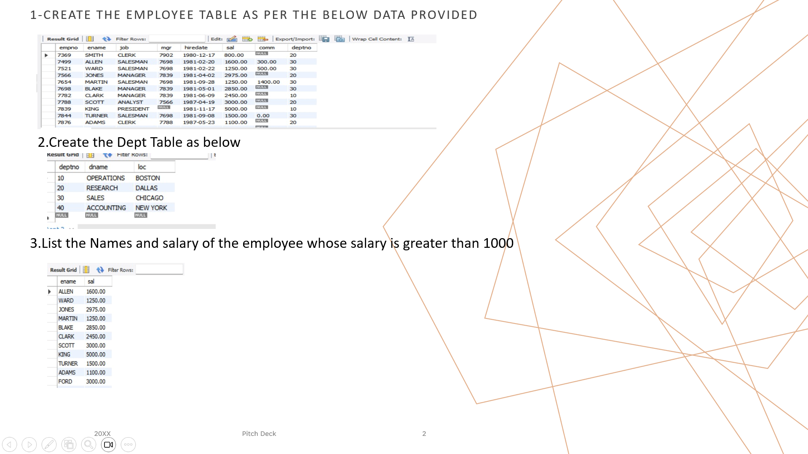

Slide 11
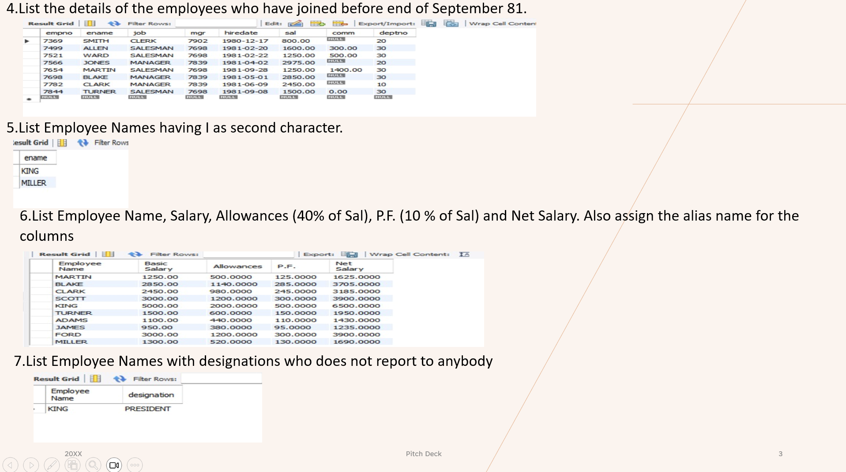

Slide 12
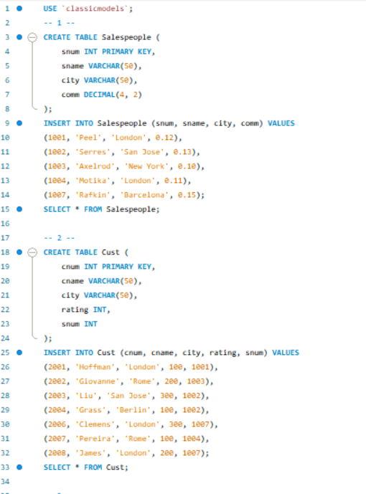
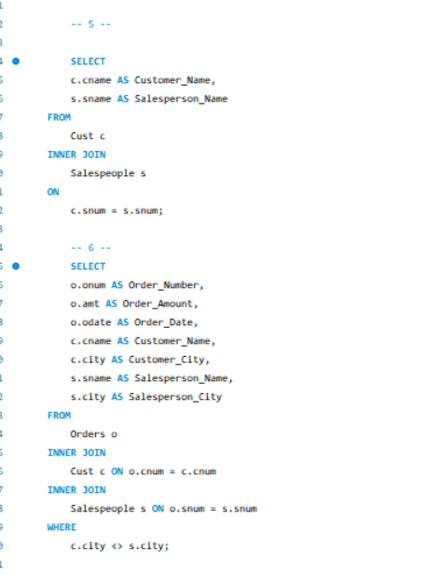
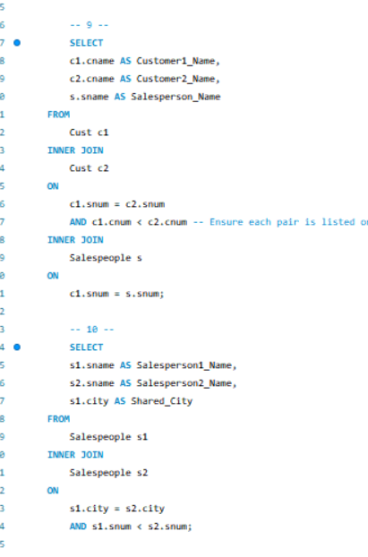
SQL Query

Slide 13
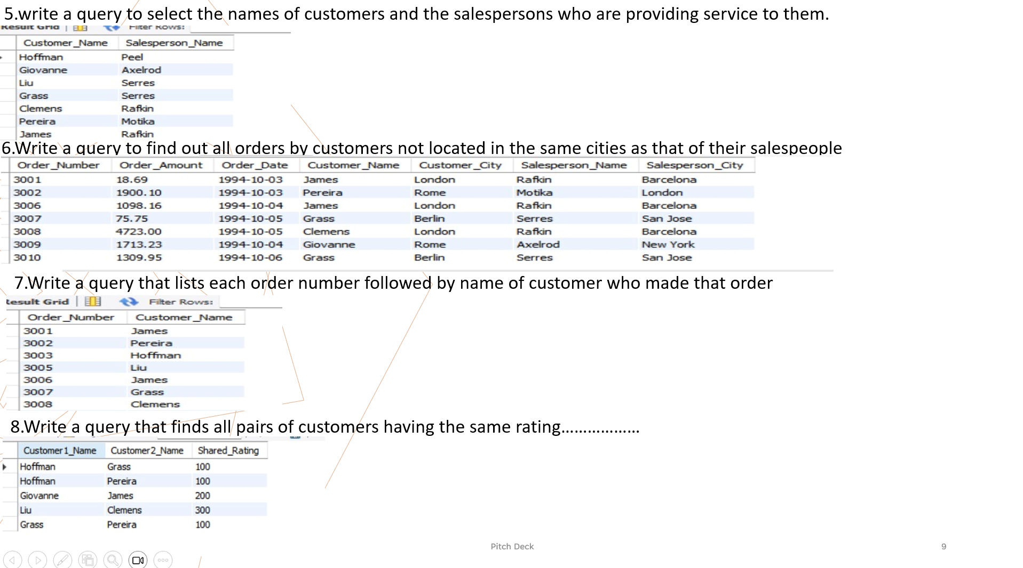

Slide 14
Conclusion
Overall Performance: Zomato maintains a strong foothold in the food delivery and restaurant discovery market, with consistent growth across multiple regions.
Popular Services: Food delivery and Zomato Pro subscriptions are among the most widely used services, driving user engagement.
Geographical Insights: Urban areas account for the majority of Zomato’s user base, with increasing penetration into Tier-2 and Tier-3 cities.
User Trends: There is a growing preference for quick delivery, regional cuisines, and affordability, indicating a shift in customer demands.
Challenges: Intense competition, delivery partner issues, and customer retention pose significant hurdles for Zomato’s growth.

Slide 15
Plan of Action Based on Analysis
• Optimize Delivery Operations
• Focus on Customer Retention Strategies
• Strengthen Marketing Campaigns
• Introduce Seasonal Discounts and Offers
• Improve Sustainability Initiatives

Slide 16

THANK YOU

