Slide 1

OLIST
Ecommerce

Slide 2

TEAM NUMBERS
1) Dayakar. U
2) Sai Krishna
3) Shruthi
4) B R Pavan
5) Pushpak
6) Sagarika

Slide 3


INTRODUCTION
Olist is a Brazilian e-commerce platform that connects small and medium-sized businesses with large online marketplaces like Amazon, Mercado Libre, and B2W Digital. It helps sellers list, manage, and optimize their products while handling logistics, payments, and customer service.

Slide 4
Problems faced by the clients
Payment Behavior discrepancy – Variations in payment methods across weekdays and weekends, requiring system optimizations.
Customer Satisfaction & Payment Preferences – Correlation between credit card payments and high reviews, influencing loyalty programs.
Delivery Inefficiencies – Delays in pet shop product deliveries impacting customer satisfaction and logistics.
Regional Spending Behavior – Need for better understanding of São Paulo customers' purchasing patterns for targeted marketing.
Delivery Speed & Data Challenges – Shipping delays affecting review scores and operational bottlenecks in order tracking and logistics.

Slide 5


Steps Taken To Solve Clients Problems
Optimize marketing campaigns by offering promotions on underused payment methods.
Introduce loyalty programs for preferred payment methods.
Improve logistics by partnering with alternative carriers.
Offer location-based promotions to boost engagement.
Prioritize express shipping for high-value orders. Standardize data entry and automate odd data.

Slide 6

DASHBOARD
EXCEL
POWRBI
TABLEAU
SQL

Slide 7
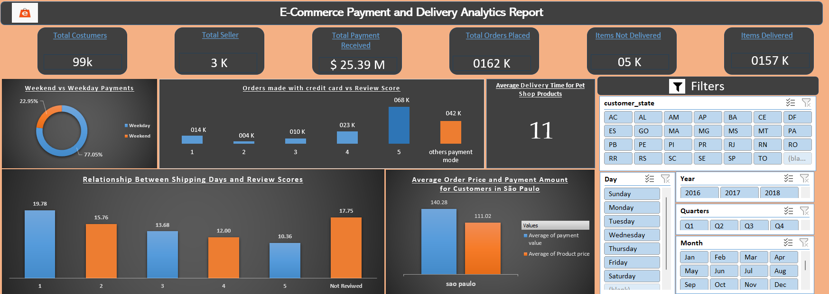
EXCEL

Slide 8
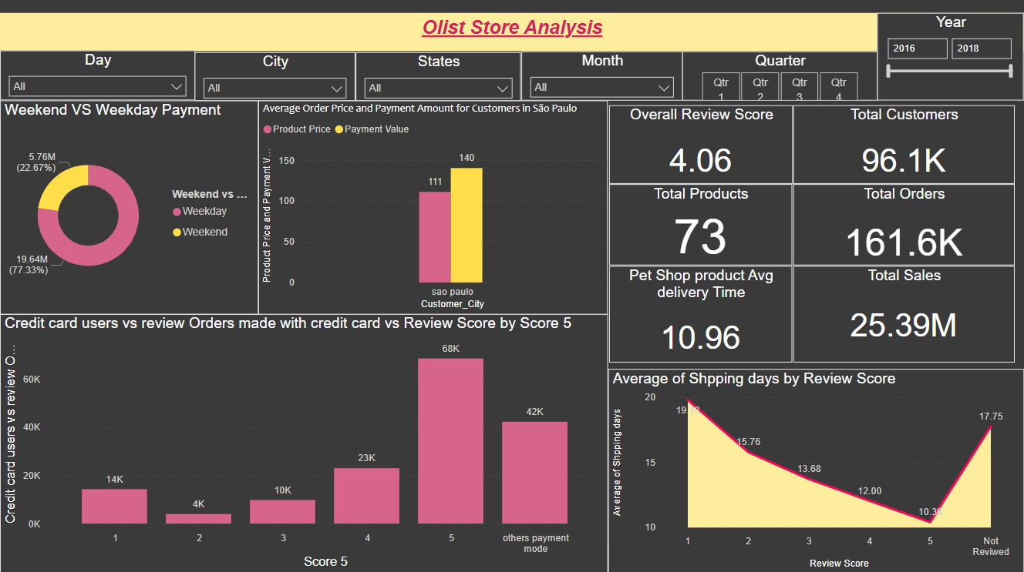
POWER BI

Slide 9
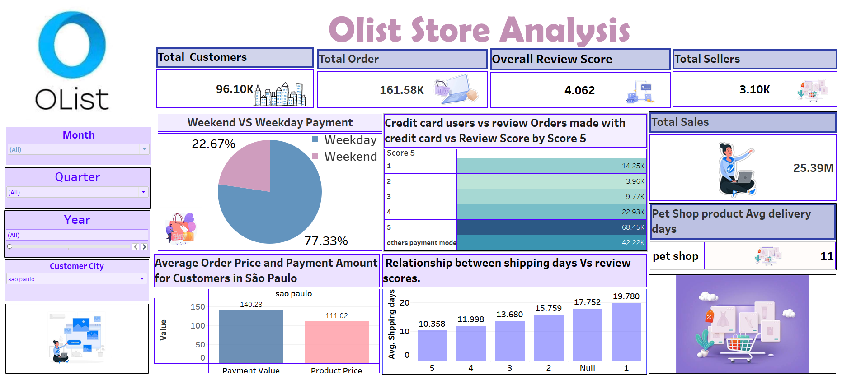
TABLEAU

Slide 10
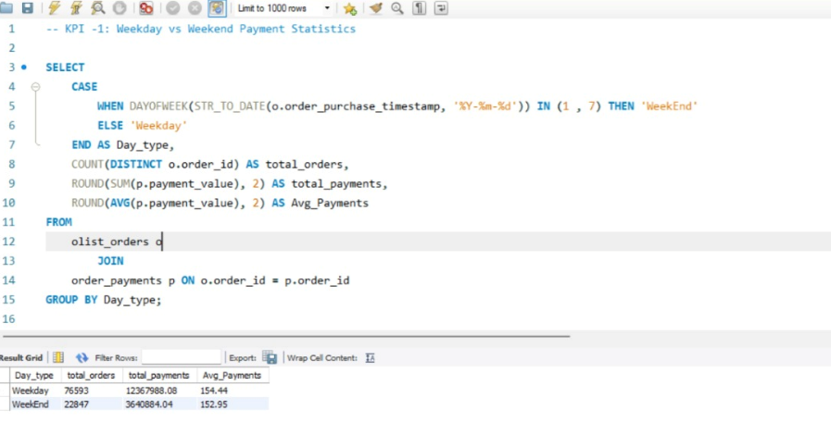
SQL_1

Slide 11
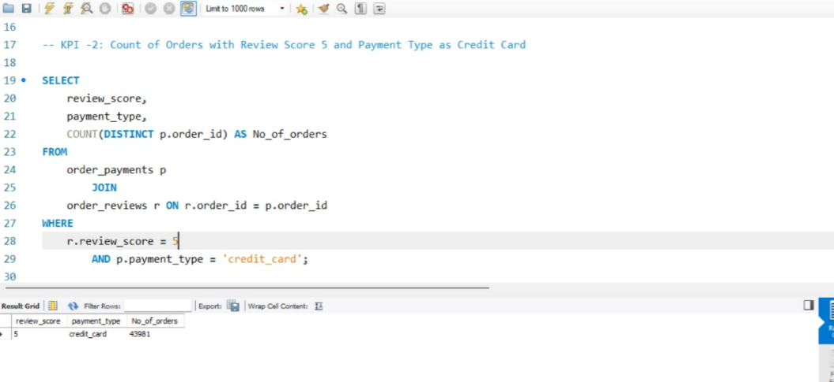
SQL _2

Slide 12
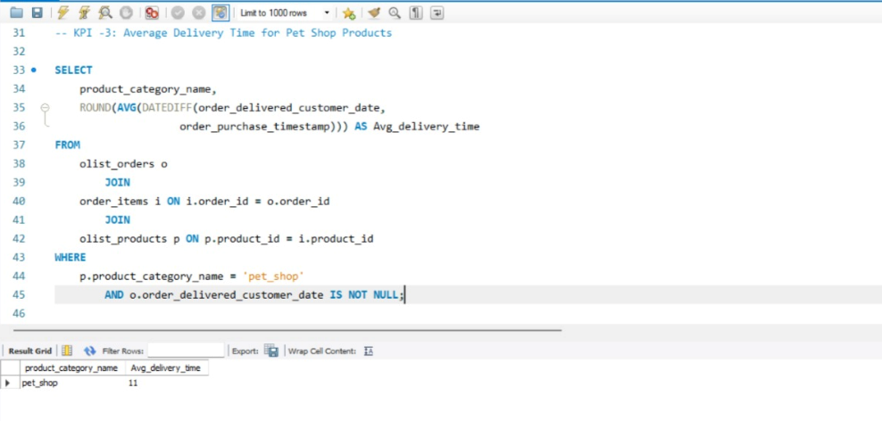
SQL _3

Slide 13
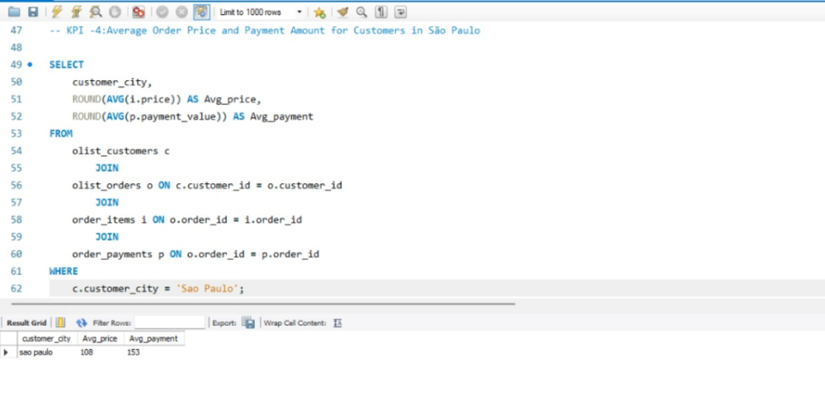
SQL _4

Slide 14
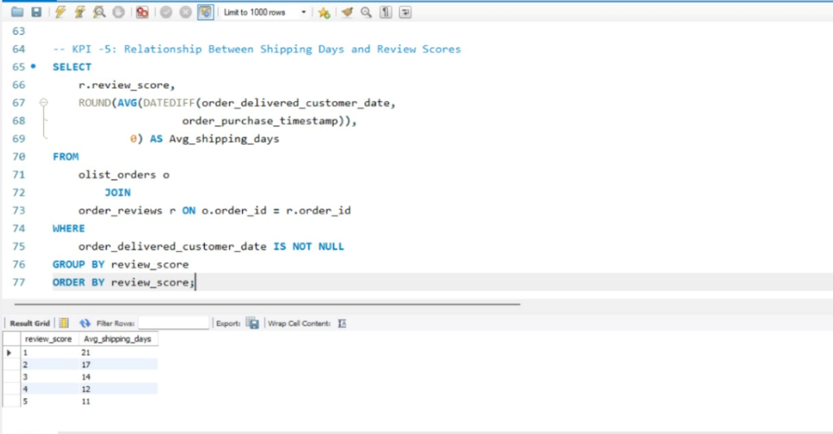
SQL _5

Slide 15
Conclusion
Optimize Payment Processes – Use SQL, Excel, and Power BI to analyze payment trends and tailor promotions.
Enhance Customer Satisfaction – Identify correlations between payment methods and reviews to improve loyalty programs.
Improve Logistics Efficiency – Address delivery inefficiencies, particularly in pet shop products, to reduce delays.
Targeted Regional Marketing – Analyze São Paulo customers' spending behavior for personalized promotions.
Boost Review Scores – Optimize delivery speed and accuracy to enhance customer feedback.
Ensure Data Accuracy – Standardize tracking systems to improve decision-making and operational efficiency.
Increase Revenue & Loyalty – Implement insights-driven strategies for long-term growth in e-commerce.

Slide 16

Thank you

