Slide 1

Deep Learning-Based SAR Image Despeckling
1602-21-737-042
1602-21-737-034
1602-21-737-301

Slide 2
MOtivation
Through extensive experiments on both synthetic and real SAR images, we demonstrate the superior performance of ID-CNN compared to state-of-the-art methods. Our approach achieves significant improvements in terms of quantitative metrics such as PSNR, SSIM, and UQI, as well as qualitative visual quality.
By addressing the challenge of speckle noise in SAR images with a deep learning-based solution, ID-CNN opens up new possibilities for enhancing SAR image interpretation, analysis, and downstream applications. This presentation highlights the importance of ID-CNN in advancing SAR image processing and lays the foundation for future research in this field.

Slide 3
Problem Statement
Synthetic Aperture Radar (SAR) images often suffer from speckle noise, a granular interference that reduces image quality and hampers visual interpretation.Traditional despeckling methods struggle to effectively suppress speckle noise while preserving essential image features, leading to compromised interpretability and analysis accuracy.
The lack of robust and efficient despeckling techniques for SAR images hinders their utility in various applications, including environmental monitoring, disaster management, and surveillance.
Addressing these challenges requires the development of advanced despeckling algorithms capable of effectively removing speckle noise while preserving relevant information in SAR images.

Slide 4
Abstract
Synthetic Aperture Radar (SAR) images are of-ten contaminated by a multiplicative noise known as speckle. Speckle makes the processing and interpretation of SAR imagesdifficult. We propose a deep learning-based approach called, Image Despeckling Convolutional Neural Network (ID-CNN), forautomatically removing speckle from the input noisy images. In particular, ID-CNN uses a set of convolutional layers along with batch normalization and rectified linear unit (ReLU) activation function and a component-wise division residual layer to estimate speckle and it is trained in an end-to-end fashion using a combination of Euclidean loss and Total Variation (TV) loss.

Slide 5
Existing system
Synthetic Aperture Radar (SAR) images are prone to speckle noise, which hinders processing and interpretation.
Traditional methods for speckle reduction include multi-look processing, filtering, wavelet-based despeckling, and Total Variation (TV) methods.
Nonlocal filtering and BM3D methods are popular but may result in blurry edges and artifacts.
CNN-based methods have shown promising results in various image processing tasks but haven't been extensively explored for SAR image despeckling.

Slide 6
Proposed Solution
The Image Despeckling Convolutional Neural Network (ID-CNN) is proposed for SAR image despeckling.
ID-CNN directly estimates speckle using the input images, leveraging a set of convolutional layers, batch normalization, and rectified linear unit (ReLU) activation.
Incorporate a component-wise division residual layer to estimate denoised images.Train the network in an end-to-end fashion using a combination of Euclidean loss and Total Variation (TV) loss.
Advantages of ID-CNN include learning parameters directly from data and preserving sharp features like edges.
Demonstrated significant improvements over state-of-the-art methods in synthetic and real SAR image despeckling.

Slide 7
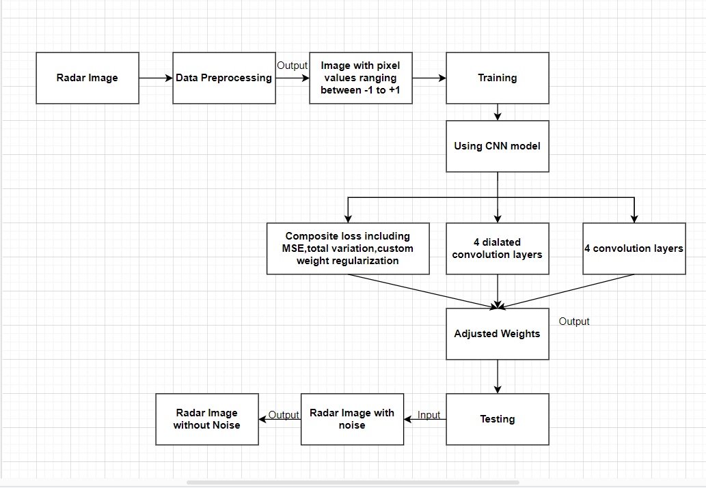
System Architecture

Slide 8
Tech Stack & DataSet
Programming Language: Python
Deep learning Frameworks: TensorFlow
Development Environments: Jupyter Notebooks, GoogleColab
DataSet: sentinel12-image-pairs-segregated-by-terrain/v_2

Slide 9
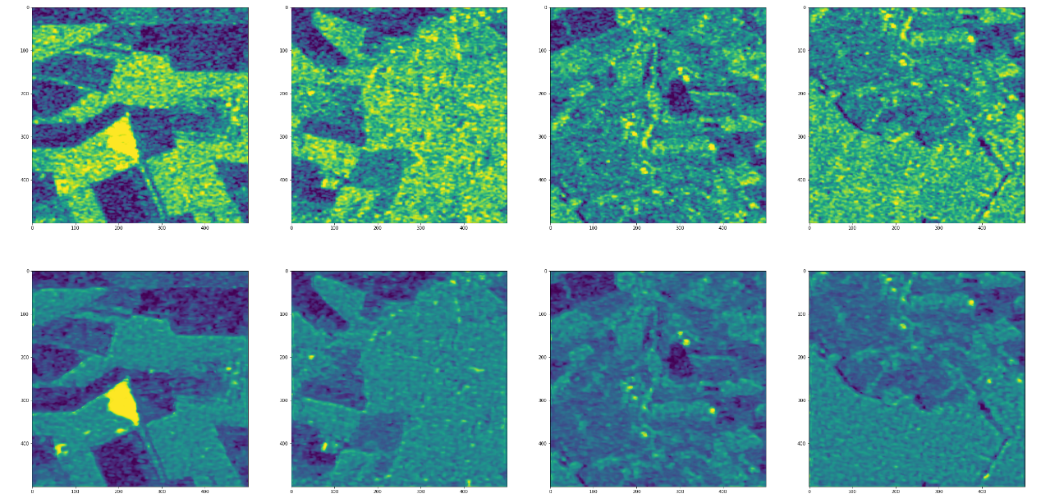
Results

Slide 10
conclusion
The proposed Image Despeckling Convolutional Neural Network (ID-CNN) demonstrates notable advancements in SAR image despeckling.
By directly estimating and removing speckle noise from SAR images, ID-CNN surpasses traditional methods and outperforms state-of-the-art CNN-based approaches.
Through end-to-end training, ID-CNN effectively learns to preserve crucial details and edges while significantly reducing speckle noise.
The incorporation of a component-wise division residual layer enhances the denoising capability of the network, ensuring high-quality despeckled images.
The success of ID-CNN underscores the potential of deep learning techniques in addressing complex challenges in SAR image processing, paving the way for improved interpretation and analysis of SAR data in various applications

Slide 11
Future Scope
Further exploration of ID-CNN's performance across diverse SAR datasets and acquisition conditions can enhance its robustness and generalization capabilities.
Investigating the integration of additional contextual information, such as multi-temporal or multi-sensor data, could potentially improve the despeckling performance and semantic interpretation of SAR images.
Exploring the application of ID-CNN in real-time or near-real-time SAR image processing systems can facilitate timely decision-making in critical scenarios like disaster monitoring and environmental surveillance.
Research into the development of lightweight versions of ID-CNN tailored for deployment on resource-constrained platforms, such as drones or embedded systems, would extend its usability in practical applications.
Collaboration with domain experts and stakeholders can provide valuable insights into specific requirements and challenges in SAR image analysis, guiding the refinement and customization of ID-CNN for targeted applications.

Slide 12
References
SAR Image Despeckling Using a Convolutional Neural Network by Puyang Wang

