Slide 1
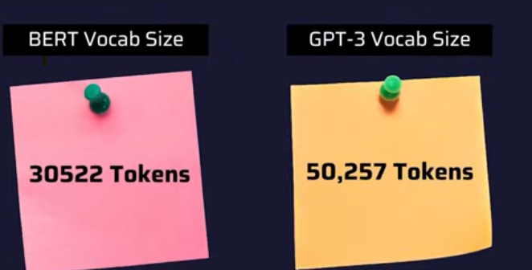

Slide 2
Why BERT Exists: The Embedding Problem
word2vec — Static Embedding
BERT — Contextual Embedding
"I deposited money at the bank"
"I deposited money at the bank"
"We sat on the river bank"
"We sat on the river bank"
↓ same vector for both
↓ different vector per context
bank → [0.3, 0.7, ...] ← fixed forever
bank → [0.9, 0.1, ...] financial
❌ Context completely ignored
bank → [0.1, 0.8, ...] geography
✅ Full sentence context used
Key Insight: Same word + Different sentence = Different vector. BERT reads the entire sentence bidirectionally.

Slide 3
Introduction to BERT
What is BERT?(Bidirectional Encoder Representations from Transformers)
Powerful language model that understands context of words better than previous model
BERT’s has bidirectional approach: it reads the entire sequence of words at once, using both the left and right context of each word.
BERT uses a transformer encoder (not the decoder like GPT), which processes input sequences in parallel.
Better understanding of context compared to previous models.
Pre-training on large datasets and fine-tuning for specific tasks, which significantly improves performance across various NLP tasks.
Gives BERT rich world knowledge out of the box.
Trained on BooksCorpus and Wikipedia (3+ billion words).

Slide 4
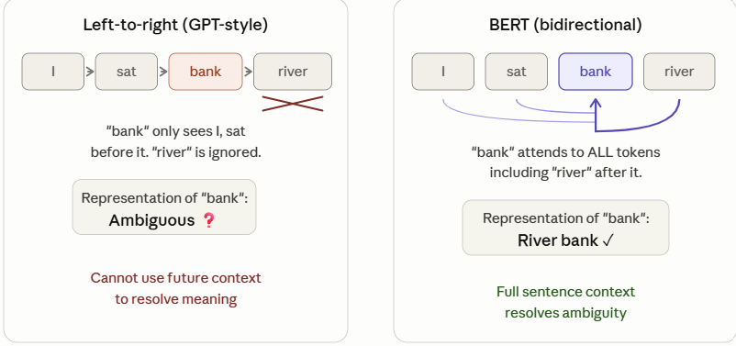
Why BERT Exists
Language has context that flows in both directions simultaneously. Earlier models couldn't model this properly.

Slide 5
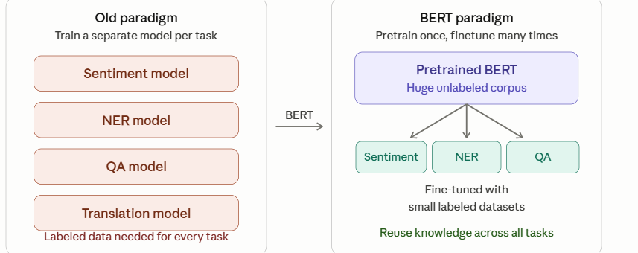
BERT's place in NLP
Bidirectional Encoder Representations from Transformers.
pretrain-then-finetune model
Tasks like question answering, sentiment analysis, and named entity recognition all suddenly got state-of-the-art results with minimal task-specific engineering.

Slide 6
BERT Model Architecture
Stage 1: Input
Stage 2: Encoder ×12
Stage 3: Output
[CLS]
The
cat
sat
[SEP]
Transformer Encoder Block × 12
Contextual Output
Embedding Layer
Multi-Head Self-Attention
[CLS] vector C
12 heads · 768-dim
Sentence tasks
Token + Segment + Positional → summed
Feed-Forward Network
2 linear layers · GELU
Token vectors T₁…Tₙ
Add & LayerNorm ×2
Token tasks (NER)
residual connections
 | BERT-base | BERT-large
Encoder Layers | 12 | 24
Attention Heads | 12 | 16
Hidden Size | 768 | 1024
Parameters | 110M | 340M
Notes:
To tell the difference between a single sentence and a pair of sentences, a special [SEP] token is added to differentiate them.
A special [CLS] token is added to the beginning of every sequence of text.
The final output with the [CLS] token is used as the input to the classification head for classification tasks.
BERT also adds a segment embedding to denote whether a token belongs to the first or second sentence in a pair of sentences.

Slide 7
BERT Model Architecture
BERT is built on the Transformer encoder — specifically, it stacks multiple encoder blocks.
There are two standard sizes:
BERT-Base: 12 encoder layers, 12 attention heads, 768 hidden dimensions → 110M parameters
BERT-Large: 24 layers, 16 heads, 1024 hidden dimensions → 340M parameters

Slide 8

Model Architecture
BERT BASE – Comparable in size to the OpenAI Transformer in order to compare performance
BERT LARGE – A ridiculously huge model which achieved the state of the art results reported in the paper

Slide 9
BERT Model Architecture
Step 1 — Input representation
Every token gets three embeddings added together:
a token embedding (what word it is),
a segment embedding (sentence A or B), and a
position embedding (where in the sequence it sits). Representation
BERT also prepends a special [CLS] token whose final hidden state is used for classification tasks, and inserts [SEP] to separate sentences.

Slide 10
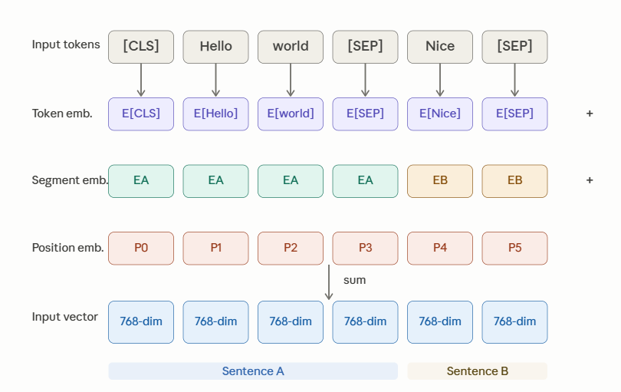
BERT Model Architecture

Slide 11
BERT Model Architecture
Step 2 — Inside one Transformer encoder block
The input vectors pass through 12 (or 24) identical encoder blocks stacked on top of each other.
Each block has two sub-layers: Multi-Head Self-Attention
Feed-Forward Network,
with layer normalization and residual connections around each. one Transformer encoder block

Slide 12
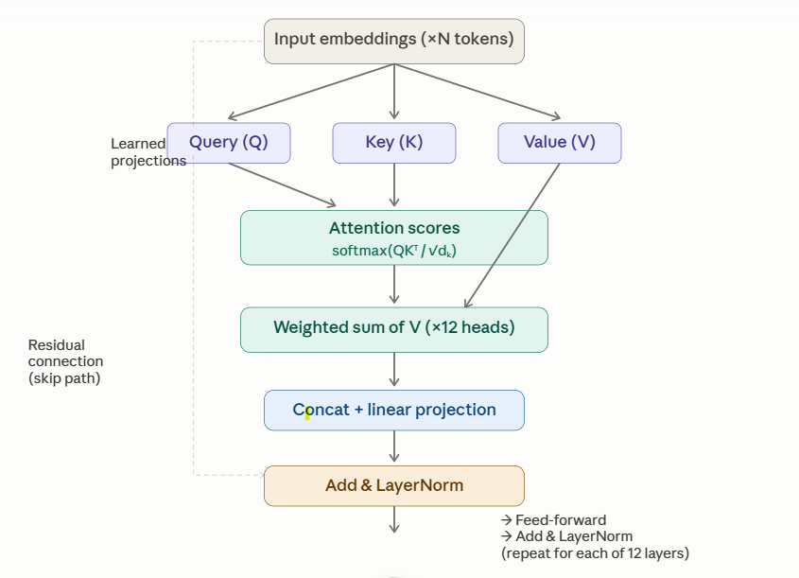
BERT Model Architecture

Slide 13
Self-Attention: BERT's Core Mechanism
Q — Query
K — Key
V — Value
What am I looking for?
"it" asks: who is tired?
What do I represent?
Every word advertises itself
What do I contribute?
Information passed if selected
Formula: Attention(Q,K,V) = softmax( Q·Kᵀ / √dₖ ) · V
Example: Resolving 'it' in context
The
animal
didn't
cross
the
street
because
it
was
tired
"it" (amber) attends most strongly to "animal" (teal) — BERT reads both directions simultaneously
Bidirectional = attends LEFT and RIGHT simultaneously — unlike GPT (left only) or older RNNs

Slide 14
Self-Attention: BERT's Core Mechanism
For each token, BERT computes three vectors — Query (what I'm looking for), Key (what I offer to others), and Value (the actual content I contribute).
The attention score between two tokens is the dot product of one's Query with the other's Key, scaled and softmax-ed.
The output is a weighted mix of all Value vectors.
With 12 heads doing this in parallel on different subspaces, BERT can simultaneously model syntactic dependencies, coreference, semantic similarity, and more.

Slide 15
Feed Forward network
The feed-forward network is two-layer MLP (linear → GELU → linear) applied identically to each token position.
It's where most of BERT's "knowledge" is actually stored — the attention finds which tokens to combine, the FFN transforms the combined representation.

Slide 16
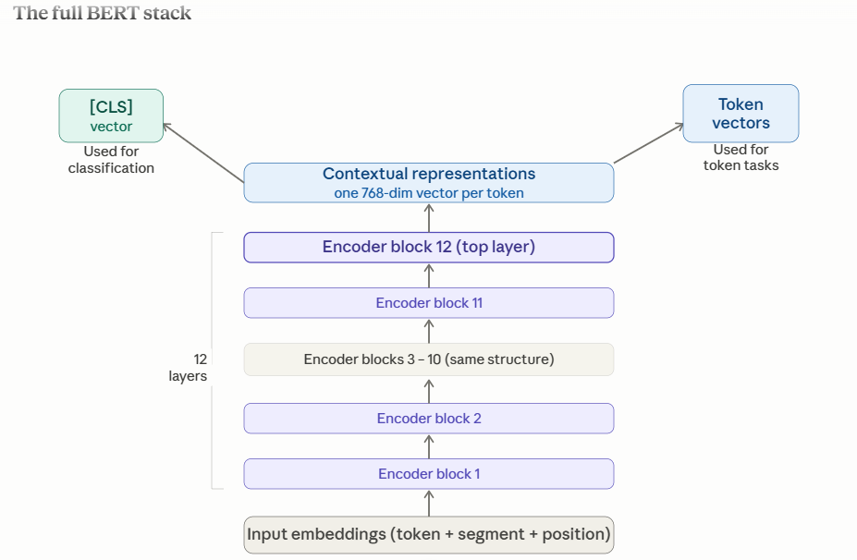

Slide 17
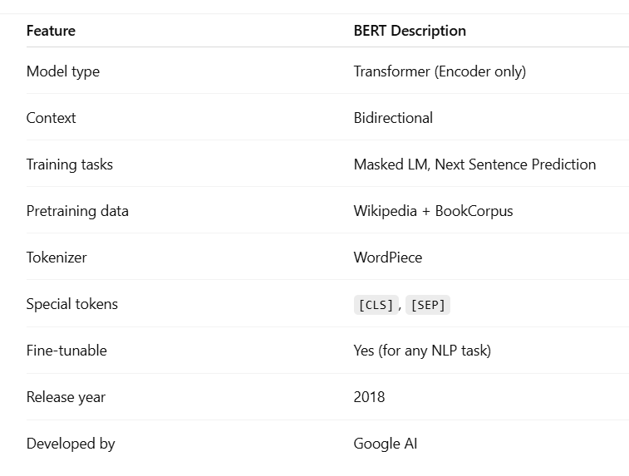

Slide 18
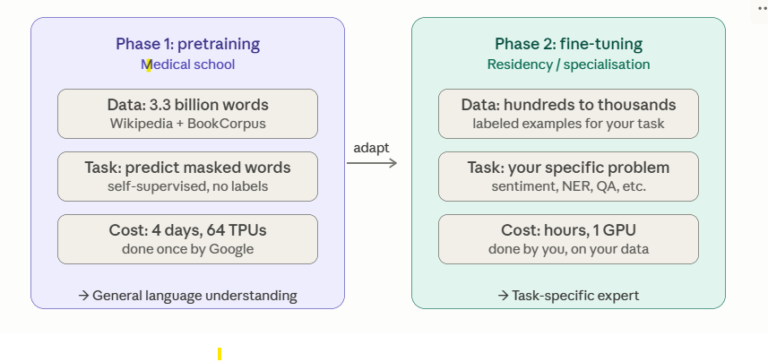
Two Phase Learning System
Notes:
Why bERT needs pre-training?
Imagine you have a student who has never learned English.
You don't directly ask the student to answer questions or classify reviews.
Instead, you first make the student read millions of books.
During reading, you give exercises like
Fill in the missing word.
Tell whether one sentence logically follows another.
After years of practice, the student understands English.
Only then do you ask him to solve real tasks.
BERT does exactly this.
It first pre-trains itself using two self-supervised tasks:
Masked Language Modeling (MLM)
Next Sentence Prediction (NSP)
These tasks teach BERT language before fine-tuning it for specific NLP applications.

Slide 19
BERT pretraining — learning from unlabeled text
BERT pretrains on BookCorpus (800M words) + English Wikipedia (2.5B words)
Uses two self-supervised tasks simultaneously.
"Self-supervised" means the labels come from the data itself — no human annotation needed.
Pretraining BERT-Large on 64 TPUs took 4 days.

Slide 20
Pretraining
Language models work by being trained to predict the probability of a word given the context of surrounding words.
This gives them a foundational understanding of language that can generalize to other tasks.
Act of training model from scratch
Weights initialized randomly
Training starts without ant prior knowledge
Done on very large amounts of data
Large corpus of data and training spans several weeks

Slide 21
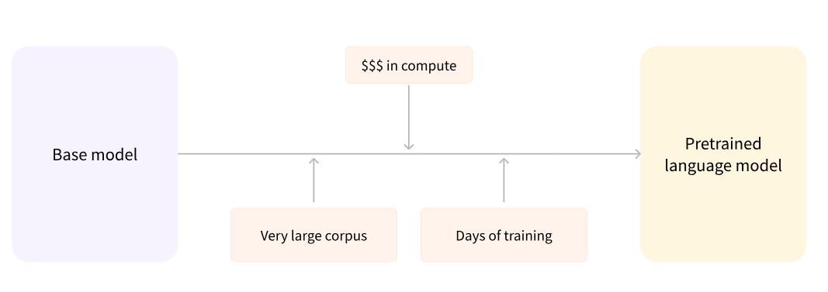
Pretraining

Slide 22
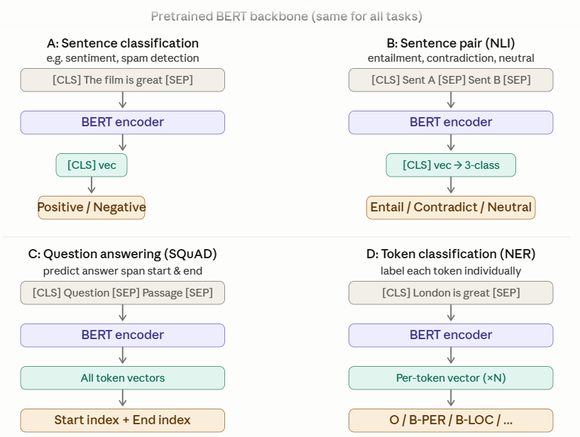
BERT pretraining — learning from unlabeled text

Slide 23
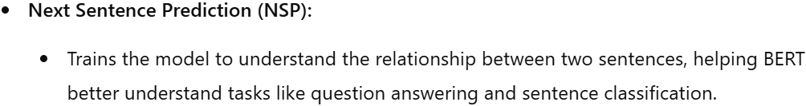
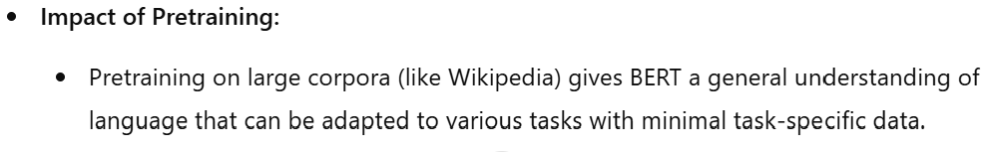
Pretraining Objectives of BERT
Two Primary Objectives:
Masked Language Modeling (MLM):
Randomly masks words in a sentence and trains the model to predict the missing words based on the context.
Understands language deeply
Input:"I love to [MASK] pizza“
Target:“eat”

Slide 24
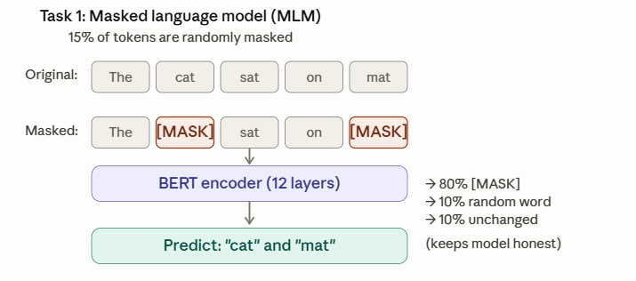
Masked Language Modelling (MLM)
Notes:
What does MLM teaches BERT
It teaches
grammar
syntax
semantics
context
word relationships
polysemy (multiple meanings)

Slide 25
Masked Language Modelling (MLM)
1
2
3
4
Select 15% of tokens
Apply 80/10/10 rule
BERT predicts original
What BERT learns
"The cat [selected: sat] on the mat"
80% → [MASK]
10% → random word
10% → unchanged
Uses left + right context
to guess: 'sat'
Grammar · Semantics
World knowledge
The 80/10/10 Split — Why Not Just 100% Masking?
80% → [MASK] token
10% → Random word
10% → Unchanged
Primary training signal — forces prediction
Keeps model alert — can't trust token identity
Critical: ensures good representations for all tokens, not just masked ones

Slide 26
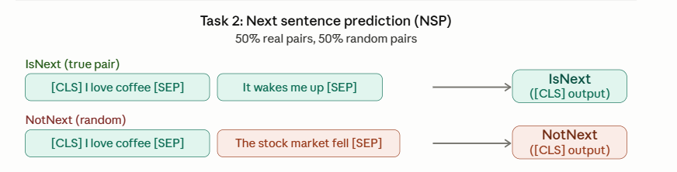
Next Sentence Prediction (NSP)
Both losses are added together and optimized simultaneously during pretraining.
Specifically:
Total Loss = L_MLM + L_NSP
Notes:
Many NLP tasks require understanding relationships between sentences.
Examples:
Question answering
Natural language inference
Dialogue systems
Paragraph understanding
MLM alone cannot explicitly teach sentence-level coherence.

Slide 27
Next Sentence Prediction (NSP)
Positive Pair (IsNext = True)
Negative Pair (IsNext = False)
A: "She studied all night for the exam."
A: "She studied all night for the exam."
B: "The results came back better than expected."
B: "Penguins live in the southern hemisphere."
← genuinely consecutive in source text
← random sentence from different document
Input format fed to BERT:
[CLS]
Sentence A tokens
[SEP]
Sentence B tokens
[SEP]
[CLS] output → linear classifier → IsNext / NotNext
MLM = within a sentence → word meaning & context
NSP = between two sentences → relationship & coherence
Both trained jointly: Loss = L_MLM + L_NSP

Slide 28
Spam email detection(Pretraining)
BERT is fed sentences from Wikipedia and books.
It never sees email. It never sees the word "spam". But it reads things like:
"The company sent unsolicited messages to thousands of customers." "Fraudulent schemes often promise unrealistic financial rewards." "Click here to claim your prize immediately.“
MLM task, BERT learns:
"unsolicited", "fraudulent", "prize" and "claim" cluster together meaningfully
"click here" and "immediately" co-occur in persuasive or urgent contexts
The word "free" in "free software" means something different than "free gift" — context matters
BERT has never been told any of this explicitly. It figured it out by predicting masked words millions of times. After pretraining, BERT's weights contain a rich map of the English language.

Slide 29
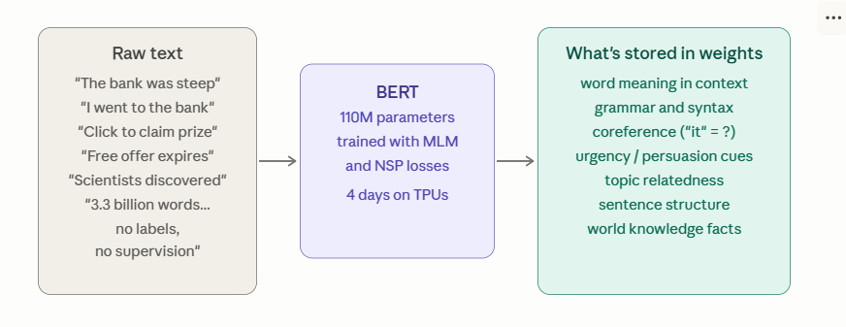
Learned Weights

Slide 30
Fine-tuning — adapting BERT to specific tasks
After pretraining, BERT's weights encode a rich general understanding of language.
Fine-tuning adds a small task-specific head on top and trains the whole thing end-to-end on labeled data — typically for just 2–4 epochs.
The key insight is that minimal architecture changes are needed: the same BERT backbone handles wildly different tasks by changing only what's attached to its output.

Slide 31
Fine-Tuning BERT for Downstream Tasks
Transfer Learning Analogy
Three Fine-Tuning Patterns
🎓
🏥
Sentence Classification
Pre-training
→
Use case: Sentiment, spam
Output: [CLS] → linear → class label
Fine-tuning
Medical school
General expertise
800M words, no labels
Specialisation residency
Task-specific
2-4 epochs, small lr
Token Classification (NER)
Fine-tuning code (PyTorch + HuggingFace)
Use case: Entities, POS
Output: T₁,T₂,… → linear per token
model = BertForSequenceClassification
.from_pretrained('bert-base-uncased',
num_labels=2)
Question Answering
Use case: SQuAD, reading comp.
Output: Token vectors → start + end span
optimizer = AdamW(model.parameters(),
lr=2e-5) # small lr — nudge BERT
outputs = model(**inputs, labels=label)
loss = outputs.loss
loss.backward()
optimizer.step()

Slide 32
Fine-tuning — adapting BERT to specific tasks
Initialize a new model from BERT's pretrained weights.
Add a small output layer (a linear projection or a two-layer MLP) on top.
Run standard supervised training on labelled dataset.
The entire model — all 110M parameters of BERT plus the new head — gets updated via backpropagation, but because BERT already knows language deeply, the fine-tuning converges quickly with very little labelled data (often just a few thousand examples).

Slide 33
Fine-tuning: teaching BERT what spam means
Take pretrained BERT and show it 1,000 labeled emails — 500 spam, 500 legitimate.
You add a single linear layer on top that outputs two numbers (spam / not spam).
The entire model — all 110M weights — gets updated slightly to specialise for this task.

Slide 34
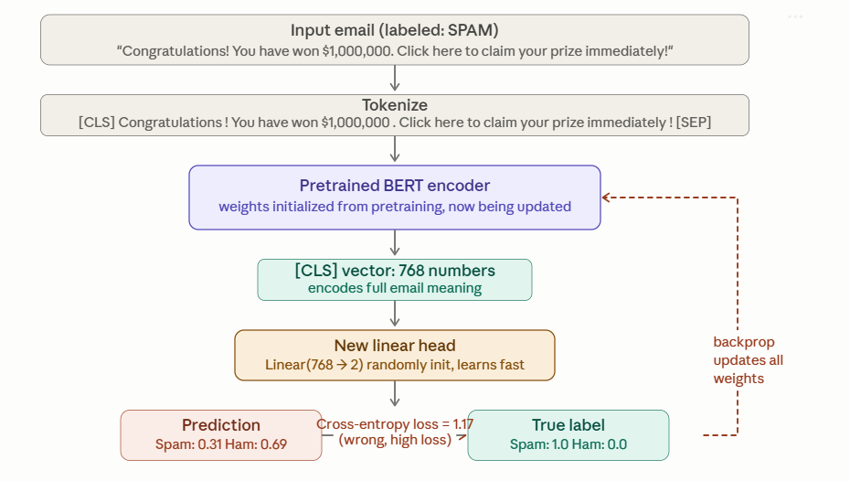

Slide 35
FineTuning BERT
On the first pass, BERT predicted "not spam" with 69% confidence — wrong.
The loss is high. Gradients flow backwards through the linear head and all 12 BERT layers.
Every weight shifts slightly.
After seeing all 1,000 labeled emails over 3 epochs, BERT has learned that patterns like "Congratulations", "claim", "prize", "immediately" together = spam.
Fine-tuning doesn't erase pretraining. It nudges the weights.

Slide 36
Why does pretraining help fine-tuning so much?
Without pretraining,
spam classifier has to learn English from scratch using only 1,000 emails.
It would overfit, generalise poorly, and fail on anything phrased differently from the training examples.
With pretraining, BERT already knows:
"claim your prize" and "win a reward" are semantically similar (so it recognises both as suspicious) "immediately", "urgent", "expires today" signal time pressure (it knows this from millions of news articles and ads) Broken grammar and unusual capitalisation are meaningful signals

Slide 37
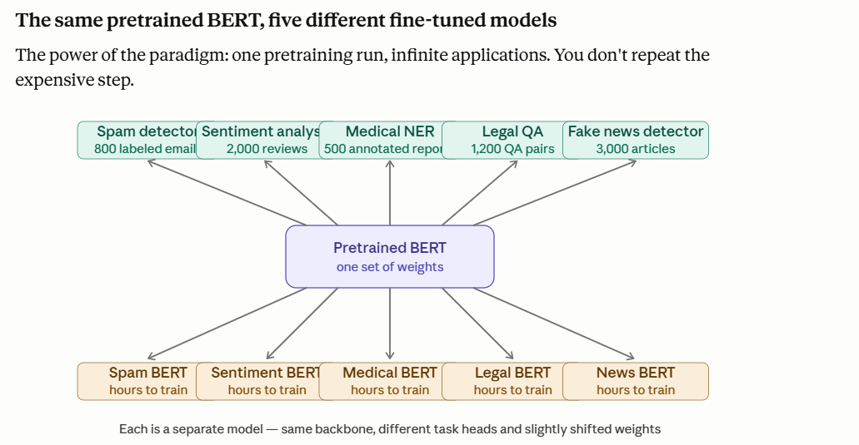

Slide 38
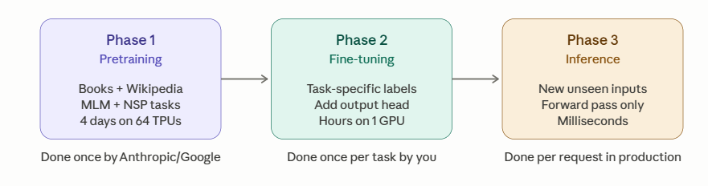
Complete BERT Cycle

Slide 39
Summary
Pretraining is BERT reading billions of words with no labels
learning the deep structure of language by predicting masked words — building a general understanding of English that captures grammar, meaning, context, and world knowledge, stored in 110 million weights.
Fine-tuning is taking those 110 million weights as a starting point
Adjusting them slightly on a small labeled dataset for your specific task
So instead of learning language from scratch, your model only needs to learn "what does spam look like given everything I already know about language".

Slide 40
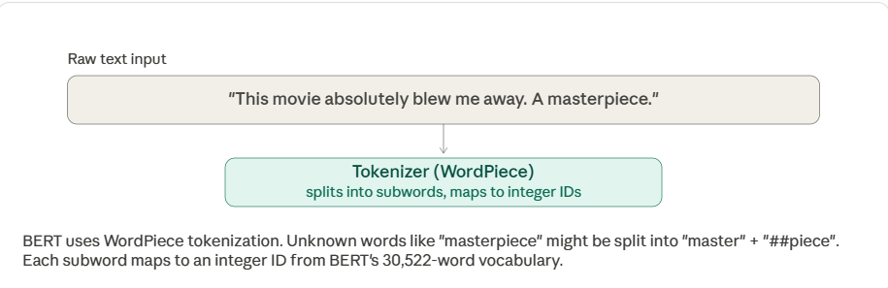
PIPELINE Step1:Tokenization

Slide 41
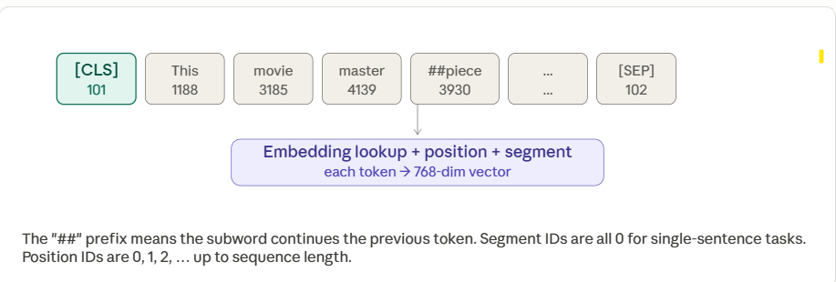
PIPELINE Step2:Embedding

Slide 42
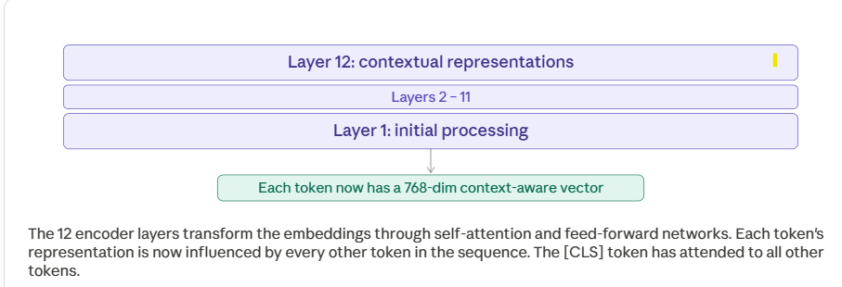
PIPELINE Step3:BERT Encoding

Slide 43
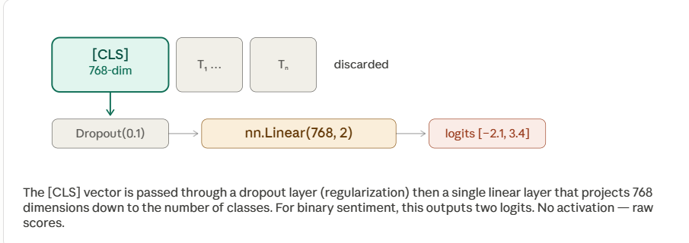
PIPELINE Step4:Classification Head

Slide 44
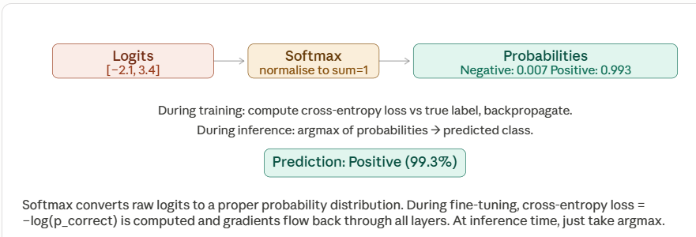
PIPELINE Step5: Softmax and Loss

Slide 45
Impact of BERT on NLP
Revolutionizing NLP Tasks:
BERT set new benchmarks on a wide range of NLP tasks, including:
Named Entity Recognition (NER)
Part-of-Speech Tagging
Question Answering
Sentiment Analysis
Transfer Learning in NLP:
The success of BERT demonstrated the power of transfer learning in NLP, where pre-trained models can be fine-tuned for specific tasks with minimal additional data.

Slide 46
Fine-tuning BERT for NLP Applications
Fine-tuning:
Fine-tuning involves training a pre-trained model (like BERT) on a smaller, task-specific dataset to adjust the model for a particular NLP task.
Fine-tuning for Sentiment Analysis:
Task: Classifying whether a text is positive, neutral, or negative.
Fine-tuning BERT for sentiment analysis requires training on a labeled dataset of sentiment-labeled sentences (e.g., movie reviews).
Fine-tuning for Question Answering:
Task: Answering a question based on a given passage of text.
Fine-tuning BERT for question answering (e.g., SQuAD dataset) allows the model to extract answers from context-based text passages.

Slide 47
Examples of Fine-Tuning Applications
Sentiment Analysis Example:
Given a movie review, fine-tuned BERT can classify it as "positive" or "negative."
Example input: “The movie was thrilling and had great performances.”
BERT output: "Positive"
Question Answering Example:
Given a passage and a question, BERT can return an answer by extracting the relevant part of the passage.
Example input:
Passage: “Albert Einstein was born in 1879 in Ulm, Germany.”
Question: “When was Albert Einstein born?”
BERT output: “1879”

Slide 48
Challenges and Limitations of BERT
Limitations:
Size and Computation:
BERT requires significant computational resources, especially in its larger versions (e.g., BERT-large).
Bias in Pretraining:
Pretraining on large corpora can result in biases being learned and propagated by the model.
Fine-tuning Challenges:
Fine-tuning requires large amounts of labeled data for specific tasks, which may not always be available.

