Slide 1
Pharmaceutical Market & Prescription Analytics
Final Results & Commercial Decisions
NHS Prescription Cost Analysis (July 2026)

Slide 2
Executive Summary & Key Findings
Highest Volume Chapters: Cardiovascular System drives the most prescriptions, followed by Central Nervous System.
Highest Expenditure Chapters: Endocrine System and Central Nervous System dominate the NHS budget.
Top Expenditure Products: The most expensive single product is FreeStyle Libre 2 Plus Sensor, indicating a high-cost specialty or high-volume chronic medication.
Regional Hotspots: The highest spending ICBs are QWO and S1Y5D, representing concentrated market opportunities.

Slide 3
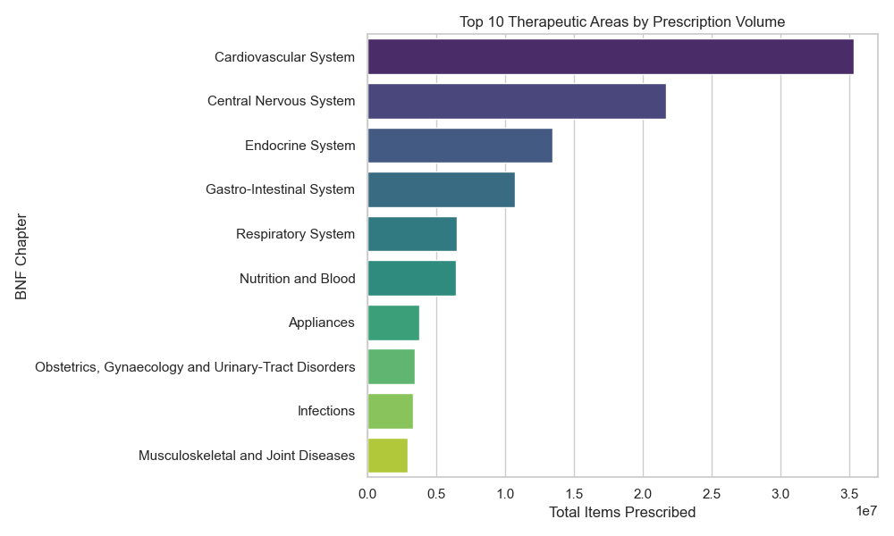
Market Dynamics: Prescription Volumes
Insight: Cardiovascular System has the highest prescription count, showing strong patient demand.

Slide 4
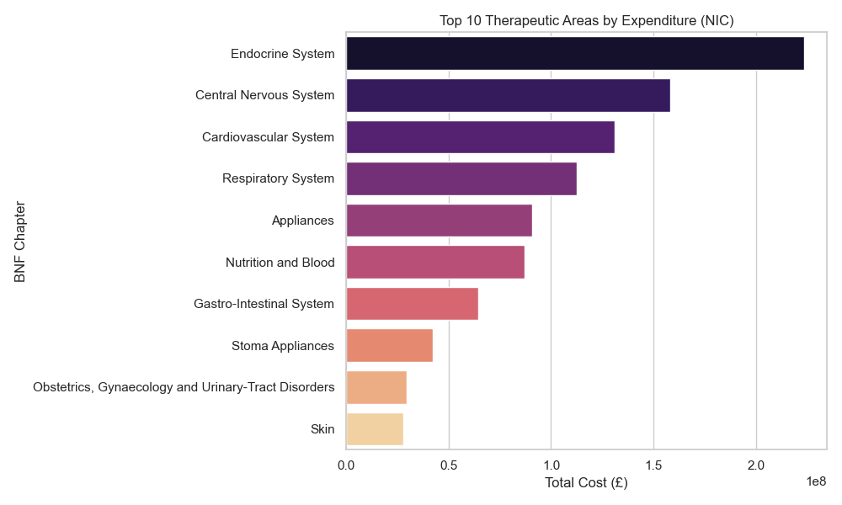
Market Dynamics: Expenditure (NIC)
Insight: Endocrine System leads in spending. High volume doesn't always equal high cost.

Slide 5
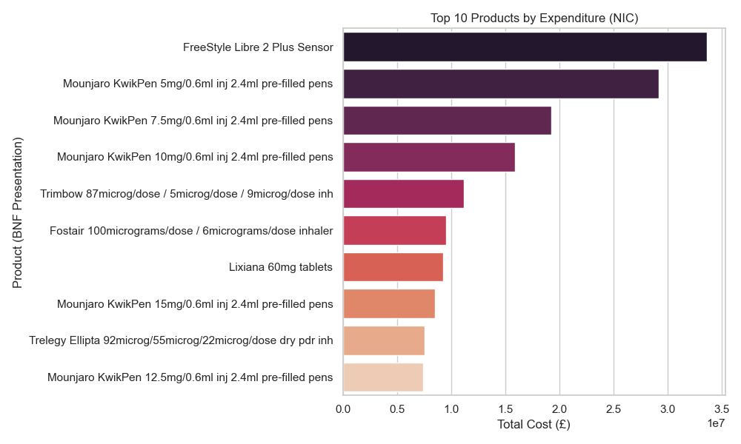
Product Deep Dive: Top Products by Cost
Insight: FreeStyle Libre 2 Plus Sensor and Mounjaro KwikPen 5mg/0.6ml inj 2.4ml pre-filled pens
are the most expensive products to the NHS.

Slide 6
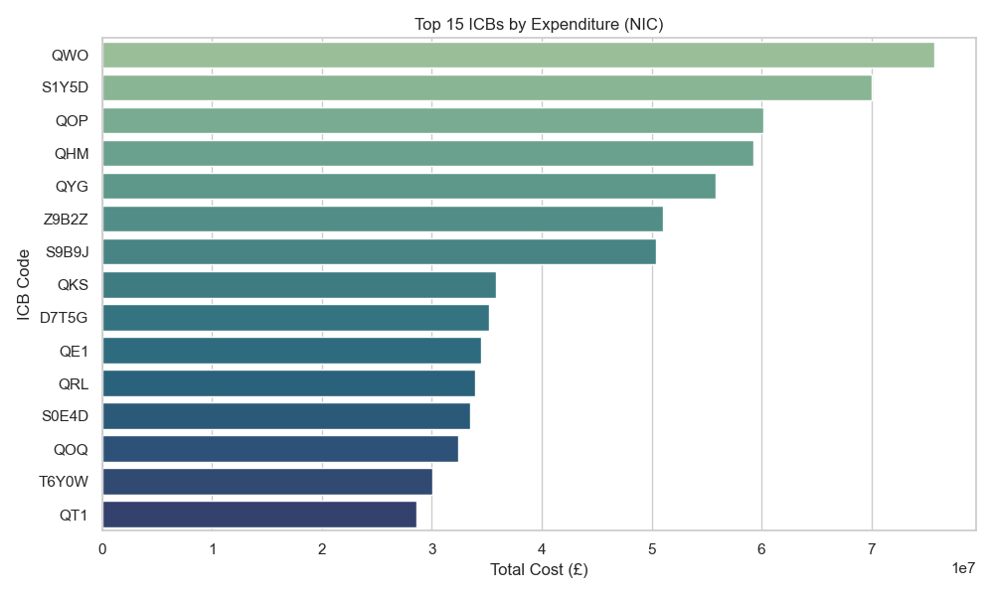
Geographic Insights: Expenditure by ICB
Insight: Regional focus should be on QWO and S1Y5D for resource allocation.

Slide 7
Commercial Decisions: Investment & Divestment
✅ STRATEGIC INVESTMENTS (Choose):
Invest heavily in Endocrine System and Central Nervous System categories as they represent the largest portion of NHS spending.
Target sales and marketing efforts toward high-spending regions like ICBs: QWO and S1Y5D.
❌ AREAS TO DE-PRIORITIZE (Do Not Choose):
Avoid over-investing in high-volume but low-cost generic categories where margins are razor thin.
Deprioritize regions in the bottom quartile of ICB expenditure, as the ROI for commercial deployment there is minimal.

