Slide 1

Kaggle: Heat Flux Imputation

Slide 2
Índice
Dataframe Inicial
EDA
Feature Engineering
Pipeline & Grid
Análisis Modelos
Conclusiones

Slide 3
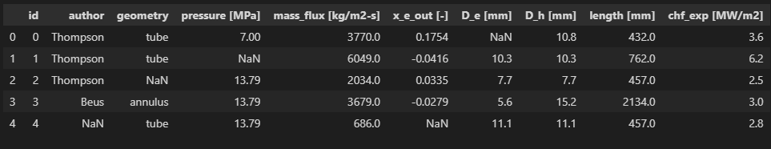
1. DATAFRAME INICIAL

Slide 4
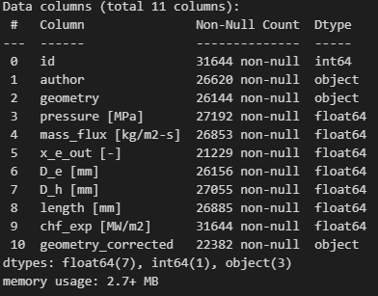
2. EDA

Slide 5
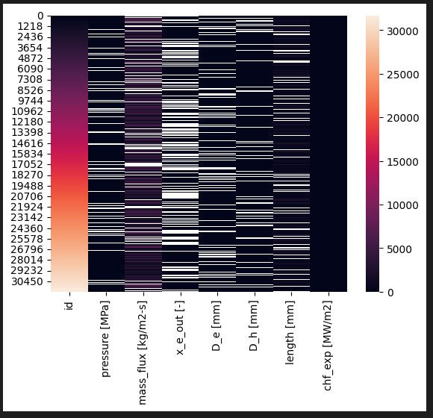
2. EDA

Slide 6
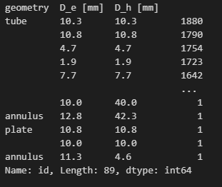
2. EDA

Slide 7
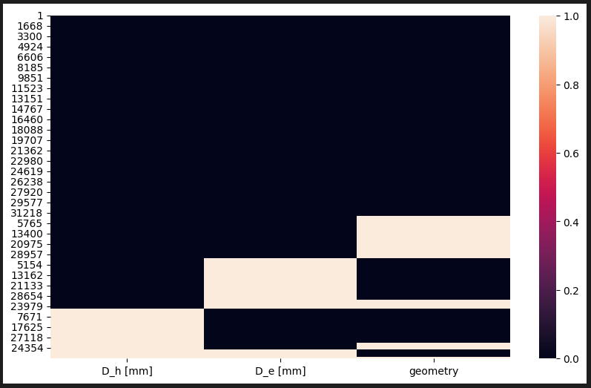
3. Feature Engineering

Slide 8
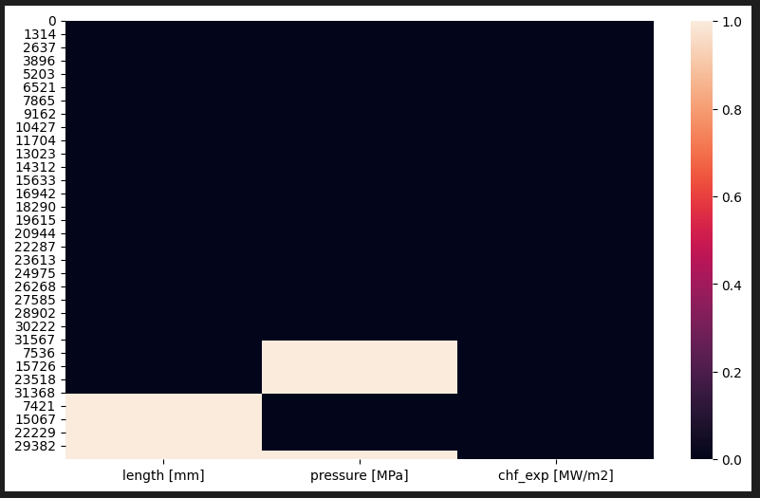
3. Feature Engineering

Slide 9
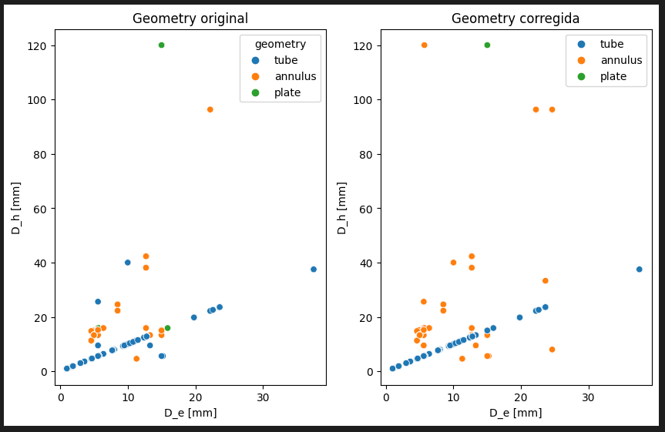
3. Feature Engineering

Slide 10
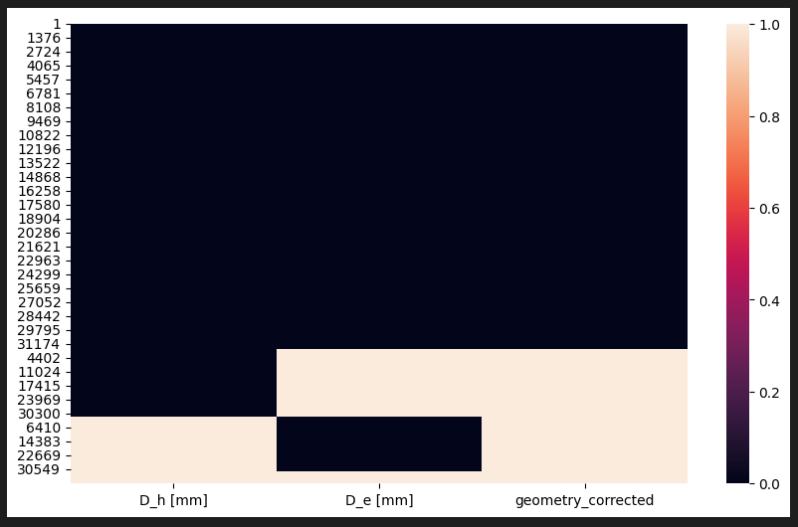
3. Feature Engineering

Slide 11
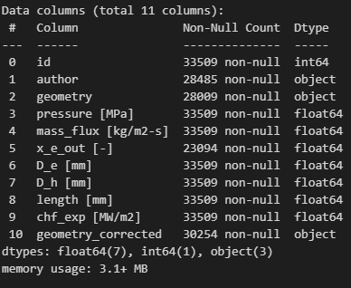
3. Feature Engineering

Slide 12
4. Pipeline & Grid
Modelos:
Random Forest
Gradient Boosting
XGBoost
ANN

Slide 13
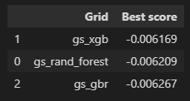
5. Análisis modelos
Mejor modelo:
Mejor modelo:
XGBoost

Slide 14
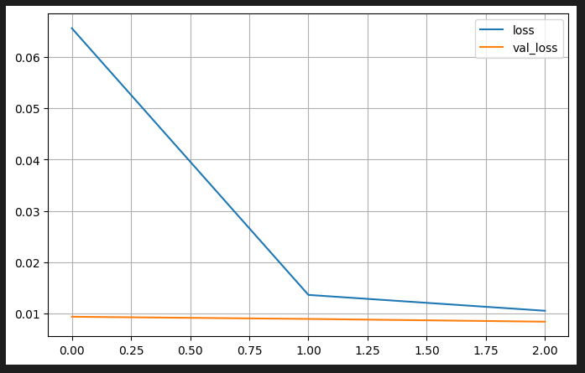
5. Análisis modelos

Slide 15
6. Conclusiones
Importancia Feature Engineering
Red Neuronal tiende a Overfitting

