Slide 1



ArenaPulse
The Next-Generation Esports Tournament Platform
GAJERA ANSH
GAJJAR VANSH
ENROLLMENT NO: 24002171310037
ENROLLMENT NO: 24002171910007
BRANCH: CST
BRANCH: CSE_CS
ROLL NO: 42
ROLL NO: 52

Slide 2

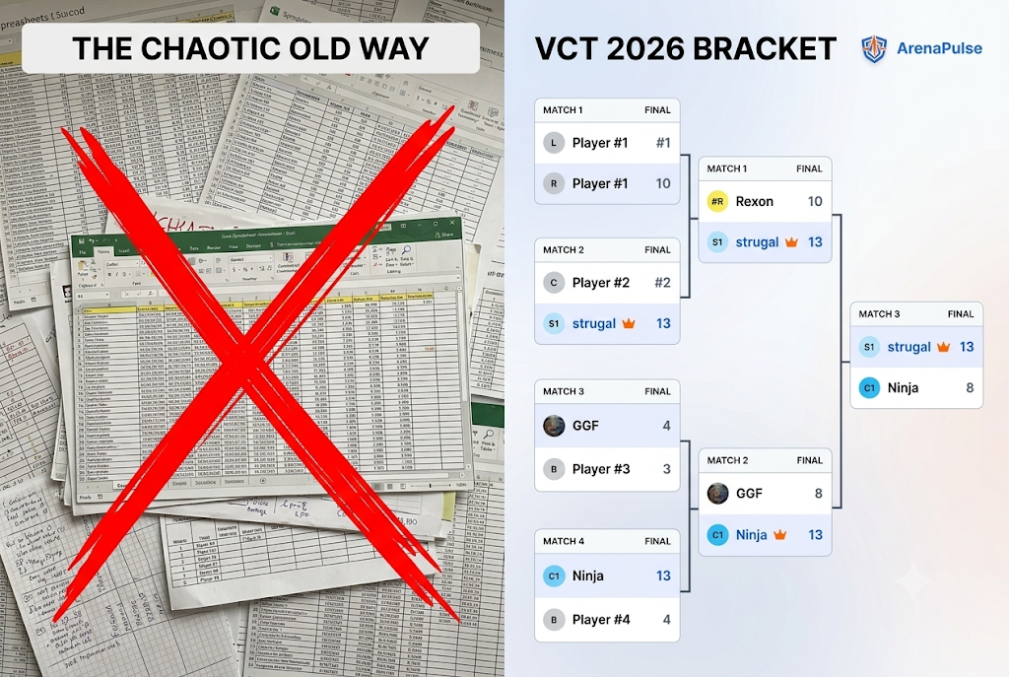
Evolving Esports Management
The Problem: Organizing tournaments usually requires messy spreadsheets, manual bracket updates, and scattered third-party chat apps.
The Solution: ArenaPulse centralizes everything. It provides automated bracket generation, real-time score tracking, and team management all in one hub.

Slide 3
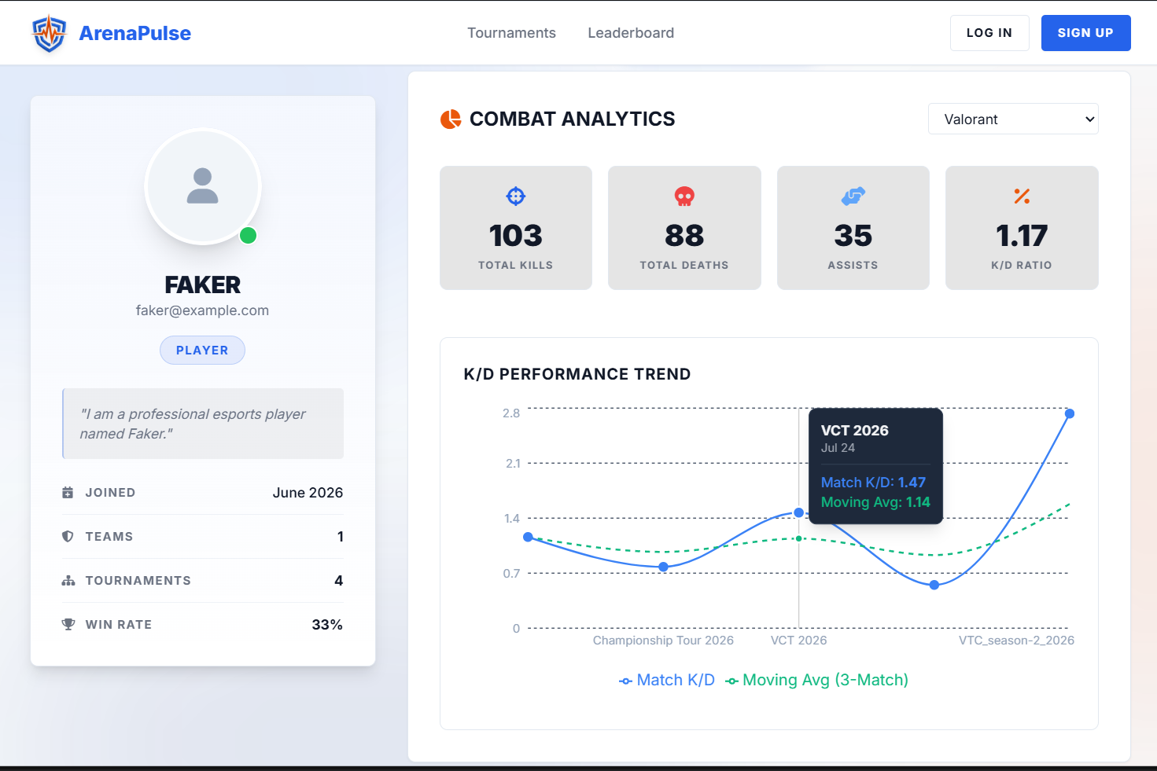
Built for Organizers & Players
Automated Brackets: One-click generation of massive tournament trees without manual data entry.
Deep Player Analytics: Tracks K/D ratios, match history, and overall rank across different games automatically.
Team Management: Create rosters, assign captains, and enroll teams seamlessly into upcoming events.

Slide 4
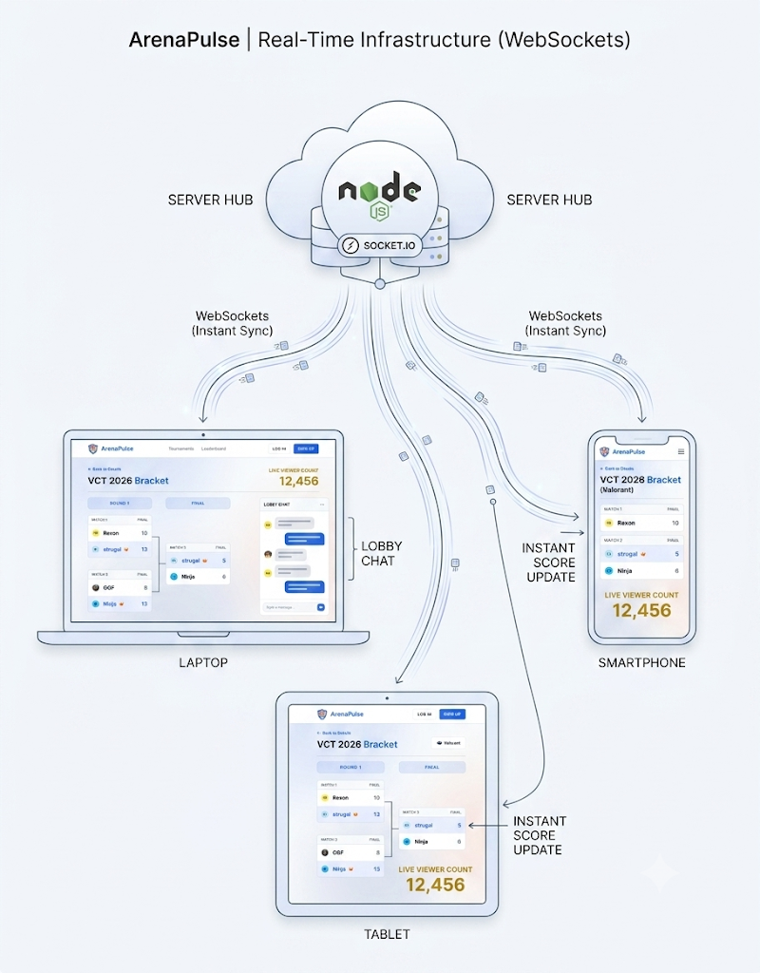
A Live, Interactive Experience
Live Viewer Counts: See exactly how many fans are watching a match unfold in real-time.
Instant Score Updates: Brackets update across all connected devices instantly via WebSockets without refreshing.
Tournament Lobbies: Real-time chat rooms for players and organizers to coordinate effectively.

Slide 5
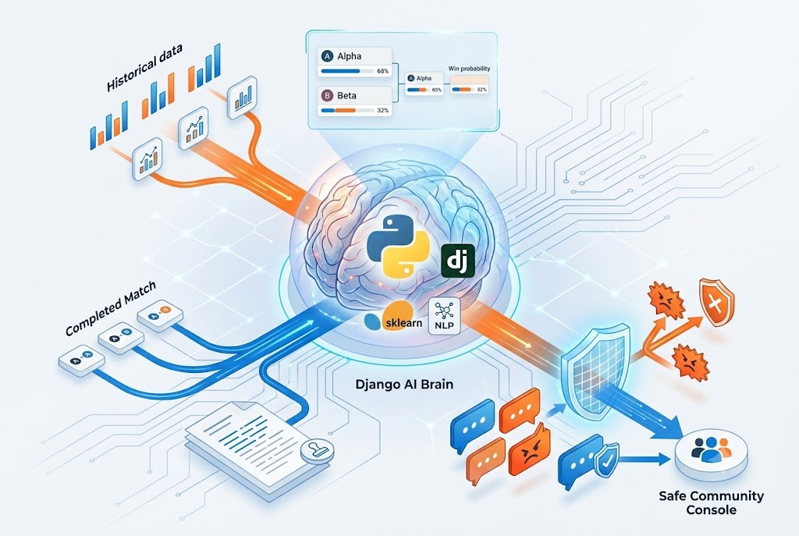
Powered by Artificial Intelligence
Predictive Match Analytics: A custom ML model analyzes historical team stats to predict match win probabilities.
Automated Match Summaries: Generates readable, human-like recaps of completed matches instantly.
AI Toxicity Filter: Instantly intercepts and blocks toxic or abusive messages in live chat to protect the community.

Slide 6


Modern Microservice Architecture
Core Operations
Real-Time & Analytics
Frontend UI: React.js, Vite, and Tailwind CSS for a dynamic, lightning-fast experience.
Real-Time Data: Socket.io for managing websocket connections
and live viewer scaling.
Main Backend: Node.js, Express, and MongoDB powering the core logic and database routing.
AI Microservice: Django, Pandas, and Scikit-Learn handling machine learning tasks.

Slide 7

What's Next for ArenaPulse?
Battle Royale Support: Expanding beyond 1v1 brackets to support 20+ team massive lobbies.
BGIS Point Matrix: Advanced scoring systems for survival placement and kill points.

Slide 8
Thank You

