Slide 1
Huffman Encoding/Decoding
Shah Vidit (1401078)
Mihir Gajjar (1401076)

Slide 2
Huffman Trees
Lossless Data Compression.
Unique Prefix Property.
Variable Length Encoding based on frequencies.
Data Encoding/Decoding.
No auxiliary information is needed as delimiter between codes.

Slide 3
Algorithm:
1. Take Text File as an Input.
2. Calculate Frequency of each character in the file.
3. Create Nodes of characters with nonzero frequencies.
4. Insert the nodes in the minimum priority queue.
5. Remove two nodes from the minimum priority queue (left and right)→ add their frequencies and make a new node and link the left and the right nodes to the new node. → Insert the new node in the minimum priority queue.
6. Is there only one element left in the minimum priority queue?
No: Go to Step 5.
Yes: Go to Step 7.
7. Remove the node from the minimum priority queue.
8. Traverse through the node (Tree) and assign the Huffman code to the respective characters.
9. Create the new text file and write the respective Huffman codes according to the characters.
10.The Encoded file is taken as an input and with the help of the Huffman Tree the original data is recovered.

Slide 4
Data Structures Used and their Importance:
Array.
Minimum Priority Queue.
Binary Tree.

Slide 5
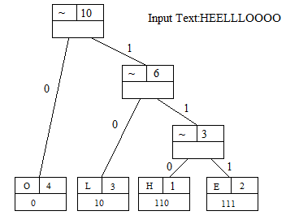
Example:
Compression Ratio: (10/2.375) = 4.21
Compressed File Size (Percentage) : (2.375/10)*100 = 23.75%

Slide 6
Under the guidance of:
Faculty:
Naveen Kumar
Mentor:
Janvi Shah
Teaching Associates:
Riddhi Patel
Pooja Bavishi
Kavita Anjaria

Slide 7
References:
Data Structures and Algorithms in java, Second Edition, Robert Lafore, Pearson.
https://www.siggraph.org/education/materials/HyperGraph/video/mpeg/mpegfaq/huffman_tutorial.html
Huffman Encoding : http://planetcalc.com/2481/

Slide 8
Thank You..!!

