Slide 1


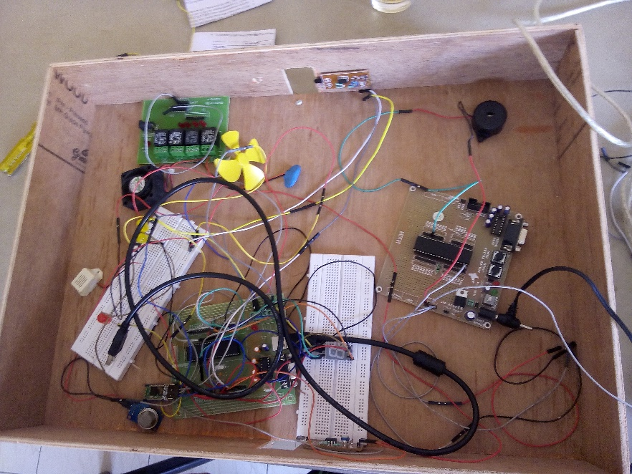
Smart Room Mihir Gajjar, Vidit Shah, Karan Patel
IET
INSTITUTE OF ENGINEERING & TECHNOLOGY
￼
Application:
To make room more secure, safe and for saving electricity.
To avoid human dependencies and chances of error.
Learnings:
Infra-Red sensor interfacing.
Interfacing MQ-2 Gas sensor for detecting gas leakage.
Interfacing with LM-35 temperature sensor.
Interfacing with Atmega 32 using Mobile Bluetooth Application with the help of HC-05.
Using Relay Board.

