Slide 1
CHAPTER 7: Clustering

Slide 2
Introduction
Parametric: Assume a single model for p (x | C_{i}). i. e Sample comes from a single known distribution.
Semiparametric: p (x | C_{i}) is a mixture of densities.A mixture of distributions are used for input sample estimation.
Clustering methods allows a mixture parameters from data.

Slide 3
Semiparametric Density Estimation
Examples:
Different handwriting styles, accents in speech.
Nonparametric: even mixture model not applicable; Data speaks for itself.

Slide 4
Mixture Densities
where G_{i} the components/groups/clusters,
P ( G_{i} ) mixture proportions (priors),
p ( x | G_{i}) component densities
k number of components called hyper parameter.
Given a sample and k, learning corresponds to estimating the component densities and proportions.

Slide 5
If the component densities are multivariate Gaussian mixture where p(x|G_{i}) ~ N ( μ_{i} , ∑_{i} ) and Φ = {P ( G_{i} ), μ_{i} , ∑_{i} }^{k}_{i=1} are the parameters to be estimated from unlabeled sample X={x^{t}}_{t} (unsupervised learning)

Slide 6
Classes vs. Clusters
Supervised: X = { x^{t} ,r^{t} }_{t}
Classes C_{i} i=1,...,K
where p ( x | C_{i}) ~ N ( μ_{i} , ∑_{i} )
Φ = {P (C_{i} ), μ_{i} , ∑_{i} }^{K}_{i=1}
Unsupervised : X = { x^{t} }_{t}
Clusters G_{i} i=1,...,k
where p ( x | G_{i}) ~ N ( μ_{i} , ∑_{i} )
Φ = {P ( G_{i} ), μ_{i} , ∑_{i} }^{k}_{i=1}
Estimate Labels, r ^{t}_{i}
Estimate the parameters of the components given set of instances belonging to them.

Slide 7
k-Means Clustering
Consider image with 24bits/pixel and up to 16 million colors.
A Color screen with 8bits/pixel that can display 256 colors.
So we need best 256 colors among 16 million colors such that the image displayed is close to original image.
This is color quantization which maps from high to low resolution.
The aim is to map continuous space to discrete space This process is called vector Quantization.

Slide 8
k-Means Clustering
Find k reference vectors (prototypes/codebook vectors/codewords) which best represent data
Reference vectors, m_{j}, j =1,...,k
Use nearest (most similar) reference:
Reconstruction error

Slide 9
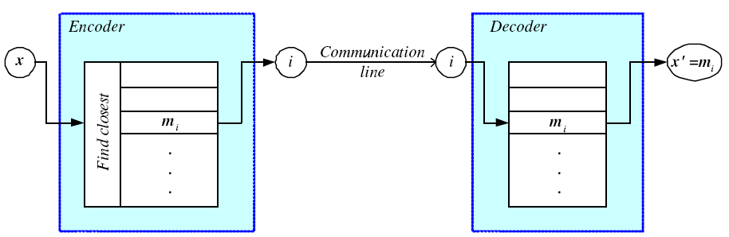
Encoding/Decoding

Slide 10
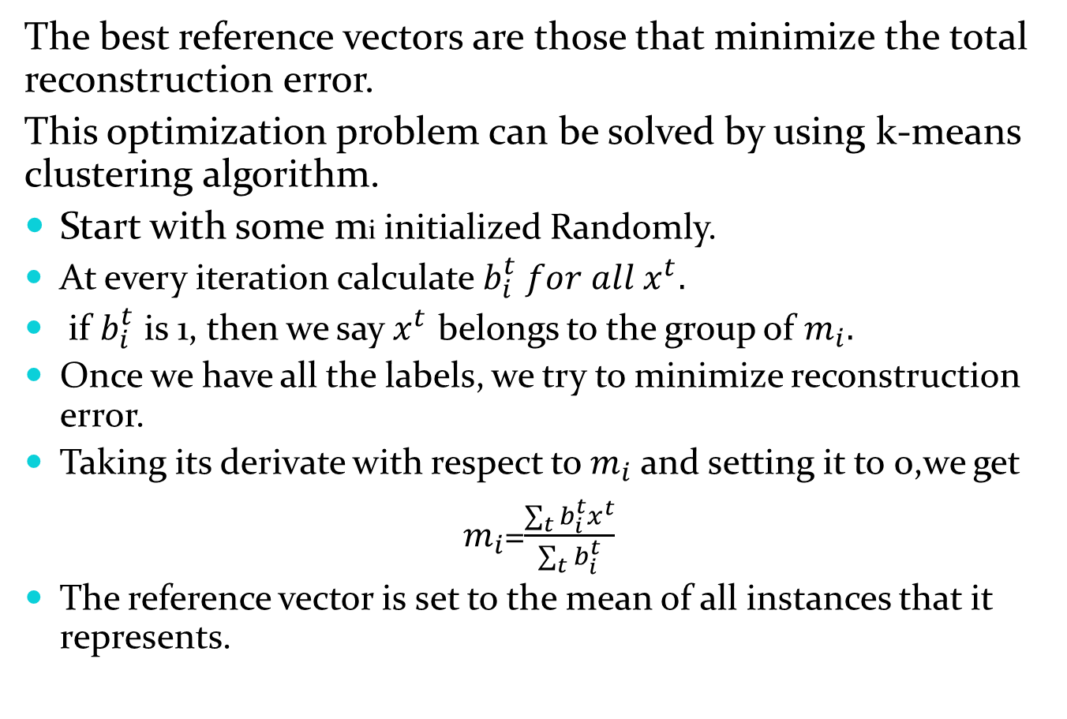
The best reference vectors are those that minimize the total reconstruction error.
This optimization problem can be solved by using k-means clustering algorithm.
Start with some mi initialized Randomly.
At every iteration calculate $b_{i}^{t} for all x^{t}.$
if $b_{i}^{t}$ is 1, then we say $x^{t}$ belongs to the group of $m_{i}.$
Once we have all the labels, we try to minimize reconstruction error.
Taking its derivate with respect to $m_{i}$ and setting it to 0,we get
$m_{i}$=$\frac{\sum_{t}{b_{i}^{t}}x^{t}}{\sum_{t}{b_{i}^{t}}}$
The reference vector is set to the mean of all instances that it represents.

Slide 11
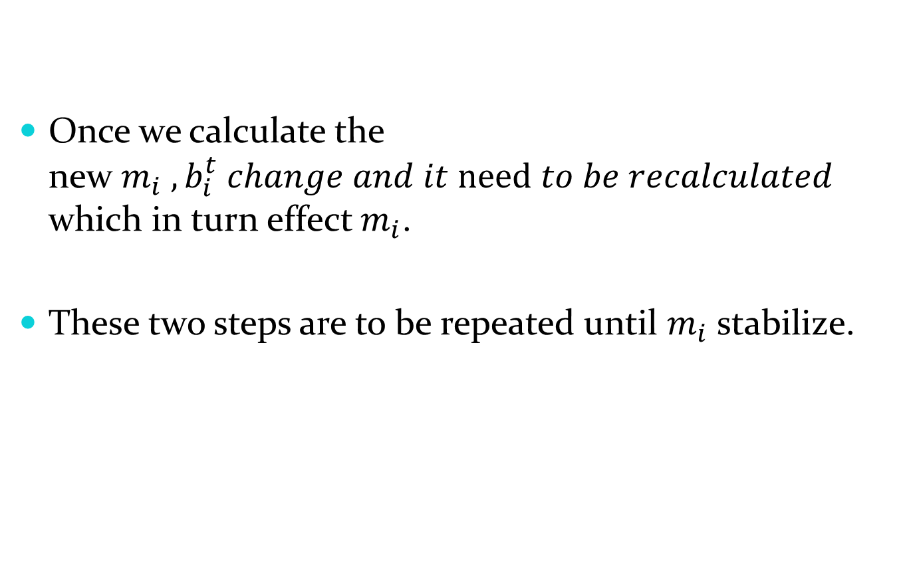
Once we calculate the new$m_{i} ,b_{i}^{t} change and it need to be recalculated$ which in turn effect $m_{i}$.
These two steps are to be repeated until $m_{i}$ stabilize.

Slide 12
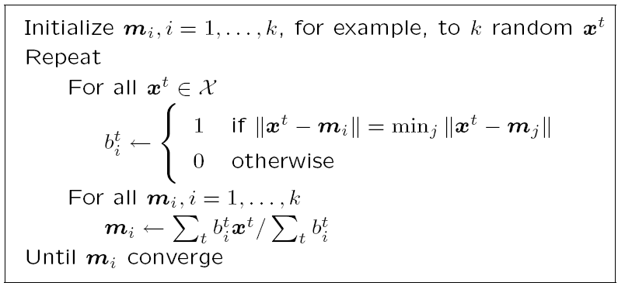
k-means Clustering

Slide 13
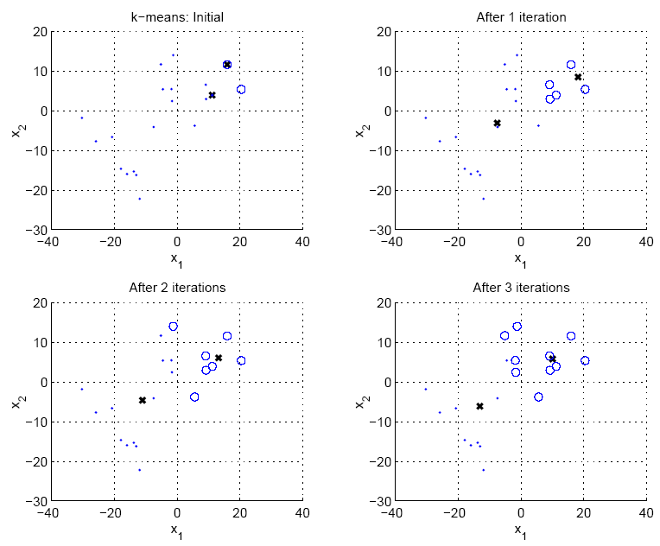

Slide 14
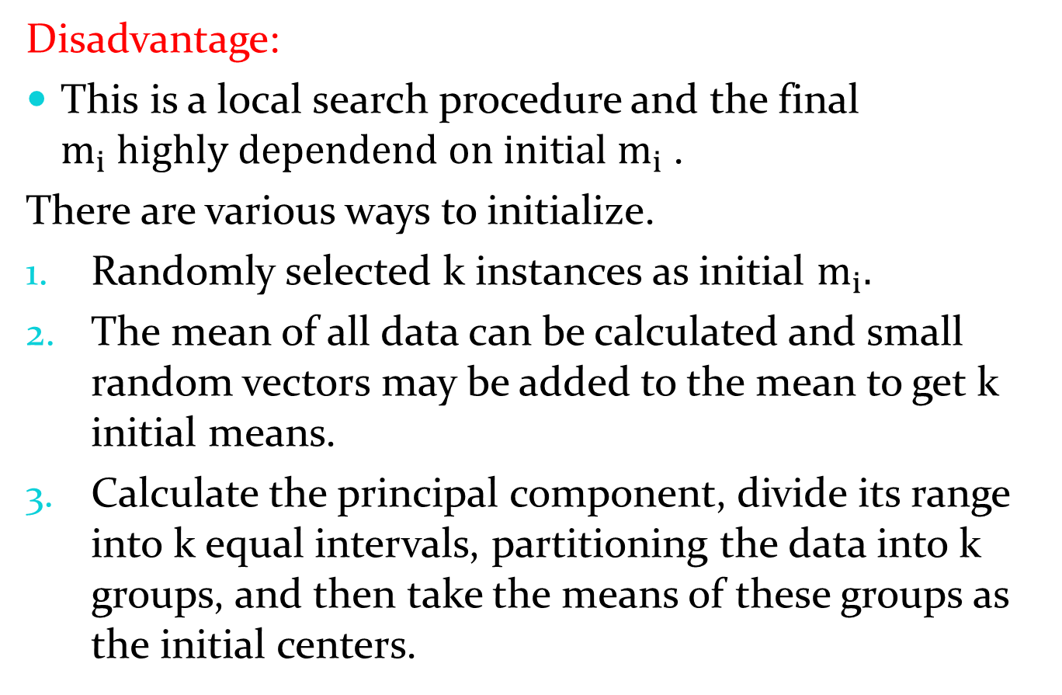
Disadvantage:
This is a local search procedure and the final $m_{i} highly dependend on initial m_{i}$.
There are various ways to initialize.
Randomly selected k instances as initial $m_{i}.$
The mean of all data can be calculated and small random vectors may be added to the mean to get k initial means.
Calculate the principal component, divide its range into k equal intervals, partitioning the data into k groups, and then take the means of these groups as the initial centers.

Slide 15
After convergence, all the centers should cover some subset of the data instances and be useful;

Slide 16
Hierarchical Clustering
We discussed clustering from a probabilistic point of view as fitting a mixture model to the data, or in terms of finding code words minimizing reconstruction error.
There are also methods for clustering that use only similarities of instances, without any other requirement on the data;
The aim is to find groups such that instances in a group are more similar to each other than instances in different groups.
This is the approach taken hierarchical by hierarchical clustering.
This needs the use of a similarity, or equivalently a distance, measure defined between instances.

Slide 17
Hierarchical Clustering
Cluster based on similarities/distances
Distance measure between instances x^{r} and x^{s}
Minkowski (L_{p}) (Euclidean for p = 2)
City-block distance

Slide 18
An agglomerative clustering algorithm starts with N groups, each initially containing one training instance, merging similar groups to form larger groups ,until there is a single one.
A divisive clustering algorithm goes in the other direction, starting with a single group and dividing large groups into smaller groups, until each group contains a single instance.
At each iteration of an agglomerative algorithm, we choose the two closest groups to merge.
In single-link clustering, this distance is defined clustering as the smallest distance between all possible pair of elements of the two groups:

Slide 19
Agglomerative Clustering
Start with N groups each with one instance and merge two closest groups at each iteration
Distance between two groups G_{i} and G_{j}:
Single-link: In single-link clustering, this distance is defined clustering as the smallest distance between all possible pair of elements of the two groups:
Complete-link:In complete-link clustering, the distance between two groups is taken as clustering the largest distance between all possible pairs:
Average-link, centroid uses the average of distances between all pairs and the centroid distance that measures the distance between the centroids (means) of the two groups.

Slide 20
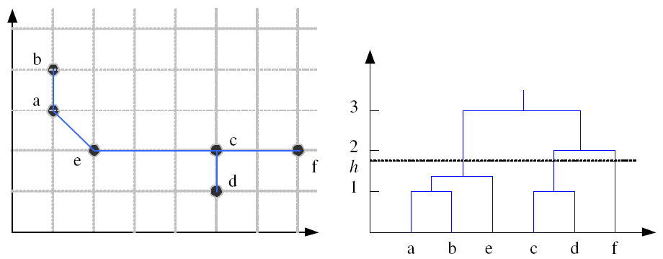
Example: Single-Link Clustering
Dendrogram

Slide 21
Choosing the Number of Clusters
In some applications such as color quantization, k is defined by the application.
Plotting the data in two dimensions using PCA may be used in uncovering the structure of data and the number of clusters in the data.
An incremental approach may also help: Setting a maximum allowed distance is equivalent to setting a maximum allowed reconstruction error per instance.
In some applications, validation of the groups can be done manually by checking whether clusters actually code meaningful groups of the data.

Slide 22
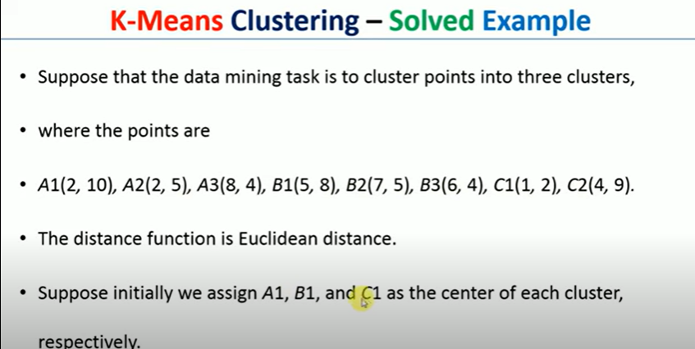

Slide 23
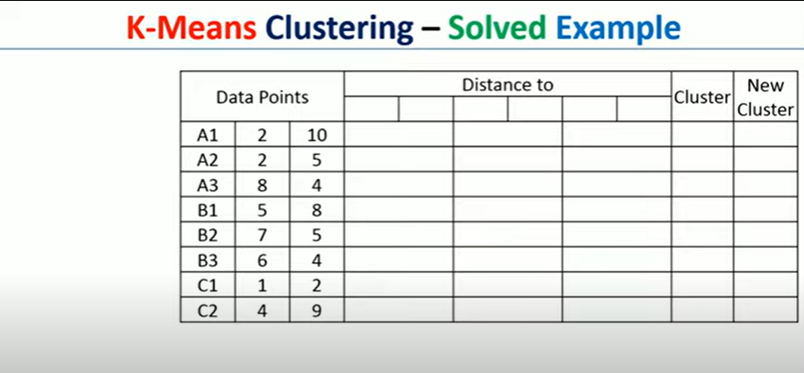

Slide 24
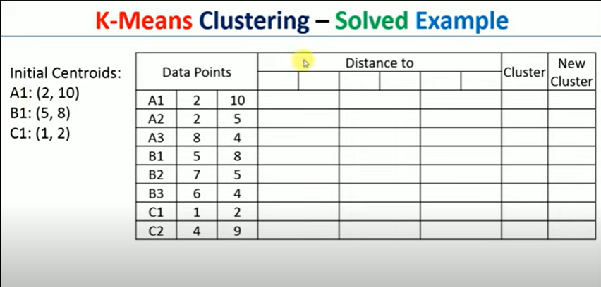

Slide 25
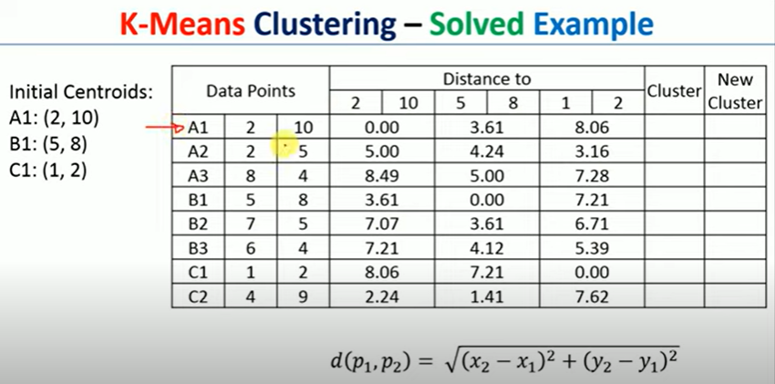

Slide 26
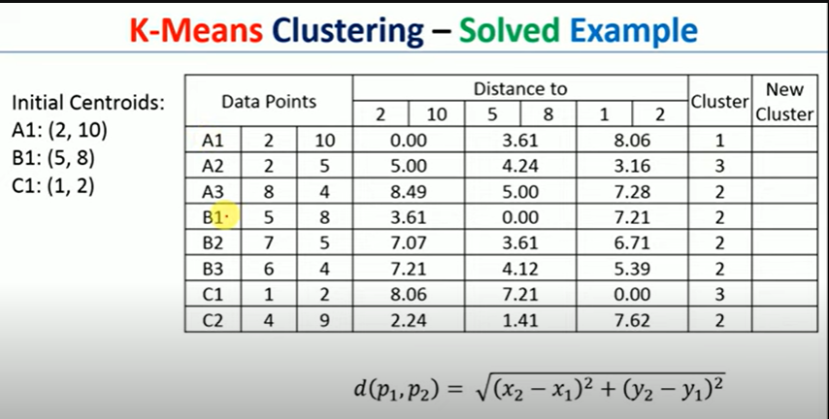

Slide 27
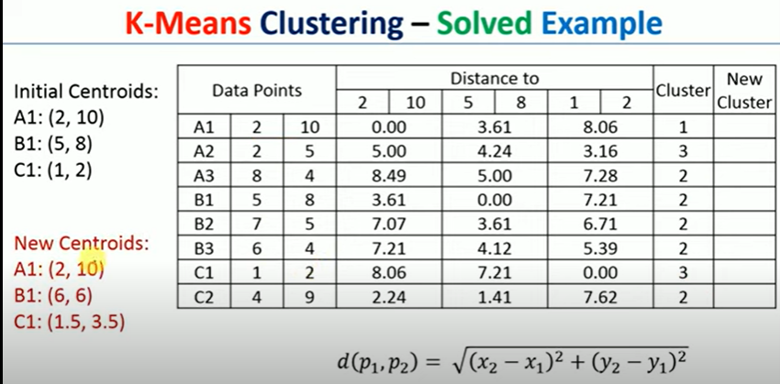

Slide 28
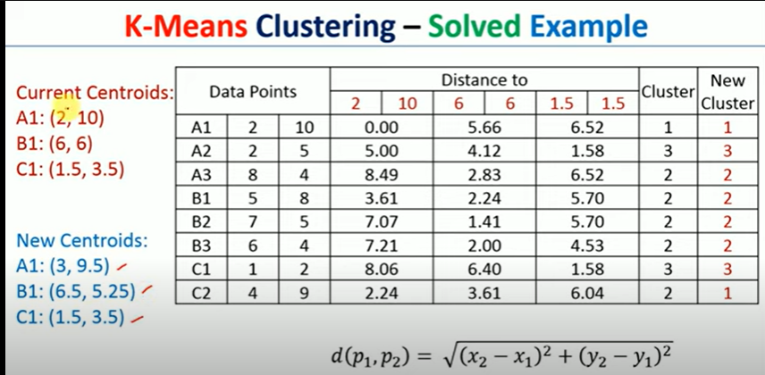

Slide 29
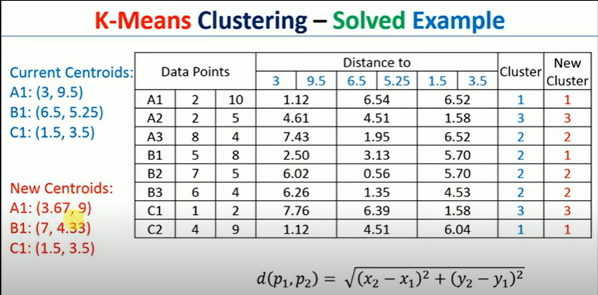

Slide 30
