Slide 1
Intranet renewal
Architecture review board: target-state architecture
Enterprise Architecture · Public copy, generalized
Notes:
Opening. This is the intranet: The first release of the departmental intranet renewal. It is bilingual, runs on-premises on an isolated network built to the department's security standards, and is built on the CMS with the design system, search and self-hosted analytics analytics.
The deck follows the board template: purpose, value proposition, business drivers, current state, target state, the proposed operating model, consultation, risks and assessment. Extra slides carry the measures the system provides, the architecture principles and three patterns (measure each language, check accessibility, publish a status page). The full detail is in the Solution Architecture document.
Presenter notes: confirm the presenter name and the review date before the session. The footer carries the Cycle stand-in text; replace it with the department signature on the slide master.

Slide 2
Purpose
Endorse the target-state architecture and its constraints
Review the target-state architecture for the intranet
Test the decisions behind it
Note that detail is refined throughout delivery
First release
Publish, find, and prove content is current and owned.
Not in this release
The service management tool sync, personalization, BI reporting, policy content.
Notes:
What we are asking. The board is asked to review the target-state architecture, test the decisions behind it, and note that detail is refined throughout delivery. The architecture is a point-in-time proposal. Suggested wording of the decision requested: endorse the target-state architecture and its constraints. The EA confirms that wording before the session.
Scope in one line. The first release is deliberately small: publish, find, and prove content is current and owned (recorded decision). Deferred to a later release: The service management tool service catalog sync and My Tasks, personalization, and a BI tool as the reporting surface. Departmental policy has its own site and is not in intranet search. Live video stays on the Communications streaming platform; the intranet links to it. The first release targets managed desktop PCs only (recorded decision).
Why name the deferred scope: so the platform is sized for it and is not built into a corner.
Sources: A recorded decision and a recorded decision; Solution Architecture sections 1 and 2.

Slide 3
Value proposition
One place to find what you need, with content that is current, owned and measured
Find it
Integrated, intuitive search, plus quick links that staff configure themselves.
Trust it
Every page has an owner, an approval workflow and an expiry date. Content is refreshed or retired.
Know what works
Built-in analytics show what people actually use, so decisions rest on evidence.
Grow into it
Two-way features and personalized news and announcements follow in later phases (a later phase).
Bilingual and accessible by design: WCAG 2.1 AA and the official languages law, proven on an ongoing basis.
Notes:
Opening line: The new intranet gives employees and contractors one place to find what they need, and gives the department confidence that the content is current, owned and measured.
Four points, taken from the business requirements.
Find it (the business requirements 1 and 2). Integrated, intuitive search that finds the common things people look for, in English and French, plus quick links that staff can configure themselves.
Trust it (the business requirements 3). Every page has a clear owner, an approval workflow and an expiry date. Content is refreshed or retired, not left to go stale. A content health report joins the CMS metadata with the analytics tool traffic so executives, Communications and IT can see what is stale and who is accountable.
Know what works (the business requirements 4). Built-in analytics show what people actually use, so decisions rest on evidence. Every measure is shown for English and French side by side (pattern PAT-011).
Grow into it (the business requirements 5 and 6). Two-way features and personalized news and announcements follow in later phases. They are marked a later phase and are not in the first release.
Bilingual and accessible by design. WCAG 2.1 AA and the official languages law are build requirements, checked automatically and proven on an ongoing basis.
Run. Open-source, on-premises and automated by default. Built once, signed, and deployed the same way every time. Transparent, allowing owners to manage their content and view readership.
Likely question: how is value measured? The next slide shows the five measures.
Sources: The business requirements; Solution Architecture sections 1, 5 and 10.

Slide 4
Value proposition: measures
Five measures give executives and owners something to act on
Content health
Stale, unowned, unread
Executives
Reach by division
Disposition
Kept, refreshed, retired
One dataset, counted per language
Content owners
Keep, refresh, retire
Bilingual parity
English and French apart
Communications
Gaps to coach and fix
Accessibility
Open findings, with owners
IT
What to patch or scale
Readership
By page, owner and branch
Source: The first release story. Reports are aggregate: no individual's browsing is visible to anyone.
Notes:
The point: The intranet does not just publish content, it measures it, and the numbers are meant to be acted on.
Five things measured, from the first release story. (1) Content health: what is stale, unowned or unread. (2) Disposition: what has been kept, refreshed, retired and archived, by branch and quarter; this shows whether ownership is real. (3) Bilingual parity: publishing lag, indexing lag and traffic, English and French counted separately so a stalled French queue cannot hide in an aggregate. (4) Accessibility: open findings, where they are, and who owns the page. (5) Readership: by page, owner and branch.
How it works. The analytics tool is self-hosted and measures use without data leaving the network (recorded decision). The CMS holds owner, review date, language and taxonomy terms. A reporting schema owned by IT joins the two nightly, which is what lets a question such as which HR pages are stale, and who owns them, be answered.
Reports are aggregate; no individual's browsing is visible. Low traffic is information, not a verdict: mandatory pages are flagged so nobody retires them for being quiet.
The actions on the right are intended uses, not commitments. Confirm with the executive audience that these are the actions they want.
Sources: The first release story; Solution Architecture principle P4 and sections 5.4 and 10; a recorded decision.

Slide 5
Business drivers
Four forces make renewal necessary now
Failure risk
Poor remote access and a risk of total failure.
Strategic alignment
Replacement is tied to the digital experience platform strategy.
Desired outcomes
Better productivity
Stronger security posture
Accessibility and inclusion
Lower total cost of ownership
Analytics and governance
Employee engagement
Compliance
Accessibility, bilingual and security standards.
Obsolescence
The platform cannot meet future needs.
Notes:
Drivers are what force the change; outcomes are what the department wants. The business case keeps them apart, so the slide does too.
Drivers. (1) Failure risk: The current intranet is failing, with poor mobile and remote access, limited bilingual and accessibility support, and a real risk of total failure. (2) Strategic alignment: replacement is tied to the digital experience platform strategy. (3) Compliance: Government of Canada accessibility, bilingual and security standards. (4) Obsolescence: existing platforms cannot support current or future digital communication needs.
Desired outcomes. Improved productivity through faster discovery and consistent templates. Stronger security posture through a standards-based deployment. Accessibility and inclusion. Lower total cost of ownership through a standard platform, reusable components and community support. Better analytics and governance through centralized lifecycle, search analytics and role-based publishing. Engagement and communication, aligned with ExCom policy.
The tinted card marks the most urgent driver; the word failure in its title carries the meaning, not the colour.
Source: business case as summarized in the business requirements notes; Solution Architecture section 6.

Slide 6
Current state
The legacy platform, with no link to security, monitoring or analytics
Employees
Not connected today
Security platform
security platform, vulnerability scanning
The legacy web front end
Intranet sites and pages
The identity provider
Sign-in
Monitoring platform
Health, logs, alerts
The legacy application services
Search, profiles, metadata
Analytics platform
Usage, search insights
The legacy content databases
Search response time is acceptable, but relevance is poor: results include retired platforms, and common queries such as HR policy and pay scales are not findable.
Notes:
Today's platform. Employees reach intranet sites and pages through the legacy web front end. Behind it, application services provide search, profiles and metadata, backed by the legacy content databases. Sign-in is through the identity provider.
What it is not connected to (dashed). Not connected to a security platform (security platform, vulnerability scanning), a monitoring platform (health, logs, alerts) or an analytics platform (usage, search insights). Nobody can see how the intranet is used, how it is performing, or what is happening to it from a security point of view.
State of the platform. It has not been patched or enhanced since launch. Configuration is left alone for fear of a failure with no recovery. This is the core of the failure risk in the business drivers: The platform cannot be maintained safely and cannot be improved.
Search. Response time is acceptable; the problem is relevance and findability. Results include platforms that no longer exist, and common queries such as HR policy and pay scales do not return the right content. The intranet addresses this with a shared taxonomy, search tuned for each language, best bets, and zero-result reporting from go-live.
Each dashed box here is connected in the target state (see the target-state slides).
Gap to name. Content volumes, the number of sites and the decommissioning plan are not in the project records. Add them if the board will ask.
Sources: DARB feedback on the current state; business case drivers; Solution Architecture section 8.

Slide 7
Architecture principles
Six principles guide every design decision
P1 Accessible by default
Accessibility is a build requirement, checked automatically.
P2 Bilingual parity
English and French are equal at every layer, and provably so.
P3 Automated
Where a task repeats, the system does it. People decide.
P4 Transparent
Anyone who publishes can see how their content is doing.
P5 Secure by design
Security in every layer, assuming any one layer can fail.
P6 Extensible
Feeds other channels later without a rebuild. Full-stack now.
Each principle names the decisions that apply it, so a design can be tested against it.
Notes:
Six principles from the Solution Architecture, section 2. They adapt common modern-intranet principles to this project's constraints. Where a common version conflicts with the isolated-network constraint or an existing decision, the conflict is flagged rather than carried over.
P1 Accessible by default. WCAG 2.1 AA is pass/fail, checked in the build (automated accessibility checkers) and again on live English and French pages. Built from accessible design system components. Video has captions and an accessible player. Status is never carried by colour alone. Decisions: recorded decisions, recorded decisions.
P2 Bilingual parity, provable. Every page is a linked English and French pair; a page with no partner is flagged, never silently published. Both languages are released together. Every measure is counted per language so an aggregate cannot hide a stalled French queue. Text from another system is mapped to a fixed set of values and translated in the CMS.
P3 Automated. Publishing workflow, scheduled publish and unpublish, review reminders, stale-page flags, scheduled reports, infrastructure as code, configuration as code, and build, test and patch in the pipeline. Automation flags; it never removes content on its own.
P4 Transparent. Owners see their own pages; Communications sees the whole site; executives see a roll-up by division. Reports are aggregate.
P5 Secure by design. Single sign-on through the identity provider, role-based access, audit logs, deploy-only production, and the narrowest rights for any system the intranet reads from.
P6 Extensible, not headless. The CMS renders the pages itself (recorded decision) and exposes content through a read-only content API so signage or a mobile view can read it later. A headless design was considered and rejected in a recorded decision.
Source: Solution Architecture section 2.

Slide 8
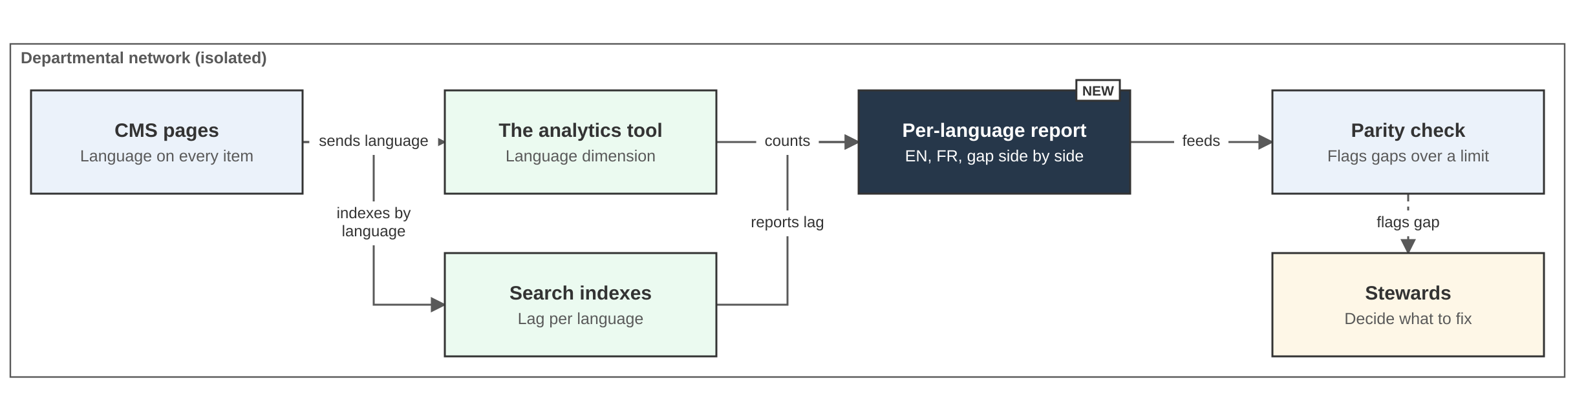
Pattern PAT-011
Measure each language on its own, so a gap cannot hide in a total
Do: record the language on every page, event and record, and report every measure for English and French side by side, with the gap.
Do not: report one total or one average.
Notes:
Pattern PAT-011, Measure each language on its own. It supports the business requirements point Know what works and principles P2 (bilingual parity, provable) and P4 (transparent).
The idea. The language is recorded once, at the source, on every page, event and record. Every measure is then reported for English and French side by side, with the gap. This is how the department proves it is bilingual, with numbers, on an ongoing basis.
Reading the diagram. The CMS sends the language to the analytics tool with each event and indexes each page by language in the search engine. A per-language report joins both. A parity check flags any gap over a set limit to the stewards, who decide what to fix. Nothing is changed automatically.
Why it matters. One combined total can look healthy while French is behind. Most dashboards default to a total, so the pattern makes the per-language view the default.
Detail: The Solution Architecture, key patterns section, and the full pattern page. Figures are reduced in size on this slide.

Slide 9
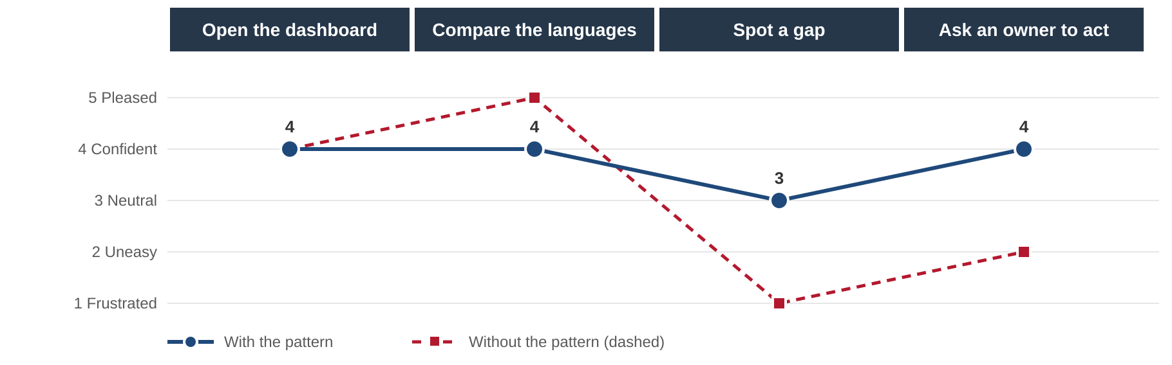
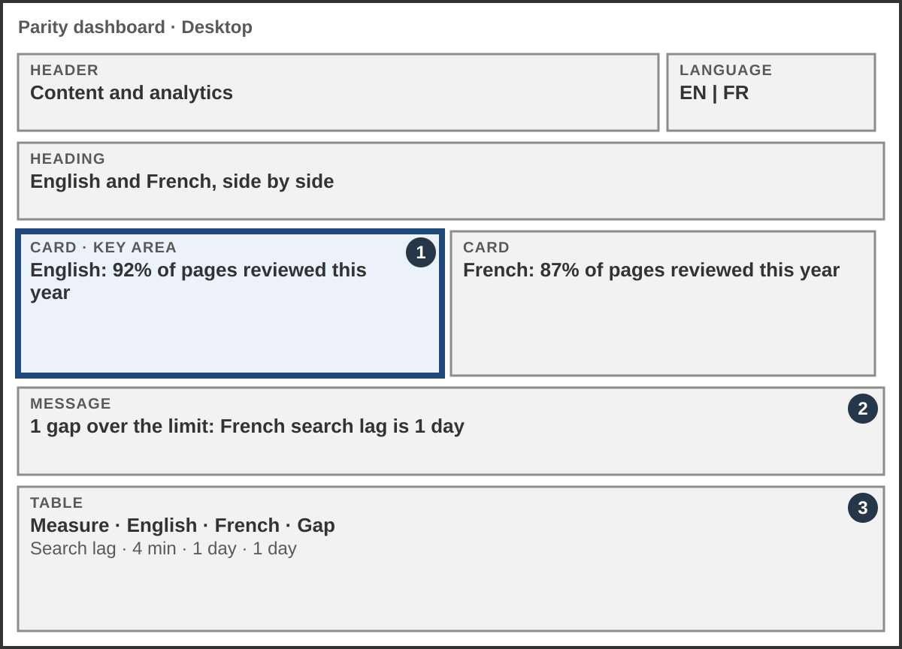
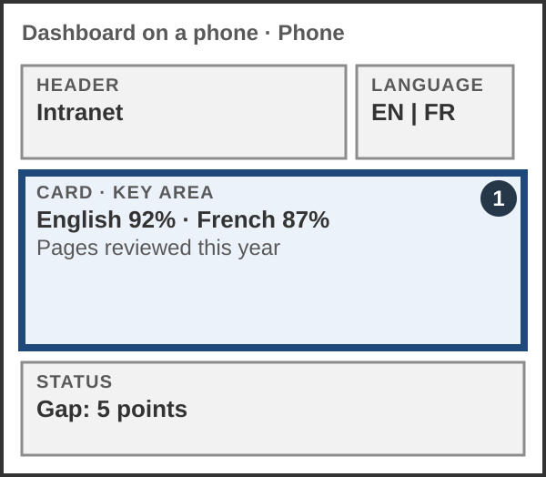
Pattern PAT-011: experience
An executive sees both languages and any gap on one page
Executives
A one-page view of both languages and the gap.
Communications
Which pages or terms cause a gap.
IT
Search and processing lag, per language.
Notes:
Journey map and mock-ups for PAT-011. The persona is an executive who opens the dashboard, compares the languages, spots a gap and asks an owner to act.
The solid line is the experience with the pattern. The dashed line is the experience without it: confidence drops at Spot a gap, because a single total hides the gap and the executive has to ask someone for the split.
The mock-ups show the same dashboard on a desktop and on a phone. Numbered markers point to the key area: The two language cards with the gap, the message when a gap is over its limit, and a table of measures with the gap for each.
The same dashboard serves Communications and IT with more detail. Sources: PAT-011 pattern page, journey map and mock-ups.

Slide 10
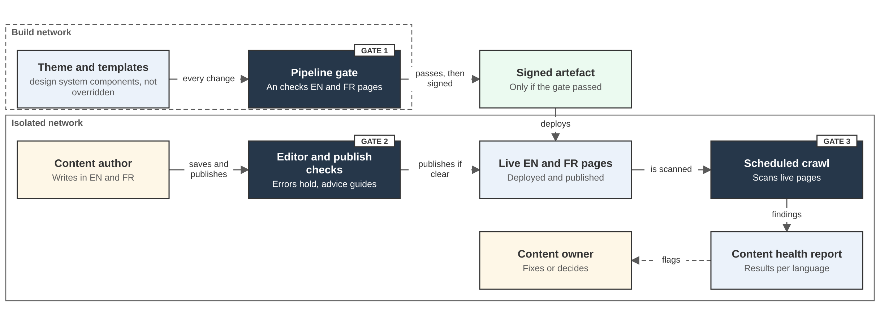
Pattern PAT-013
Accessibility is checked automatically where themes are built and where content is published
Build side: theme and template changes pass an automated gate, then a signed build is made. Authoring side: publishing checks hold errors and give advice, and a scheduled crawl checks live pages.
A person decides. A tool never removes live content.
Notes:
Pattern PAT-013, Check accessibility at every gate. It supports the business requirements point Trust it and principles P1 (accessible by default), P2 and P3 (automated). It applies a recorded decision.
The idea. Problems come from two places: code (themes, templates, components) and content (images, headings, links, documents, video). A check on only one misses half. So automated checks run at three points, and people test the rest.
Build side. Every change to a theme or template runs through a pipeline gate. The design system components are used, not overridden, and an accessibility checker scans English and French pages. Only a build that passes is signed and moved to the isolated network.
Content-authoring side. When an author saves or publishes, editor and publish checks hold errors and give plain advice. A scheduled crawl then scans the live English and French pages and reports per language. Each finding has an owner who fixes it or decides.
Guardrail. A tool never removes live content. A person decides. People, including those who use assistive technology, test what tools cannot.
Detail: The Solution Architecture, key patterns section, and the full pattern page.

Slide 11
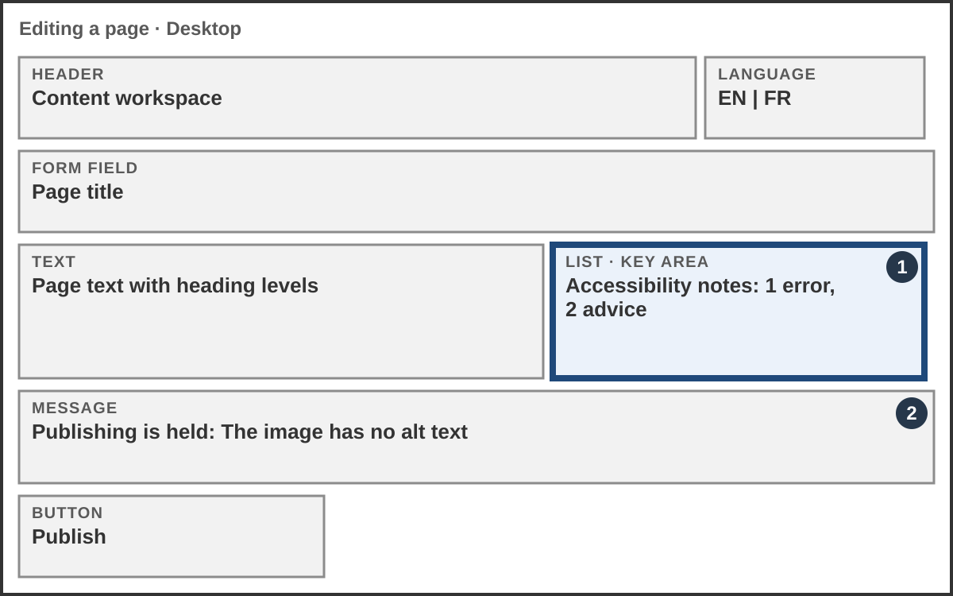
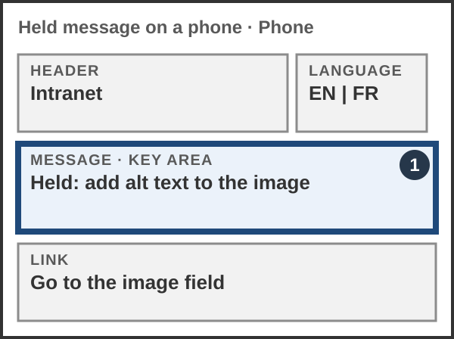
Pattern PAT-013: authoring
The author is told what to fix before publishing, in plain words
Errors hold publishing.
Advice does not.
The message says what to do and links to the field.
Same checks, English and French.
Notes:
Mock-ups for PAT-013 on the content-authoring side.
Desktop. The author edits a page. A list beside the form shows one error and two pieces of advice. A message says publishing is held because the image has no alternative text.
Phone. The same held message and a link that takes the author straight to the image field.
Design points. Errors hold publishing; advice does not. Messages are plain and say what to do. The same checks run for English and French pages, and results are kept as evidence.

Slide 12
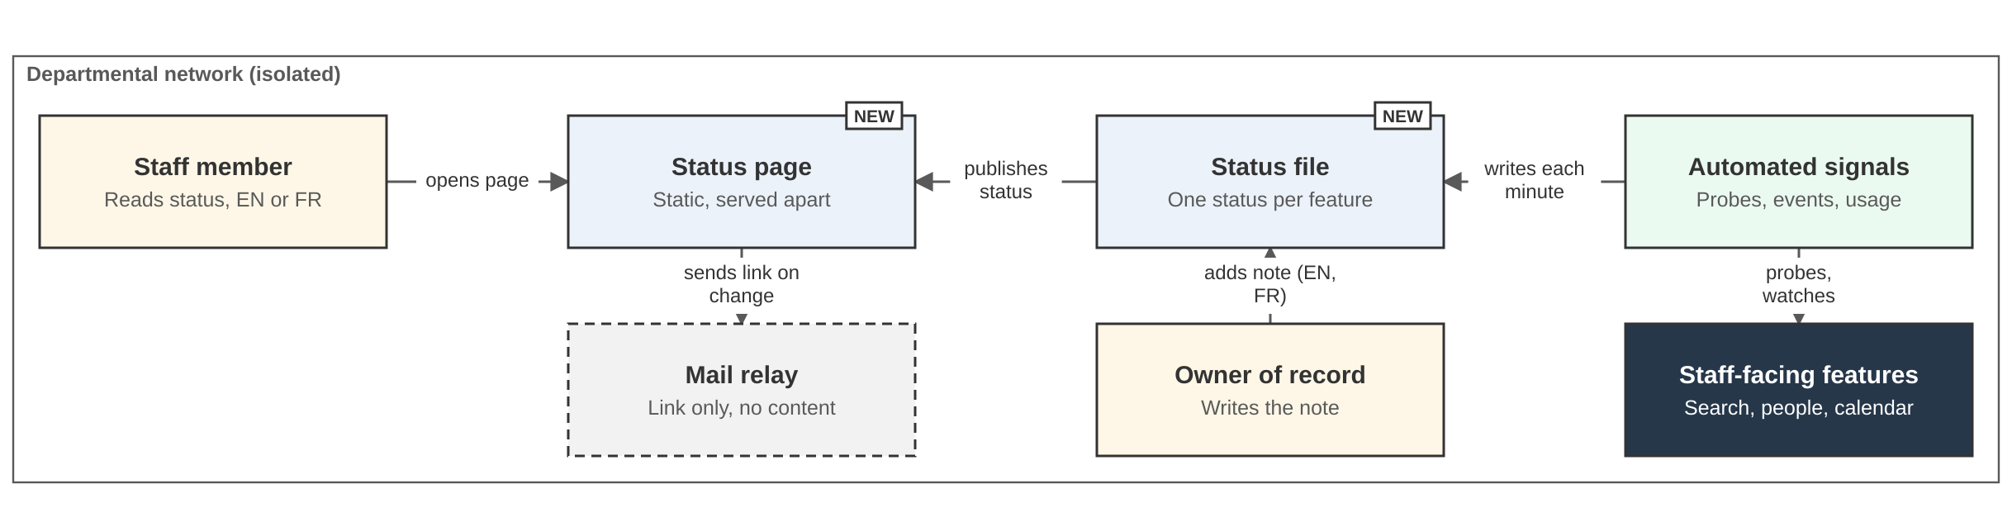
Pattern PAT-015
A status page, served apart from the site, shows staff what is working
Do: list each staff-facing feature in everyday words, with one status set by automated checks and a short note from a named owner, in English and French.
Do not: rely on a banner inside the site. It goes down with the site.
Notes:
Pattern PAT-015, Publish a status page. It shows how the transparency principle (P4) is applied to the system itself, so the product gives staff a view of its own status. It supports the business requirements points Trust it and Know what works.
The idea. Staff can see, on one page, whether each feature they use is working. The page lists features in everyday words and shows one status for each from a fixed set of values.
Reading the diagram. Automated signals (probes, events, usage) write a status file each minute. A named owner of record adds a short note in English and French. The status page is served separately from the main site, so it still loads when the site does not. A mail relay can send a link only, with no content.
What it avoids. A banner inside the main site goes down with the site, and help desk calls pile up without telling the next person anything.
Detail: The Solution Architecture, key patterns section, and the full pattern page.

Slide 13
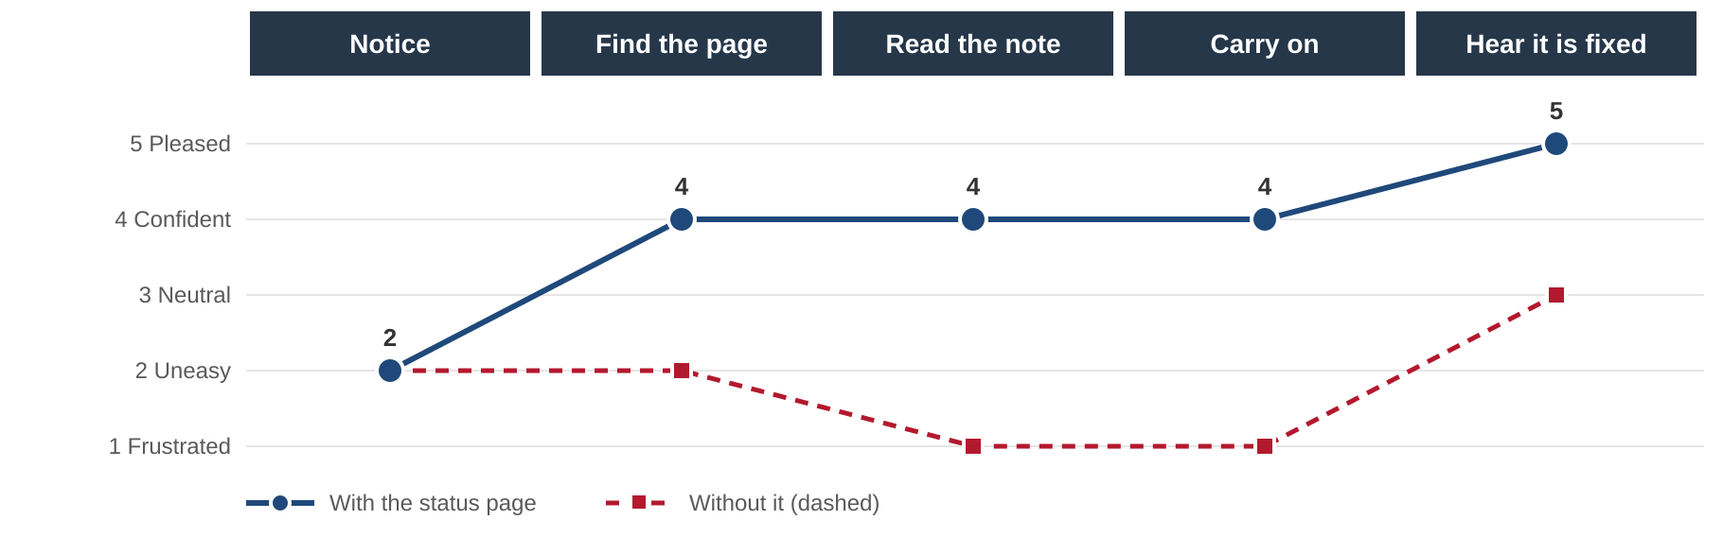
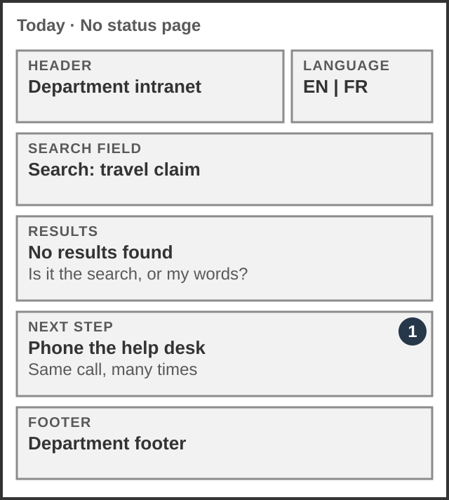
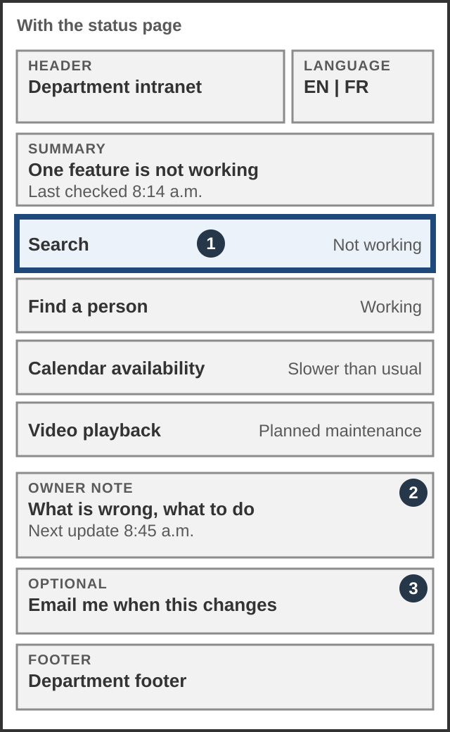
Pattern PAT-015: experience
Staff can tell whether it is them or the system, without calling the help desk
Today
No results, and no way to tell why. Staff call the help desk.
With the status page
One page, one status per feature, one note from an owner.
Notes:
Journey map and mock-ups for PAT-015. The persona is a staff member whose search stops working.
Without the pattern, they find no results and cannot tell whether the fault is the search or their own words, so they phone the help desk. With the pattern, they open the status page, read the note from the owner, carry on, and hear when it is fixed.
The mock-ups compare today with the status page on a phone. Search shows Not working, other features show Working, an owner note says what is wrong and what to do, and an optional notice can be requested.
Detail: The pattern page and the Solution Architecture, key patterns section.

Slide 14
Pattern PAT-015: suite of services
One page lists every feature, each with a word, a symbol and a 30-day history
Feature
Status
What it means for you
Past 30 days
Search
✕ Not working
Search is returning no results. We are looking into it. For now, browse the directory by topic. Next update 8:45 a.m.
Last 30 days: 29 days working, today not working
Find a person
✓ Working
No known problem.
Last 30 days: working every day
Calendar availability
▲ Slower than usual
Availability can be a few minutes old. Next update 9:30 a.m.
Last 30 days: 26 days working, 4 slower
Video playback
■ Planned maintenance
Planned maintenance on Sunday, 2 a.m. to 4 a.m.
Last 30 days: working every day
Usage reports
? Not known
We have not heard from the reporting check since 7:50 a.m. Numbers may be incomplete.
Last 30 days: working, but unknown since 7:50 a.m.
Status is never carried by colour alone: each status has a word, a symbol and a border style.
Example content, to show the concept. Not final wording.
Notes:
The status page as staff see it. Five features are shown as an example. This is the concept, not final content.
Each row has a feature in everyday words, one status from a fixed set of values, a plain note that says what it means for the reader and what to do, and a 30-day history.
The fixed set of values: Working, Slower than usual, Not working, Planned maintenance, Not known. Colour is never the only signal. Each status has a word, a symbol and a border style. Not known is shown when the automated check has not reported, so the page never guesses.
Examples in the picture. Search is not working, with a workaround and the time of the next update. Calendar availability is slower than usual. Video playback has planned maintenance. Usage reports are not known because the reporting check has been silent since 7:50 a.m.
Detail: The Solution Architecture, key patterns section.

Slide 15
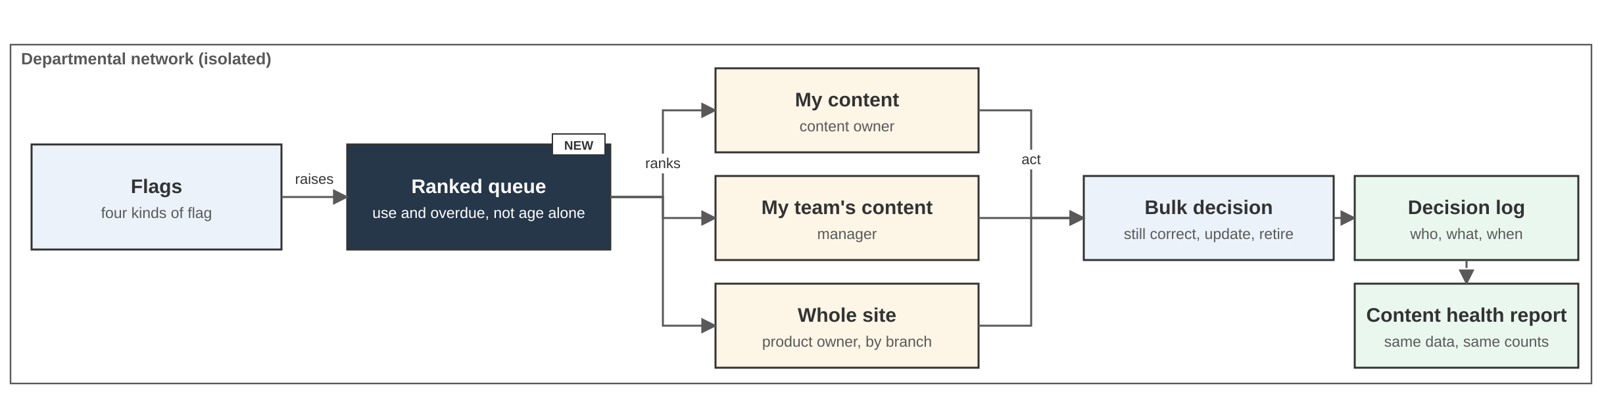
Pattern PAT-016
One ranked queue replaces a flood of emails, so owners can act in minutes
Do: give each person one ranked list of what is waiting on them, with bulk decisions, a preview and an undo.
Do not: send one message per flag. Every count opens the list behind it.
Notes:
Pattern PAT-016, Deliver one ranked queue. It supports the business requirements point Trust it and principles P3 (automated) and P4 (transparent). It is the people side of 'the system flags, people decide'.
The idea. Flags such as stale, no owner, orphan and failed search feed one ranked queue. Each person sees a view of the same data: owners see their own pages, managers see their team's, the product owner sees the whole site by branch. People apply one decision to many items at once, and every decision is logged. The content health report uses the same data.
Why it matters. A separate notification per flagged page is noise and people learn to ignore it. A long unranked list does the same. A ranked queue turns a pile of obligations into a short list of decisions, which is how content stays current and owned.
Ranking uses how many people use a page as well as how overdue it is, so a rarely read old page can wait. Notifications carry a link to the queue, not content (recorded decision).
Detail: The Solution Architecture, key patterns section.

Slide 16
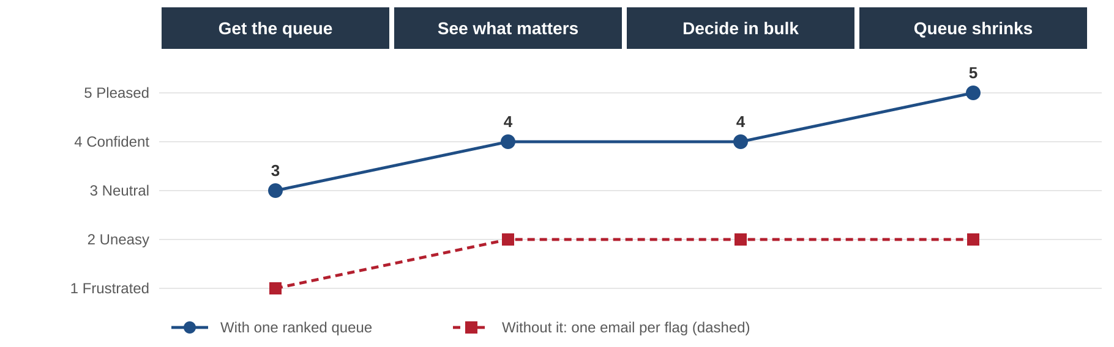
Pattern PAT-016: experience
An owner clears the queue in one sitting, and trust in the content grows
Owner
Decide to keep, update or retire.
Manager
Spot overloaded people or stalled piles.
Product owner
Direct effort to the largest problems.
Notes:
Journey map for PAT-016. The persona is a content owner. With one ranked queue they get the queue, see what matters, decide in bulk and watch the queue shrink; confidence rises from neutral to pleased. Without it, one email per flag leaves them uneasy and then frustrated.
Three views of the same data: owner (My content), manager (My team's content) and product owner (Whole site, by branch). Because they share data, there is no argument about the figures.
Detail: The Solution Architecture, key patterns section.

Slide 17
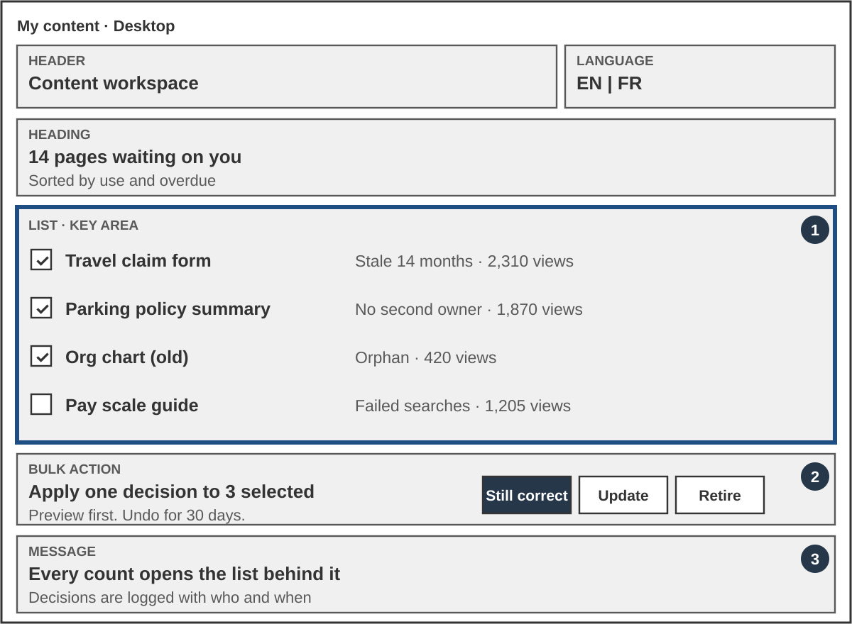
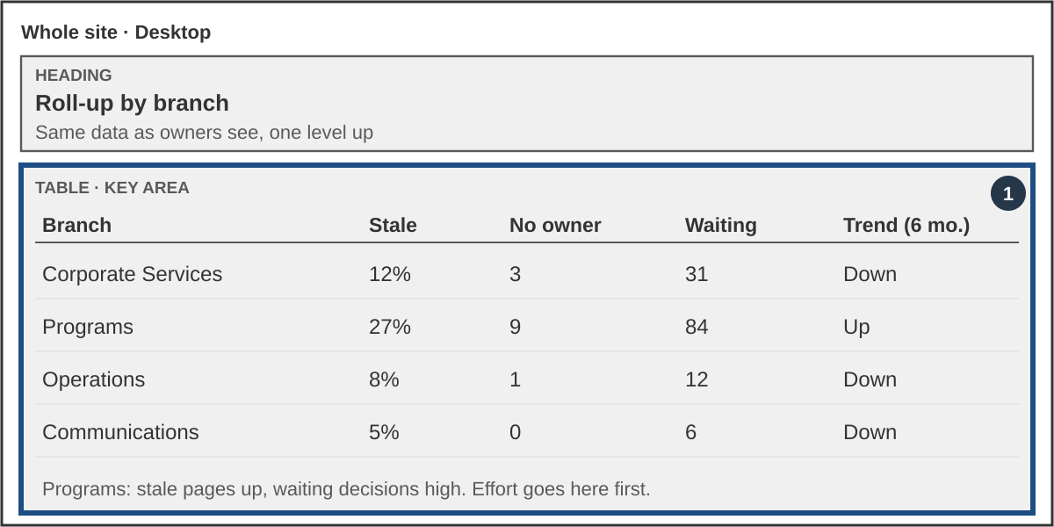
Pattern PAT-016: mock-ups
The owner sees a ranked list and decides in bulk; leaders see a roll-up by branch
Sample numbers. The same data serves owners, managers and the product owner. Every count opens the list behind it.
Notes:
Mock-ups for PAT-016, with sample numbers. Left: The owner queue. A ranked list of pages waiting on the owner, each with a tick box. Numbered markers point to the ranked list, the bulk action bar, and the message that every count opens the list behind it. A bar at the foot applies one decision (still correct, update, retire) to the selected rows after a preview, with an undo.
Right: The roll-up by branch, for managers and the product owner. Stale pages, pages with no owner, decisions waiting and the trend, per branch. In the example, one branch has rising stale pages and a long list of waiting decisions, so effort goes there first.
Same data, different level. Every count opens the list behind it.

Slide 18
Target state: logical architecture
The CMS is the one application; three services support it
Search: The search engine
Staff browser
Reverse proxy cache
CMS + design system
Analytics: The analytics tool
Data: database, cache, media
Team observability platform
One-way feeds out
Security platform: security events
Monitoring platform: health metrics
Unlike today, the platform is connected to security, monitoring and analytics. The site team also gets its own observability view.
Notes:
The logical architecture from the Solution Architecture, simplified for the board. The next slides show integrations and sizing.
How to read it. Staff browsers reach the CMS through a reverse proxy cache that serves stored page copies keyed by path, language and role, doing the job a CDN would do. The CMS is the one application: pages, workflow, translation, media and access control, with the design system theme. Three services support it.
Search: The search engine holds one bilingual index with language-specific fields, so French is handled as carefully as English. Analytics: self-hosted analytics, IP addresses anonymized, English and French counted separately. Data: A database for content and the people directory, the memory cache for cache, shared storage for files and video. Video is transcoded to four qualities by an transcoder, left off the picture for simplicity.
Today the intranet is not connected to a security, monitoring or analytics platform. In the target state all three are connected. The bottom row shows the two one-way feeds: security events to the security platform, operational health to monitoring (recorded decision). They now leave through the team observability platform, a small platform inside the secure zone that gives the site team its own dashboards and alerts (a recorded decision, proposed). The security feed carries identifying detail; the health feed carries none.
Design choices. The CMS is built full-stack, not headless (recorded decision). No CDN; layered caching does that job (recorded decision). The design system theme loads from a CDN by default, so every asset, font and icon is self-hosted.
Gaps to name. The diagram shows production; the pre-production alpha is a smaller subset with synthetic data. The calendar availability worker is a design choice whose phase is refined in delivery.
Sources: Solution Architecture sections 4 to 6; recorded decisions, a recorded decision; a recorded decision.

Slide 19
Target state: integrations
Six integrations, each kept small and bounded
The HR data service: nightly batch
The mail relay: review reminders
The intranet CMS
The identity provider: sign-on, roles
The records API: archive after approval
calendar availability: cached, timing refined in delivery
Streaming platform: playback link
Policy stays on its own site and is linked only.
Notes:
The integrations from the Solution Architecture, section 6. Inbound to the CMS on the left, outbound on the right. Each uses a simple, bounded pattern, so a change on the other side cannot break the intranet.
Inbound. (1) the HR data service (HR and contractor data): nightly batch into a people directory with a minimum set of work-contact fields; the directory keeps working if the source is down. A Privacy Impact Assessment is under way. (2) the identity provider: single sign-on with a standard sign-in protocol; roles come from dedicated security groups and are mapped at each sign-in; one break-glass administrator account exists. (3) calendar availability: A coarse status beside people (available, tentative, busy, out of office) read from the on-premises mail and calendar system, cached; the page never calls the mail and calendar system while rendering. Free/busy only; meeting subjects and out-of-office text are prohibited. The source is settled (recorded decision); when it ships is refined in delivery.
Outbound. (4) the mail relay: review reminders and report digests through the departmental mail relay; messages point to the page and carry no sensitive content. (5) the records API: when the owner and publisher approve a retirement, the CMS archives both language versions to the records system in an archival PDF format; the page is unpublished only after the records system confirms receipt. (6) Streaming platform: live events stay on the Communications platform; the intranet publishes the playback link only (recorded decision).
Not shown. The policy site is linked only. The business requirements also names ServicePlus, the legacy platform, Software Center and a replacement for the Learning Management System as optional integrations; none is designed yet and the existing batch and link patterns apply.
Sources: Solution Architecture section 6; recorded decisions, recorded decisions; recorded decisions, a recorded decision; the business requirements.

Slide 20
Target state: observability
The site team gets its own view, and both one-way feeds stay as they are
Secure zone: The site team owns the platform
Site parts
The CMS, the search engine, cache, the analytics tool
Local forwarder
Team observability platform
dashboards, alerts, runbooks
Health probes
separate host
Local copy is the record
Security stream
Health stream: metrics only
Two one-way feeds. Nothing flows back.
Security platform
Monitoring platform
Not a security platform: no second security platform. English and French are measured side by side, and a gap raises an alert.
Every alert has a runbook with a named owner. The platform needs a named owner before go-live.
Notes:
Observability means telling what a system is doing from the signals it gives out: logs (what happened), metrics (numbers over time) and, later, traces. The aim is plain: The site team sees a problem, in either language, before a user reports it. Decision: A recorded decision, proposed. It builds on a recorded decision.
Three lanes. Lane 1, the team (new): A small observability platform inside the secure zone. It stores logs and metrics, runs health probes from inside, and gives the site team dashboards and alerts. Lane 2: security events to the security platform, for the security operations centre. Lane 3: health metrics to the monitoring platform, for the network operations centre, with no names, addresses or request paths.
It is not a security platform. It does no detection that duplicates the security operations centre, and no second security platform is built. Nothing flows back: settings arrive only in the signed release.
Per language. Wherever a number can differ by language it is kept per language: page errors, page time, search index delay, searches with no results, and pages in one language only. A gap of more than 10 percent raises an alert. This is the operational half of the bilingual requirement.
Every alert has a runbook: one page with what it means, what to check, what to do and who to call, kept in Git with a named owner and a review date, and followed by someone who did not write it in each quarterly drill.
Constraint flag. Hosted observability and security services fail the on-premises constraint and are not allowed. Nothing may call home. Open items: A named owner for the platform (the same gap as platform administration), the one-way feed details (owner, protocol, running numbers, speed, status signal), and service-level targets. Proof is on staging, not the pre-production alpha. Service levels: 99.5 percent available in business hours, 95 percent of pages under 3 seconds, search delay under 15 minutes in each language, no more than 10 percent between languages, silence noticed within 15 minutes, local log copy kept 14 days, certificate warning at 60 days, daily backups, recovery point one week and recovery time one business day.
Sources: Solution Architecture section 13; a recorded decision; a recorded decision.

Slide 21
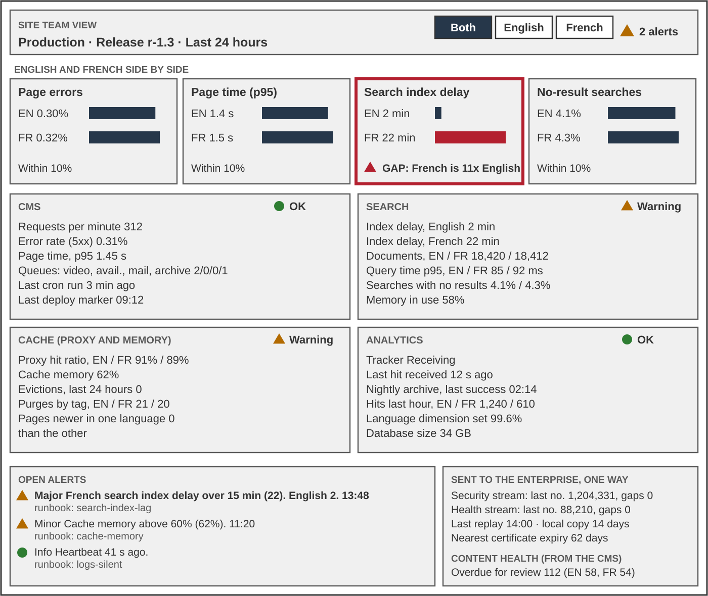
Observability: The site team's dashboard
English and French sit side by side, and every alert says what to do
Language first
English and French side by side. A gap over 10 percent raises an alert.
Alerts say what to do
Each links to a runbook with an owner.
Sample numbers, for illustration.
Notes:
Mock-up of the site team's own dashboard. Illustration only, with sample numbers. The vendor chooses the tool and designs the real screens against the outcomes in the Solution Architecture, section 13.
Language first. English and French are side by side at the top. In the example, French search index delay is 22 minutes against 2 in English, so a gap alert is open, while a combined number would look fine.
One panel per part: The CMS, the search engine, cache and the analytics tool, each with a text status, a few numbers and a trend. Status is always text plus a symbol, never colour alone (WCAG 2.1 criterion 1.4.1).
Alerts say what to do: every row links to a runbook with an owner.
The export is visible: The team can see that both streams are leaving and that no numbers are missing, without the enterprise reaching in.
Likely question: who owns it? The platform needs a named owner before go-live, which is the platform administration gap in the operating model.

Slide 22
Service levels
Service levels are transparent, measured on the platform and viewable by role
Measure | Service level
Availability | 99.5% in business hours
Page speed | 95% under 3 seconds, per language
Search delay | Under 15 minutes, per language
Language gap | No more than 10%
Silence noticed | Within 15 minutes
Local log copy | 14 days
Backups | Daily
Recovery point / time | One week / one business day
Transparent
Measured on the observability platform, per language.
Site team
Sees everything, live.
Owners and executives
Read-only view and trend.
Staff
Live status page (PAT-015).
Notes:
Service levels agreed for the first release. The site team watches the system in business hours, about 7 a.m. to 5 p.m.
Availability 99.5 percent in business hours. Page speed: 95 percent of pages in under 3 seconds, English and French separately. Search index delay under 15 minutes in each language. No more than 10 percent between English and French on any measure. A silent platform noticed within 15 minutes in business hours. Local log copy kept 14 days; after export the receiving platform owns what it received. Certificate warning 60 days before expiry. Daily backups. Recovery point one week. Recovery time one business day.
Transparency, kept simple for the first release. The numbers are measured on the team observability platform, and the right stakeholders view them there, read-only, by role. The site team sees everything live, per language. The business owner, the IT service owner and executives see the service levels and their trend. Staff see the live status of each feature on the status page (PAT-015), served apart from the site. Nothing is built in the CMS for this; a service level report in the CMS can follow in a later phase if wanted.
Read together. At 99.5 percent in business hours, allowed downtime is about 50 minutes a month. One major outage that uses the full one-business-day recovery time would exceed that. 99.5 percent is the target for normal running; the recovery time is the limit for a major failure.
Source: Solution Architecture section 13; a recorded decision.

Slide 23
Target state: sizing
Production needs 15 instances; all three environments total 33
Edge, storage
Reverse proxy ×2
4 vCPU, 16 GB
Shared storage
200 GB, video 2 TB
Three environments
Environment | Count | vCPU | RAM
Development | 7 | 13 | 38 GB
Staging | 11 | 27 | 70 GB
Production | 15 | 57 | 162 GB
Total | 33 | 97 | 270 GB
Application
The CMS ×2
4 vCPU, 8 GB
Transcode ×1
8 vCPU, 16 GB
The analytics tool ×1
2 vCPU, 4 GB
Data (VMs)
Database ×2
4 vCPU, 16 GB
The search engine ×2
4 vCPU, 8 GB
The memory cache ×1
2 vCPU, 4 GB
Analytics
The analytics database ×1
4 vCPU, 16 GB (VM)
Observability
Platform ×1
4 vCPU, 8 GB
Store ×1 (VM)
4 vCPU, 16 GB
Probes ×1
1 vCPU, 2 GB
Planning basis: 4,000 staff, about 22,000 page views a day, up to 200 people watching video at once. Sizes are per instance and are validated in load testing. Application parts run as containers; databases and the observability store run on virtual machines.
Notes:
The sizing from the Solution Architecture, section 8. It is a planning estimate for budgeting, to be validated in load and performance testing.
Planning basis. 4,000 staff, about 70 percent signing in on a working day, about 8 page views each, so about 22,000 page views a day. The busy hour carries about 20 percent of the day and bursts run 10 times the average. Video: about 100 hours added a year and up to 200 people watching recorded video at once. Live events are on the Communications platform and not counted.
Production, 15 instances: two reverse proxy caches, two the CMS, one transcode worker, two databases (primary and replica), one the memory cache, two the search engine, one the analytics tool application and one the analytics database, plus the team observability platform, its data store and a small health probe host. Shared storage: files 200 GB and video 2 TB. Totals: 57 vCPU, 162 GB RAM, 1.1 TB SSD, 2.2 TB shared. Two of most things gives resilience and patching without downtime. The transcode worker may need to double if a modern codec is accepted (recorded decision).
How parts are hosted. The application parts (proxy, the CMS, transcode, the search engine, the analytics tool and the observability platform) run as container instances (recorded decision). The databases and the observability data store run on virtual machines or servers, so their vCPU and RAM are the size of the host. The health probes run on their own small virtual machine. The observability sizes are planning estimates, because event volume is not yet measured; the data store is checked at design.
The constraint is the network, not the servers: 200 people at about 2 Mbps is roughly 400 Mbps leaving the proxy. Confirm the network can carry that to the regions before promising nation-wide playback.
Development is seven small single instances with synthetic data. Staging is eleven instances: production topology, not production scale, with real content and real connections. Neither carries production-scale video or caching, so load testing runs on production before go-live. Schedule it with time to act on the result. Dev and staging add about 70 percent more vCPU and about 65 percent more RAM on top of production. Development does not run the observability platform; staging does, because that is where it is proved.
Sources: Solution Architecture sections 8 and 8.2; a recorded decision; recorded decisions.

Slide 24
Target state: deployment
The alpha proves the least; staging builds the confidence
Alpha
Pre-production, short-lived
Shape of the solution with synthetic data. No real content or the records system.
Development
Isolated, permanent
Does the code work? Holds the build toolchain.
Staging
Isolated, permanent
Real data, real connections. The last gate.
Production
Isolated, permanent
Deploy-only. Load tests run here before go-live.
The same image moves up the path; only configuration differs. Staging holds real personal data, so it needs production-level accreditation. Staging availability is confirmed during delivery.
Notes:
This is a recorded decision. Four environments, in order. An environment should be described by what it can prove.
Alpha (pre-production network, short-lived, one and done under a recorded decision). Proves the shape of the solution: content model, taxonomy, editorial workflow, design system components, the bilingual gate and the authoring experience. No real content, no personal data, no the records system access, different scale, short life. The first release scope is not gated on what the alpha shows.
Development (isolated network). Where ongoing development happens after go-live. Holds source control, CI runners, registry and package mirrors. Seven instances (13 vCPU, 38 GB RAM).
Staging (isolated network). Production topology, not production scale. Real content, the real identity feed, the real the records system and the mail and calendar system. Eight instances (22 vCPU, 56 GB). This is where confidence is built.
Production (isolated network). Fifteen instances (57 vCPU, 162 GB). Nothing is built or changed here. Load and performance testing runs here before go-live.
Say out loud: (1) staging existence is the highest-value unknown (a recorded decision E1); if it cannot be provisioned, real-data validation moves into production. (2) Staging holds real personal data, so it needs production-level accreditation, access control and audit. (3) Single-instance staging does not prove failover.
How code gets there. A build on the low side produces signed container images with a manifest and checksums. They cross to the isolated network through a controlled, audited transfer owned by Security, and a pipeline deploys what was transferred. The same image is promoted through all three environments.
Sources: recorded decisions; a recorded decision; Solution Architecture section 8.2; Project Plan the work plan.

Slide 25
Target state: key decisions
Each major part traces to a recorded decision
Part | Decision | Status
CMS, a recorded decision | The CMS, full-stack, design system assets self-hosted | Accepted
Search, a recorded decision | The search engine, one bilingual index, per-language fields | Accepted
Analytics, a recorded decision | self-hosted analytics, IP anonymized, per language | Accepted
Speed, a recorded decision | No CDN; layered caching | Accepted
Hosting, a recorded decision | Container images are the unit of deployment | Proposed
Delivery, a recorded decision | Signed build on the low side, deploy-only on the high side | Accepted
Video, a recorded decision | Four renditions; an open-source player and a modern codec proposed | Part proposed
Archive, a recorded decision | Owner-approved retirement to the records system as an archival PDF format | Proposed
Observability, a recorded decision | Team platform in the secure zone; health per language | Proposed
Proposed decisions await EA confirmation. Live video stays on the Communications platform (recorded decision).
Notes:
Why these decisions. Each has a record with context, alternatives and consequences, so the board can test the reasoning.
A recorded decision the CMS, full-stack. Keeps the CMS's translation, workflow, caching and accessibility features. A decoupled front end would double the stack to accredit and patch, and make bilingual routing and accessible markup custom code. Rejected: decoupled the CMS, a Government of Canada the CMS distribution, WordPress, the legacy platform.
A recorded decision the search engine. Accepted by the EA on. English and French sit in one bilingual index with language-specific fields; separate indexes would be a justified exception only. Chosen for the deepest the CMS integration and existing team skills. OpenSearch is closed unless one of five named triggers fires. One live exposure: The written security position on the CMS-level access filtering for search (F3) is carried as an accepted position.
A recorded decision the analytics tool. Open source, runs on our infrastructure, other federal departments use it, and it supports the custom dimensions that freshness and ownership reporting need.
A recorded decision No CDN. Layered caching instead: The CMS render cache in the memory cache, a reverse proxy cache, long-lived static assets. Purge is by tag and per language.
A recorded decision Containers (proposed). The image is the unit of deployment. Fallback if no accredited container platform exists: virtual machines with configuration management.
A recorded decision Signed artefacts built on the low side and deployed on the high side. Production is deploy-only.
A recorded decision / 008 / 010 Video. Four renditions with adaptive streaming. An open-source player proposed as the player. A recorded decision proposes a modern codec with an a widely supported codec fallback in place of an older codec: A modern codec plays in current browsers, is royalty-free and needs roughly 20 to 30 percent less network. The client asked for an older codec and a newer codec by name, so confirm the need.
A recorded decision the records system archive as an archival PDF format (proposed). Every content type needs an archive rendering that converts cleanly, so this is a content model constraint. The call is made through the records API.

Slide 26
Target state: security
Identity, logging and patching are built for an isolated network
Sign-on
A standard sign-in protocol to the identity provider.
Roles
From dedicated security groups, mapped at each sign-in.
Logon
Follows department policy.
Logging
Two one-way feeds, fed by a team observability platform.
Patching
Split watch: security operations and the IT platform owner.
Supply chain
Internal mirrors, signed artefacts, bill of materials proposed.
Controls follow the government security control profile. Formal categorization comes from the threat and risk assessment.
Notes:
Six points from the Security Architecture decisions (a recorded decision to 008; all accepted except a recorded decision, which is proposed).
Sign-on (recorded decision). A standard sign-in protocol to the identity provider using the CMS a standard sign-in protocol module. SAML is not implemented. The CMS's own login is blocked except for one break-glass administrator limited to the management subnet. An the identity provider outage blocks all access, which is why the break-glass account exists.
Roles (recorded decision). The CMS roles come from small dedicated security groups created for the intranet: author per branch, reviewer, publisher and admin. Mapped at every sign-in, so a membership change takes effect at the next login. No role is assigned by hand.
Logon (recorded decision). Logon follows department policy, and sign-on is carried from that logon. Administrative actions and role changes go to the security platform, with alerts on break-glass use and production configuration change. The Security Authority confirms the position at accreditation.
Logging (recorded decision). Two separate one-way feeds through approved controls. The security feed carries identifying detail to the security platform; the operational feed carries only metrics and state to network operations. Cleansing happens at the source. This closes the current-state gap.
Patching (recorded decision). Nothing inside the isolated network will say that an update exists. Security operations watches the operating system, base image, PHP, database, the search engine and web server. The IT platform owner watches the CMS, contributed modules and the analytics tool. The enterprise patch standard sets timing; the transfer path is rehearsed. The platform owner role needs to be resourced for the life of the system (see risks).
Supply chain. Internal Composer, npm and OS mirrors; signed artefacts with manifest and checksums; no cloud build runners; update checks and telemetry disabled. A software bill of materials, an offline advisory snapshot and named component owners are proposed (recorded decision).
Dependency: The certificate authority and secret store are being modernized during the build; the intranet inherits that schedule (recorded decision).

Slide 27
Consultation
Six groups to consult as the design is finalized
Group | What we will consult on
IT Security | Accreditation path and the search access position
Privacy, ATIP | Privacy review of the directory, including calendar status
Records | The records API format, file numbers, hold and redaction
mail and calendar team | Rights and limits for reading calendar status
Communications | Unfilled roles; the two the business requirements items to define
Network, Dept IT | Video capacity, staging, container platform
Consultation continues as the design is refined throughout delivery.
Notes:
What this slide is. It lists who will be consulted and on what, so the board can see the design is tested with the teams who own the dependencies. Consultations have not been held yet; add dates once sessions are booked.
IT Security. The accreditation path, including staging, which holds real personal data (a recorded decision E2). The written position on whether the CMS-level access filtering is acceptable for search (F3 in a recorded decision). Confirmation of the logon position at accreditation.
Privacy and ATIP. A Privacy Impact Assessment for the people directory, which holds personal information about employees and contractors; the minimum field set (recorded decision) is a proposed input. It also covers the calendar status shown beside people (recorded decision). The applicable Personal Information Bank is to confirm.
Records (Information Management). The format the records system accepts through the records API, whether file numbers are needed, and requirements for litigation hold, sequestering and redaction.
The mail and calendar system (Messaging team). Service account rights and limits on how often the intranet may ask for calendar status, agreed before build.
Communications. The four unfilled roles, and a definition with a benefits measure for the two the business requirements items still to be defined: one-stop-shop, and social collaboration and gamification.
Network and Dept IT. Network capacity for video to the regions, staging, the container platform, and who owns the package mirrors.
Sources: recorded decisions; recorded decisions; a recorded decision; Solution Architecture section 13.

Slide 28
Operating model (proposed)
A small team of hypothetical roles keeps the platform healthy after go-live
Work to be done | Hypothetical role | Impact if not secured
Publish and engage | Content manager; bilingual authors | Pages go stale; owners are not onboarded
Taxonomy and design | Taxonomy steward; designer | Terms drift; search and menus harder to use
Measure | Analytics lead; the analytics tool owner | Reports exist; nobody acts on them
Build and change | Two CMS developers | Cannot change or patch safely
Run and patch | Platform administrator (a gap) | Unpatched software; no one owns observability
Proposed, not confirmed. Roles are hypothetical and based on anticipated resources.
Accountable: The business owner for content; the IT service owner for the platform.
Notes:
Proposed, not confirmed. The roles below are hypothetical, based on the anticipated resources in the project plan. They describe the work that has to be done once the intranet is live. They are not approved posts.
Service model. The IT web team provides the site as a service. Communications uses it to serve clients and staff. The aim is a site that stays fresh through automated lifecycle and disposition workflows, without heavy manual oversight.
Accountability. Two existing management roles carry it: The business owner for content, and the IT service owner for the platform.
Hypothetical roles, anticipated resources. Nine positions are anticipated: six in Communications and three in IT development. None is in place today and the staffing target is the staffing target date. Five are needed before that date, two of them in the second week of the project, when the content architecture workshops run.
Gap. Day-to-day platform administration (patching the CMS, the search engine, cache and containers, backups, monitoring, and owning the team observability platform and its runbooks) has no home in the anticipated positions. It needs a new post or named capacity from IT operations (change request a change request).
Taxonomy and accessibility. The link is indirect. Without a taxonomy steward, category and label terms drift, English and French terms fall out of step, and search and menus get harder to use. People who rely on screen readers or magnification depend on search and clear navigation more than most. The direct accessibility work sits with the designer, the content authors and the automated checks (PAT-013).
Impact if not secured. Taxonomy decisions are made by people who will not live with them. Pages go stale and unowned. Analytics exist but nobody acts on them. The department cannot change or safely patch what it has. On an isolated network nothing refreshes itself, so unpatched software becomes an accreditation problem.
Sources: Project Plan section 7 and risk R8; operating model (CONOPS); Solution Architecture section 11.

Slide 29
Risks
The risk is sustained resourcing, not technology
Platform ownership
A named owner who patches the CMS, the analytics tool and the mirrors every cycle.
CMS skills
Developers who can change and support it, long after the vendor leaves.
The platform stays healthy only if the organization resources it for its whole life, beyond the project phase.
Nine departmental posts are targeted for the staffing target date and assessed high risk.
Four key roles are still unfilled.
Stewardship roles
Taxonomy, design system and analytics roles stay filled.
Owners with time
Content owners keep their pages current, release after release.
Notes:
The board will see this as the main risk. The technology is chosen, documented and open source. What decides whether the intranet stays healthy is whether the organization resources it for its whole life, not just through the project.
Platform ownership. The team observability platform (recorded decision) also needs a named owner before go-live. On an isolated network nothing refreshes itself, and nothing inside will say that an update exists. Someone has to watch the CMS and the analytics tool advisories, raise transfer requests, keep the internal package mirrors current and rehearse the emergency patch path (recorded decisions, a recorded decision). The patching duty for the search service and the mirror refresh cadence are assigned in delivery. The enterprise patch standard applies, so this is a standing duty, not a project task.
CMS skills. After go-live all development happens on the high side (recorded decision), with cleared staff. The two CMS developers posts are not yet filled, so knowledge transfer from the vendor is a named deliverable. Without those skills the department cannot change or safely patch what it has, which is where the current platform is today.
Taxonomy and accessibility. The link is indirect. Without a taxonomy steward, category and label terms drift, English and French terms fall out of step, and search and menus get harder to use. People who rely on screen readers or magnification depend on search and clear navigation more than most. The direct accessibility work sits with the designer, the content authors and the automated checks (PAT-013).
Stewardship roles. Taxonomy and IA Steward, Design System Steward, analytics platform owner and Digital Analytics Lead are not filled. The UX post is also at risk in a change request.
Owners with time. Every page has a named owner (recorded decision), and the measures depend on owners acting on what they see. If owner capacity is squeezed, the department pays the migration cost and gets stale content again.
Staffing facts. Nine departmental posts are targeted for the staffing target date and the target is assessed high risk. Four roles are unfilled and needed before the alpha can be accepted.
What to ask the board. Endorse the architecture with the expectation that resourcing throughout the product lifecycle is committed by the department, and name the sponsor accountable for it.
Sources: Project Plan section 7 and risk R8; recorded decisions; a recorded decision; Solution Architecture sections 8 and 11.

Slide 30
Assessment
The design is sound; resourcing throughout the product lifecycle is not yet committed
Area | Result | Basis
Accessible, bilingual | By design | Checked in build and after publishing
Security | Conforms | Logon follows department policy
Enterprise data | Reuse | Consumes enterprise reference data
Decisions | 19 recorded | 11 accepted; 8 proposed and agreed throughout delivery
Resourcing throughout product lifecycle | Not committed | Owners and skills beyond the project
Decision requested
Endorse the target-state architecture and its constraints.
Detail is refined throughout delivery.
Notes:
Assessment, in the board's terms, using only what the records support.
Accessible and bilingual: by design, proof to come. WCAG 2.1 AA is pass/fail, with automated accessibility checkers in the build, scheduled crawls of live English and French pages, and a manual audit before go-live. The accessibility standard is the stated target with a conformance report and remediation log. Parity is measured per language. The proof arrives at milestone M6.
Security: conforms. Logon follows department policy, and the Security Authority confirms the position at accreditation. The written position on search access control (F3 in a recorded decision) is carried as accepted.
Enterprise data: reuse. The intranet consumes enterprise reference data as appropriate; its shared taxonomy and reporting data can be reused by other business cases.
Decisions: 19 are recorded in the decision log: 11 accepted and 8 proposed. The proposed ones are a recorded decision, 009, 010 (with 008), 011, 013, 014, 016 to 018 and 019, and are agreed throughout delivery.
Resourcing throughout the product lifecycle: not committed. This is the main risk (previous slide). The architecture is sound but needs named owners, funded for the whole life of the product, for platform patching, CMS skills, the stewardship roles and content owners beyond the project phase.
Decision requested. Endorse the target-state architecture and its constraints. The architecture is a point-in-time proposal; detail is refined throughout delivery. The EA confirms the exact wording of the ask, and whether the board is asked to endorse conditionally on lifecycle resourcing.
Sources: Solution Architecture sections 9 to 13; Architecture, Project and Security decision records.

