Slide 1
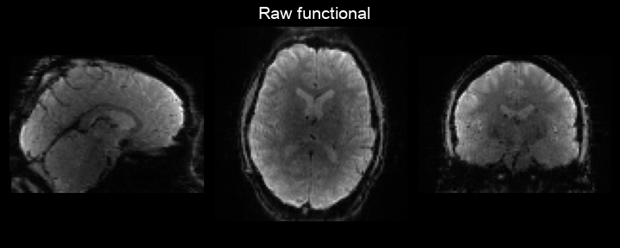
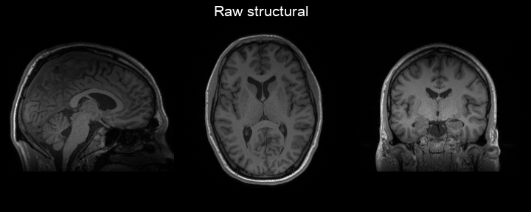
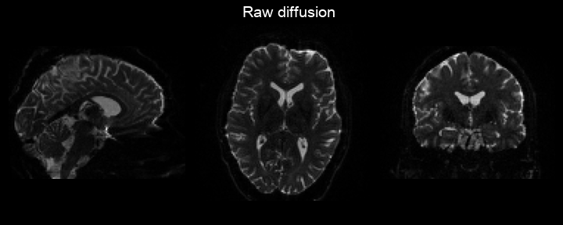
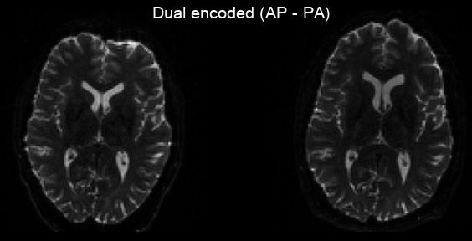
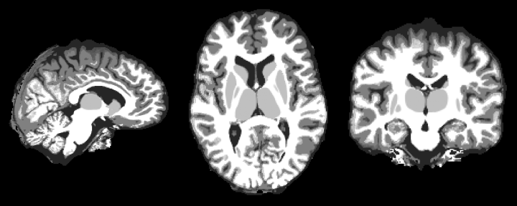
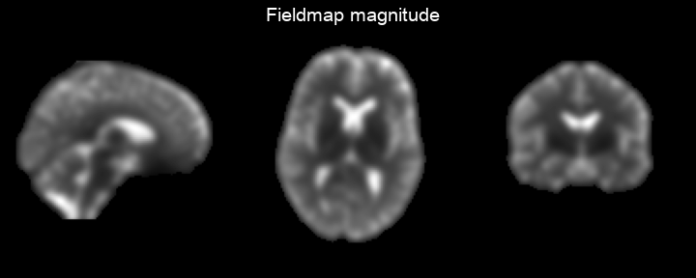

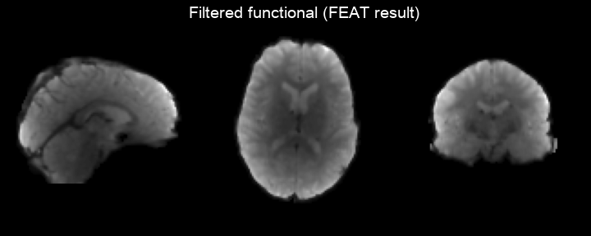
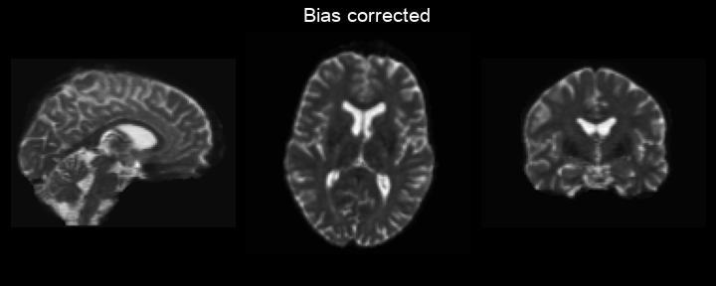
PyPrep – Automated preprocessing
fsl_anat
TopUp
Preprocessing
FEAT
Functional
Functional
Diffusion
MNI to highres field (warp) file.
5TT gen
(WM mask)
Apply warp
SubjectsAtlas
Linear registration

Slide 2
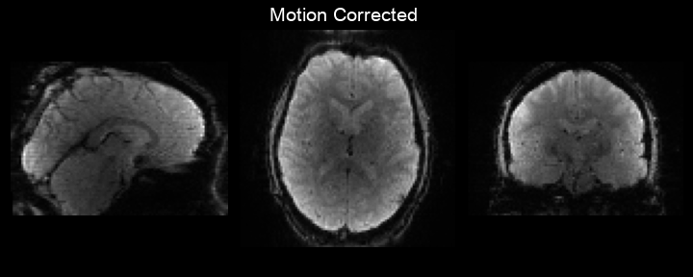
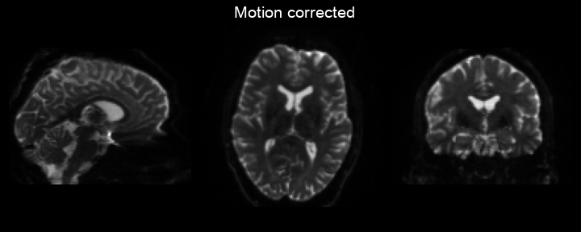
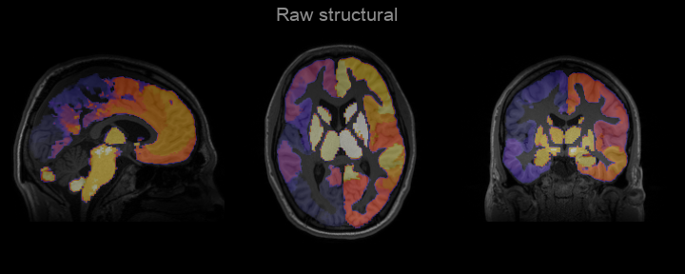
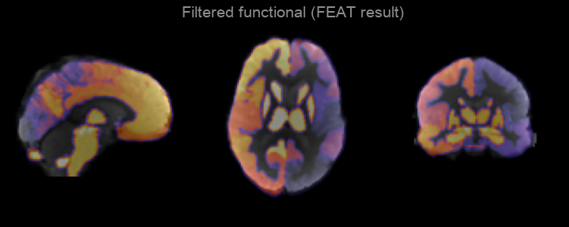
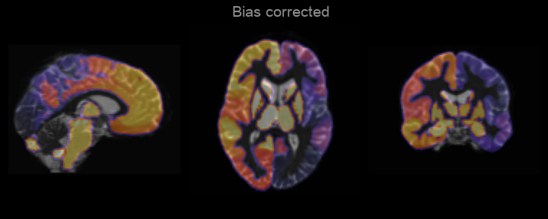
PyPrep – Automated preprocessing
fsl_anat
TopUp
Preprocessing
FEAT
Functional
Functional
Diffusion
MNI to highres field (warp) file.
5TT gen
(WM mask)
Apply warp
SubjectsAtlas
Linear registration

Slide 3
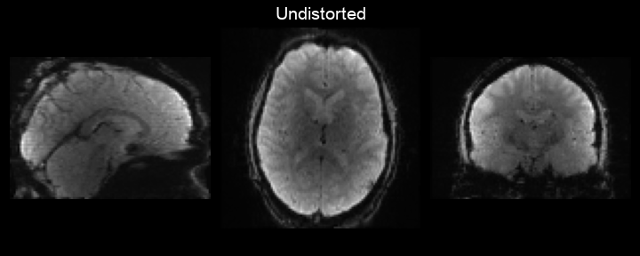
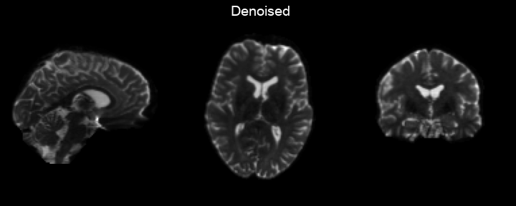
PyPrep – Automated preprocessing
fsl_anat
TopUp
Preprocessing
FEAT
Functional
Functional
Diffusion
MNI to highres field (warp) file.
5TT gen
(WM mask)
Apply warp
SubjectsAtlas
Linear registration

Slide 4

PyPrep – Automated preprocessing
fsl_anat
TopUp
Preprocessing
FEAT
Functional
Functional
Diffusion
MNI to highres field (warp) file.
5TT gen
(WM mask)
Apply warp
SubjectsAtlas
Linear registration

Slide 5

PyPrep – Automated preprocessing
fsl_anat
TopUp
Preprocessing
FEAT
Functional
Functional
Diffusion
MNI to highres field (warp) file.
5TT gen
(WM mask)
Apply warp
SubjectsAtlas
Linear registration

Slide 6
PyPrep – Automated preprocessing
fsl_anat
TopUp
Preprocessing
FEAT
Functional
Functional
Diffusion
MNI to highres field (warp) file.
5TT gen
(WM mask)
Apply warp
SubjectsAtlas
Linear registration

