Slide 1
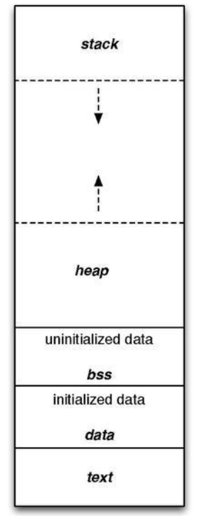
Program Structure

Slide 2
The Call Stack
A stack is a data structure that stores data values contiguously in memory.
Unlike an array, acces is done in a LIFO manner.
Temporary storage area in RAM that allows quick store/retrieve.
The current top of the stack is always pointed at by %rsp.
The stack grows downwards, from higher to lower memory.
Storing and fetching can be done using push/pop
Increasing/decreasing %rsp, and reading/writing to the stack
But also, this can be done directly
Using sub/add and mov

Slide 3
The Call Stack
push $0x3
pop %rax
%rax = ?? (garbage)
0xffffffc8
%rsp

Slide 4
The Call Stack
push $0x3
pop %rax
%rax = ?? (garbage)
0xffffffc8
0x3
0xffffffc0
%rsp

Slide 5
The Call Stack
push $0x3
pop %rax
%rax = 0x3
0xffffffc8
%rsp
0x3
0xffffffc0

Slide 6
Motivation
What’s the difference between “goto”s (jumps) and functions?
Abstraction
Memory
I.e: when we call a function, we know that the program will return to the place where we called from.
How does this “magic” happen?
We utilize the stack!

Slide 7
Transferring control via call/ret
Call/return are used to transfer control between functions
The “call” instruction takes one operand - function address.
Pushes return address to the stack, and then jumps to callee address.
The “ret” instruction pops the return address from the stack into %rip

Slide 8
Transferring control via call/ret
0000000000401106 <main>:
401106: call 40110c <f>
40110b: ret
000000000040110c <f>:
40110c: call 401112 <g>
401111: ret
0000000000401112 <g>:
401112: ret
0xffffffc8
%rsp

Slide 9
Transferring control via call/ret
0000000000401106 <main>:
401106: call 40110c <f>
40110b: ret
000000000040110c <f>:
40110c: call 401112 <g>
401111: ret
0000000000401112 <g>:
401112: ret
0xffffffc8
0x40110b
0xffffffc0
%rsp

Slide 10
Transferring control via call/ret
0000000000401106 <main>:
401106: call 40110c <f>
40110b: ret
000000000040110c <f>:
40110c: call 401112 <g>
401111: ret
0000000000401112 <g>:
401112: ret
0xffffffc8
0x40110b
0xffffffc0
0x401111
%rsp
0xffffffb8

Slide 11
Transferring control via call/ret
0000000000401106 <main>:
401106: call 40110c <f>
40110b: ret
000000000040110c <f>:
40110c: call 401112 <g>
401111: ret
0000000000401112 <g>:
401112: ret
0xffffffc8
0x40110b
0xffffffc0
%rsp
0x401111
0xffffffb8

Slide 12
Transferring control via call/ret
0000000000401106 <main>:
401106: call 40110c <f>
40110b: ret
000000000040110c <f>:
40110c: call 401112 <g>
401111: ret
0000000000401112 <g>:
401112: ret
0xffffffc8
%rsp
0x40110b
0xffffffc0
0x401111
0xffffffb8

Slide 13
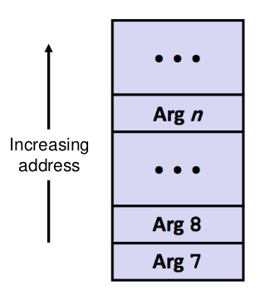
Function Calling Conventions
To set up for a call, the caller puts the first six arguments into registers
%rdi, %rsi, %rdx, %rcx, %r8, %r9
the rest are passed through the stack, in a reverse order
Return value is passed by %rax
Caller-saved registers (volatile):
%rax, %rdi, %rsi, %rdx, %rcx, %r8, %r9, %r10, %r11
Callee-saved registers (non-volatile):
%rsp, %rbp, %rbx, %r12, %r13, %r14, %r15
Important to remember when calling library functions

Slide 14
The Frame Pointer
To manage a variable-size stack frame, we’ll use %rbp as a frame pointer
Stores the value of the stack pointer in the beginning of a the procedure
I.e: points to the base of the frame
Using %rbp we can access the return address and function arguments
Two main purposes:
If we’ll make an error managing %rsp we can always recover its value as it was when the procedure started.
Makes “freeing” space used in the procedure much easier

Slide 15
The Frame Pointer - Cont.
Usually, the structure of our functions will be along the line of:
push %rbp # save base register of last frame
mov %rsp, %rbp # set up new base
# …
mov %rbp, %rsp # restore stack frame to “free” local variables
pop %rbp # restore old frame pointer
ret

Slide 16
The Frame Pointer - Cont.
<main>:
# …
40110a: call func
40110f: incq %rax
# …
<func>:
401113: pushq %rbp
401114: movq %rsp, %rbp
# ….
401417: movq %rbp, %rsp
40141a: popq %rbp
40141b: ret
0xffffff00
%rbp
0xfffffdc8
%rsp

Slide 17
The Frame Pointer - Cont.
<main>:
# …
40110a: call func
40110f: incq %rax
# …
<func>:
401113: pushq %rbp
401114: movq %rsp, %rbp
# ….
401417: movq %rbp, %rsp
40141a: popq %rbp
40141b: ret
0xffffff00
%rbp
0xfffffdc8
0x40110f
%rsp
0xfffffdc0

Slide 18
The Frame Pointer - Cont.
<main>:
# …
40110a: call func
40110f: incq %rax
# …
<func>:
401113: pushq %rbp
401114: movq %rsp, %rbp
# ….
401417: movq %rbp, %rsp
40141a: popq %rbp
40141b: ret
0xffffff00
%rbp
0xfffffdc8
0x40110f
0xfffffdc0
0xfffffdb8
0xffffff00
%rsp

Slide 19
The Frame Pointer - Cont.
<main>:
# …
40110a: call func
40110f: incq %rax
# …
<func>:
401113: pushq %rbp
401114: movq %rsp, %rbp
# ….
401417: movq %rbp, %rsp
40141a: popq %rbp
40141b: ret
0xffffff00
0xfffffdc8
0x40110f
0xfffffdc0
0xfffffdb8
0xffffff00
%rsp,%rbp

Slide 20
The Frame Pointer - Cont.
<main>:
# …
40110a: call func
40110f: incq %rax
# …
<func>:
401113: pushq %rbp
401114: movq %rsp, %rbp
# ….
401417: movq %rbp, %rsp
40141a: popq %rbp
40141b: ret
0xffffff00
0xfffffdc8
0x40110f
0xfffffdc0
0xfffffdb8
0xffffff00
%rbp
0xfffffa00
%rsp

Slide 21
The Frame Pointer - Cont.
<main>:
# …
40110a: call func
40110f: incq %rax
# …
<func>:
401113: pushq %rbp
401114: movq %rsp, %rbp
# ….
401417: movq %rbp, %rsp
40141a: popq %rbp
40141b: ret
0xffffff00
0xfffffdc8
0x40110f
0xfffffdc0
0xfffffdb8
0xffffff00
%rbp, %rsp
0xfffffa00

Slide 22
The Frame Pointer - Cont.
<main>:
# …
40110a: call func
40110f: incq %rax
# …
<func>:
401113: pushq %rbp
401114: movq %rsp, %rbp
# ….
401417: movq %rbp, %rsp
40141a: popq %rbp
40141b: ret
0xffffff00
%rbp
0xfffffdc8
0x40110f
%rsp
0xfffffdc0
0xfffffdb8
0xffffff00
0xfffffa00

Slide 23
The Frame Pointer - Cont.
<main>:
# …
40110a: call func
40110f: incq %rax
# …
<func>:
401113: pushq %rbp
401114: movq %rsp, %rbp
# ….
401417: movq %rbp, %rsp
40141a: popq %rbp
40141b: ret
0xffffff00
%rbp
0xfffffdc8
%rsp
0x40110f
0xfffffdc0
0xfffffdb8
0xffffff00
0xfffffa00

Slide 24
Stack Alignment
Another important part of our calling convention is stack alignment!
When calling a function, we need to make sure that %rsp is 16 bytes aligned
Two main reasons:
Some instructions (e.g printf and scanf) assume address alignment, and we’d like functions to be able to store data on the stack.
Performance.
Usually less important when calling functions written by you (using instructions we learned thus far), but can cause annoying bugs.
Also, this means that forgetting to set up a stack frame can be very dangerous!

Slide 25

GDB

Slide 26
GDB
GNU Project debugger
First written in 1986 by Richard Stallman
Free, open source software released under GNU General Public License
Allows to see what is going on inside another program while it executes
Four main functionalities
Starting programs, and interacting with them
Making them stop on specified conditions
Examining what happened, when program stops
Changing things in the program on runtime

Slide 27
GEF
GDB is indeed a very strong tool
However, its interface is fairly outdated
In order to achieve a better experience, we can use plugins!
Specifically, GEF: https://github.com/hugsy/gef

Slide 28
Compiling programs for GDB
Normally, we compile programs the following way:
gcc [flags] <source file> -o <output file>
Adding “-g” option as a flag enables built-in debugging support
gcc [flags] -g <source file> -o <output file>
This flag instructs the compiler to add debugging symbols
Helps the debugger interpret assembly relative to program
Very important in order to achieve the best debugging experience.

Slide 29

GDB Shell
Gdb is a command line tool, and once opened it pops an interactive shell
Recalls history with arrows, auto-completes with TAB
This means, all interaction with debugger is in command form.
Typing “help [command]” gives a nice description in case of confusion.
Also, GDB allows to use our (normal) shell without leaving the debugger
“shell [command]” or “![command]” will run commands as usual.

Slide 30
Running Programs
To run the program, simply use “run” (or “r”)
If no serious problem, the program will run fine
If there are issues, then gdb will present useful info about the crash
We’ll be able to utilize commands to investigate further
We can also specify command line arguments and redirect i/o
“run arg1 arg2 … argn”
“run < input.txt > output.txt”
In fact, GDB allows us to control many aspects of program’s environment

Slide 31
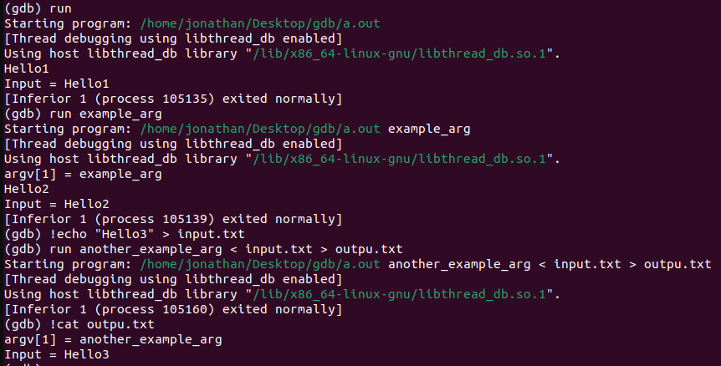
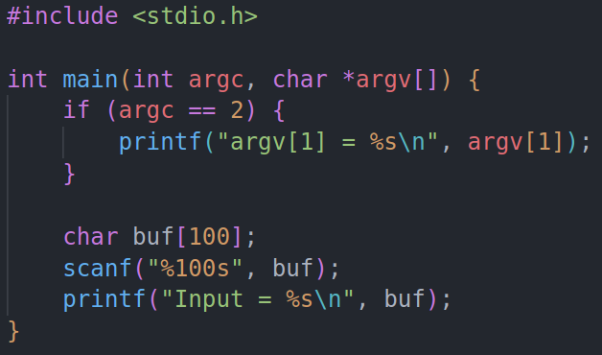
Running Programs

Slide 32
GDB commands
A GDB command is a single line of input.
Starts with a command name, followed by arguments
E.g: “help help”
We can abbreviate a gdb command to the first few letters of the command name, if that abbreviation is unambiguous.
For example, “s” instead of “step”
Add comments using #

Slide 33
GDB breakpoints
Used to stop the program at a designated point
“break [target]” or “b [target]”
Target can either be a line in the code, function or address
“break file1.c:6”, “break my_func”, “break *0x11111111”, “break *func+offset”
Depends whether there are debugging or any symbols.
Delete by using “del [break point number]”
“Info breakpoints” or “i b” for details

Slide 34
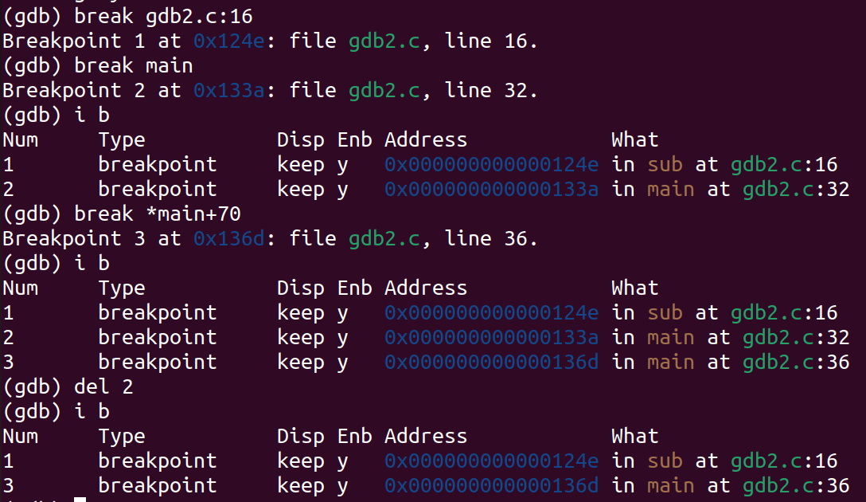
GDB breakpoints

Slide 35
Stepping through program
After setting up breakpoint, run the program again
If the program reaches there, it’ll stop
Proceed to the next breakpoint using “continue” or “c”
We can also skip the next N break points with “c [N]”
Step through the program
“step” / ”s” - proceed till program reaches a different source line
“stepi” / ”si” - proceed one instruction
Can also be given integer argument

Slide 36
Stepping through program
Similarly to step/stepi there’s also “next” / ”nexti”
Doesn’t go inside sub-routines
If you want a higher-level look of the function, use “disas” command
gives us a disassembly of the function
“disas [func-name]”

Slide 37
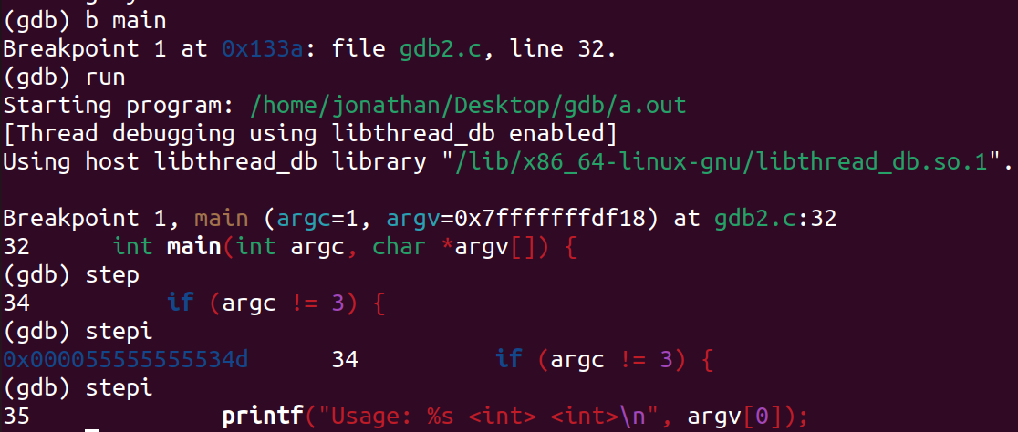
Stepping through program

Slide 38
Examining Registers
Refer to machine register contents with names starting with “$”
e.g : “$rax”
“info registers” to see names and values of all registers (except vector)
We can also alter values of registers using “set” command
“set $rcx += 4”

Slide 39
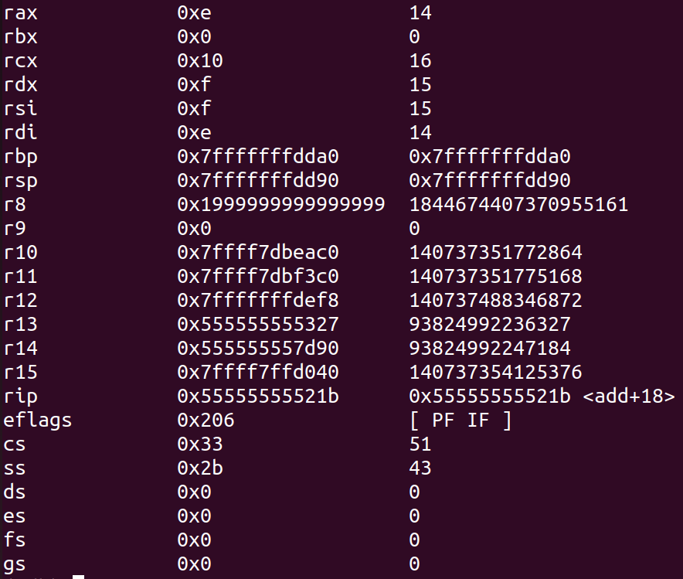
Examining Registers

Slide 40
Examining Program Stack
Program stack can tell us a lot about execution
When a program stops - we want to know how it got where it is!
GDB provides us many tools to examine the program stack
“frame [N]” or “f [N]” to look at the Nth frame on the stack
And “info frame [N]” or “i f [N]” to get more details
“backtrace [N]” to print a backtrace of the innermost N frames of the stack
If executable has debugging symbols we can do even more!
“info args" and “info locals” to print variables and arguments

Slide 41
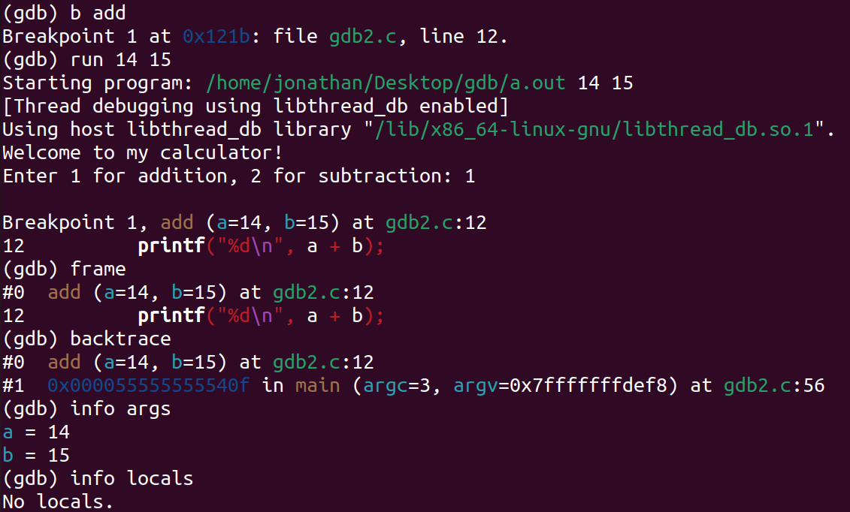
Examining Program Stack

Slide 42
Examining Memory
We can examine memory using “x/nfu addr”
n,f,u are optional parameters
Specify how much memory to display and how to format it
n - repeat count, f - format, u - unit size
addr is an expression giving the address we want to inspect
Example: “x/3uh 0x54320” = display 3 halfwords formatted as unsigned integers..
There are many format letters, most self explanatory
Some are more interesting than other

Slide 43
Format Letters
The available format letters are: “x, d, u, o, t, a, c, f, s, r” and “i”
“x” - format as hexadecimal
“t” - format as binary integer
“a” - print as both absolute hexadecimal address and offset from nearest symbol.
“s” - regard as string, if possible
“i” - print data as machine instructions (assembly)

Slide 44
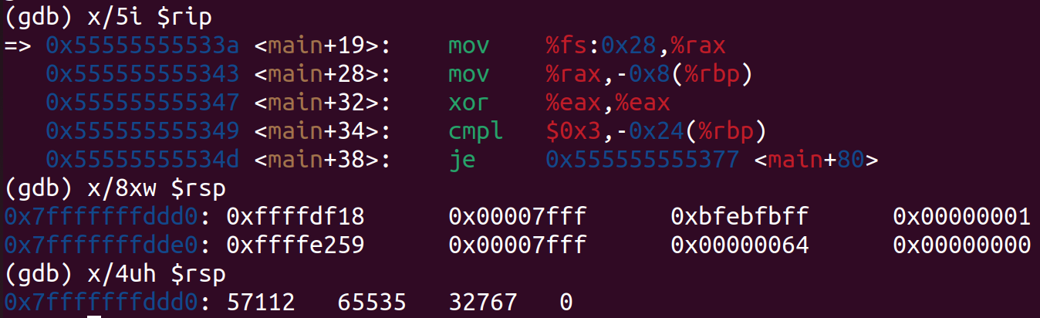
Example

