Slide 1


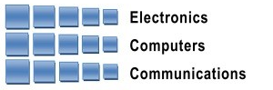
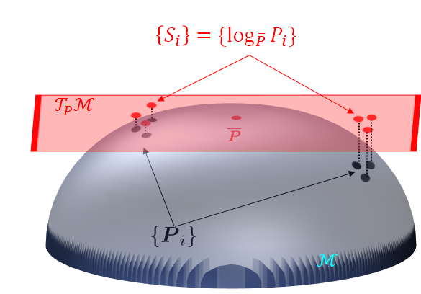
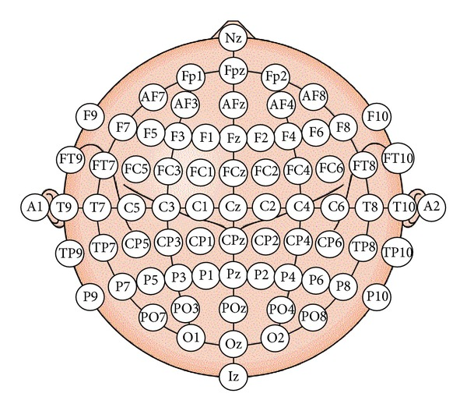
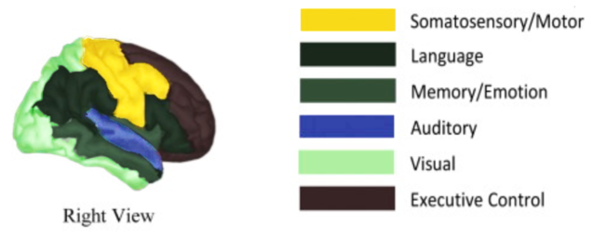
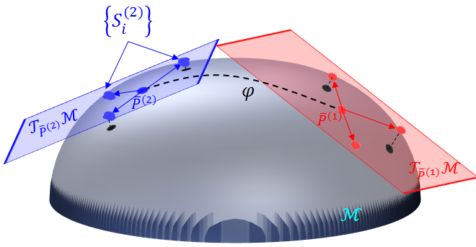
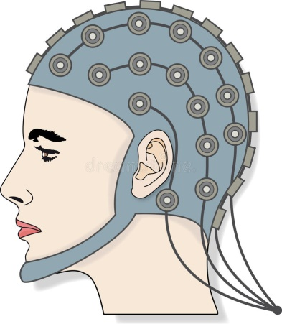
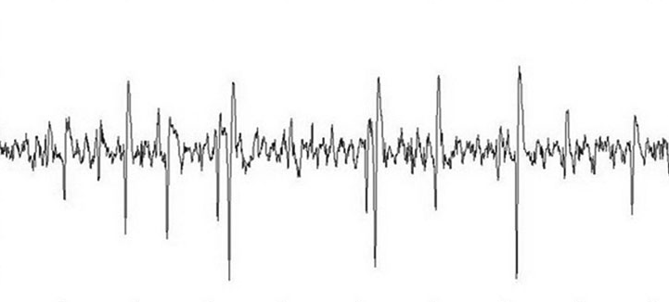

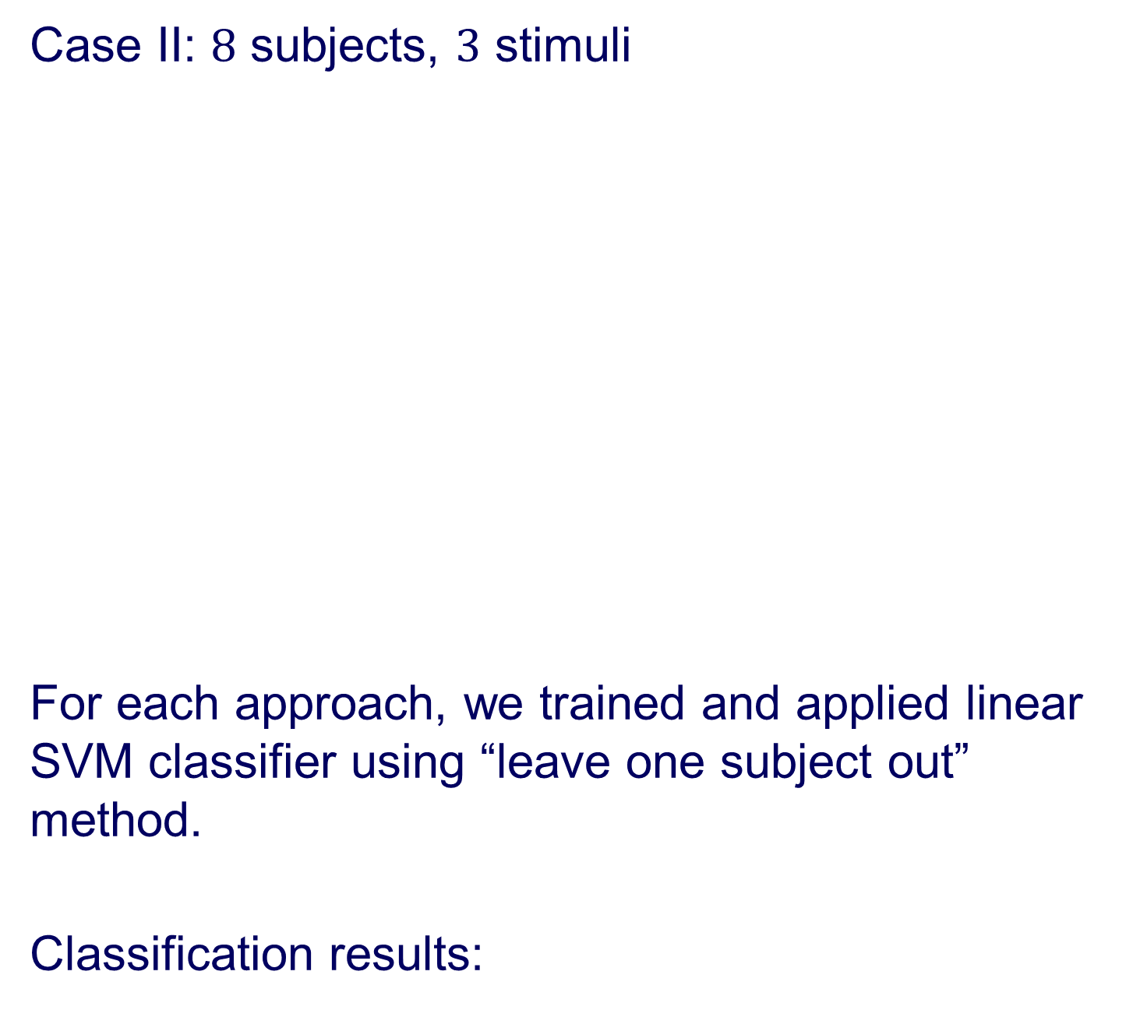
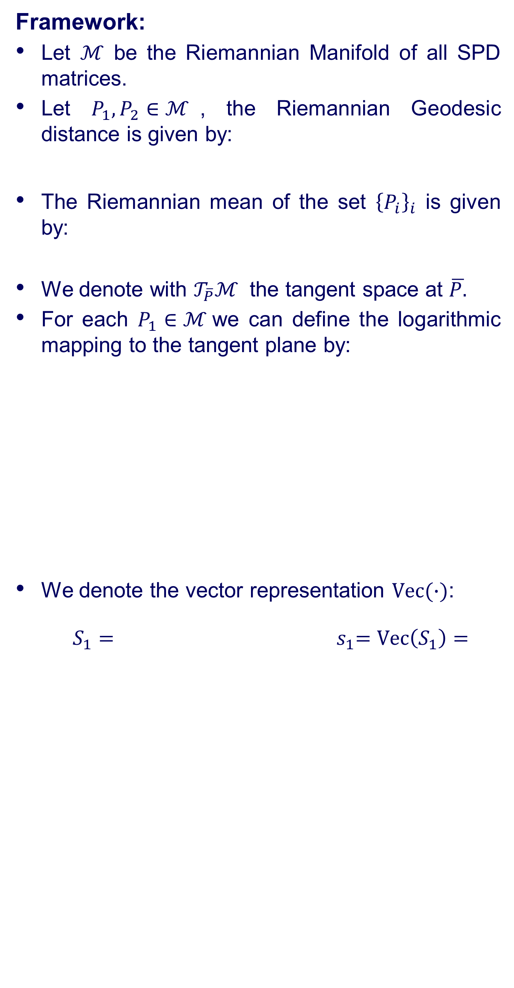


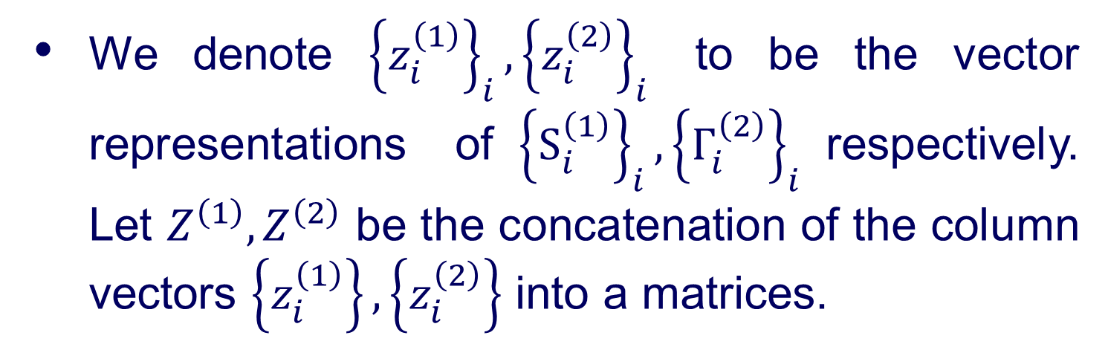





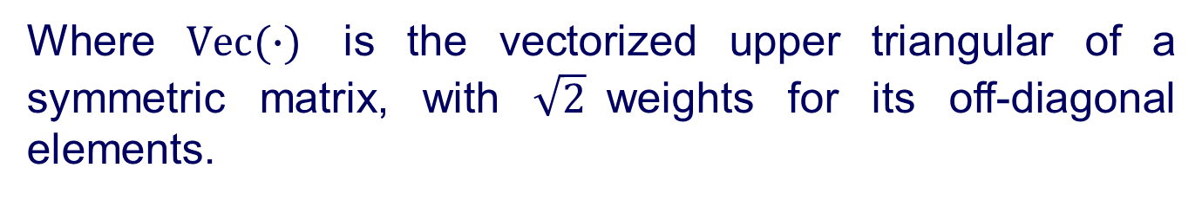


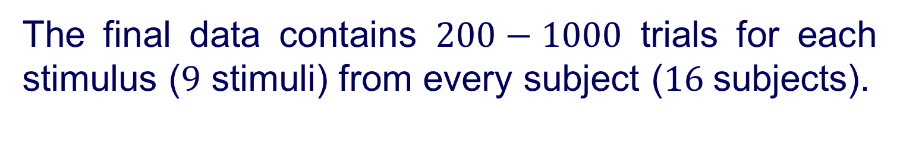


Andrew and Erna Viterbi
Faculty of Electrical Engineering
Signal and Image Processing Lab
Estimating Brain Activation Patterns from EEG Data
Gal Maman, Supervised by Or Yair
Introduction
Riemannian Geometry
Results
Problem:
Popular modalities for brain imaging are not always feasible or available at early stages of the illness.
Goal:
A system that can be applied at the bedside of critically-ill patients, detect neurological injury, aid in guiding therapy and improve outcomes.
Solution:
Research brain activity using EEG monitoring:
Measures voltage fluctuations resulting from ionic current within the neurons of the brain.
Noninvasive, with the electrodes placed along the scalp.
Framework:
Let $ℳ$ be the Riemannian Manifold of all SPD matrices.
Let $P_{1},P_{2}∈ℳ$, the Riemannian Geodesic distance is given by:
The Riemannian mean of the set ${\left\{P_{i}\right\}}_{i}$ is given by:
We denote with $𝒯_{\overline{P}}ℳ$ the tangent space at $\overline{P.}$
For each $P_{1}∈ℳ$we can define the logarithmic mapping to the tangent plane by:
We denote the vector representation $Vec(∙)$:
$S_{1}=$ ${ s}_{1}=Vec\left(S_{1}\right)=$
Previous (baseline) work – projecting all SPD matrices to$𝒯_{\overline{P}}ℳ$where$\overline{P}$ is the Riemannian mean of the entire dataset.
Our algorithm holds for any SPD matrix, in our implementation we used covariance matrices as features.
$$δ_{R}\left(P_{1},P_{2}\right)≜{\left\|\log\left({P_{1}}^{−1}P_{2}\right)\right\|}_{F}$$
Low dimensional representation:
We present the first 2 principle components (PCA)
Case I: $2$ subjects, $3$ stimuli
$$\overline{P}≜arg\min_{P}{\sum_{i}{δ_{R}^{2}(P,P_{i})}}$$
$$S_{1}={Log}_{\overline{P}}P_{1}{≜\overline{P}}^{\frac{1}{2}}\log\left({\overline{P}}^{−\frac{1}{2}}P_{1}{\overline{P}}^{−\frac{1}{2}}\right){\overline{P}}^{\frac{1}{2}}$$
Objectives
$${\left\|S_{1}−S_{2}\right\|}_{F}\tilde{=} δ_{R}(P_{1},{ P}_{2})$$
Case II: $8$ subjects, $3$ stimuli
For each approach, we trained and applied linear SVM classifier using “leave one subject out” method.
Classification results:
Stimulus classification bases on EEG recording
Raw Data
Where $Vec(∙)$ is the vectorized upper triangular of a symmetric matrix, with $\sqrt{2}$weights for its off-diagonal elements.
$11$healthy volunteers ranged in age from $7$ to $16$years.
$5$ critically-ill patients ranged in age from $2.5$ to $16$years; all with various brain injuries.
The stretchable electrode cap contained $64$EEG electrodes.
The set-up consists of three types of stimuli: somatosensory, auditory and visual.
Parallel Transport (PT)
Let ${\overline{P}}^{\left(1\right)}$and ${\overline{P}}^{\left(2\right)}$ be the Riemannian means of subsets ${\left\{P_{i}^{\left(1\right)}\right\}}_{i}$ and ${\left\{P_{i}^{\left(2\right)}\right\}}_{i}$ .
Compute ${\left\{S_{i}^{\left(2\right)}\right\}}_{i}$, where $S_{i}^{\left(2\right)}={Log}_{{\overline{P}}^{\left(2\right)}}\left(P_{i}^{\left(2\right)}\right)$
Compute ${\left\{Γ_{i}^{\left(2\right)}\right\}}_{i}$ the PT of ${\left\{S_{i}^{\left(2\right)}\right\}}_{i}$ along the geodesic path $φ$ between ${\overline{P}}^{\left(1\right)}$ and ${\overline{P}}^{(2)}:$
$$Γ_{i}^{(2)}=E S_{i}^{(2)}E^{T}$$
$$E≜{\left({\overline{P}}^{\left(1\right)} {\left({\overline{P}}^{(2)}\right)}^{−1}\right)}^{\frac{1}{2}}$$
The final data contains $200−1000$ trials for each stimulus ($9$ stimuli) from every subject ($16$subjects).
System Diagram
We denote ${\left\{z_{i}^{\left(1\right)}\right\}}_{i},{\left\{z_{i}^{\left(2\right)}\right\}}_{i}$ to be the vector representations of${\left\{S_{i}^{\left(1\right)}\right\}}_{i},{\left\{Γ_{i}^{\left(2\right)}\right\}}_{i}$respectively. Let $Z^{\left(1\right)},Z^{\left(2\right)}$ be the concatenation of the column vectors $\left\{z_{i}^{\left(1\right)}\right\},\left\{z_{i}^{\left(2\right)}\right\}$ into a matrices.
$$⋮$$
$$⋮$$
Rotation Using PCA
compute $U^{(1)},U^{(2)}$, the left singular vectors of $Z^{(1)},Z^{(2)}$.
Compute and substitute:
$∀j:u_{j}^{\left(2\right)}←sign\left(\left\langle u_{j}^{\left(1\right)},u_{j}^{\left(2\right)}\right\rangle \right)u_{j}^{\left(2\right)}$
where $u_{j}^{\left(i\right)}$ is the $j$th column of $U^{\left(i\right)}$.
Rotate the subsets by:
${ Y}^{\left(i\right)}={\left(U^{\left(i\right)}\right)}^{T}Z^{\left(i\right)}, i=1,2$
Preprocessing:
BP filter
Down sampling
Disqualify trials and reject noisy electrodes
Features extraction: SPD matrices
Features processing
Classification
Conclusions
Somatosensory
We managed to obtain improved classification performance using PT and rotation, especially with stimuli from different functional areas.
Auditory
Visual
In collaboration with Dr. Danny Eitan
July 2018

