Slide 1


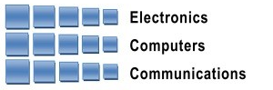
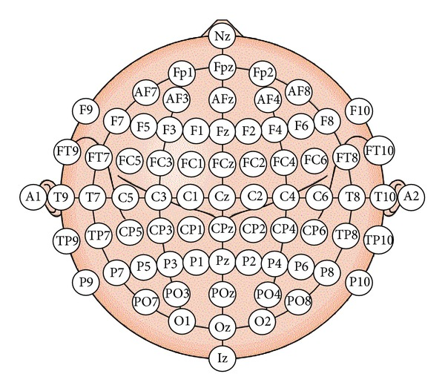
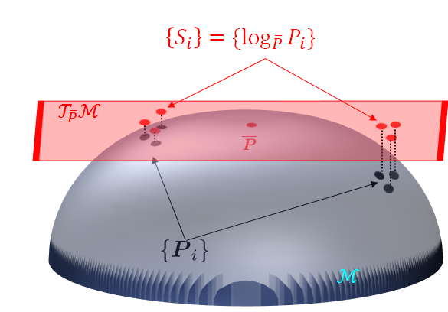
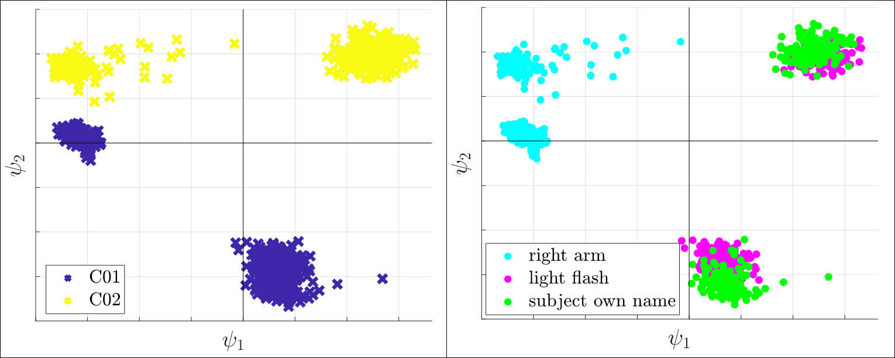
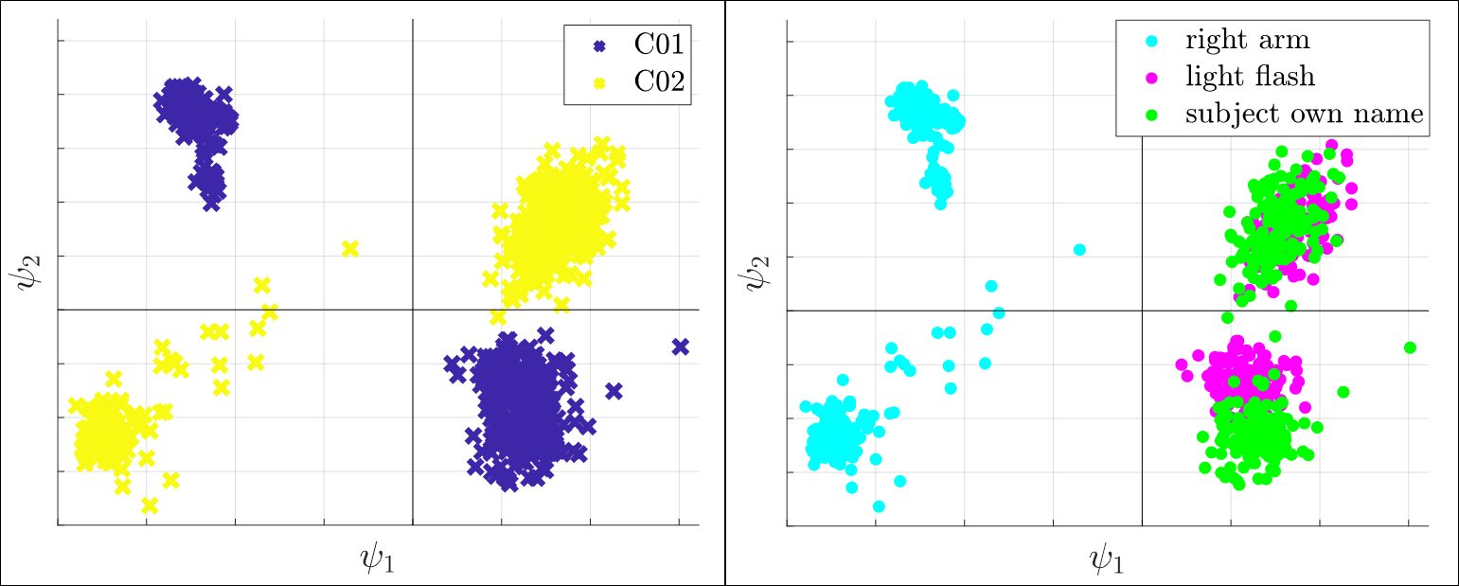
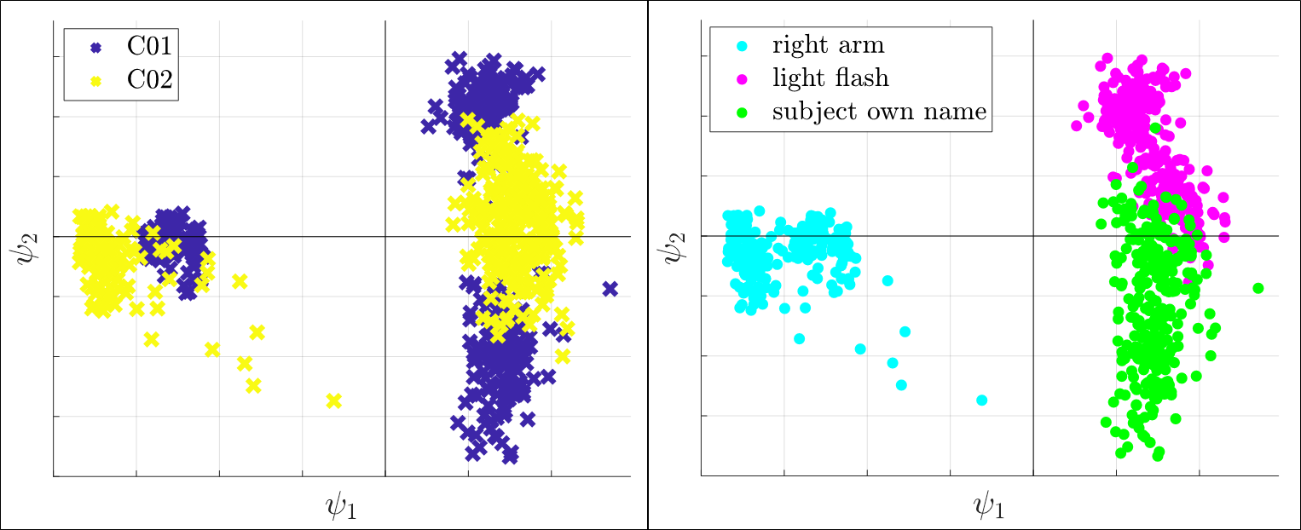
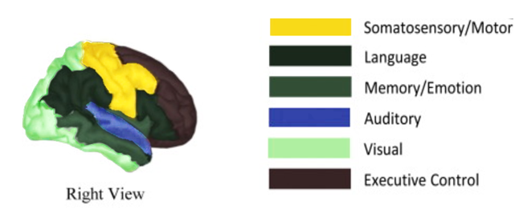
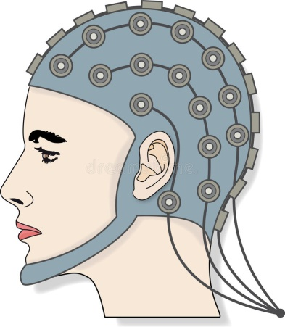
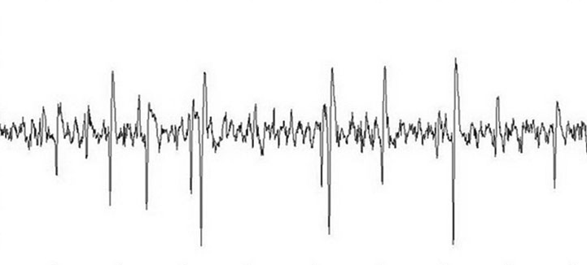
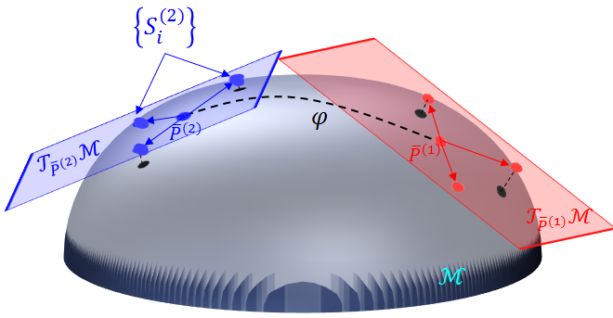
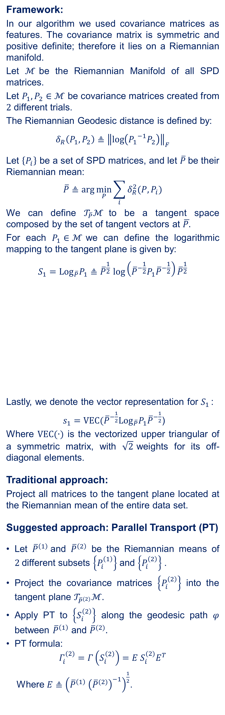
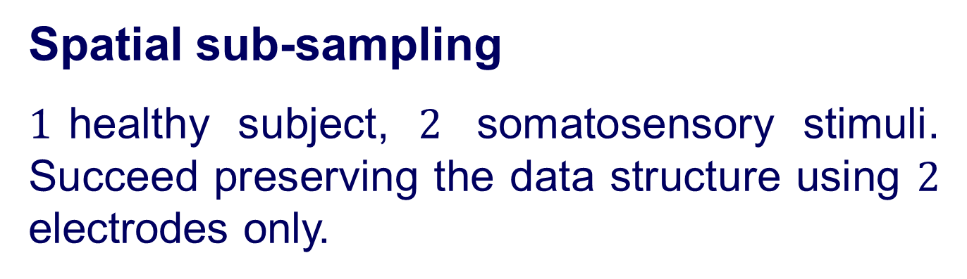
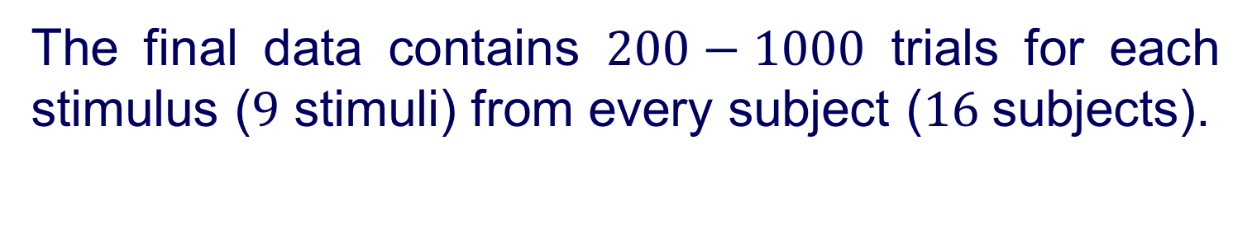
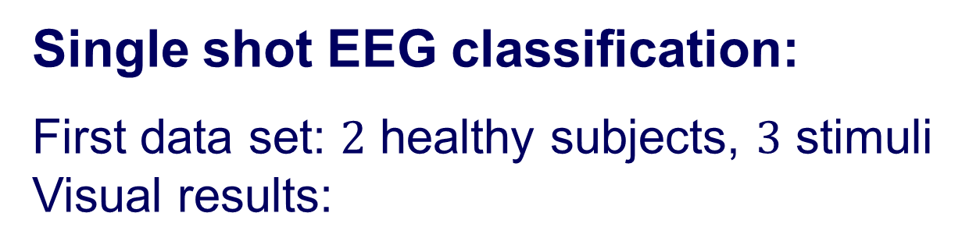

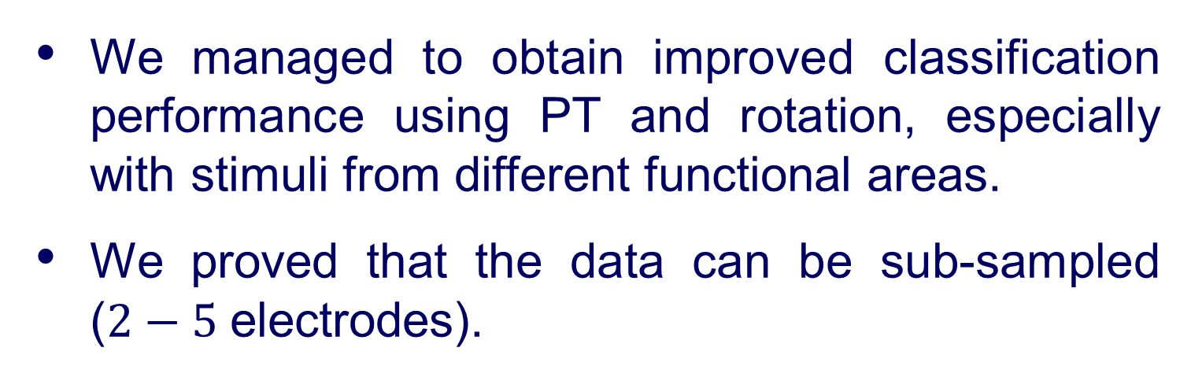

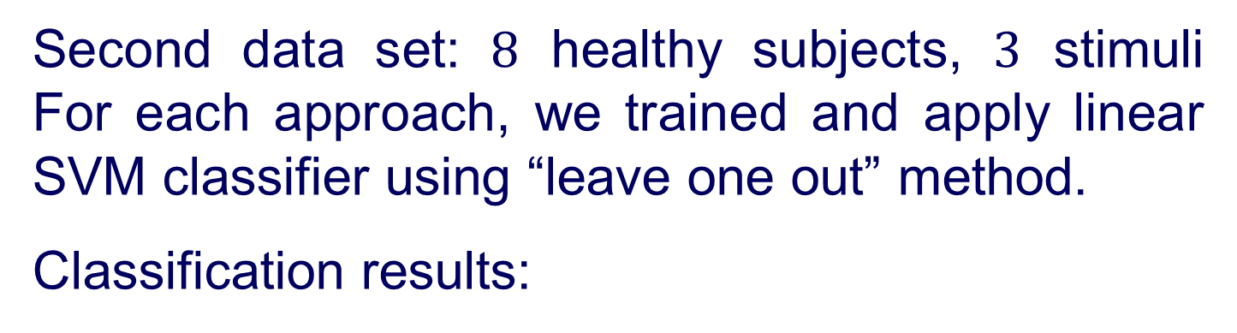



Andrew and Erna Viterbi
Faculty of Electrical Engineering
Signal and Image Processing Lab
Estimating Brain Activation Patterns from EEG Data
Gal Maman, Supervised by Or Yair
Introduction
Riemannian Geometry
Rotation Using PCA
Problem:
Popular modalities for brain imaging are not always feasible or available at early stages of the illness.
Goal:
A system that:
Can be applied at the bedside of critically-ill patients.
Detect neurological injury.
Aid in guiding therapy and improve outcomes.
Solution:
Research brain activity using EEG monitoring.
Framework:
In our algorithm we used covariance matrices as features. The covariance matrix is symmetric and positive definite; therefore it lies on a Riemannian manifold.
Let $ℳ$be the Riemannian Manifold of all SPD matrices.
Let $P_{1},P_{2}∈ℳ$ be covariance matrices created from $2$ different trials.
The Riemannian Geodesic distance is defined by:
$$δ_{R}\left(P_{1},P_{2}\right)≜{\left\|\log\left({P_{1}}^{−1}P_{2}\right)\right\|}_{F}$$
Let $\left\{P_{i}\right\}$ be a set of SPD matrices, and let $\overline{P}$be their Riemannian mean:
$$\overline{P}≜arg\min_{P}{\sum_{i}{δ_{R}^{2}(P,P_{i})}}$$
We can define $𝒯_{\overline{P}}ℳ$to be a tangent space composed by the set of tangent vectors at $\overline{P.}$
For each $P_{1}∈ℳ$we can define the logarithmic mapping to the tangent plane is given by:
$$S_{1}={Log}_{\overline{P}}P_{1}{≜\overline{P}}^{\frac{1}{2}}\log\left({\overline{P}}^{−\frac{1}{2}}P_{1}{\overline{P}}^{−\frac{1}{2}}\right){\overline{P}}^{\frac{1}{2}}$$
Lastly, we denote the vector representation for $S_{1 }$:
$s_{1}=VEC({\overline{P}}^{−\frac{1}{2}}{Log}_{\overline{P}}P_{1}{\overline{P}}^{−\frac{1}{2}}$)
Where $VEC(∙)$ is the vectorized upper triangular of a symmetric matrix, with $\sqrt{2}$weights for its off-diagonal elements.
Traditional approach:
Project all matrices to the tangent plane located at the Riemannian mean of the entire data set.
Suggested approach: Parallel Transport (PT)
Let ${\overline{P}}^{\left(1\right)}$and ${\overline{P}}^{\left(2\right)}$ be the Riemannian means of $2$different subsets $\left\{P_{i}^{\left(1\right)}\right\}$ and $\left\{P_{i}^{\left(2\right)}\right\}$ .
Project the covariance matrices $\left\{P_{i}^{\left(2\right)}\right\}$ into the tangent plane $𝒯_{{\overline{P}}^{(2)}}ℳ.$
Apply PT to $\left\{S_{i}^{\left(2\right)}\right\}$ along the geodesic path $φ$ between ${\overline{P}}^{\left(1\right)}$ and ${\overline{P}}^{(2)}.$
PT formula:
$$Γ_{i}^{(2)}=Γ\left(S_{i}^{\left(2\right)}\right)=E S_{i}^{(2)}E^{T}$$
Where $E≜{\left({\overline{P}}^{\left(1\right)} {\left({\overline{P}}^{(2)}\right)}^{−1}\right)}^{\frac{1}{2}}$.
After achieving the new representation using PT, we obtain the final alignment $Y^{\left(1\right)},Y^{\left(2\right)}$using PCA:
compute $U^{(1)},U^{(2)}$, the left principal directions of $Z^{(1)},Z^{(2)};$the vector representations of $\left\{Γ_{i}^{\left(1\right)}\right\}$, $\left\{Γ_{i}^{\left(2\right)}\right\}$ respectively.
Compute and substitute:
$∀j:u_{j}^{\left(2\right)}←sign\left(\left\langle u_{j}^{\left(1\right)},u_{j}^{\left(2\right)}\right\rangle \right)u_{j}^{\left(2\right)}$
Transfer subsets to the new coordinate system:
$$Y^{\left(i\right)}={\left(U^{\left(i\right)}\right)}^{T}Z^{\left(i\right)}, i=1,2$$
Results
Objectives
Single shot EEG classification:
First data set: $2$ healthy subjects, $3$ stimuli Visual results:
Single shot EEG classification.
Spatial sub-sampling.
Traditional Approach PT PT and Rotation
Raw Data
$${\left\|S_{1}−S_{2}\right\|}_{F}\tilde{=} δ_{R}(P_{1},{ P}_{2})$$
$11$healthy volunteers ranged in age from $7$ to $16$years.
$5$ critically-ill patients ranged in age from $2.5$ to $16$years; all with various brain injuries.
The stretchable electrode cap contained $64$EEG electrodes.
The set-up consists of three types of stimuli: somatosensory, auditory and visual.
Second data set: $8$ healthy subjects, $3$ stimuli For each approach, we trained and apply linear SVM classifier using “leave one out” method.
Classification results:
The final data contains $200−1000$ trials for each stimulus ($9$ stimuli) from every subject ($16$subjects).
System Diagram
Spatial sub-sampling
$1$healthy subject, $2$ somatosensory stimuli. Succeed preserving the data structure using $2$ electrodes only.
$$⋮$$
$$⋮$$
Preprocessing:
BP filter
Down sampling
Disqualify trials and reject noisy electrodes
Statistical features extraction
Features processing
Conclusions
Classification
We managed to obtain improved classification performance using PT and rotation, especially with stimuli from different functional areas.
We proved that the data can be sub-sampled ($2−5$electrodes).
Classified data
In collaboration with Dr. Danny Eitan
July 2018

