Slide 1



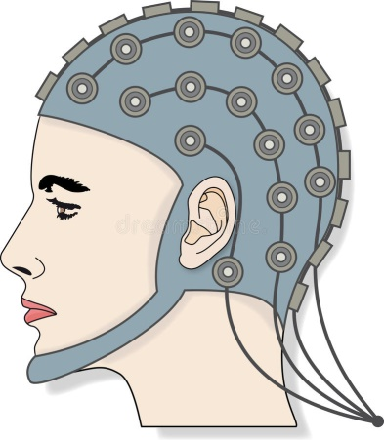
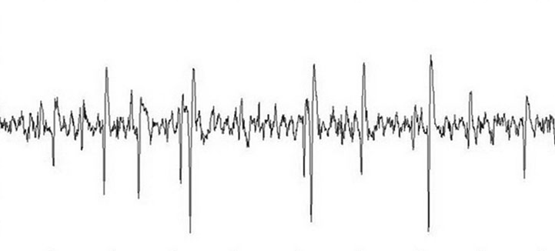
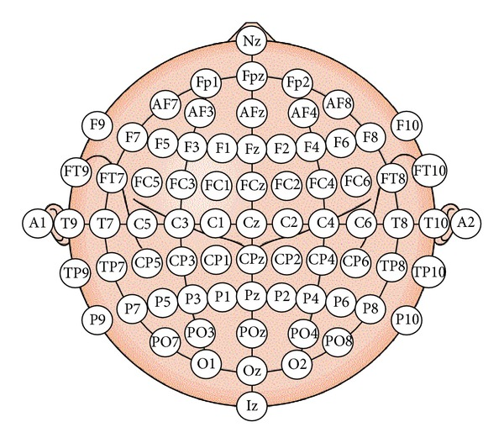
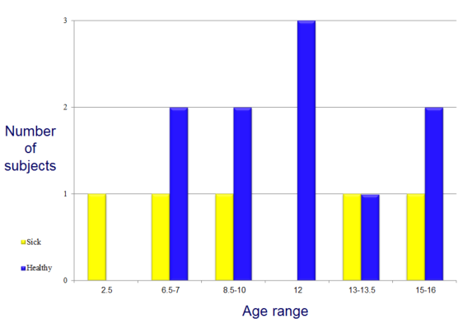
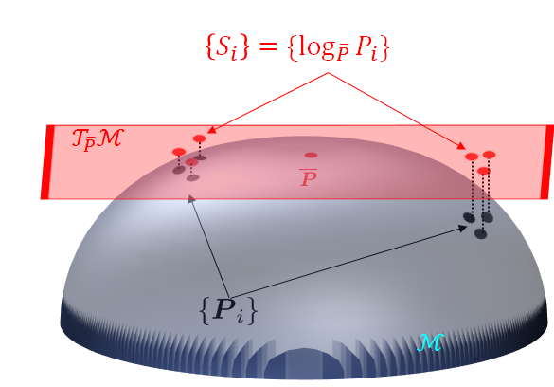
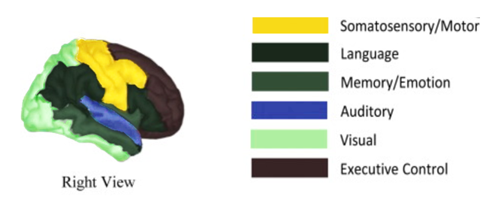


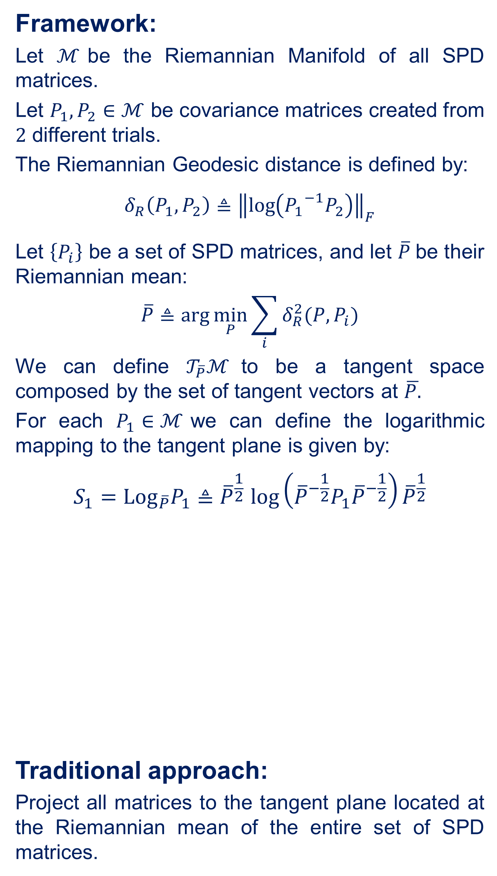

Andrew and Erna Viterbi
Faculty of Electrical Engineering
Signal and Image Processing Lab
Estimating Brain Activation Patterns from EEG Data
Gal Maman, Supervised by Or Yair In Collaboration with Dr. Danny Eitan
Introduction
System Diagram
Distance to Horizon
Problem:
Popular modalities for brain imaging are not always feasible or available at early stages of the illness.
Goal:
A system that:
Can be applied at the bedside of critically-ill patients.
Detect neurological injury.
Aid in guiding therapy and improve outcomes.
Solution:
Research brain activity using EEG monitoring:
Measures voltage fluctuations resulting from ionic current within the neurons of the brain.
Noninvasive, with the electrodes placed along the scalp.
Challenges:
Noise - causes poor spatial resolution comparing to other methods.
Bad consistency (Sensitive to movement, modifications, etc.)
Distance of each pixel in the ROI from the horizon is calculated
The pixel with maximal distance is chosen
$$⋮$$
$$⋮$$
Preprocessing:
BP filter
Down sampling
Disqualify trials and reject noisy electrodes
Statistical features extraction
Features processing
Classification
Classified data
The distance of two pixels in the ROI to the horizon
Spatial Sub-Sampling
Riemannian Geometry
Framework:
Let $ℳ$be the Riemannian Manifold of all SPD matrices.
Let $P_{1},P_{2}∈ℳ$ be covariance matrices created from $2$ different trials.
The Riemannian Geodesic distance is defined by:
$$δ_{R}\left(P_{1},P_{2}\right)≜{\left\|\log\left({P_{1}}^{−1}P_{2}\right)\right\|}_{F}$$
Let $\left\{P_{i}\right\}$ be a set of SPD matrices, and let $\overline{P}$be their Riemannian mean:
$$\overline{P}≜arg\min_{P}{\sum_{i}{δ_{R}^{2}(P,P_{i})}}$$
We can define $𝒯_{\overline{P}}ℳ$to be a tangent space composed by the set of tangent vectors at $\overline{P.}$
For each $P_{1}∈ℳ$we can define the logarithmic mapping to the tangent plane is given by:
$$S_{1}={Log}_{\overline{P}}P_{1}{≜\overline{P}}^{\frac{1}{2}}\log\left({\overline{P}}^{−\frac{1}{2}}P_{1}{\overline{P}}^{−\frac{1}{2}}\right){\overline{P}}^{\frac{1}{2}}$$
Traditional approach:
Project all matrices to the tangent plane located at the Riemannian mean of the entire set of SPD matrices.
Objectives
Single shot EEG classification
Spatial sub-sampling
Results
Raw Data
11 healthy volunteers ranged in age from 7 to 16 years.
5 critically-ill patients ranged in age from 2.5 to 16 years; all with various brain injuries.
The stretchable electrode cap contained 64 EEG electrodes.
$${\left\|S_{1}−S_{2}\right\|}_{F}\tilde{=} δ_{R}(P_{1},{ P}_{2})$$
The set-up consists of three types of stimuli: somatosensory, auditory and visual.
Conclusions
We managed to reach good classification performance using PT and rotation, especially with stimulus from different functional areas.
We proved that the data can be sub-sampled (2-5 electrodes).
The final data contains 200-1000 trials for each stimulus (9 stimuli) from every subject (16 subjects).
July 2018

