Slide 1


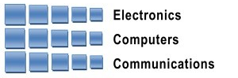
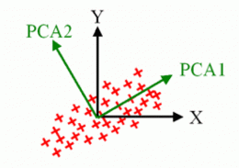
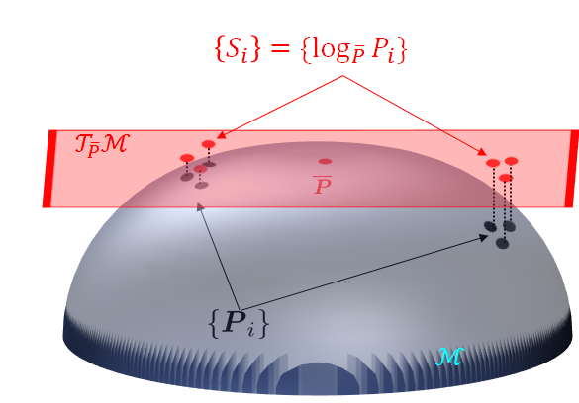
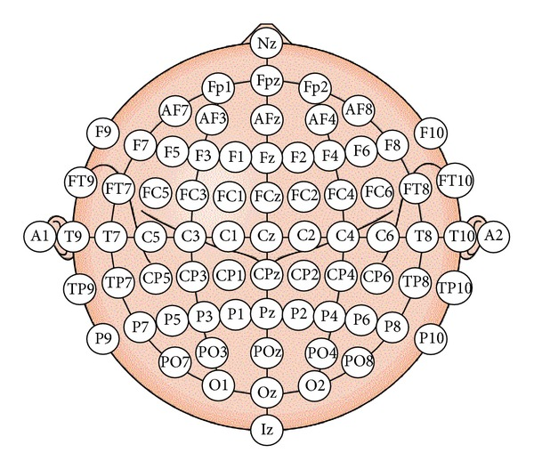
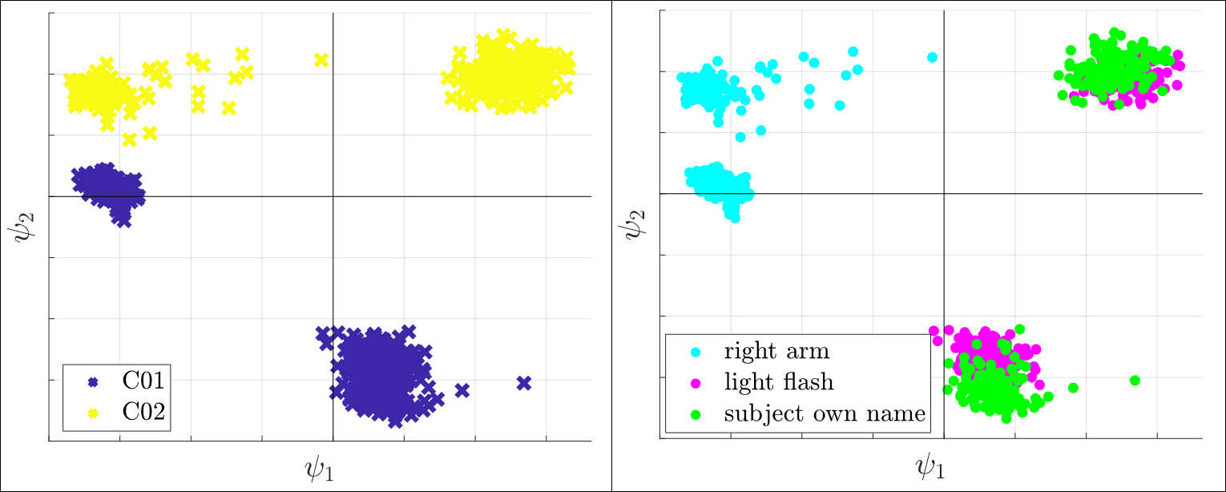
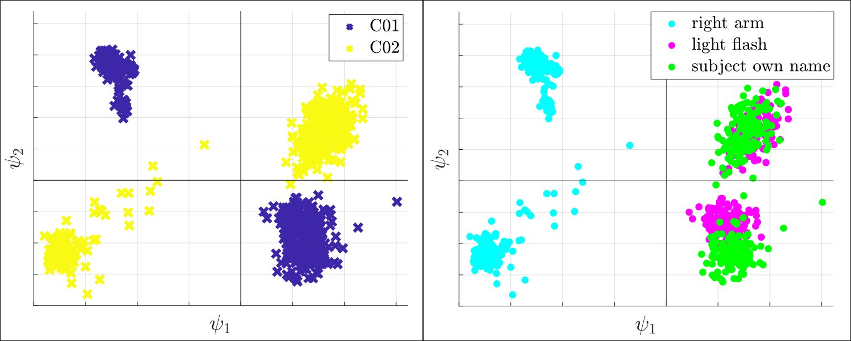
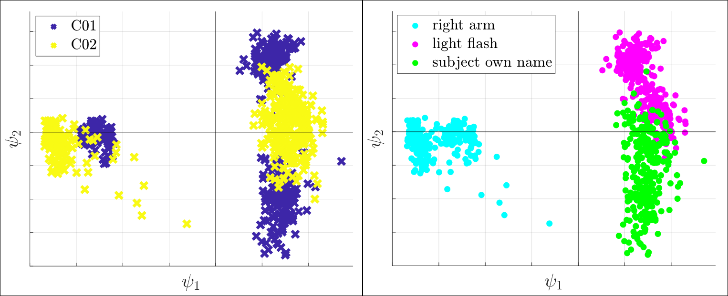
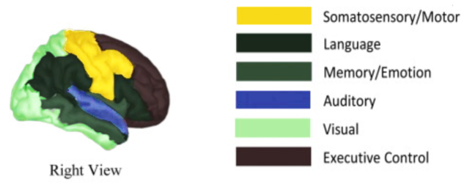
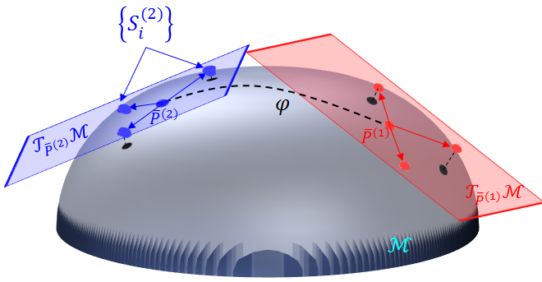
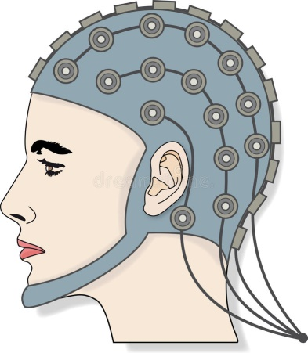
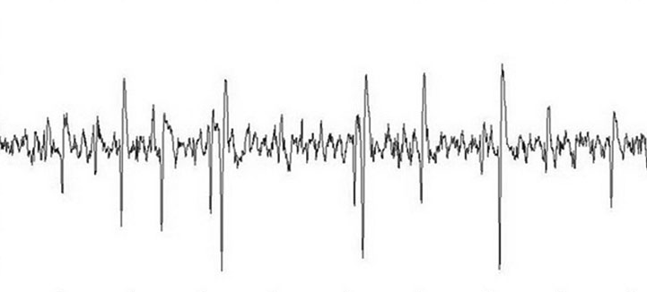



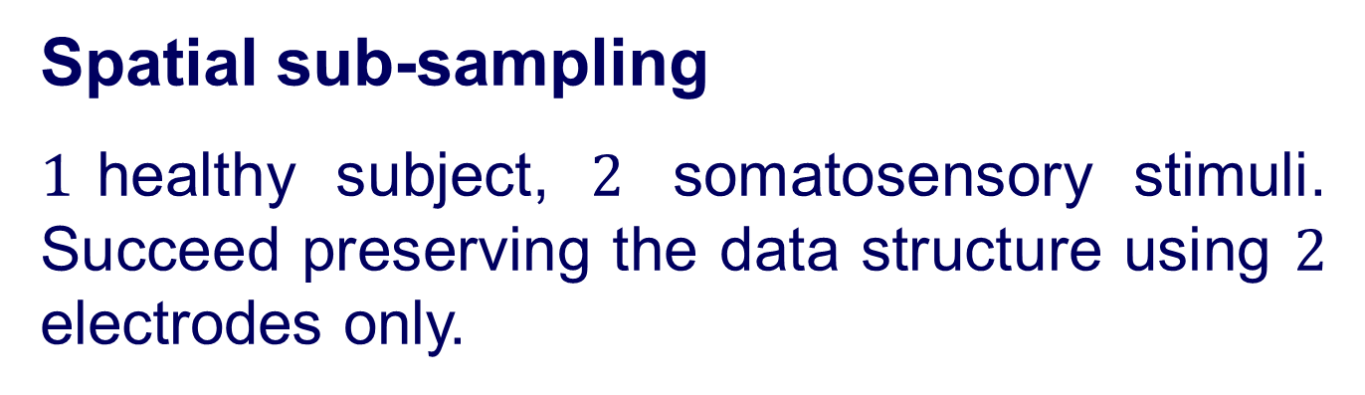
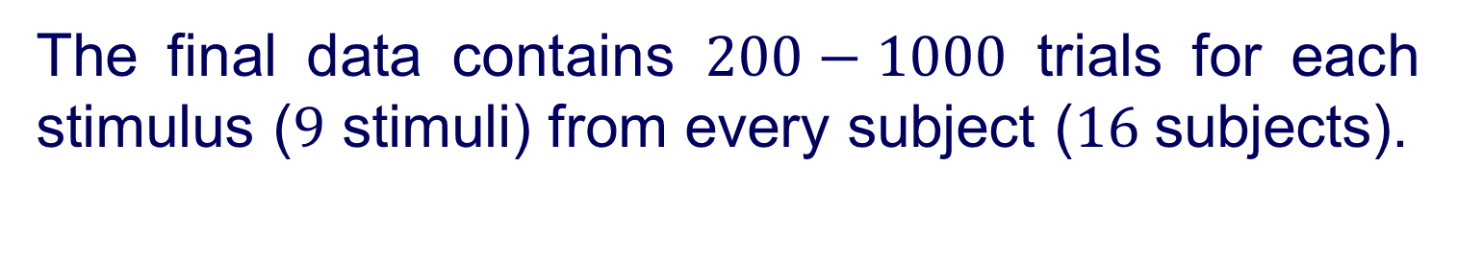
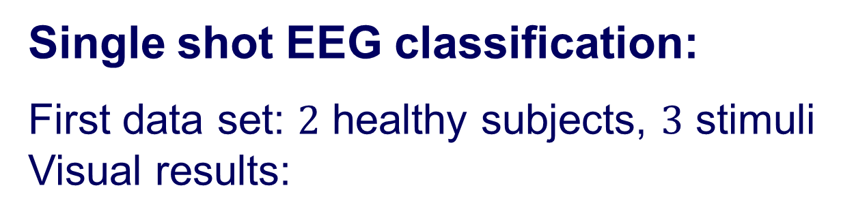


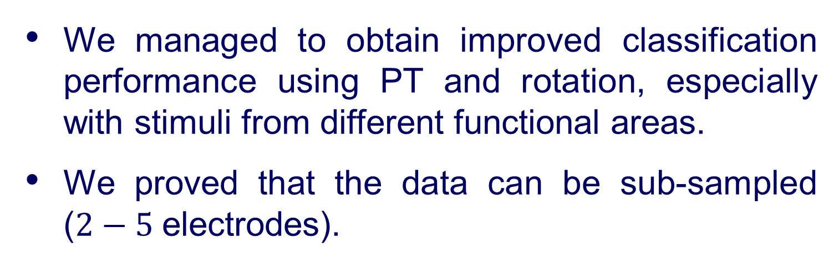

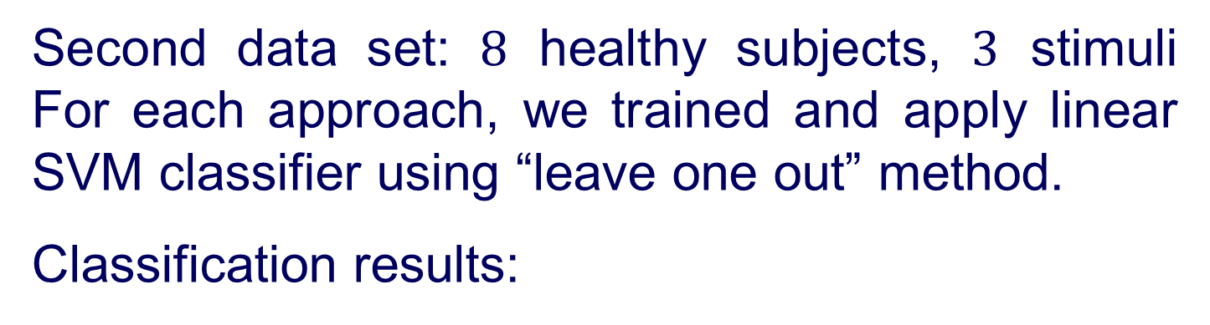



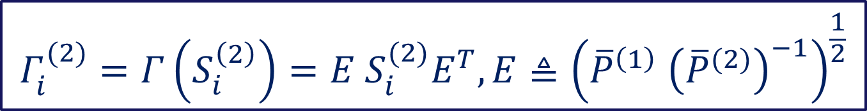


Andrew and Erna Viterbi
Faculty of Electrical Engineering
Signal and Image Processing Lab
Estimating Brain Activation Patterns from EEG Data
Gal Maman, Supervised by Or Yair
Introduction
Riemannian Geometry
Rotation Using PCA
Problem:
Popular modalities for brain imaging are not always feasible or available at early stages of the illness.
Goal:
A system that can be applied at the bedside of critically-ill patients, detect neurological injury, aid in guiding therapy and improve outcomes.
Solution:
Research brain activity using EEG monitoring:
Measures voltage fluctuations resulting from ionic current within the neurons of the brain.
Noninvasive, with the electrodes placed along the scalp.
Framework:
We used SPD (symmetric and positive definite) matrices as features. SPD matrices lie on the Riemannian Manifold of all SPD matrices $ℳ$.
Let $P_{1},P_{2}∈ℳ$, the Riemannian Geodesic distance is given by:
The Riemannian mean of the set ${\left\{P_{i}\right\}}_{i}$ is given by:
We denote with $𝒯_{\overline{P}}ℳ$ the tangent space at $\overline{P.}$
For each $P_{1}∈ℳ$we can define the logarithmic mapping to the tangent plane by:
We denote the vector representation $VEC(∙)$:
$S_{1}=$ $s_{1}=VEC\left(S_{1}\right)=$
After achieving the new representation using PT, we obtain the final alignment $Y^{\left(1\right)},Y^{\left(2\right)}$using PCA:
compute $U^{(1)},U^{(2)}$, the left principal directions of $Z^{(1)},Z^{(2)};$the vector representations of $\left\{Γ_{i}^{\left(1\right)}\right\}$, $\left\{Γ_{i}^{\left(2\right)}\right\}$ respectively.
Compute and substitute:
$∀j:u_{j}^{\left(2\right)}←sign\left(\left\langle u_{j}^{\left(1\right)},u_{j}^{\left(2\right)}\right\rangle \right)u_{j}^{\left(2\right)}$
Transfer subsets to the new coordinate system:
$$Y^{\left(i\right)}={\left(U^{\left(i\right)}\right)}^{T}Z^{\left(i\right)}, i=1,2$$
$$δ_{R}\left(P_{1},P_{2}\right)≜{\left\|\log\left({P_{1}}^{−1}P_{2}\right)\right\|}_{F}$$
$$\overline{P}≜arg\min_{P}{\sum_{i}{δ_{R}^{2}(P,P_{i})}}$$
$$S_{1}={Log}_{\overline{P}}P_{1}{≜\overline{P}}^{\frac{1}{2}}\log\left({\overline{P}}^{−\frac{1}{2}}P_{1}{\overline{P}}^{−\frac{1}{2}}\right){\overline{P}}^{\frac{1}{2}}$$
Results
Objectives
$${\left\|S_{1}−S_{2}\right\|}_{F}\tilde{=} δ_{R}(P_{1},{ P}_{2})$$
Single shot EEG classification:
First data set: $2$ healthy subjects, $3$ stimuli Visual results:
Single shot EEG classification.
Spatial sub-sampling.
Traditional Approach PT PT and Rotation
Raw Data
$11$healthy volunteers ranged in age from $7$ to $16$years.
$5$ critically-ill patients ranged in age from $2.5$ to $16$years; all with various brain injuries.
The stretchable electrode cap contained $64$EEG electrodes.
The set-up consists of three types of stimuli: somatosensory, auditory and visual.
Where $VEC(∙)$ is the vectorized upper triangular of a symmetric matrix, with $\sqrt{2}$weights for its off-diagonal elements.
Parallel Transport
Second data set: $8$ healthy subjects, $3$ stimuli For each approach, we trained and apply linear SVM classifier using “leave one out” method.
Classification results:
Let ${\overline{P}}^{\left(1\right)}$and ${\overline{P}}^{\left(2\right)}$ be the Riemannian means of subsets $\left\{P_{i}^{\left(1\right)}\right\}$ and $\left\{P_{i}^{\left(2\right)}\right\}$ .
Project the SPD matrices $\left\{P_{i}^{\left(2\right)}\right\}$ into the tangent plane $𝒯_{{\overline{P}}^{(2)}}ℳ.$
Apply PT to $\left\{S_{i}^{\left(2\right)}\right\}$ along the geodesic path $φ$ between ${\overline{P}}^{\left(1\right)}$ and ${\overline{P}}^{(2)}:$
The final data contains $200−1000$ trials for each stimulus ($9$ stimuli) from every subject ($16$subjects).
$$Γ_{i}^{(2)}=Γ\left(S_{i}^{\left(2\right)}\right)=E S_{i}^{(2)}E^{T},E≜{\left({\overline{P}}^{\left(1\right)} {\left({\overline{P}}^{(2)}\right)}^{−1}\right)}^{\frac{1}{2}}$$
System Diagram
Spatial sub-sampling
$1$healthy subject, $2$ somatosensory stimuli. Succeed preserving the data structure using $2$ electrodes only.
$$⋮$$
$$⋮$$
Preprocessing:
BP filter
Down sampling
Disqualify trials and reject noisy electrodes
Statistical features extraction
Features processing
Conclusions
Classification
We managed to obtain improved classification performance using PT and rotation, especially with stimuli from different functional areas.
We proved that the data can be sub-sampled ($2−5$electrodes).
Somatosensory
Auditory
Visual
In collaboration with Dr. Danny Eitan
July 2018

