Slide 1
May 7, 2018

Slide 2
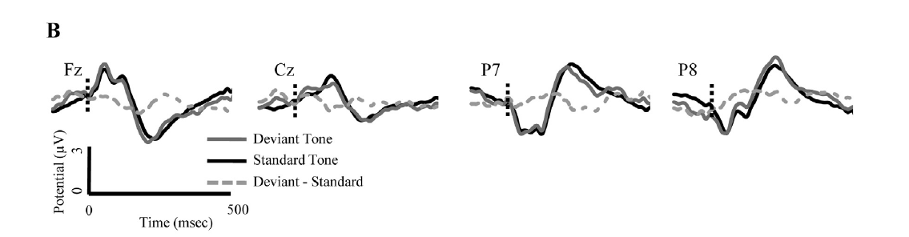
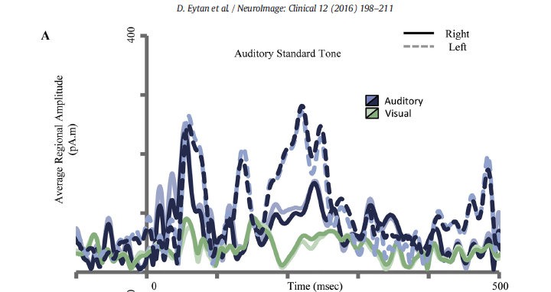

Slide 3
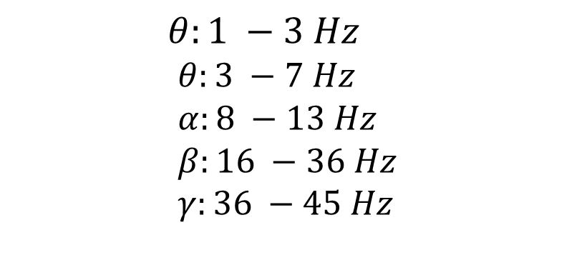
EEG Frequency Bands
$$θ:1 −3 Hz$$
$$θ:3 −7 Hz \\ α:8 −13 Hz \\ β:16 −36 Hz \\ γ:36 −45 Hz$$

