Slide 1
April 30, 2018

Slide 2
Phase Locking Value

Slide 3
Riemannian Geometry
Subjects C01, C02
Stimulations 1,2

Slide 4
Riemannian Geometry with PT
Subjects C01, C02
Stimulations 1,2

Slide 5
Riemannian Geometry with PT
Subjects C01, C02
Stimulations 1,2

Slide 6
Riemannian Geometry
Subjects C02,C05,C08
Stimulations 1,3,11

Slide 7
Riemannian Geometry with PT
Subjects C02,C05,C08
Stimulations 1,3,11

Slide 8
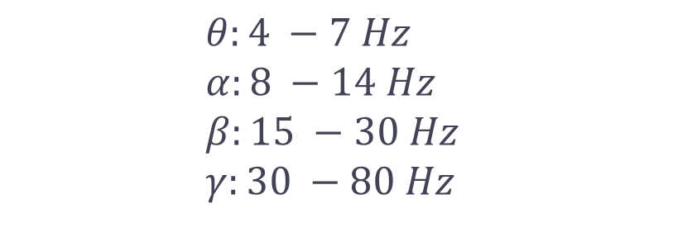
EEG Frequency Bands
$$θ:4 −7 Hz \\ α:8 −14 Hz \\ β:15 −30 Hz \\ γ:30 −80 Hz$$

Slide 11
Sick Subjects

Slide 14
S02 3 stimulations
Time Domain Frequency Domain PLV

