Slide 1
Results for Paper

Slide 2
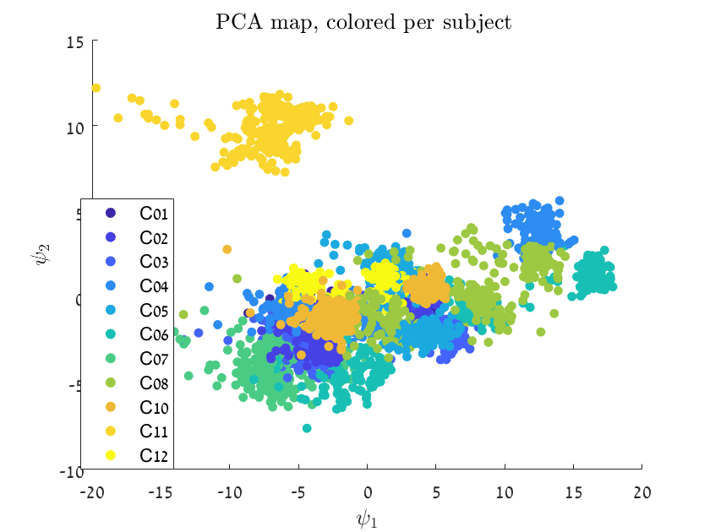
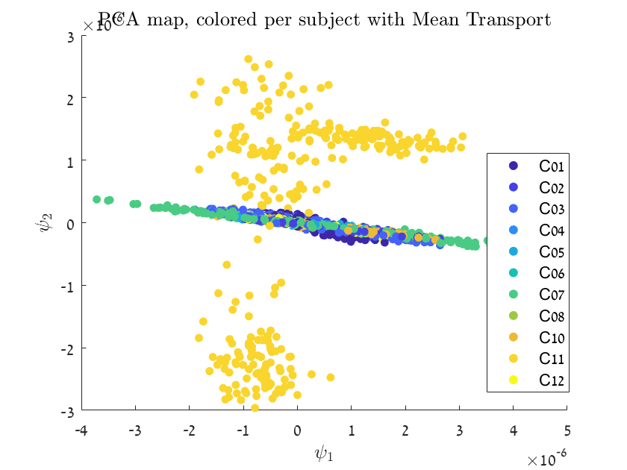
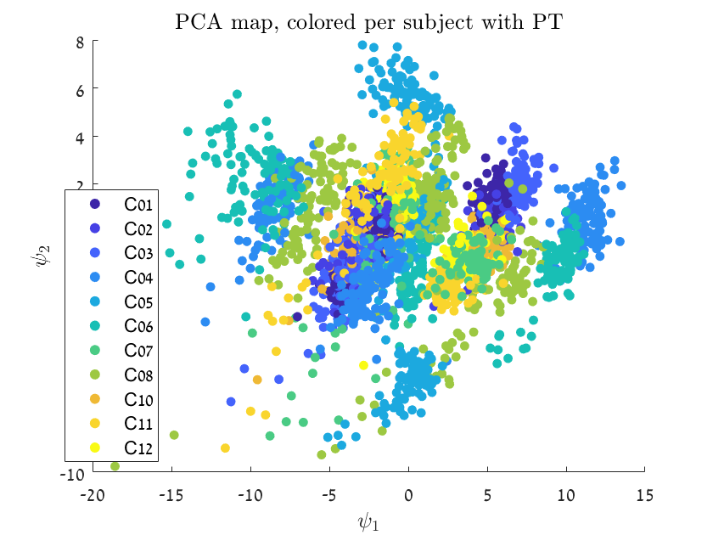
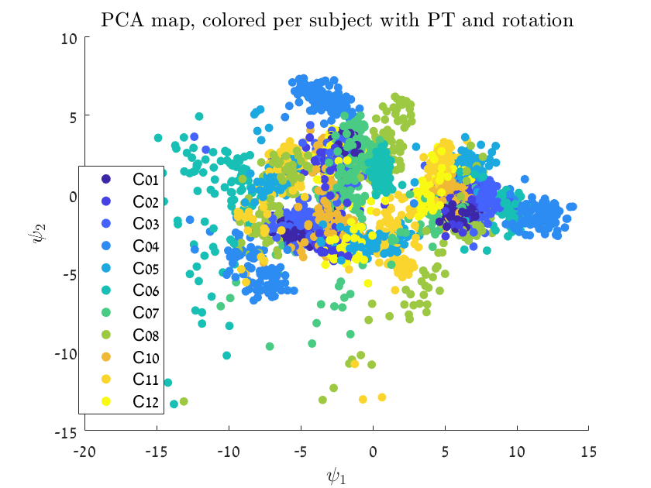
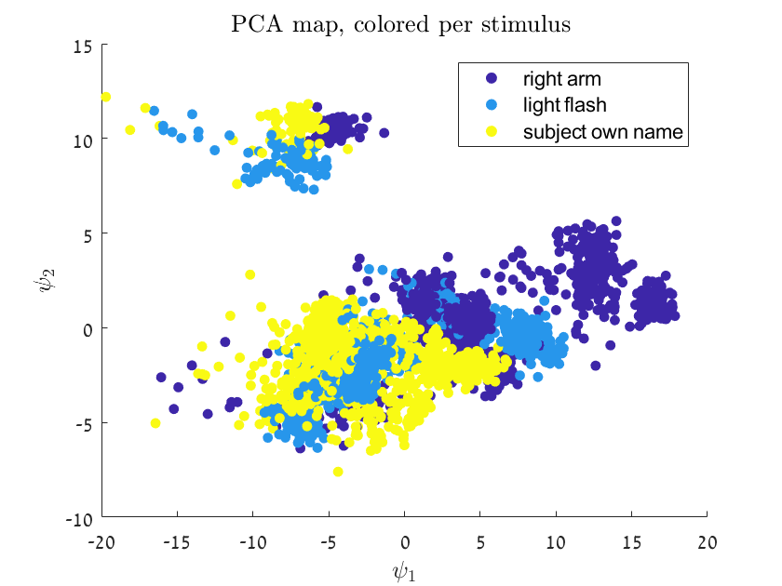
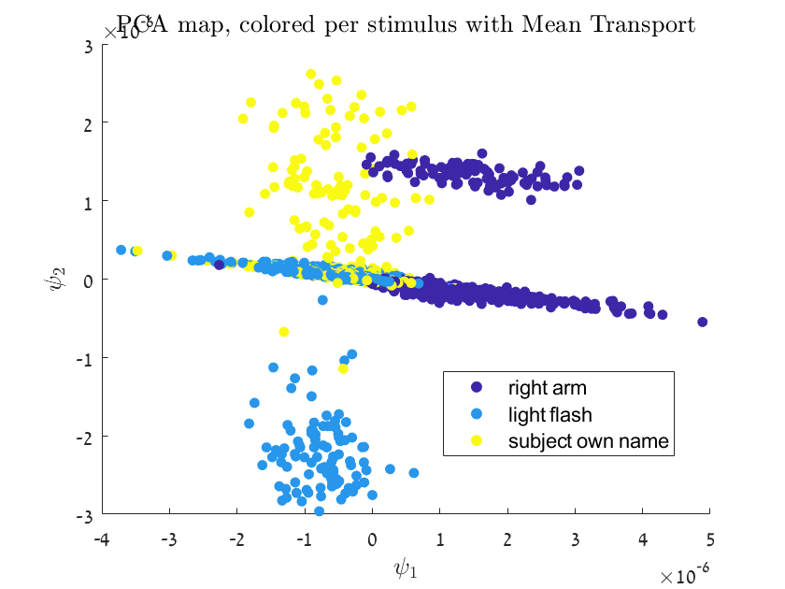
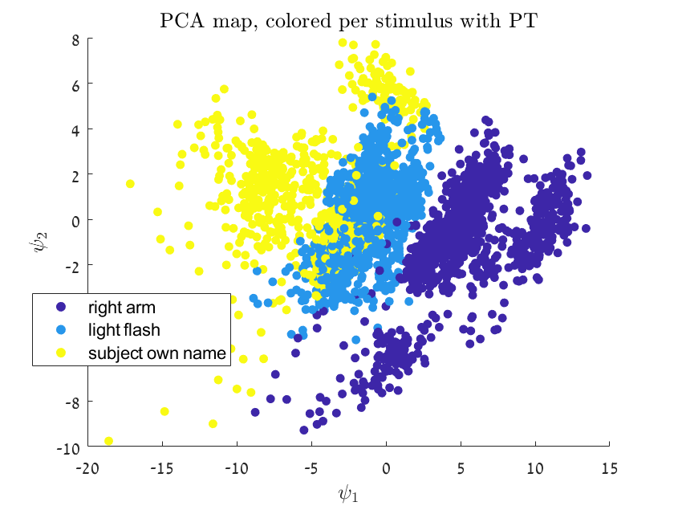
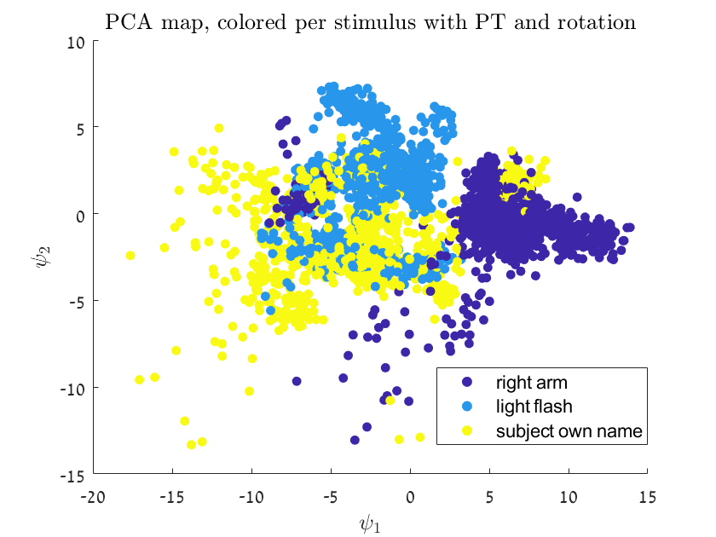
11 subjects

Slide 3
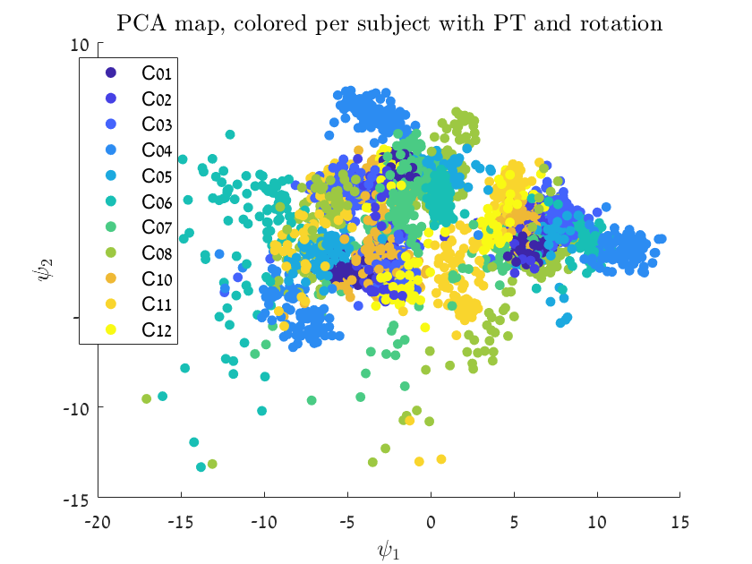
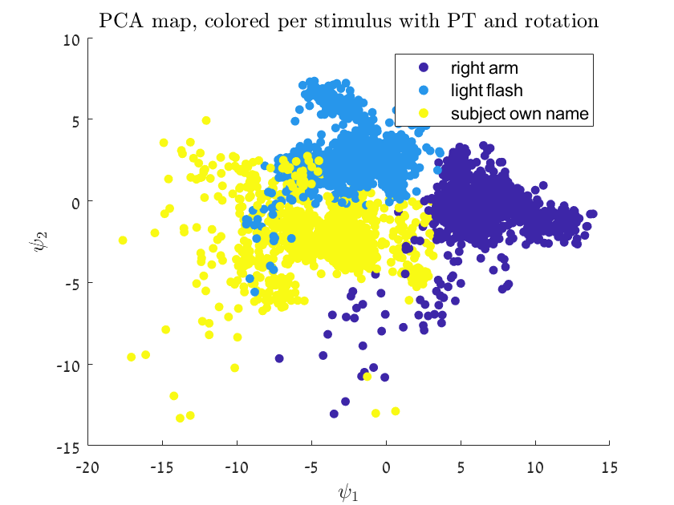
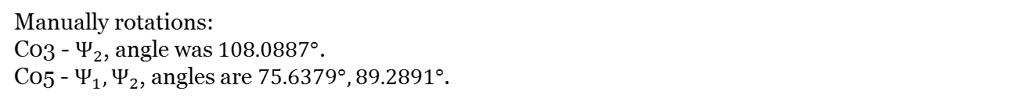
Manually rotations:
C03 - $Ѱ_{2}$, angle was $108.0887°$.
C05 - ${Ѱ_{1},Ѱ}_{2}$, angles are $75.6379°, 89.2891°$.

Slide 4
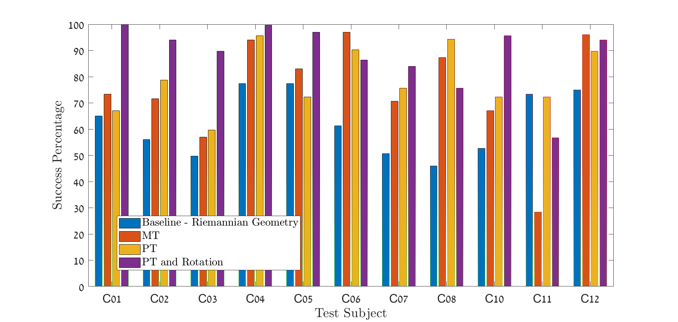
Linear SVM

Slide 5
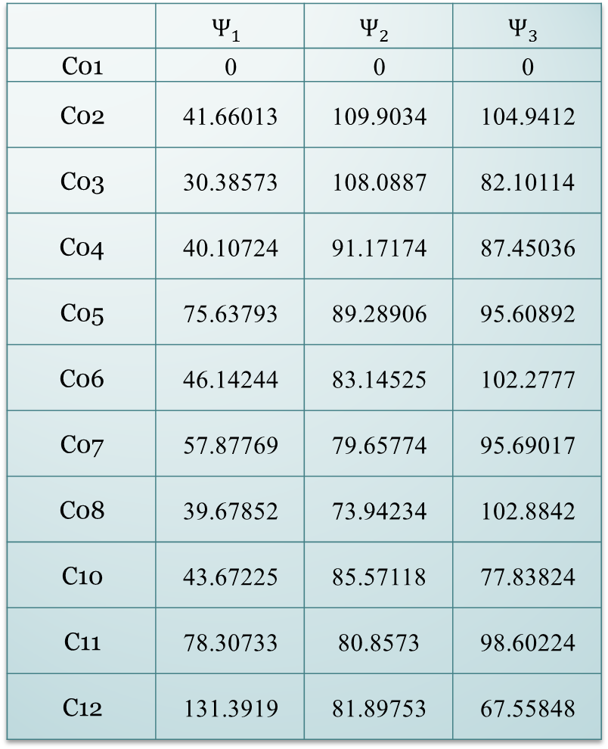
 | $$Ѱ_{1}$$ | $$Ѱ_{2}$$ | $$Ѱ_{3}$$
C01 | 0 | 0 | 0
C02 | 41.66013 | 109.9034 | 104.9412
C03 | 30.38573 | 108.0887 | 82.10114
C04 | 40.10724 | 91.17174 | 87.45036
C05 | 75.63793 | 89.28906 | 95.60892
C06 | 46.14244 | 83.14525 | 102.2777
C07 | 57.87769 | 79.65774 | 95.69017
C08 | 39.67852 | 73.94234 | 102.8842
C10 | 43.67225 | 85.57118 | 77.83824
C11 | 78.30733 | 80.8573 | 98.60224
C12 | 131.3919 | 81.89753 | 67.55848

Slide 6
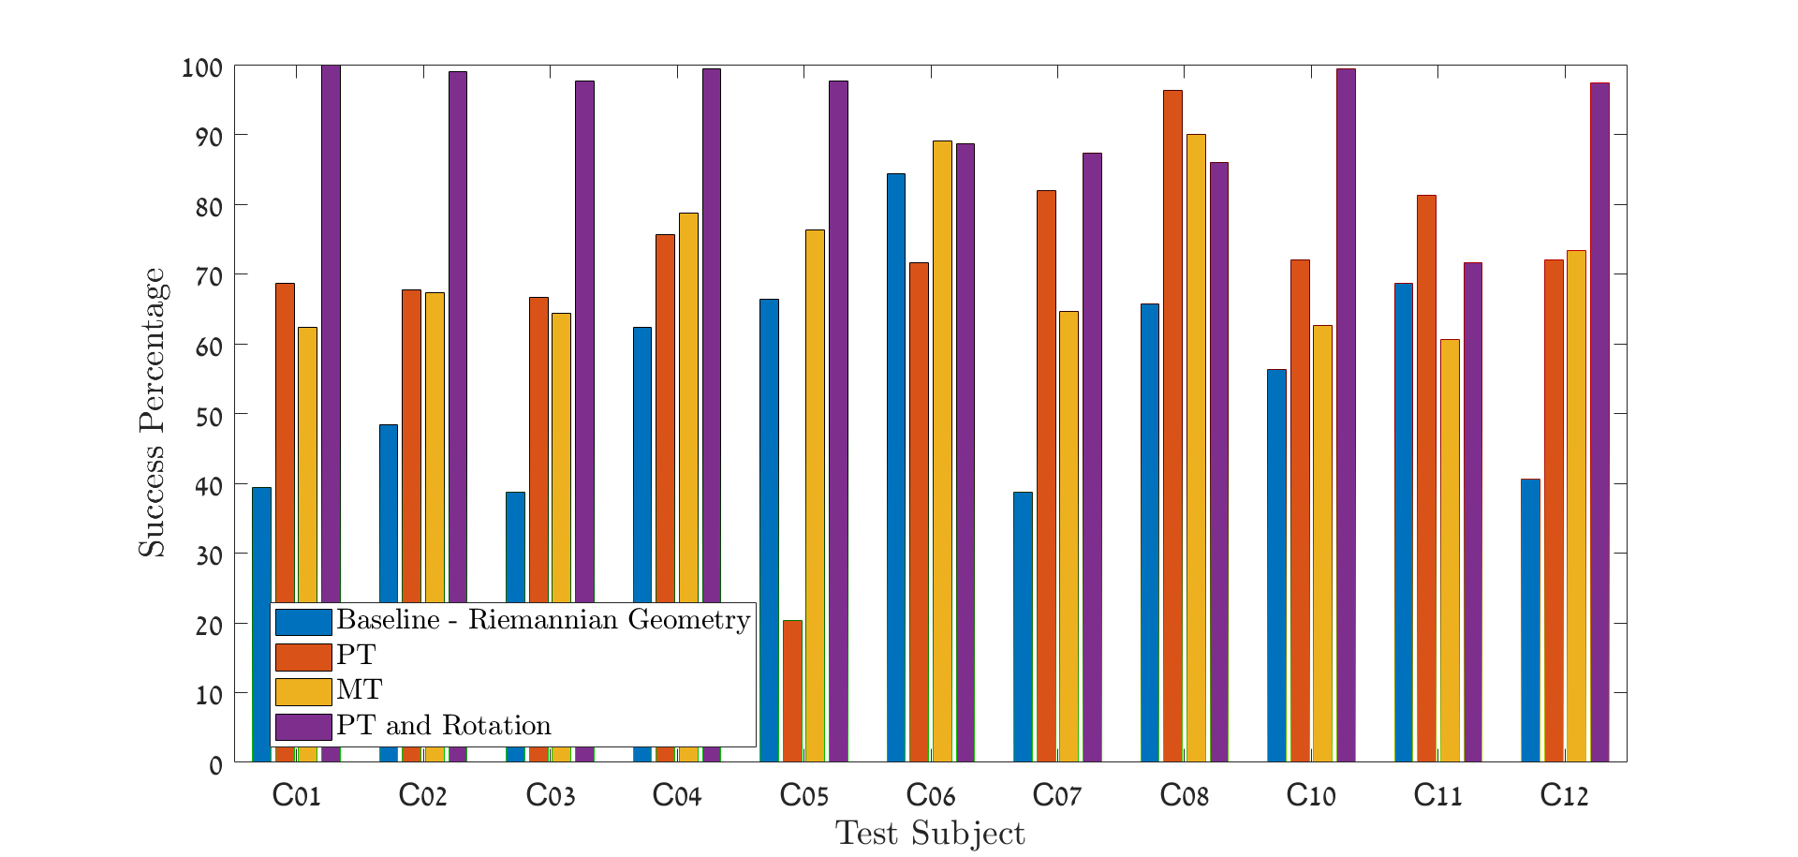
10KNN

Slide 7
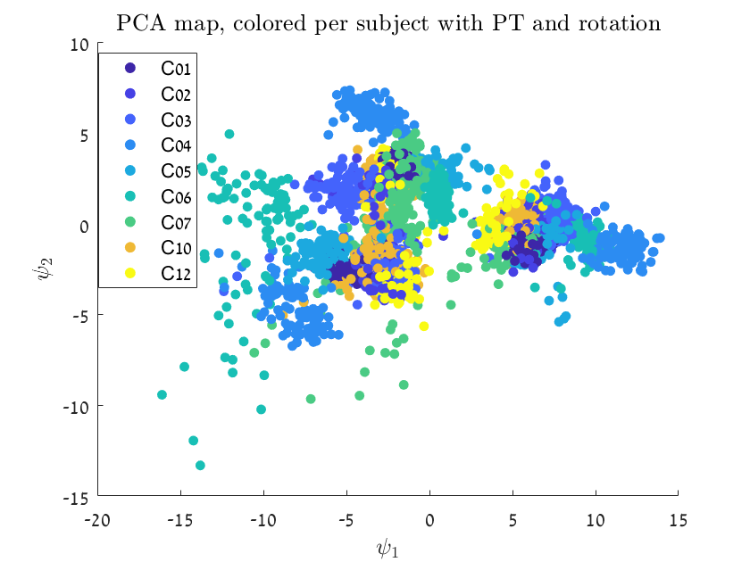
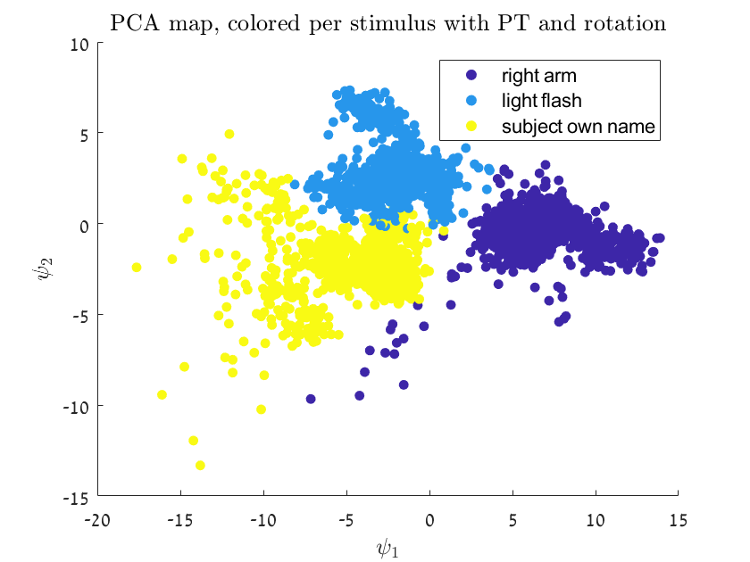
Without C08,C11

Slide 8
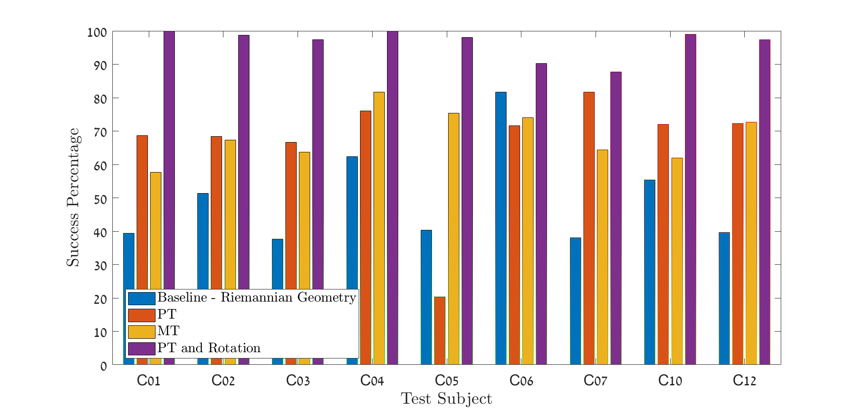
10KNN

