Slide 1
Results for Paper

Slide 2
2 Subjects Figures

Slide 3
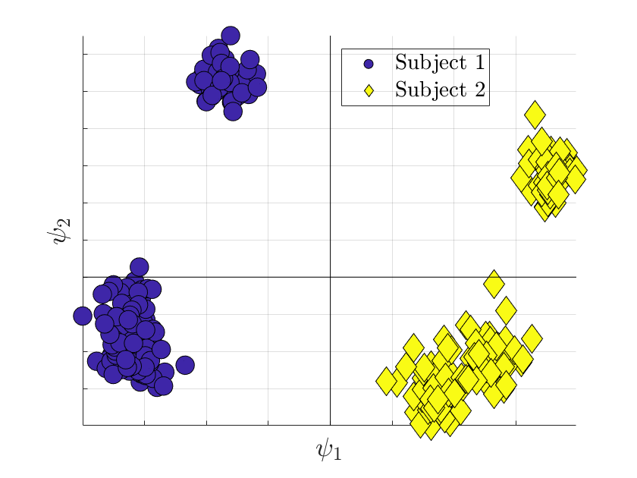
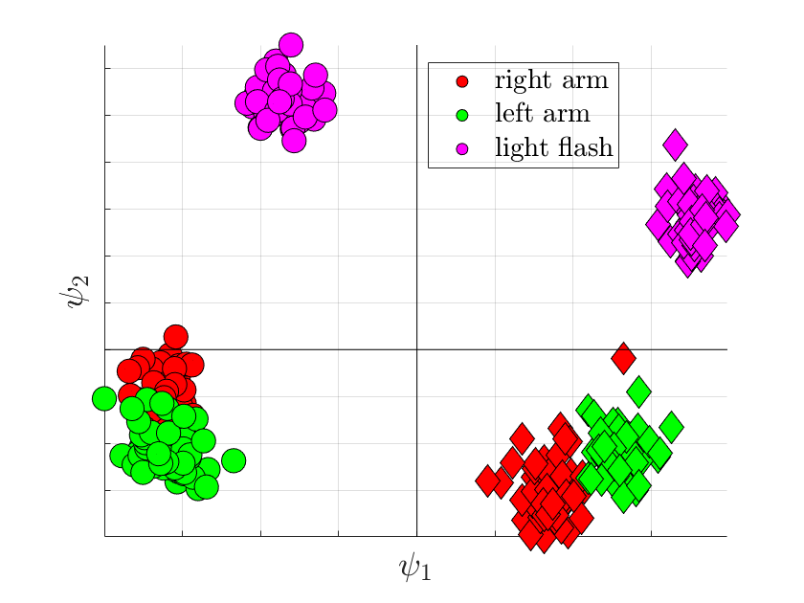

Slide 4
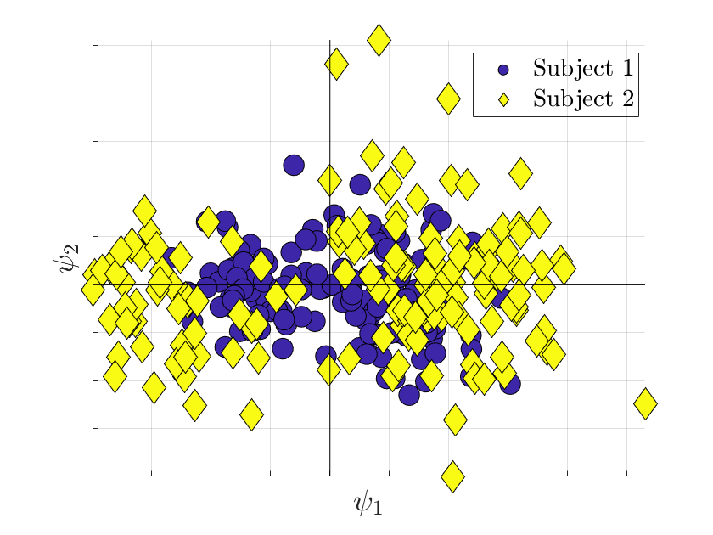
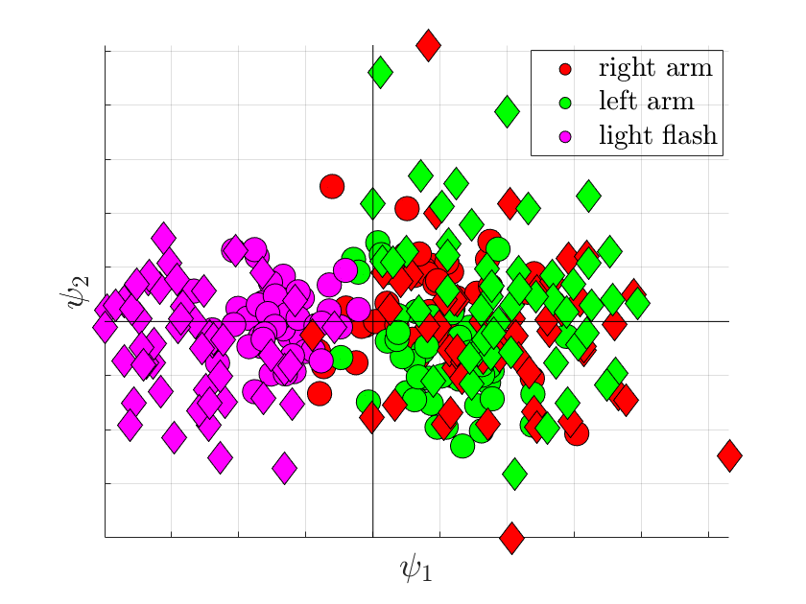

Slide 5
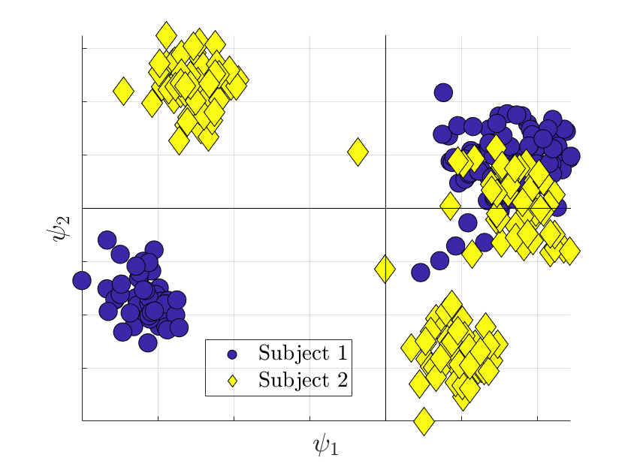
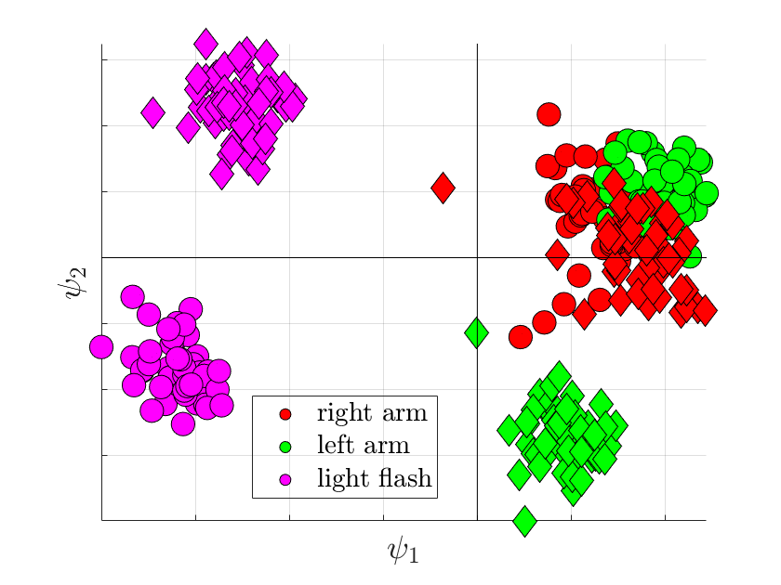

Slide 6
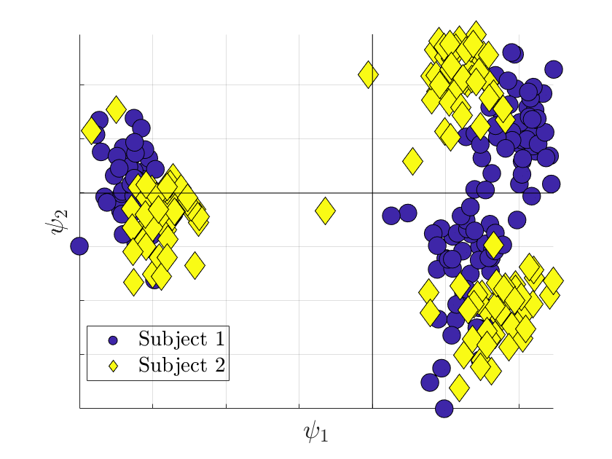
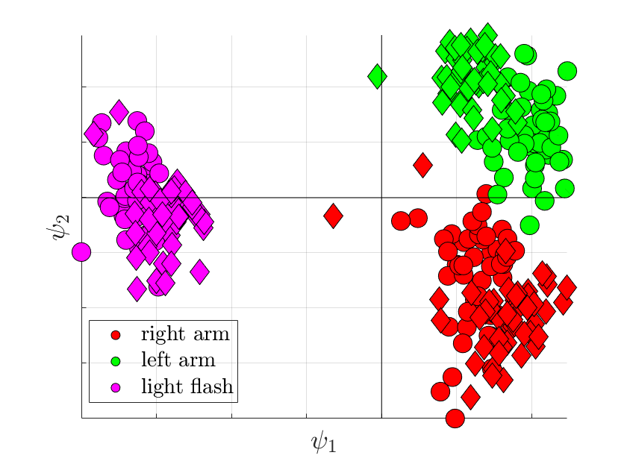

Slide 7
11 Subjects Figures

Slide 8
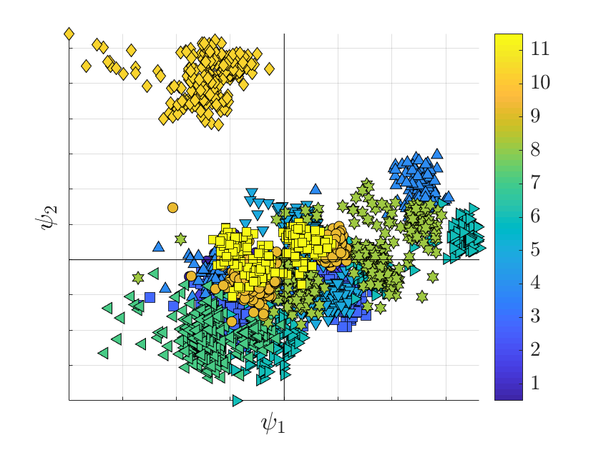
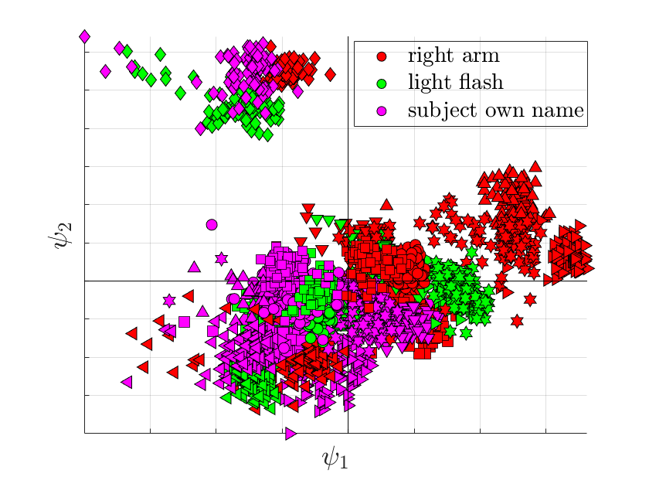

Slide 9
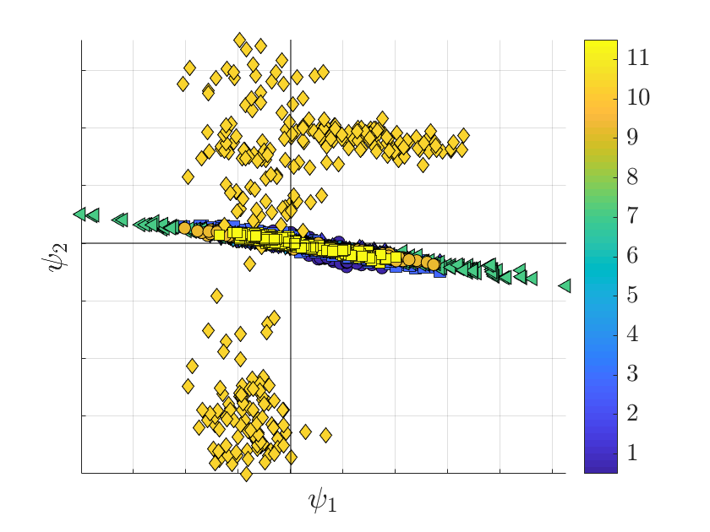
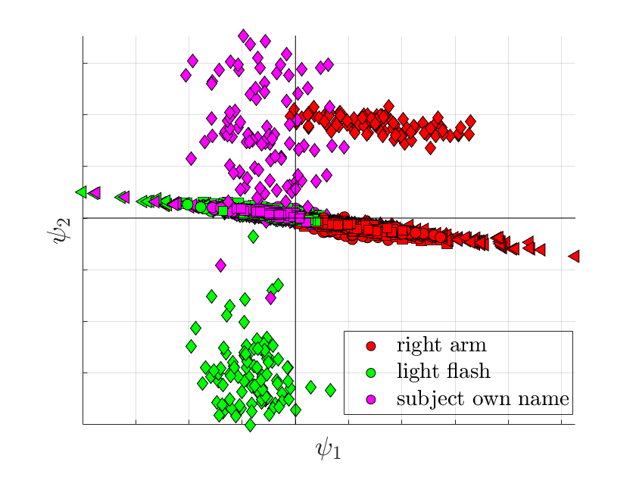

Slide 10
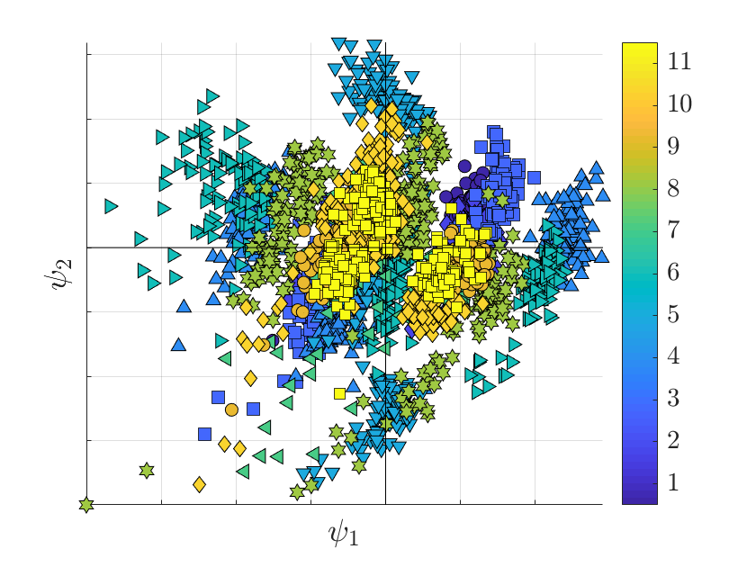
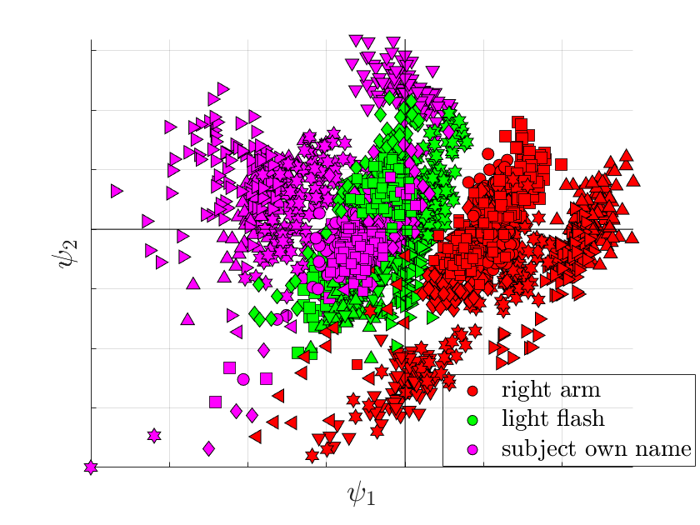

Slide 11
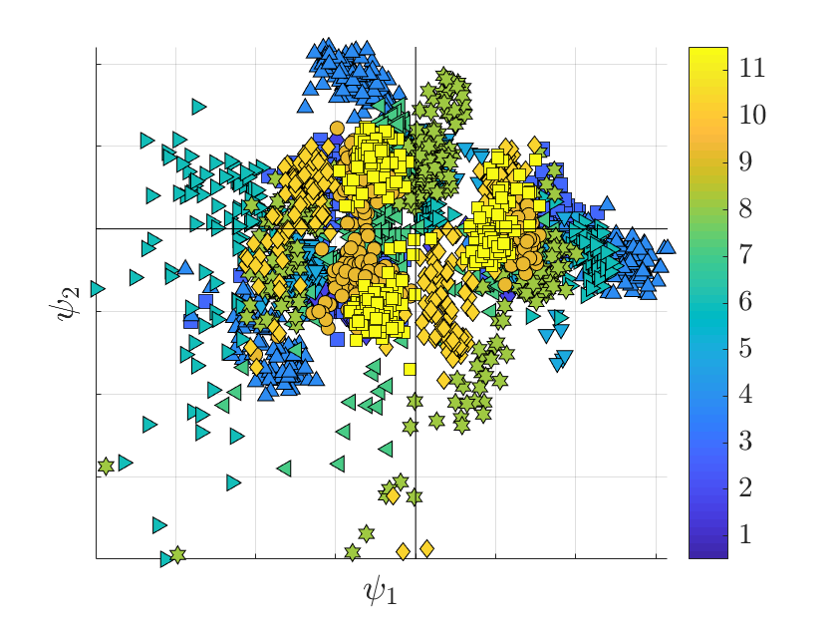
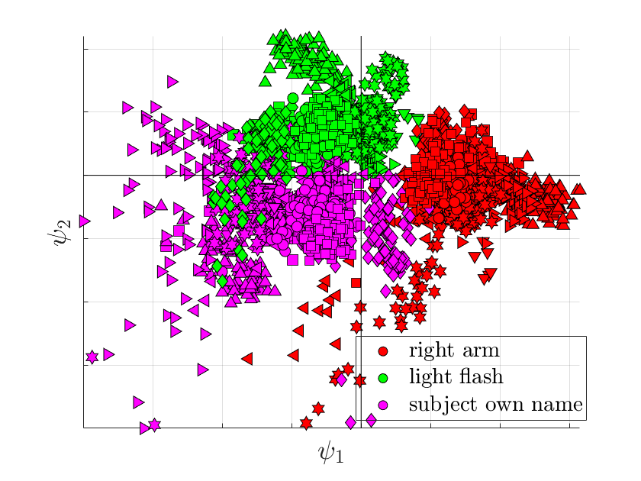

Slide 12
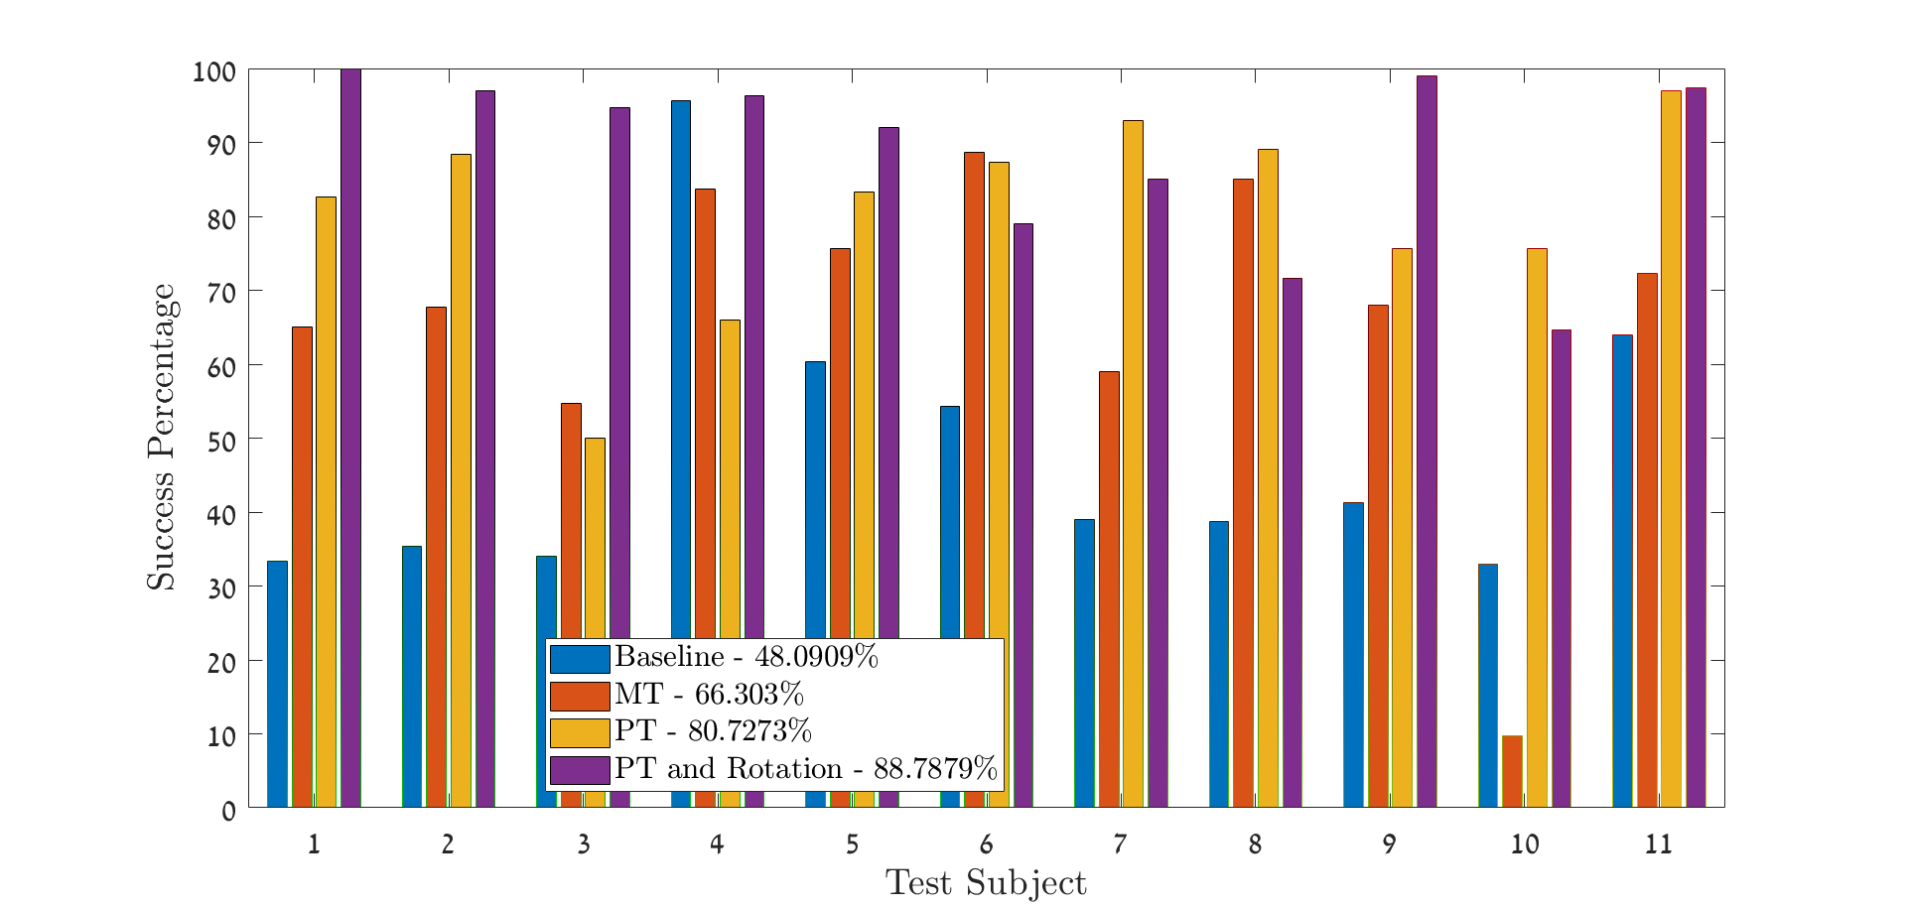
Classification – 3 principle directions polynomial classifier order 3

Slide 13
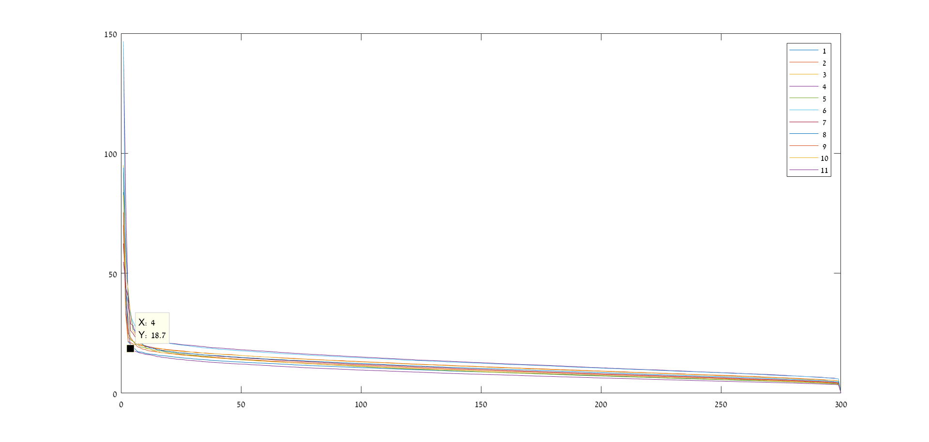
eigenvalues

Slide 14
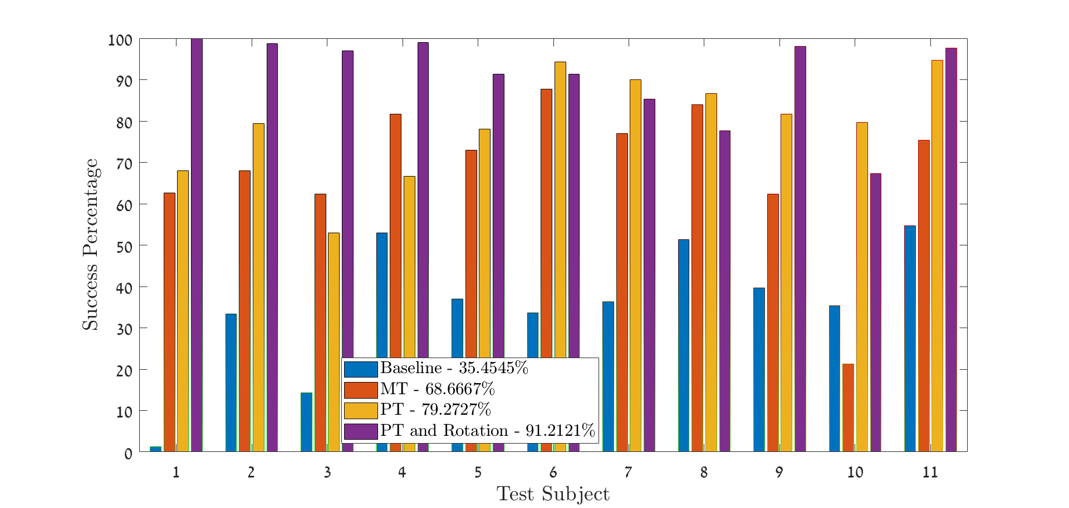
Classification – 4 principle directions polynomial classifier order 3

Slide 15
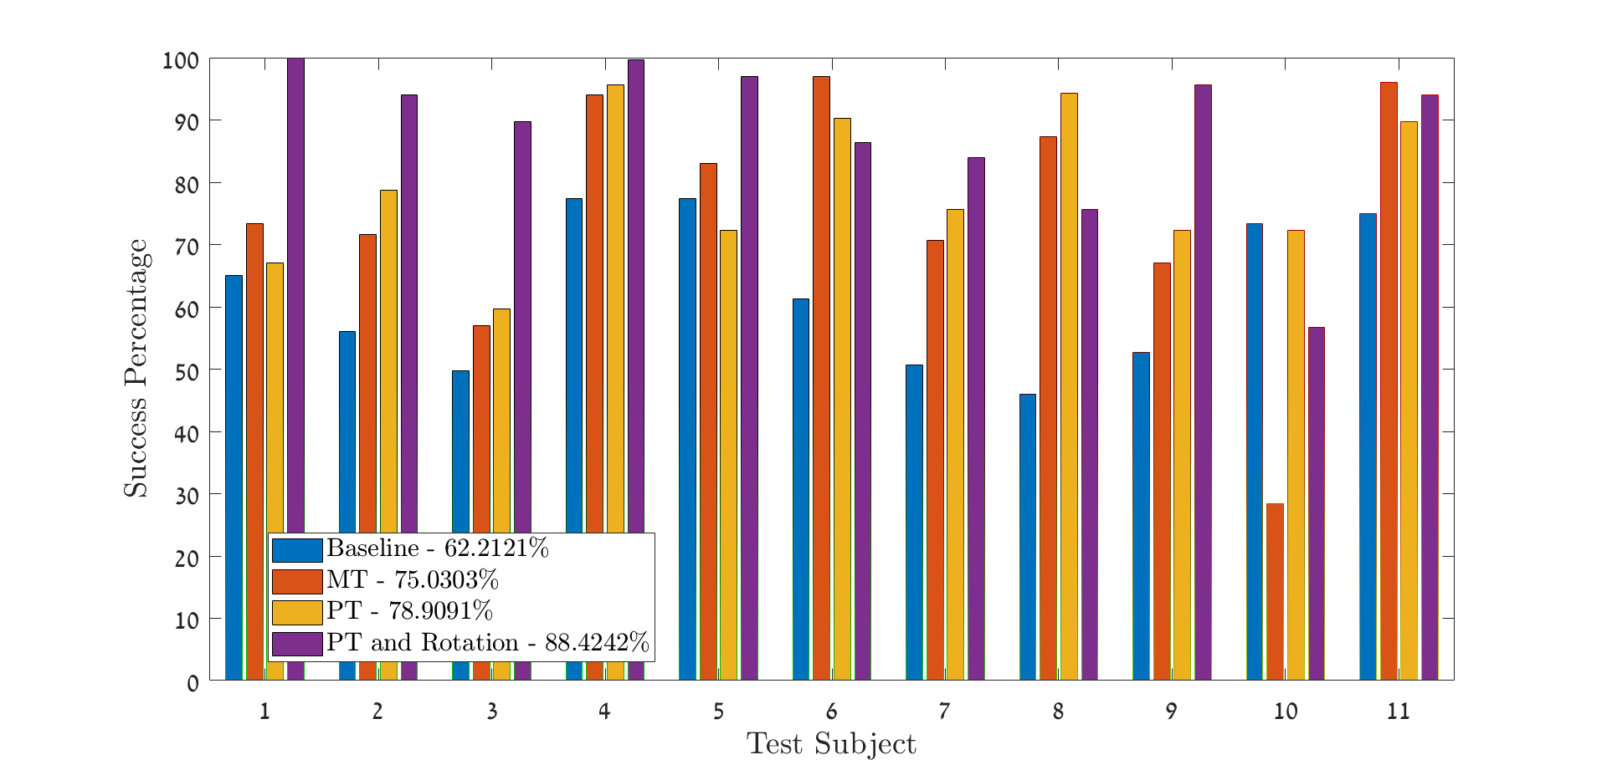
Classification – all directions Linear SVM

Slide 16
 | 1 | 2 | 3 | 4 | 5 | 6 | 7 | 8 | 9 | 10
C01 | 0 | 0 | 0 | 0 | 0 | 0 | 0 | 0 | 0 | 0
C02 | 41.66013 | 109.9034 | 104.9412 | 98.13613 | 88.40158 | 80.8939 | 94.41131 | 87.42824 | 86.35803 | 86.67278
C03 | 30.38573 | 108.0887 | 82.10114 | 75.40923 | 95.3627 | 95.64035 | 96.86752 | 84.70953 | 88.85267 | 87.39285
C04 | 40.10724 | 91.17174 | 87.45036 | 82.99471 | 96.36532 | 83.40467 | 88.44797 | 90.00466 | 91.94279 | 88.95561
C05 | 75.63793 | 89.28906 | 95.60892 | 100.8349 | 92.64376 | 93.79035 | 89.8952 | 87.94924 | 90.11147 | 95.84102
C06 | 46.14244 | 83.14525 | 102.2777 | 87.74971 | 91.18344 | 93.03578 | 90.11208 | 84.6274 | 85.88504 | 87.48198
C07 | 57.87769 | 79.65774 | 95.69017 | 99.25131 | 85.76546 | 90.07601 | 96.14121 | 94.51414 | 90.75772 | 96.8073
C08 | 39.67852 | 73.94234 | 102.8842 | 105.3901 | 95.07366 | 95.98207 | 91.87327 | 91.81178 | 90.02274 | 90.20985
C10 | 43.67225 | 85.57118 | 77.83824 | 89.65604 | 95.92021 | 89.40441 | 97.03422 | 84.91987 | 91.34351 | 90.27561
C11 | 78.30733 | 80.8573 | 98.60224 | 92.65659 | 81.65362 | 91.25628 | 85.17562 | 90.00857 | 92.60608 | 93.54243
C12 | 131.3919 | 81.89753 | 67.55848 | 80.18713 | 86.89185 | 89.92748 | 86.24715 | 86.76184 | 92.02769 | 90.2982

