Slide 1


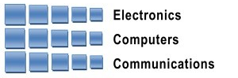
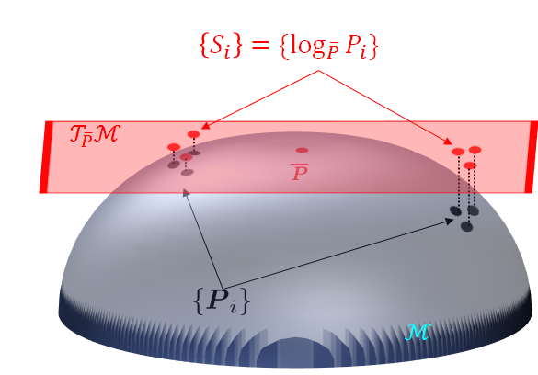
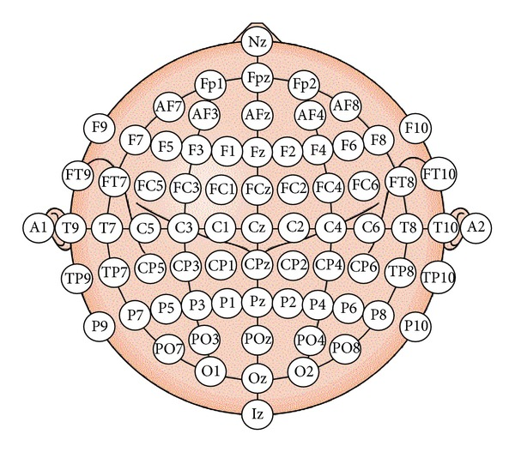
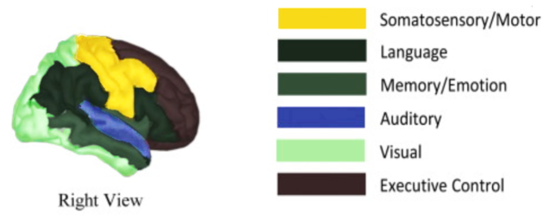
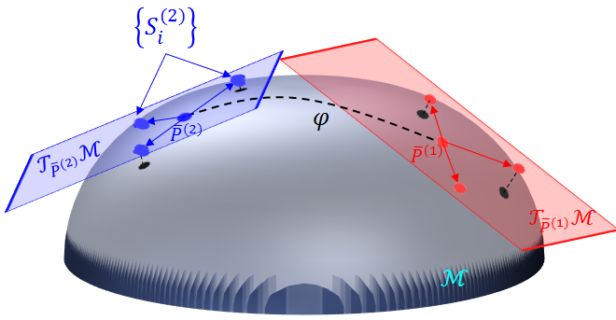
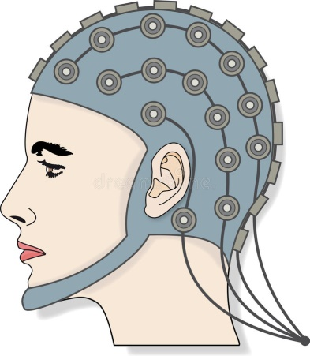
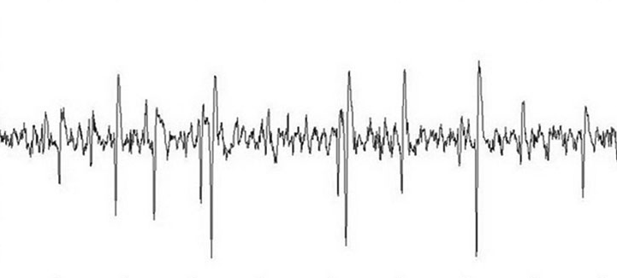


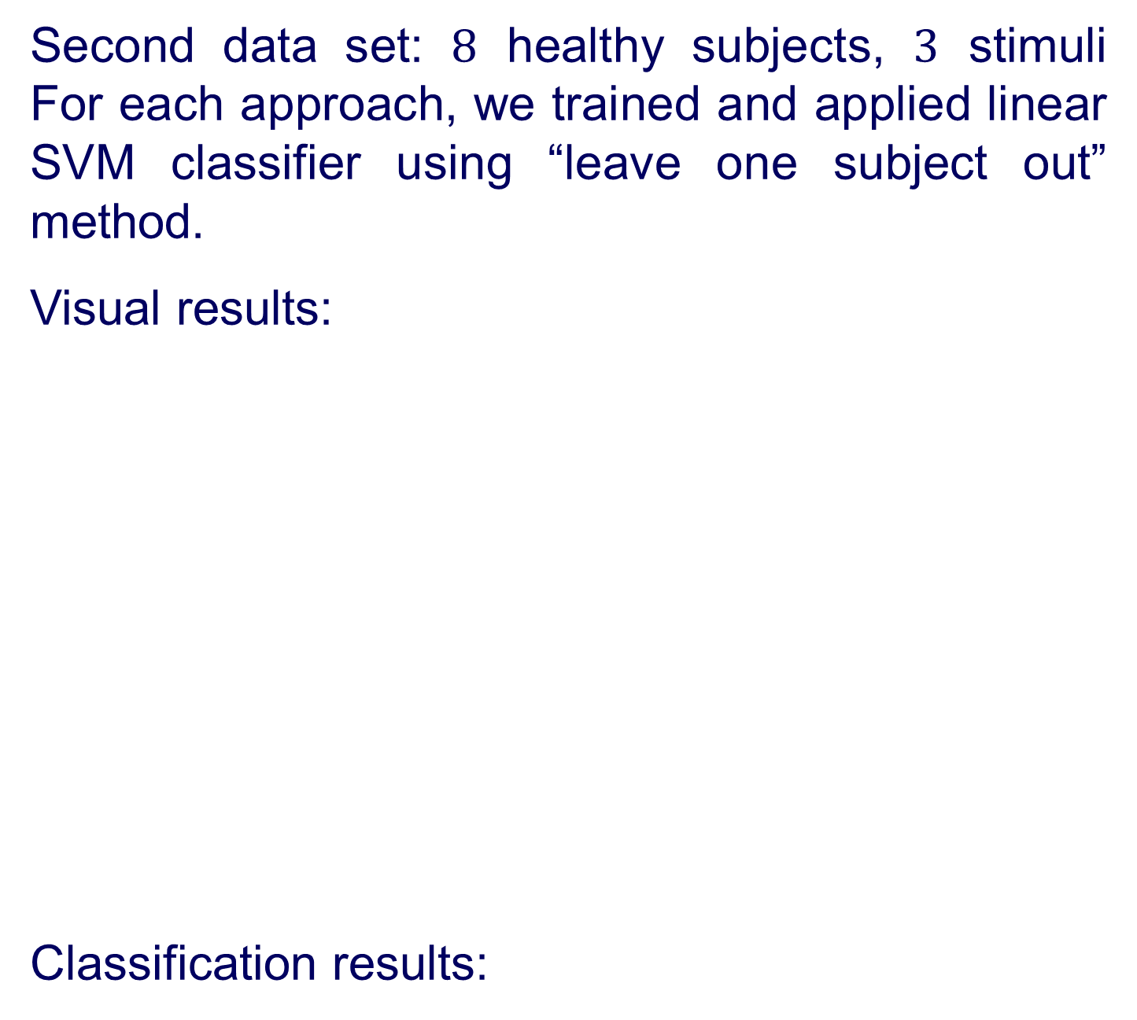
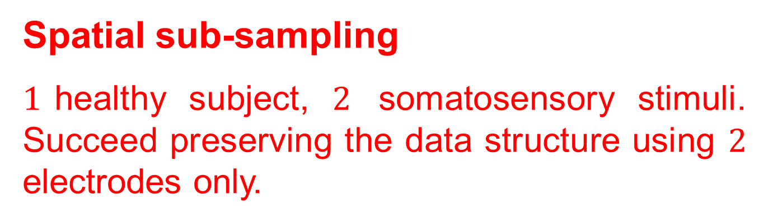




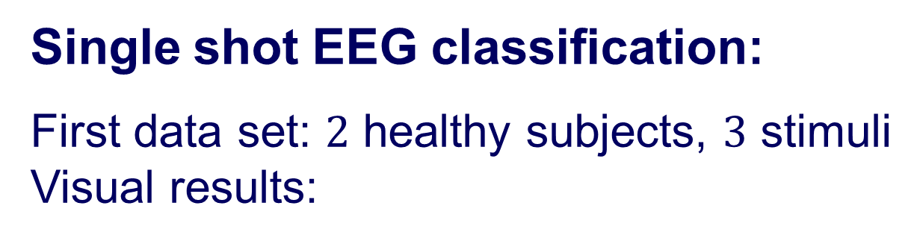
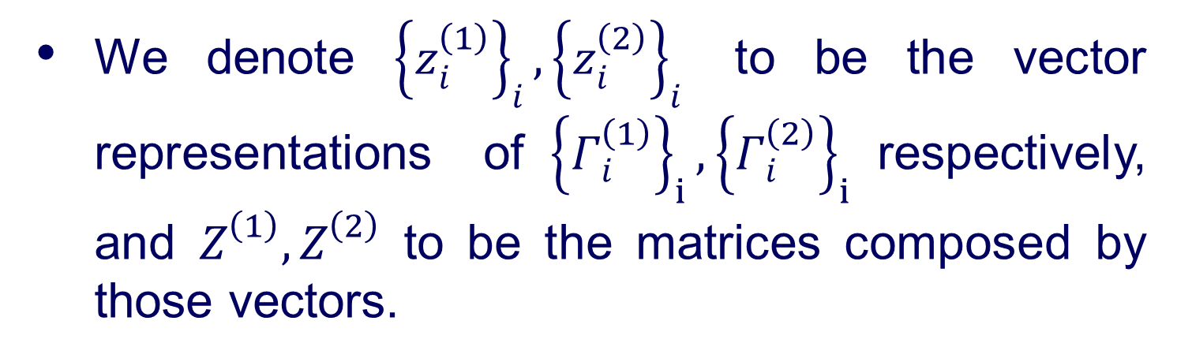
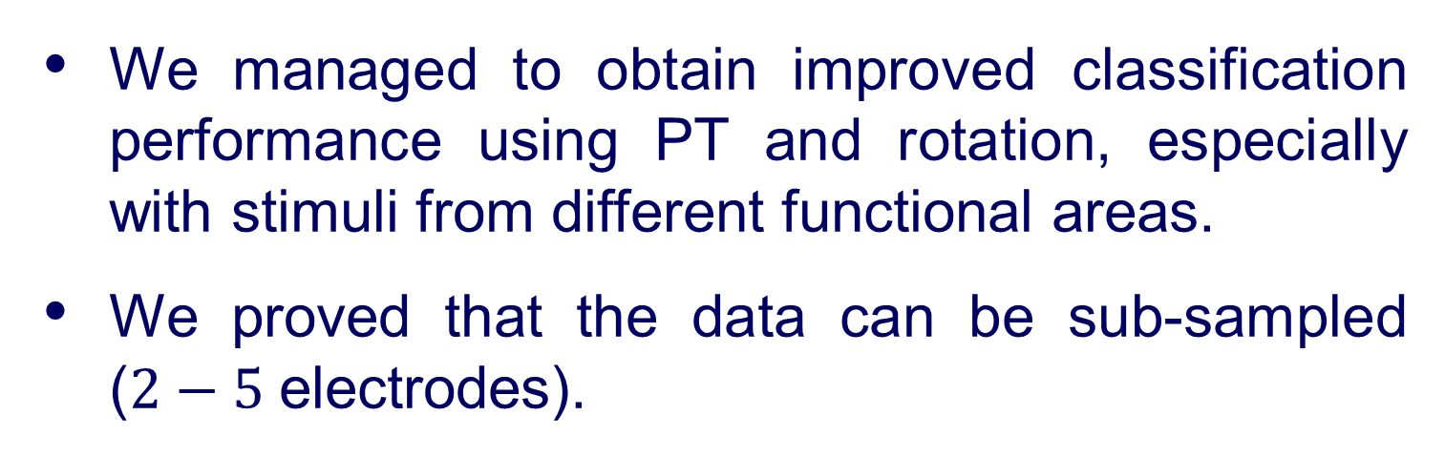





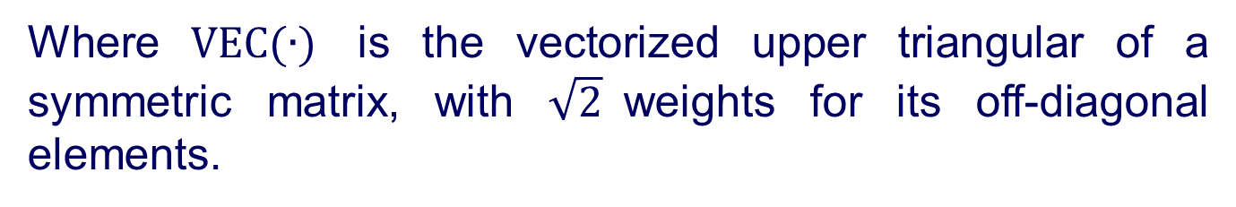

Andrew and Erna Viterbi
Faculty of Electrical Engineering
Signal and Image Processing Lab
Estimating Brain Activation Patterns from EEG Data
Gal Maman, Supervised by Or Yair
Introduction
Riemannian Geometry
Results
Problem:
Popular modalities for brain imaging are not always feasible or available at early stages of the illness.
Goal:
A system that can be applied at the bedside of critically-ill patients, detect neurological injury, aid in guiding therapy and improve outcomes.
Solution:
Research brain activity using EEG monitoring:
Measures voltage fluctuations resulting from ionic current within the neurons of the brain.
Noninvasive, with the electrodes placed along the scalp.
Framework:
Let $ℳ$ be the Riemannian Manifold of all SPD matrices.
Let $P_{1},P_{2}∈ℳ$, the Riemannian Geodesic distance is given by:
The Riemannian mean of the set ${\left\{P_{i}\right\}}_{i}$ is given by:
We denote with $𝒯_{\overline{P}}ℳ$ the tangent space at $\overline{P.}$
For each $P_{1}∈ℳ$we can define the logarithmic mapping to the tangent plane by:
We denote the vector representation $VEC(∙)$:
$S_{1}=$ $s_{1}=VEC\left(S_{1}\right)=$
Previous work – projecting all the matrices in the data set into an Euclidean tangent space located in the Riemannian mean of the entire data set.
Our algorithm holds for any SPD matrix, in our implementation we used covariance matrices as features.
$$δ_{R}\left(P_{1},P_{2}\right)≜{\left\|\log\left({P_{1}}^{−1}P_{2}\right)\right\|}_{F}$$
Single shot EEG classification:
First data set: $2$ healthy subjects, $3$ stimuli Visual results:
$$\overline{P}≜arg\min_{P}{\sum_{i}{δ_{R}^{2}(P,P_{i})}}$$
$$S_{1}={Log}_{\overline{P}}P_{1}{≜\overline{P}}^{\frac{1}{2}}\log\left({\overline{P}}^{−\frac{1}{2}}P_{1}{\overline{P}}^{−\frac{1}{2}}\right){\overline{P}}^{\frac{1}{2}}$$
Objectives
$${\left\|S_{1}−S_{2}\right\|}_{F}\tilde{=} δ_{R}(P_{1},{ P}_{2})$$
Second data set: $8$ healthy subjects, $3$ stimuli For each approach, we trained and applied linear SVM classifier using “leave one subject out” method.
Visual results:
Classification results:
Single shot EEG classification.
Spatial sub-sampling.
Raw Data
Where $VEC(∙)$ is the vectorized upper triangular of a symmetric matrix, with $\sqrt{2}$weights for its off-diagonal elements.
$11$healthy volunteers ranged in age from $7$ to $16$years.
$5$ critically-ill patients ranged in age from $2.5$ to $16$years; all with various brain injuries.
The stretchable electrode cap contained $64$EEG electrodes.
The set-up consists of three types of stimuli: somatosensory, auditory and visual.
Parallel Transport (PT)
Let ${\overline{P}}^{\left(1\right)}$and ${\overline{P}}^{\left(2\right)}$ be the Riemannian means of subsets ${\left\{P_{i}^{\left(1\right)}\right\}}_{i}$ and ${\left\{P_{i}^{\left(2\right)}\right\}}_{i}$ .
Project ${\left\{P_{i}^{\left(2\right)}\right\}}_{i}$ into the tangent plane $𝒯_{{\overline{P}}^{(2)}}ℳ.$
Apply PT to ${\left\{S_{i}^{\left(2\right)}\right\}}_{i}$ along the geodesic path $φ$ between ${\overline{P}}^{\left(1\right)}$ and ${\overline{P}}^{(2)}:$
$$Γ_{i}^{(2)}=Γ\left(S_{i}^{\left(2\right)}\right)=E S_{i}^{(2)}E^{T}$$
$$E≜{\left({\overline{P}}^{\left(1\right)} {\left({\overline{P}}^{(2)}\right)}^{−1}\right)}^{\frac{1}{2}}$$
The final data contains $200−1000$ trials for each stimulus ($9$ stimuli) from every subject ($16$subjects).
System Diagram
We denote ${\left\{z_{i}^{\left(1\right)}\right\}}_{i},{\left\{z_{i}^{\left(2\right)}\right\}}_{i}$ to be the vector representations of${\left\{Γ_{i}^{\left(1\right)}\right\}}_{i},{\left\{Γ_{i}^{\left(2\right)}\right\}}_{i}$respectively, and $Z^{\left(1\right)},Z^{\left(2\right)}$ to be the matrices composed by those vectors.
Spatial sub-sampling
$1$healthy subject, $2$ somatosensory stimuli. Succeed preserving the data structure using $2$ electrodes only.
$$⋮$$
$$⋮$$
Rotation Using PCA
compute $U^{(1)},U^{(2)}$, the left principal directions of $Z^{(1)},Z^{(2)}$
Compute and substitute:
$∀j:u_{j}^{\left(2\right)}←sign\left(\left\langle u_{j}^{\left(1\right)},u_{j}^{\left(2\right)}\right\rangle \right)u_{j}^{\left(2\right)}$
where $u_{j}^{\left(i\right)}$ is the $j$th column of $U^{\left(i\right)}$.
Project subsets to the new
coordinate system:
${ Y}^{\left(i\right)}={\left(U^{\left(i\right)}\right)}^{T}Z^{\left(i\right)}, i=1,2$
Preprocessing:
BP filter
Down sampling
Disqualify trials and reject noisy electrodes
Features extraction: SPD matrices
Features processing
Conclusions
Classification
We managed to obtain improved classification performance using PT and rotation, especially with stimuli from different functional areas.
We proved that the data can be sub-sampled ($2−5$electrodes).
Somatosensory
Auditory
Visual
In collaboration with Dr. Danny Eitan
July 2018

