Slide 1
May 21, 2018

Slide 2
Trials over time

Slide 3
I took 120 trials from each stimulus and subjects with steps of 2: ‘1 : 2 : 240’

Slide 7
New Features

Slide 8
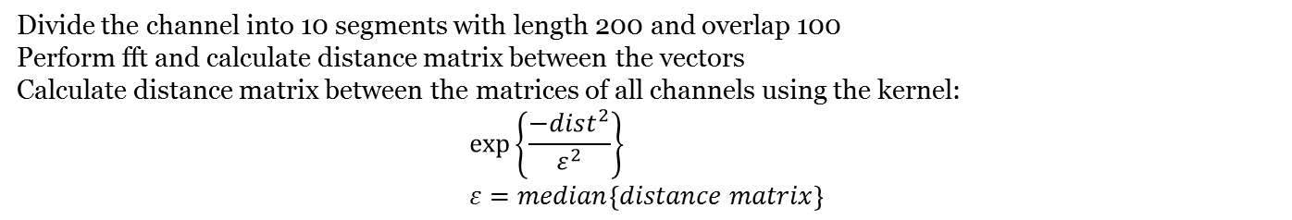
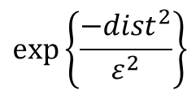
Divide the channel into 10 segments with length 200 and overlap 100
Perform fft and calculate distance matrix between the vectors
Calculate distance matrix between the matrices of all channels using the kernel:
$$\exp\left\{\frac{−dist^{2}}{ε^{2}}\right\} \\ ε=median\left\{distance matrix\right\}$$
$$\exp\left\{\frac{−dist^{2}}{ε^{2}}\right\}$$
covariance

Slide 9
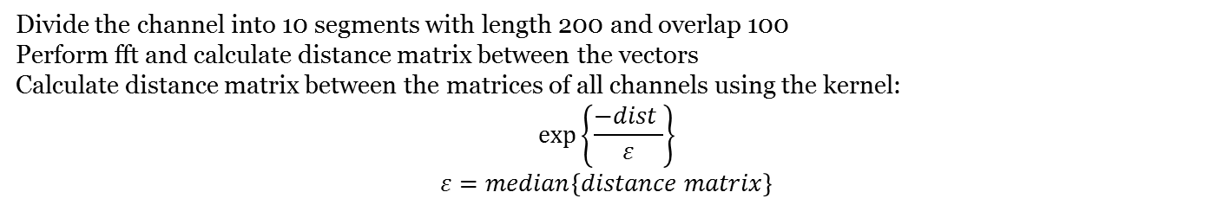
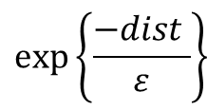
Divide the channel into 10 segments with length 200 and overlap 100
Perform fft and calculate distance matrix between the vectors
Calculate distance matrix between the matrices of all channels using the kernel:
$$\exp\left\{\frac{−dist }{ε}\right\} \\ ε=median\left\{distance matrix\right\}$$
$$\exp\left\{\frac{−dist }{ε}\right\}$$
covariance

Slide 10
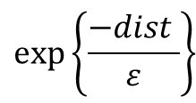
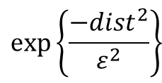
$$\exp\left\{\frac{−dist^{2}}{ε^{2}}\right\}$$
$$\exp\left\{\frac{−dist }{ε}\right\}$$
covariance

Slide 11
Find Optimal Electrode
2 somatosensory stimuli

Slide 12
Subject C01, Stimuli 1,2
60 electrodes

Slide 13
Subject C02, Stimuli 1,2
63 electrodes

Slide 14
Subject C03, Stimuli 1,2
63 electrodes

Slide 15
Subject C04, Stimuli 1,2
53 electrodes

Slide 17
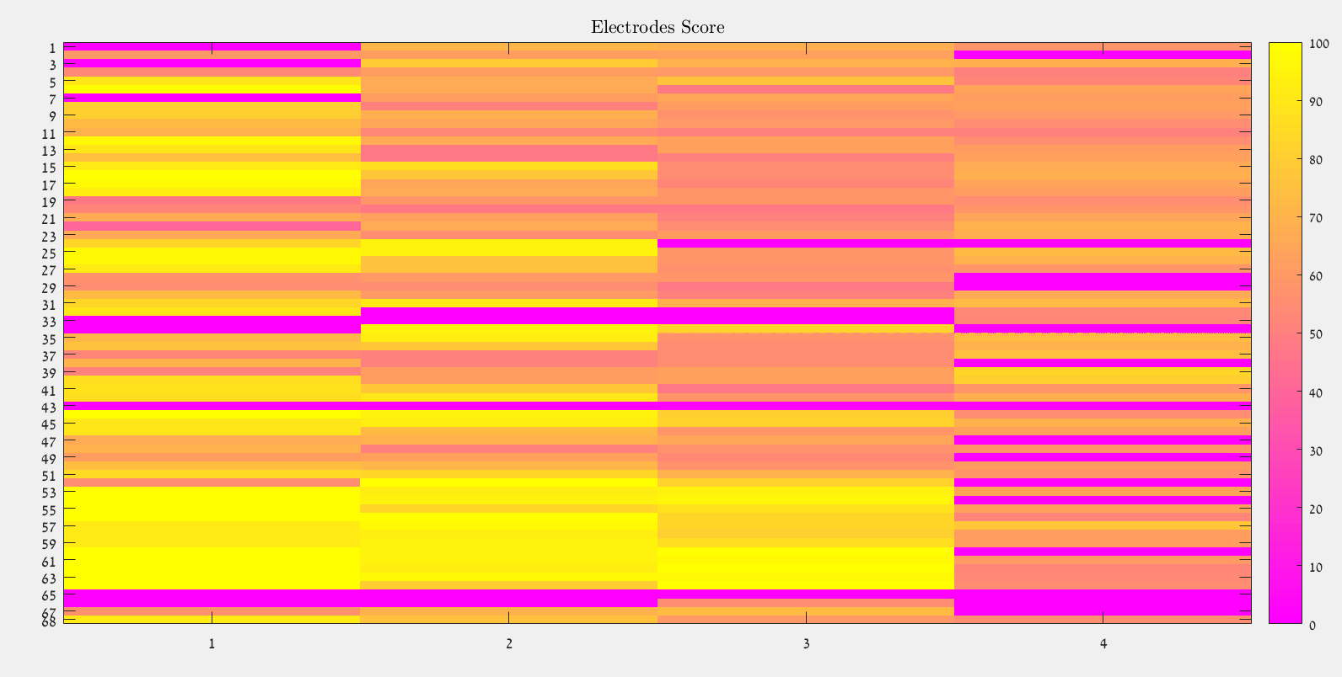

Slide 18
Find Optimal Electrode
2 auditory stimuli

Slide 19
Subject C01, Stimuli 11,14
60 electrodes

Slide 20
Subject C02, Stimuli 11,14
63 electrodes

Slide 21
Subject C03, Stimuli 11,14
63 electrodes

Slide 22
Subject C04, Stimuli 11,14
53 electrodes

Slide 24
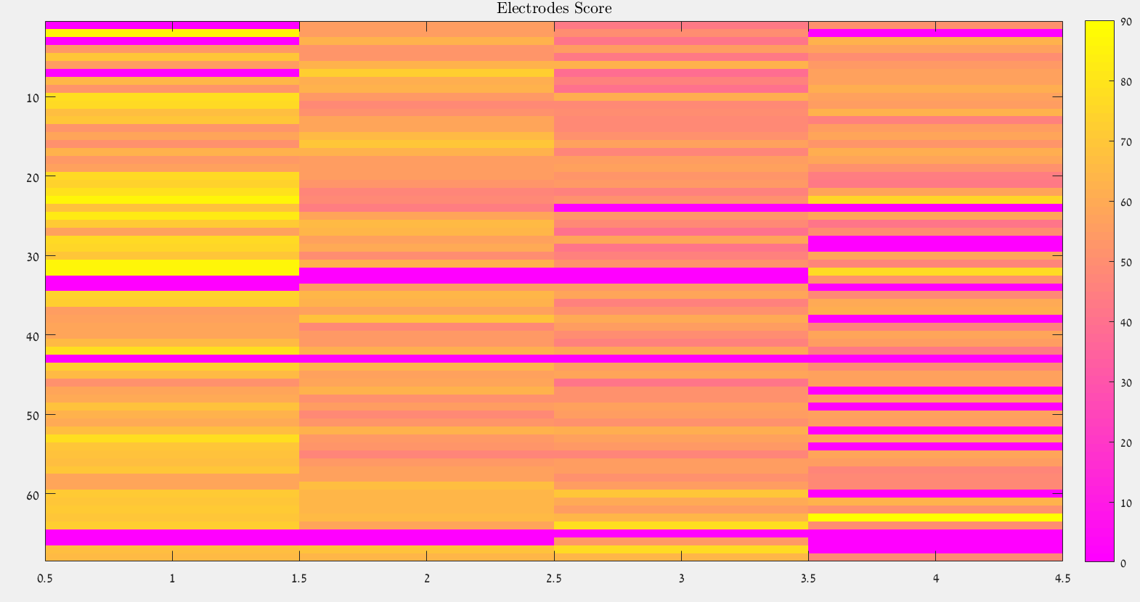

Slide 25
Find Optimal Electrode
2 auditory stimuli

Slide 26
Subject C01, Stimuli 11,15
60 electrodes

Slide 27
Subject C02, Stimuli 11,14
63 electrodes

Slide 28
Subject C03, Stimuli 11,14
63 electrodes

Slide 29
Subject C04, Stimuli 11,14
53 electrodes

Slide 31
