Slide 1
June 5, 2018

Slide 2
Find Optimal Electrode
2 electrodes
2 Auditory stimuli

Slide 3
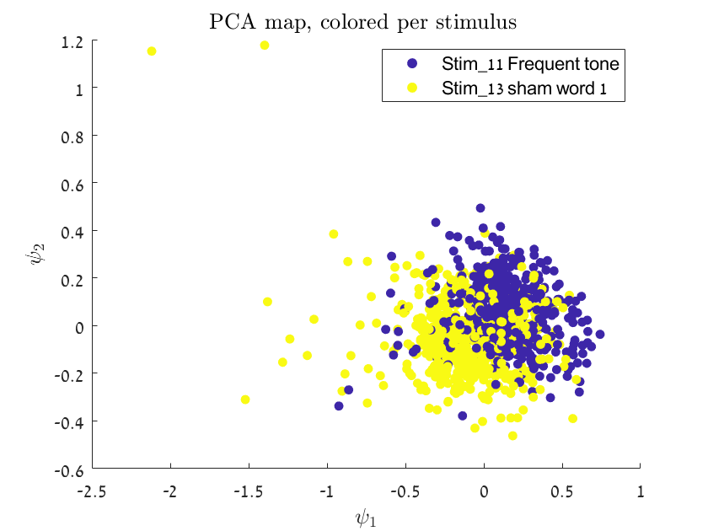
Subject C01, Stimuli 11,13
60 electrodes
Best: 59,64
86.5%

Slide 4
Subject C02, Stimuli 11,13
63 electrodes
Best: 7,8
84%

Slide 5
Subject C03, Stimuli 11,13
63 electrodes
Best: 2,42
87%

