Slide 1
Micro-Project #2 PPG
Presentors:
Oren Gal
Gendlin Liran
All of the pictures were taken at the same date of 18/03/2018 in 14:00P.M. to 13:00P.M. At a residence at Kiryat Mozkin.

Slide 2
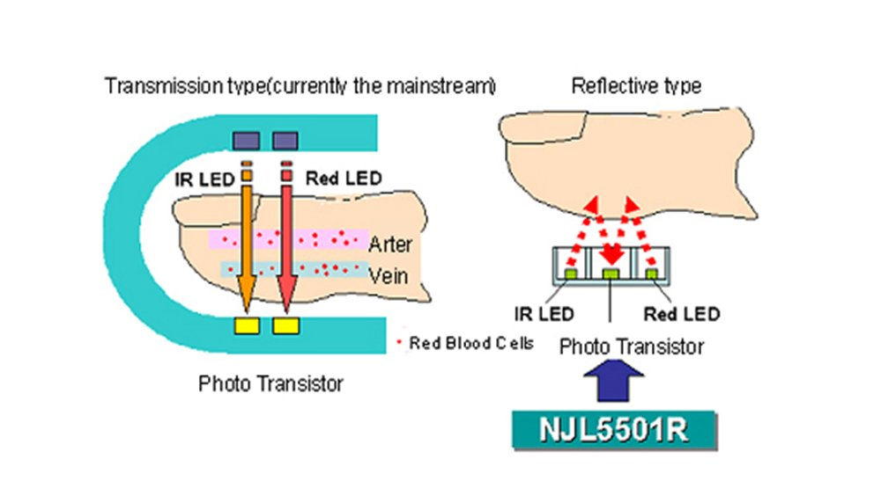
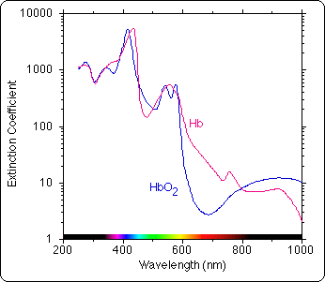
01. PPG: Theory
1. How PPG (photoplethysmogram) signal is measured, pre-processed and processed?
PPG signal is usually measured by an Oxygen meter (Pulse Oximeter).
After measurement 2 signals can be extracted:
The level of Hemoglobin inside the blood.
The level of Hemoglobin and Oxygen inside the blood.
After extraction the extracted signal is transferred through
an adaptive filter (for example: least mean square (LMS))
in order to remove noise artifacts.
After filtration the signal is transferred to a DSP processor
in order to extract information.

Slide 3
PPG: Theory
2. Typical noise and other signals mixed with PPG signal:
Motion artifacts caused by the subject, or by the surroundings, which have varying frequencies which may have the same range of the signal frequencies.
White Noise can be mixed with the PPG signal.
DC levels which contain: constant arterial blood absorption, venous blood absorption and tissue and bone absorption.
Heart beats which represents Human breathes can also be mixed with the PPG signal.

Slide 4
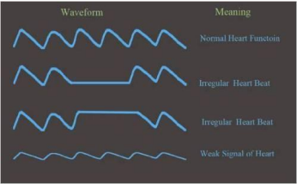
PPG: Theory
3. Which parameters of the PPG signal are important and why?
Local Amplitude of the specific PPG signal: indicates high or low heart pulse.
Local Period of heart beats: indicates on a fast or slow heart beats.
Rising time of the specific PPG signal: indicates the true
moment when the hearts beats occurs.
oxygen saturation, blood pressure and arterial stiffness,
cardiac output: can assess autonomic function
and detect peripheral vascular diseases.

Slide 5
PPG: Theory
4. Which DSP techniques are used to process and analyze PPG signal in the commercial devices?
least mean square (LMS) algorithm is used to extract the actual signal from the noisy filled signal.
FIR filtering for removing unwanted signals.
IIR filtering for DC removal.
Recording, in order to save a signal which was not checked upon.

Slide 6
PPG: Theory
5. When and how PPG RT monitoring can save life?
By monitoring Oxygen levels, Asthma attacks can be prevented long before an irreversible damage is occurred, Cerebral Vascular Accidents (Strokes) can be also be prevented.
By monitoring the BPM, the rate of blood pressure (high/low) can be deduced (we can find out if the blood is circulating in a correct pace).
In real time a patient can be immediately operated on if the reading of the PPG monitor are relevant to the situation.
The personal health care of old people is of great importance for prevention and rehabilitation. Continuous monitoring of vital parameters is essential for that aim.

Slide 7
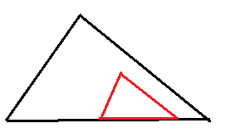
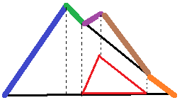
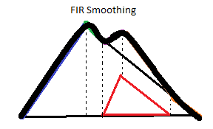
Model of the PPG Signal
Our Model was to build 2 triangles and separate them into 5 diagonal lines which go one by the other in order to create a signal which looks like PPG.
The line go in this order:
Large triangle ascent.
Large triangle descent.
Large triangle descent + small triangle ascent.
Large triangle descent + small triangle descent.
Large triangle descent.
Next we built a FIR filter to smooth the signal, so it will look like PPG.
We decide that the corner frequency of the FIR filter will be 3Hz because the spectrum of a heart beat signal behave closely to a sine wave, and that is why its frequencies are determined by the signal period, we can determine BPM=60*Fsignal.

Slide 8
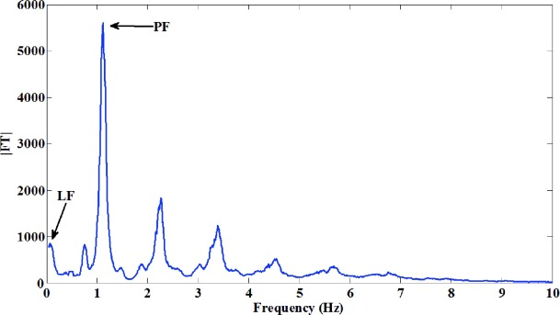
02. Model of the PPG Signal
The AC component of the PPG signal depends on the heart rate which varies around 1-1.4Hz.
https://www.sciencedirect.com/science/article/pii/S0960077915001344

Slide 9
Model of the PPG Signal
According to Wingate Institute the typical values of BPM at rest for adults and babies are between 120-40(, that’s why the maximal frequency is around 2Hz. We took a safety distance and took 3Hz as the corner frequency.
https://www.wingate.org.il/Index.asp?ArticleID=5900&CategoryID=105
We design according to the worst case scenario, if our BPM is smaller our signal will be more filtered.
If we use a BPM which is too small, we might filter parts out of the signal itself, and that is why our BPM is limited to 40 which is the minimal value for a human in good condition in rest.
Our signal frequency range is around: 40BPM/60 - 120BPM/60 = 2/3 – 2 Hz.

Slide 10
03. Arduino Due as a generator of the PPG signal + White Noise
03. Arduino Due as a generator of the PPG signal + White Noise

Slide 11
Signal creation in Arduino
We connect 5 signals (of diagonal lines) together in order to create out PPG signal (total signal length is 200 samples in the default signal) (max amplitude of the default signal is 0.5 volts).
1st signal starts from 0 till the Rising time (0.2 of signal length). The signal ascents from 0 to 0.5 volts.
2nd signal starts from the Rising time till 0.4 of the signal length. The signal descents from 0.5 volts to 0.375 volts.
3rd signal starts from 0.4 of the signal length till 0.5 of the signal length. The signal ascents from 0.375 volts to 0.412 volts.
4th signal starts from 0.5 of the signal length till 0.85 of the signal length. The signal descents from 0.412 volts to 0.0937 volts.
5th signal starts from 0.85 of the signal length till the end of the signal. The signal descents from 0.0937 volts to 0 volts.
Amplitude values can be changed around 0-0.5 volts, a value outside this range is intercepted by an error message (maximum digital value (4096/3.3)*0.5 =621 bits).

Slide 12
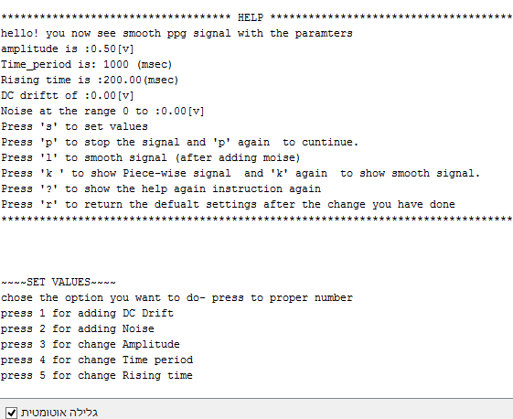
Arduino PPG Signal GUI

Slide 13
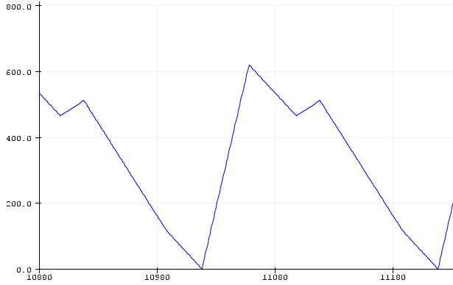
Arduino PPG Signal Piece-wise model

Slide 14
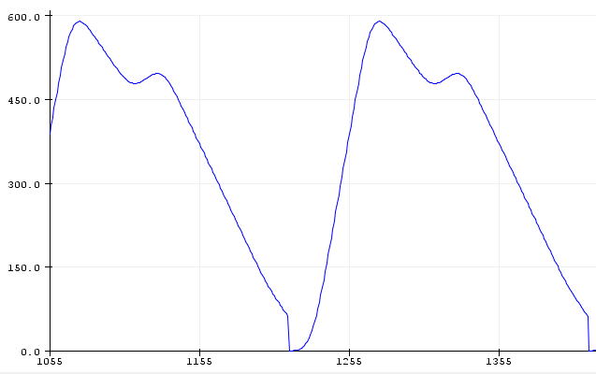
Arduino PPG Signal smoothing

Slide 15
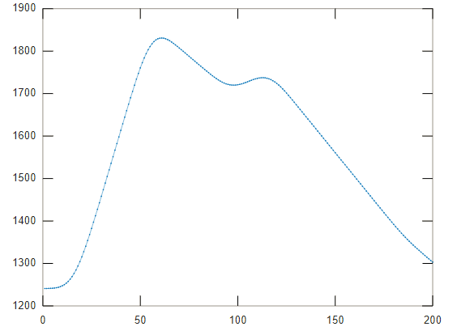
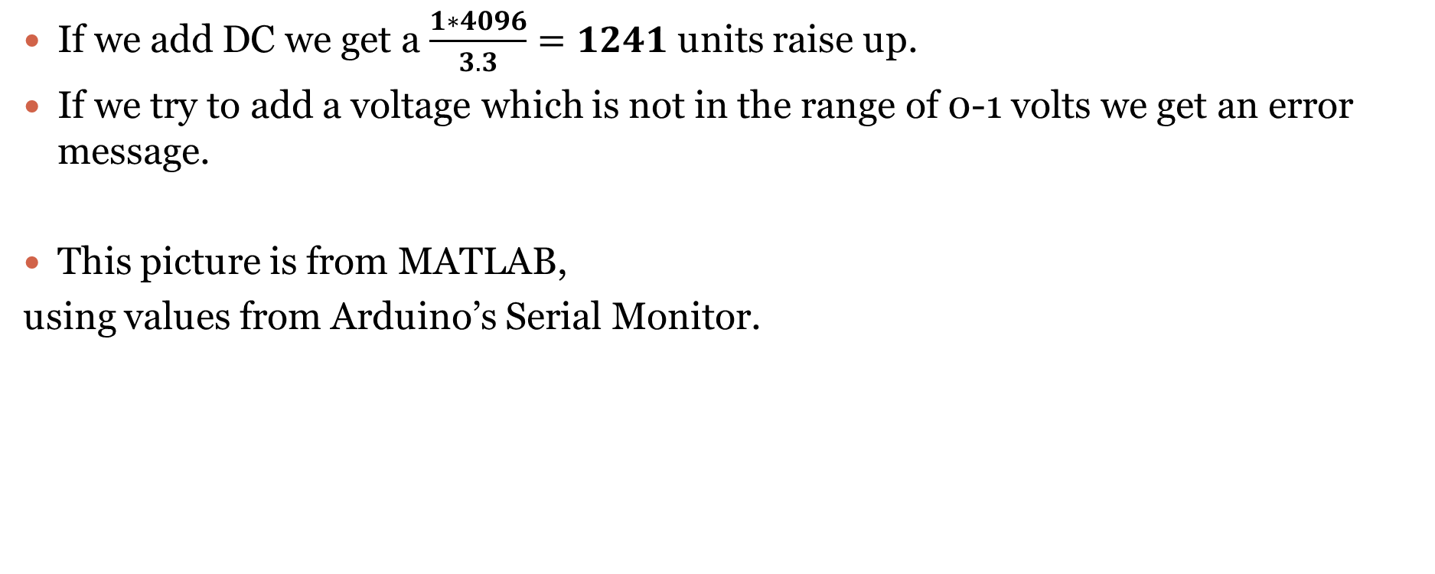
1 volt DC addition
If we add DC we get a $\frac{1∗4096}{3.3}=1241$ units raise up.
If we try to add a voltage which is not in the range of 0-1 volts we get an error message.
This picture is from MATLAB,
using values from Arduino’s Serial Monitor.

Slide 16
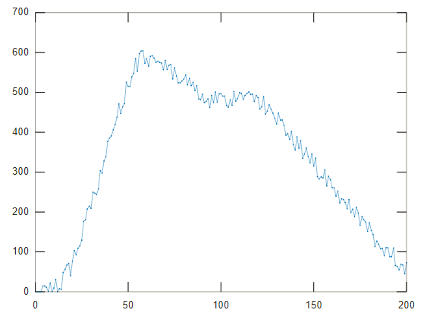
0-0.05 volts Noise addition
A noise which is not in this range (0-0.05 volts) is intercepted by an error message appear at the Serial Monitor.
Here we also check for the amplitude limits (0 -0.5 volts).
In the picture ahead the Noise addition
value added is 0.02 volts.

Slide 17
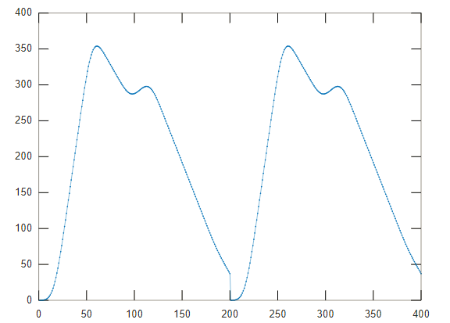
Amplitude Change
The amplitude can be changed between 0-0.5 volts.
In the picture ahead we use 0.3 volts amplitude

Slide 18
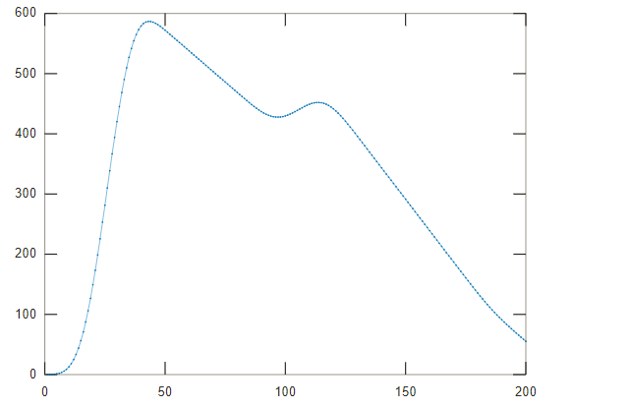
Rising time change
There is a possibility to change the raising time in the range: 0.1 - 0.3(length_of_signal*time_of_interrupt).
In the picture ahead the rising time was changed from 300mSec to 100mSec.

Slide 19
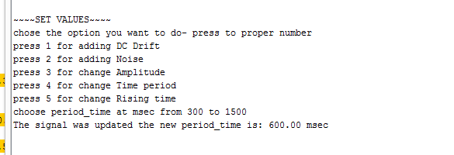
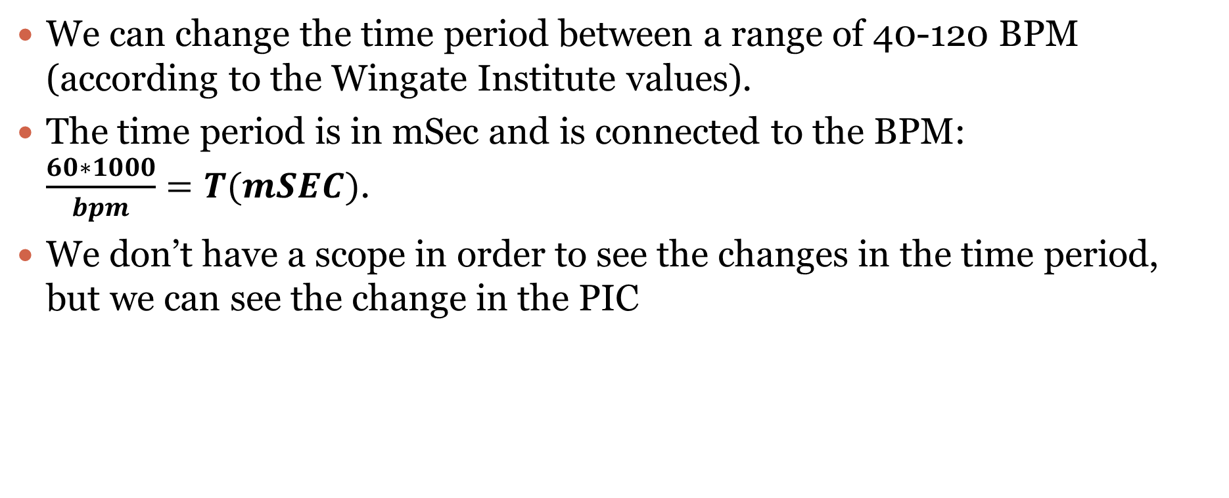
Time period Change
We can change the time period between a range of 40-120 BPM (according to the Wingate Institute values).
The time period is in mSec and is connected to the BPM: $\frac{60∗1000}{bpm}=T(mSEC)$.
We don’t have a scope in order to see the changes in the time period, but we can see the change in the PIC

Slide 20
Other options in the Arduino code
A Manu which shows the signal parameters is always present for help.
By pressing ‘s’ a Manu of value changes appears.
The signal presentation can be stop/continued by pressing ‘p’.
By pressing ‘r’ you return to the default values of the signal.
By pressing ‘k’ a Piece-wise model of the signal is shown, pressing ‘k’ again will return the signal back to a smooth model (filtration by a 30 coefficients and 4Hz corner frequency Filter).
By pressing ‘l’ the noise can be filtered by the filter which smoothed the Piece-wise signal.
‘?’ is for HELP Manu.
* There is a delay of 7 sec in order to see both serial plotter and serial monitor.

Slide 21
04. PIC32 PPG Monitor
04. PIC32 PPG Monitor

Slide 22
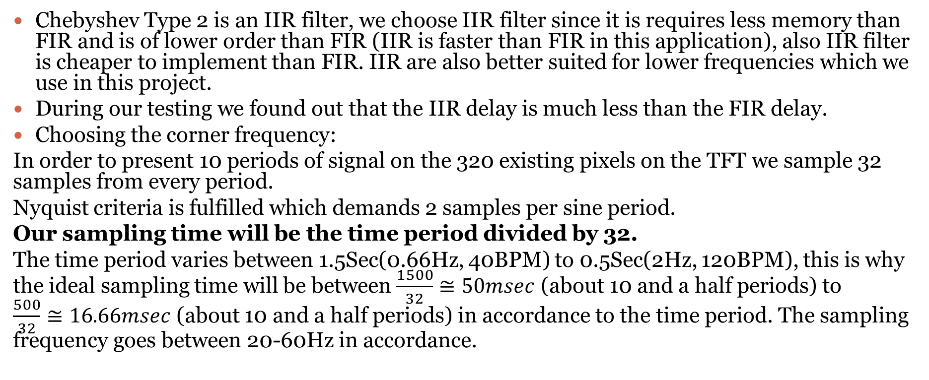
Designing a Chebyshev Type 2 Filter.
Chebyshev Type 2 is an IIR filter, we choose IIR filter since it is requires less memory than FIR and is of lower order than FIR (IIR is faster than FIR in this application), also IIR filter is cheaper to implement than FIR. IIR are also better suited for lower frequencies which we use in this project.
During our testing we found out that the IIR delay is much less than the FIR delay.
Choosing the corner frequency:
In order to present 10 periods of signal on the 320 existing pixels on the TFT we sample 32 samples from every period.
Nyquist criteria is fulfilled which demands 2 samples per sine period.
Our sampling time will be the time period divided by 32.
The time period varies between 1.5Sec(0.66Hz, 40BPM) to 0.5Sec(2Hz, 120BPM), this is why the ideal sampling time will be between $\frac{1500}{32}≅50msec$ (about 10 and a half periods) to $\frac{500}{32}≅16.66msec$ (about 10 and a half periods) in accordance to the time period. The sampling frequency goes between 20-60Hz in accordance.

Slide 23
Designing a Chebyshev Type 2 Filter.
Because we want about 10 periods on the screen as well as a corner frequency which filters the noise without harming the data in the signal, we will take sampling frequency as the average 40Hz
(taking 20Hz as the sampling frequency would’ve allowed 10 periods on the screen, but the change between 40-120 BPM would have been more significant and would have allowed more noise to appear at the signal).
40Hz allows 5 periods at 40BPM and 15 periods at 120BPM.
The corresponding sampling time is 25msec.

Slide 24
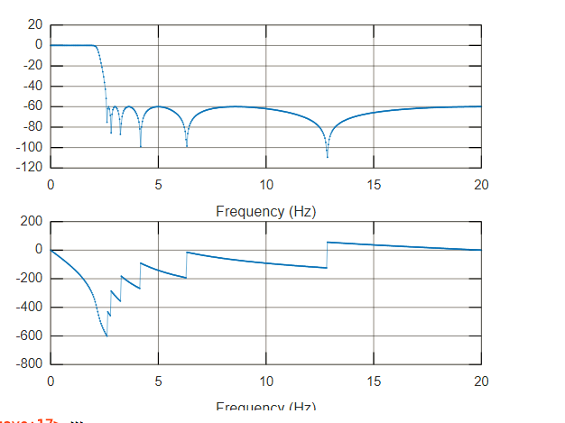
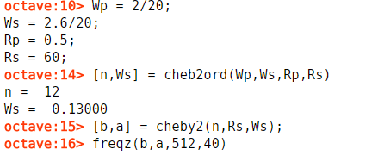

Designing a Chebyshev Type 2 Filter.
We will design our filter according to the corner frequency $\frac{2∗f}{fs}=\frac{2∗f}{40}=0.033−0.1$.
We will take a frequency which a little bit bigger than the corner frequency, since we want that even for the maximal BPM the signal will pass (more noise at lower BPMs).
Choosing Ws-the frequency for the edge of the pass band (while experimenting we found that 0.13 is enough).
Choosing rp=0.5dB waviness in the pass band.
Choosing rs=60dB attenuation after the edge of the pass band.

Slide 25
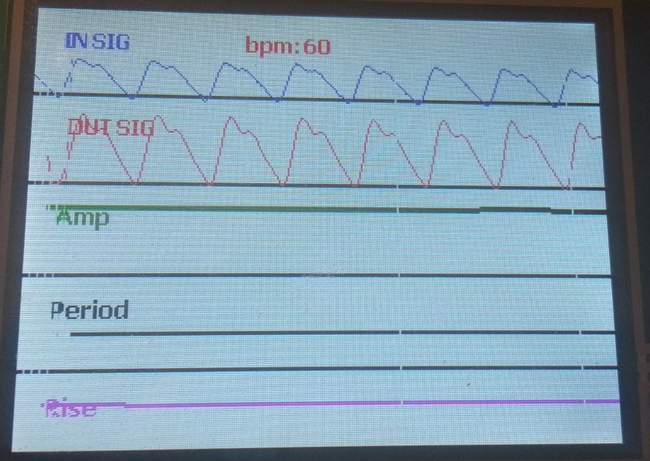
PIC GUI default signal

Slide 26
Finding Maximums and Minimums algorithm
We use the shape of the signal and we try to find a range in which grows monastically in the left of the point taken.
We go across the signal to find these points.
We also check for at least 2 indexes further from our point to check we don’t have a multiplication of the same values for one maximum (we only want 1 point to be taken from 1 maximum).
Same idea goes for minimum finding.

Slide 27
Calculating Amplitudes, Time Periods, Rising Times and BPM
Amplitudes: We hold an arrays of maximum values and their indexes, from them we deduce the amplitude.
Time periods: Period can be found by subtracting two indexes of minimums.
Rising times: Rising time can be found by subtracting a maximum index with a minimum index from before the maximum (we search first for the minimum).
BPM: first we must find the IBI (Inter Beat Interval), which is the true moment of start for the heart beat , which is the time it take to get to half of the amplitude (we 50%, but some Cardiologists assume its at 25% of the rise) (we presume our rise is linear):
IBI = minimum index + (PPG period)/2
BPM can be found by dividing our sampling frequency or our timer with an average of IBI values (we find an average of the amount of IBI values which appear on 1 screen iteration):
BPM = Finterupt/IBI average

Slide 28
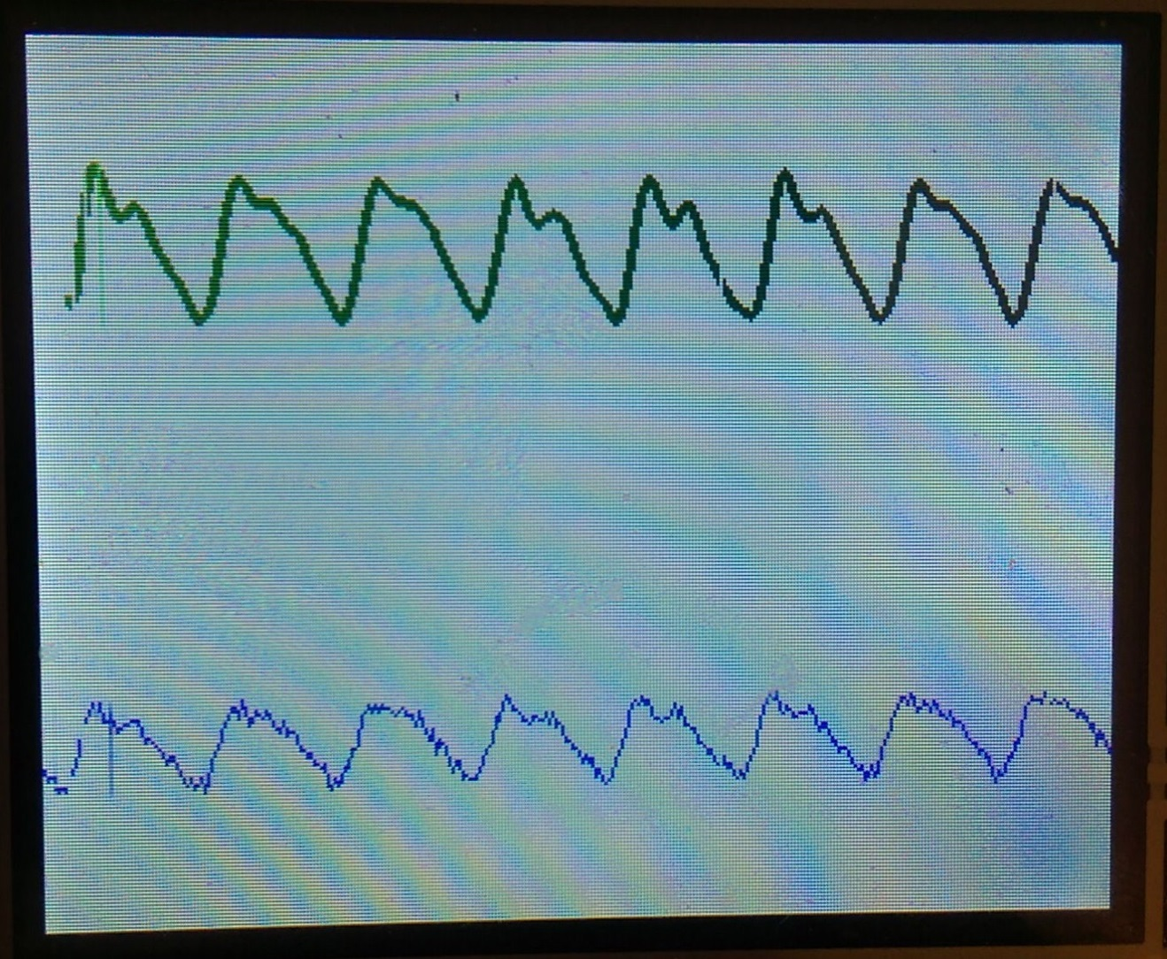
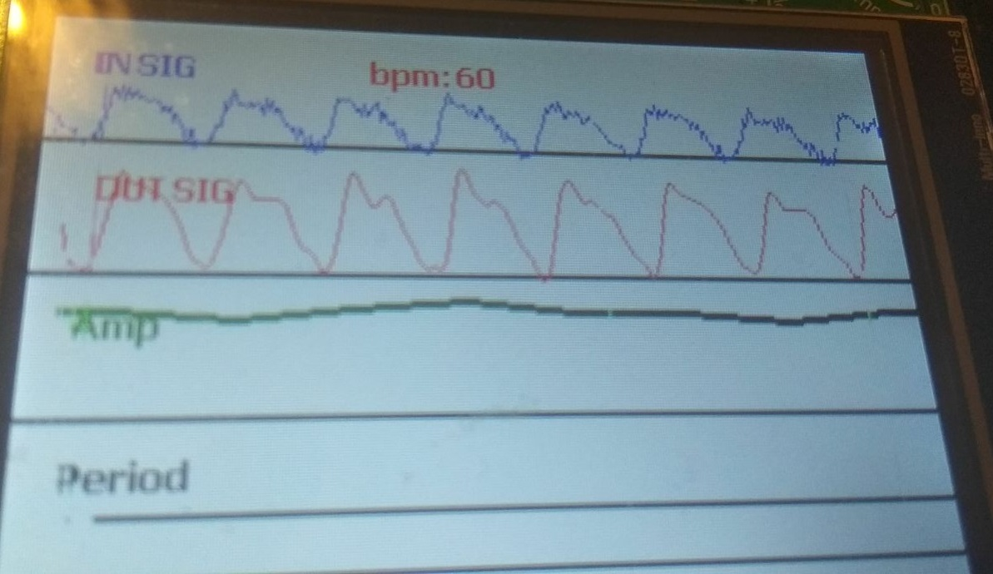
Tests Documentation Of PPG Monitor
Filtering a Noise filled PPG using IIR Filtration:

Slide 29
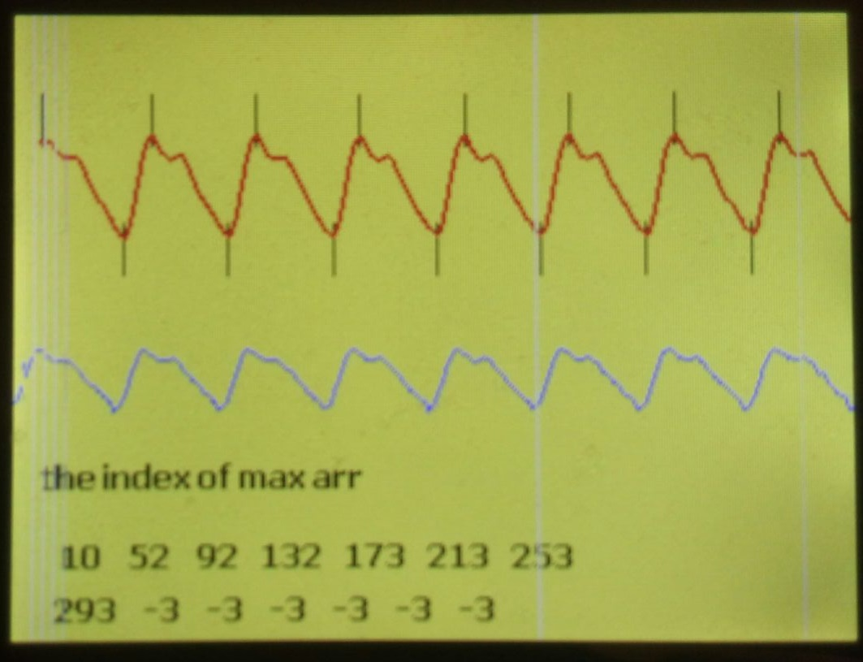
Tests Documentation Of PPG Monitor
Finding maximums and minimums in the signal in order to progress:
Our found maximums and minimums while programing were marked with a line.

Slide 30
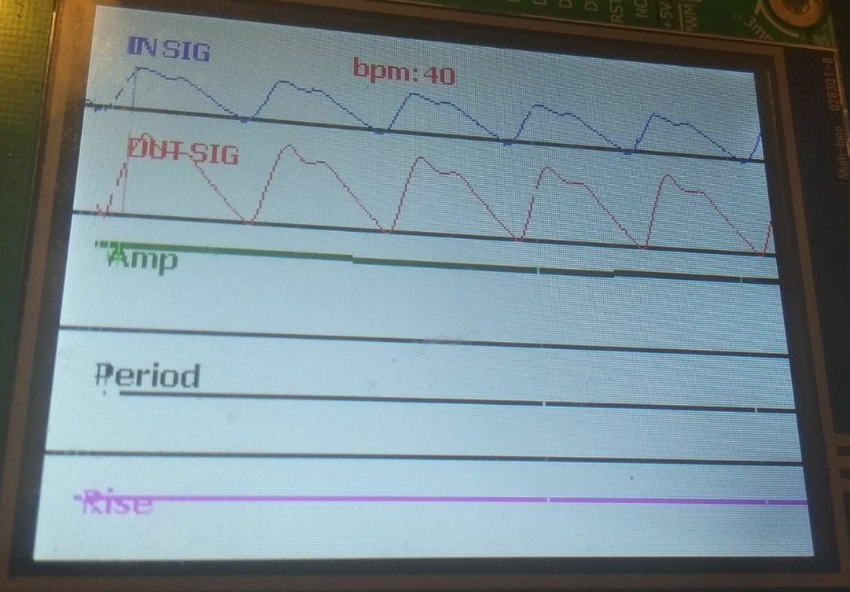
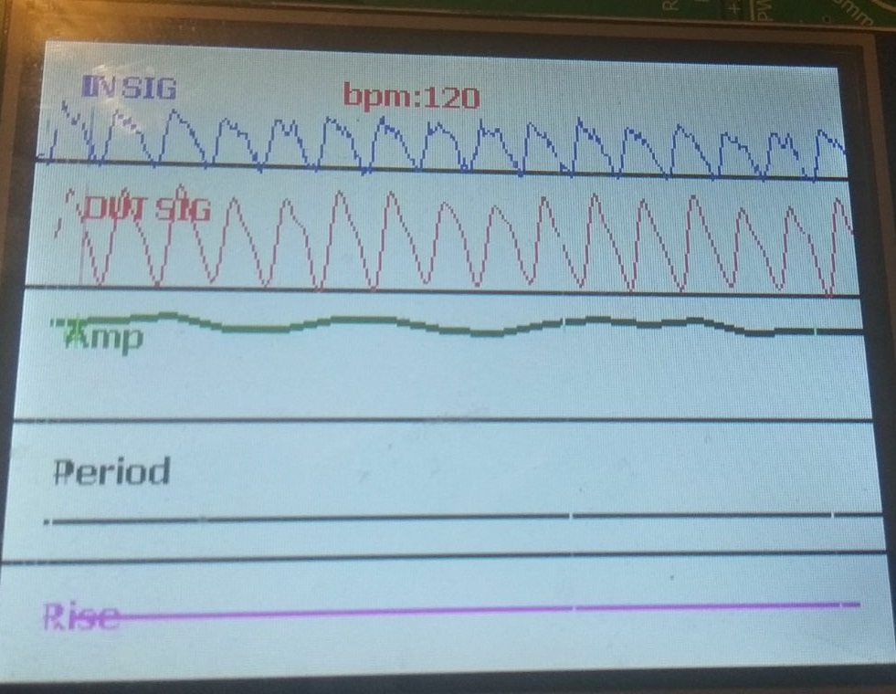
Tests Documentation Of PPG Monitor
Showing that there is maximum 15 pulses and minimum 5 pulses of signal.

Slide 31
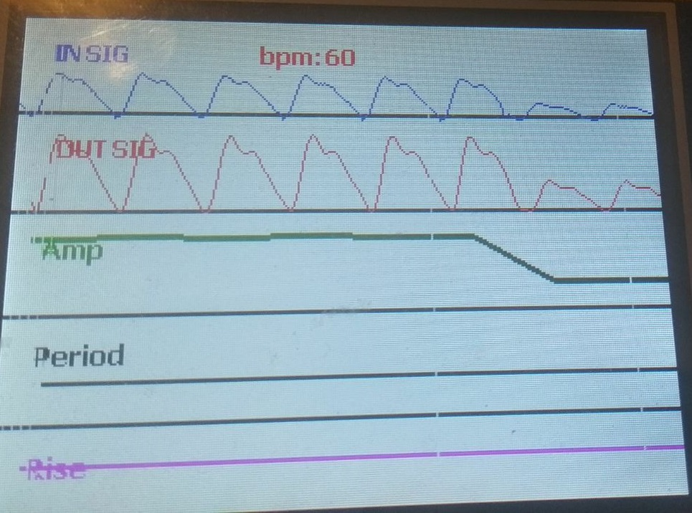
Tests Documentation Of PPG Monitor
Changing amplitude to 0.2 volts.

Slide 32
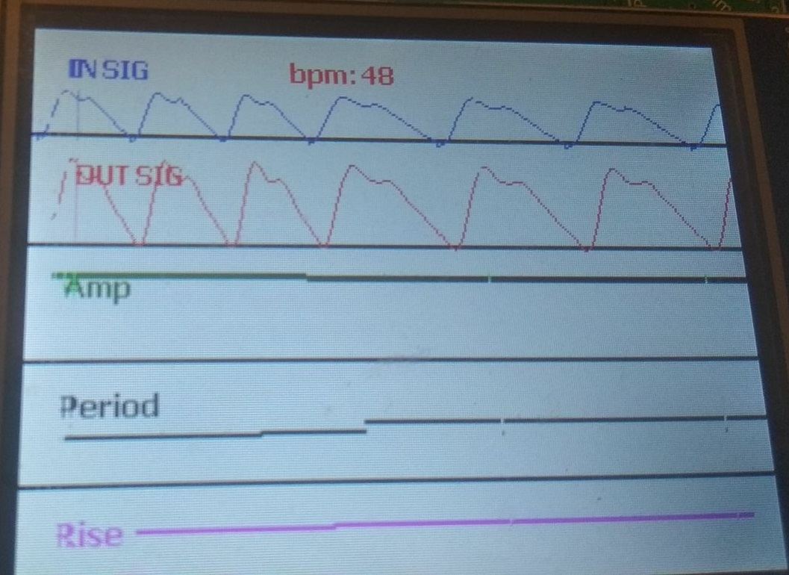
Tests Documentation Of PPG Monitor
Changing time Period

Slide 33
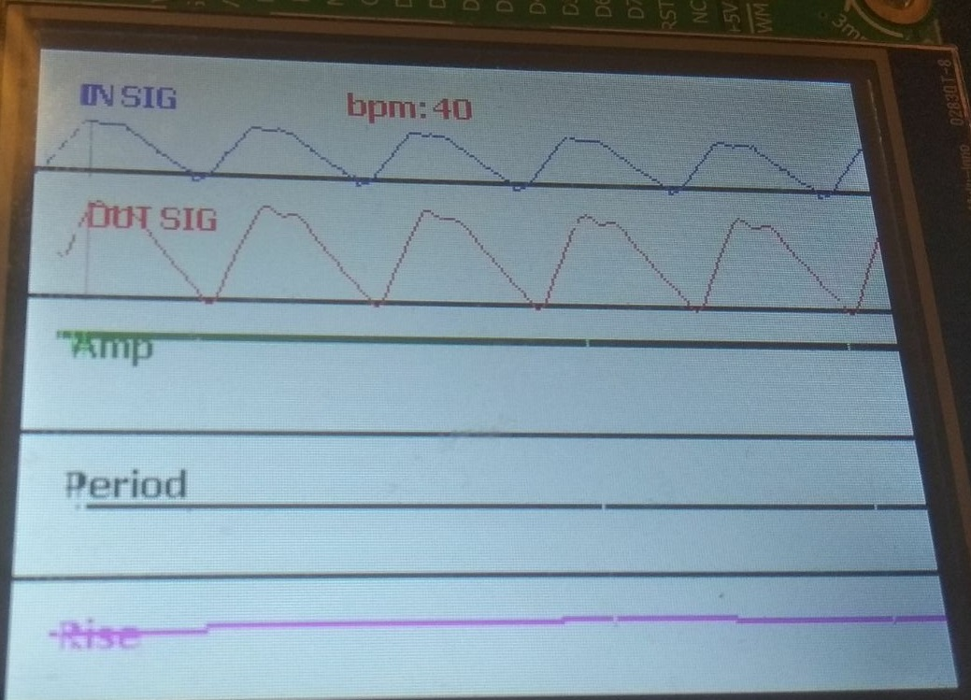
Tests Documentation Of PPG Monitor
Changing rising time from 200 mSec to 450 mSec

Slide 34
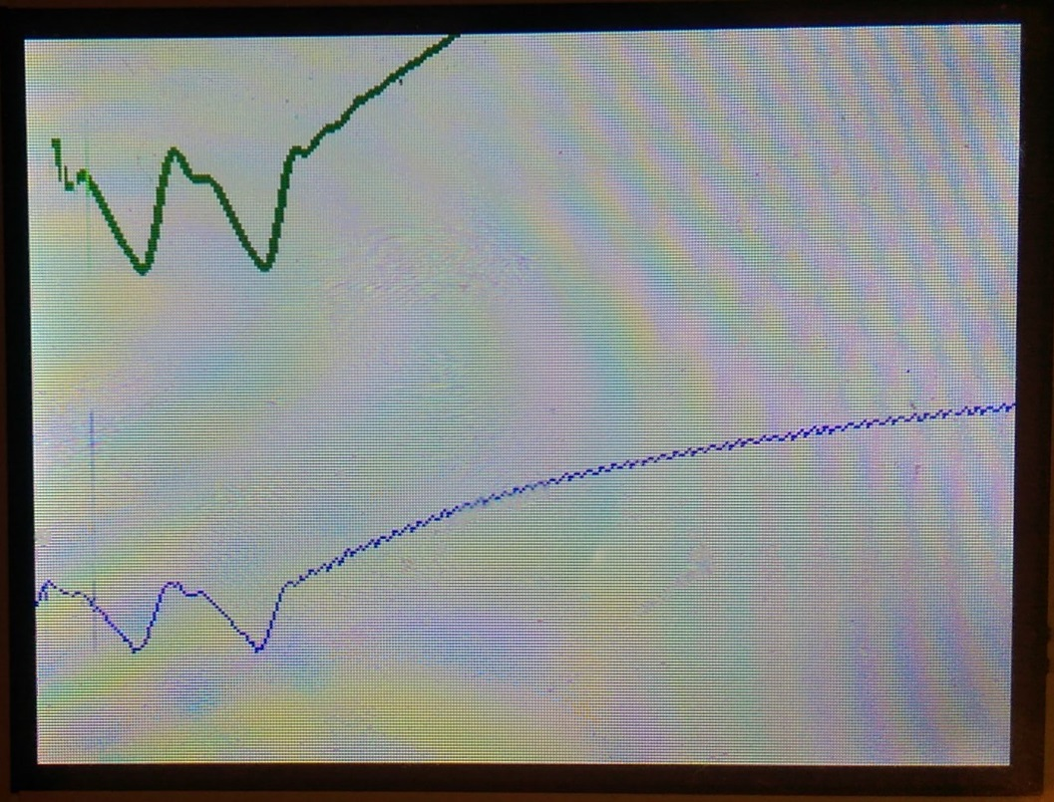
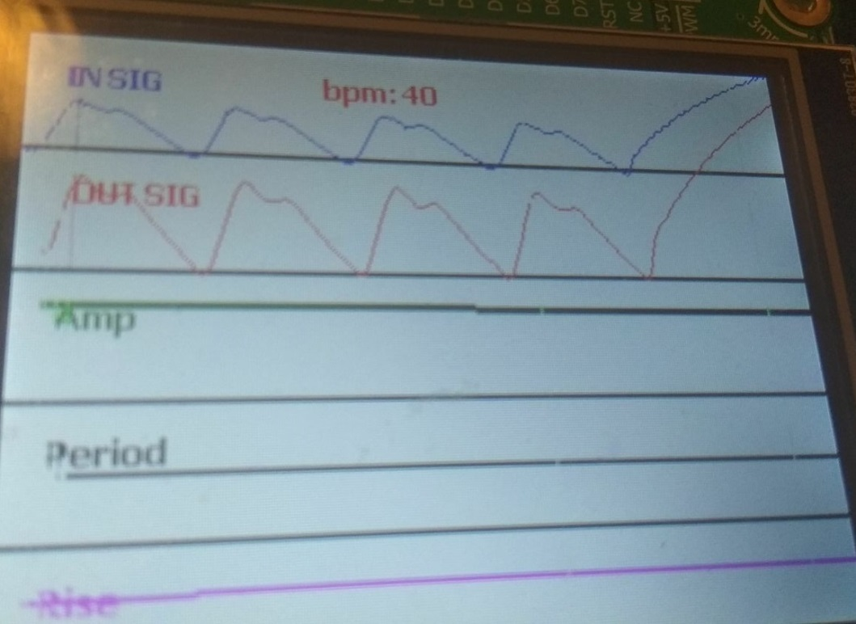
Evaluation for PPG Monitor accuracy in real life
If suddenly the connection between the Arduino and PIC32 is broken and then put back (an effect similar to motion artifact), the signal will be distorted and the authorized personnel which check the Monitor, might think an emergency is happening, while nothing of importance has happened.

Slide 35
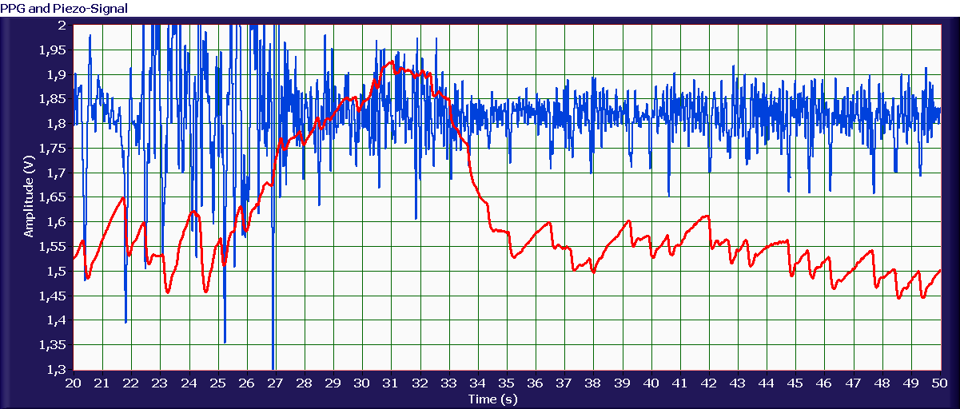
Evaluation for PPG Monitor accuracy in real life
One way of dealing with this kind of phenomenon is to generate a signal inside the PIC which the PPG signal will rely upon, it will be able to detect irregular disturbances and will not false alarm the authorized staff.
An other way is using a is to use a simple acceleration sensor of a piezoelectric element in order to get information about the desired signal or motion to estimate the motion artifact noise or to generate the reference signal in order to get the filtered one. This signal could differentiate whether or not there is a disconnection or an actual flaw in the PPG signal

