Slide 1

Tidy project
Ariel Ozary
Gal Rabin
https://github.com/GalRabin/cloud_course/tree/master/tidy

Slide 2
Project overview
Tidy project is a SAS solution which allow enterprise to install/update/fix existing employees development enviorment.
Terminology:
Users – User is configuration of PCs in the organization. (Username, Password, IP in VPN).
Profiles – Profile is configuration of set of tools used by specific Employee/Team in enterprise. (IDEs, git/svn etc)
Jobs – Jon is configuration of profile and user combined (User is part of specific team or multiple)

Slide 3
Demo Flow
Add/Delete user.
1
Add/Remove profile.
2
Add/Remove job.
3
Execute job.
4
Retrieve job status.
5
For demo purposes – We are using openVPN as our enterprise VPN server.

Slide 4
Technology stack
Server Side
AWS infrastructure – EKS, DynamoDB.
Programming language – Python (3-rd party packs – Ansible-runner, Flask).
Other – Ansible.
Client Side
AWS infrastructure – S3, CloudFront.
Programming language – JavaScript (React framework)

Slide 5
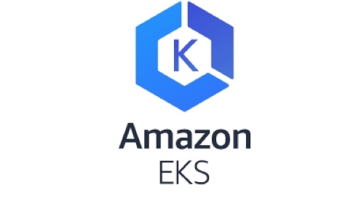
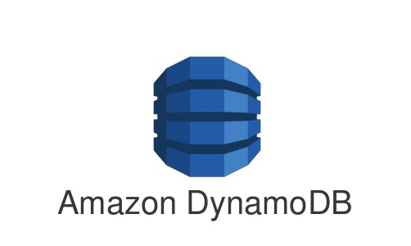
Server side

Slide 6
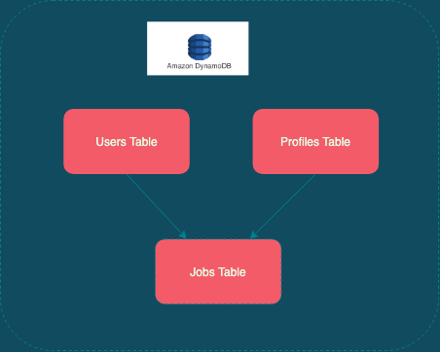
DynamoDB architecture

Slide 7
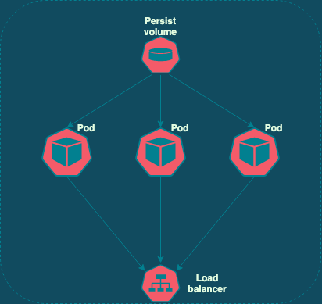
EKS – Overview

Slide 8
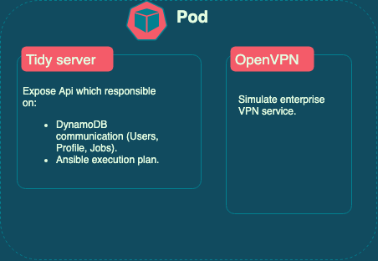
EKS – Pods

Slide 9
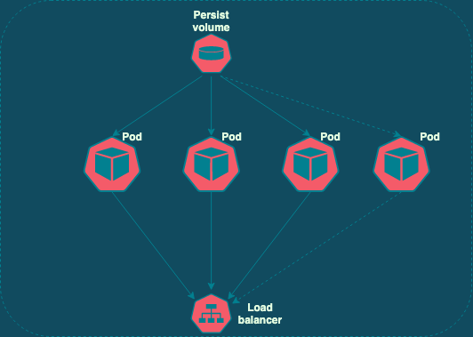
EKS – Scaling

Slide 10

Server - Code review Infrastructure review

Slide 11
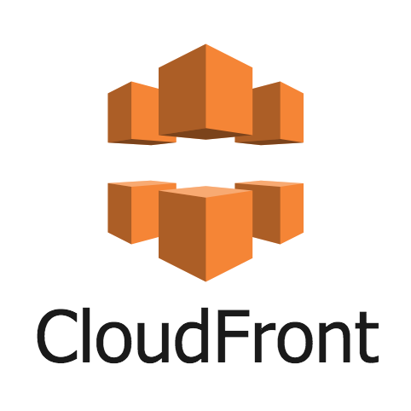
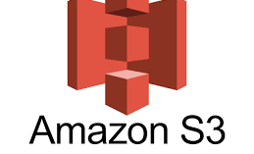
Client side

Slide 12
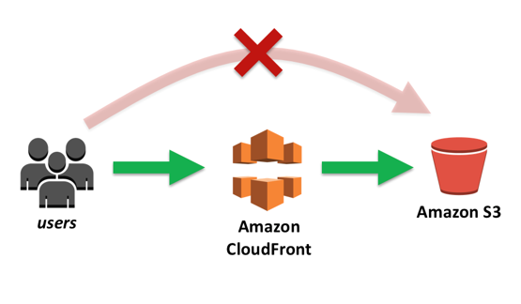
Hosting a static website on Amazon S3 using cloud-front

Slide 13
Client side - Code review

