Slide 1
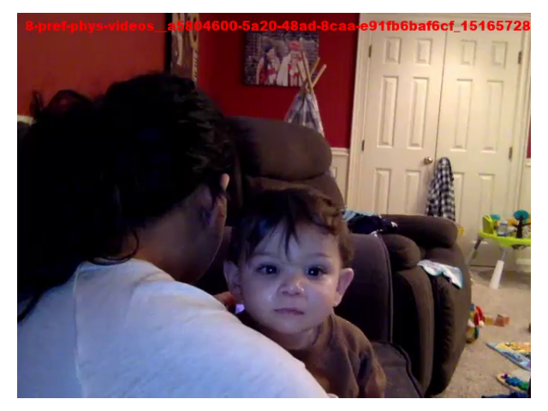
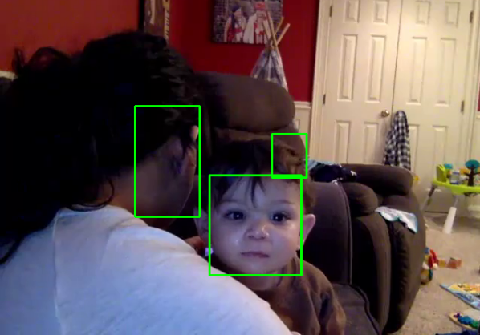
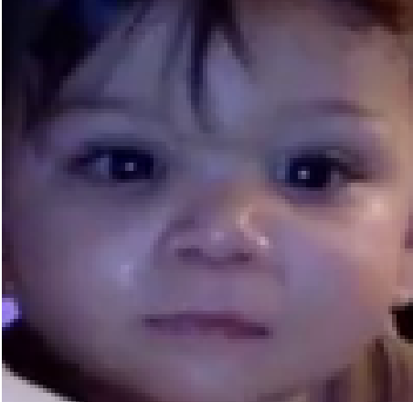
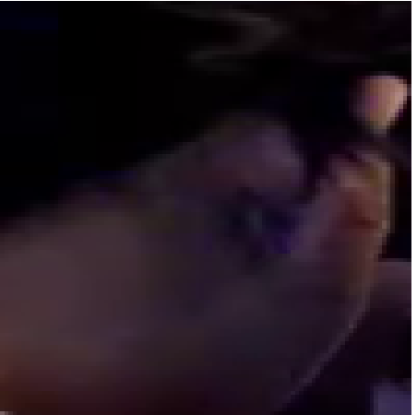
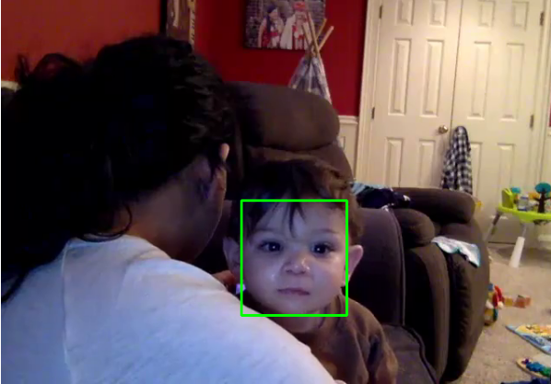
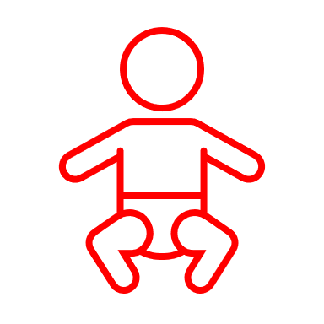
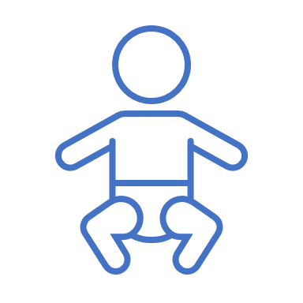
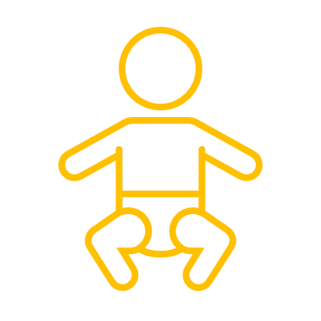

Face Detector
Face Classifier
Gaze Estimator
Away / Left / Right
(a)
(e)
0.71
0.34
0.82
W
0.95
(c)
(b)
Previous Frame
Current Frame
S
H
(X, Y)
(d)
Notes:
Video from:
/disk3/yotam/icatcher+/datasets/lookit_raw/videos/study-cfddb63f-12e9-4e62-abd1-47534d6c4dd2_child-4e3e2517-4788-45ae-94cb-1a0dbd22d4d7_video-a5804600-5a20-48ad-8caa-e91fb6baf6cf_privacy-public_video.mp4'

