Slide 1


Global Warming
final project
Gal Sar Israel
Mor Fishman

Slide 2
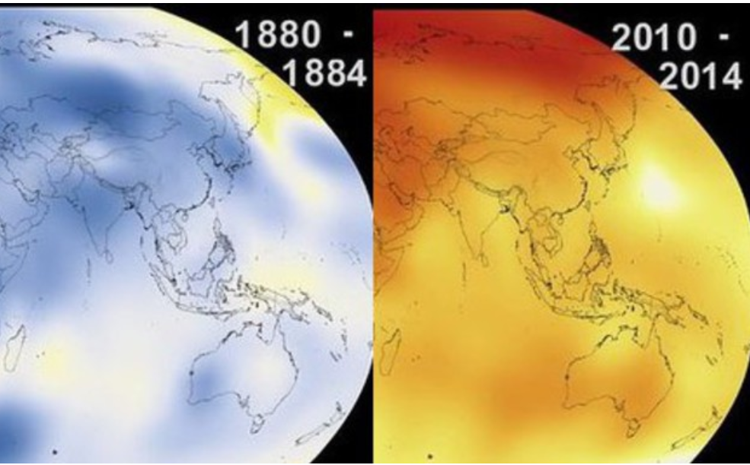
Our research - Intro
Can we understand what will be in 10 years from now with global warming?
Data acquisition
Exploratory data analysis
Machine Learning
Data cleaning

Slide 3
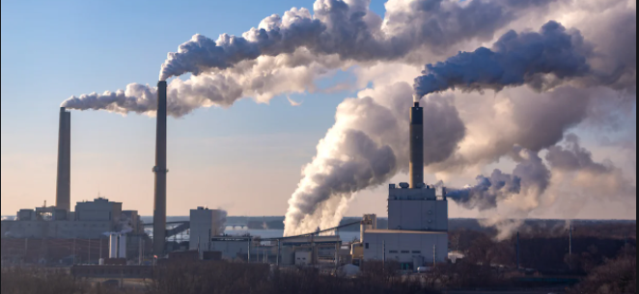
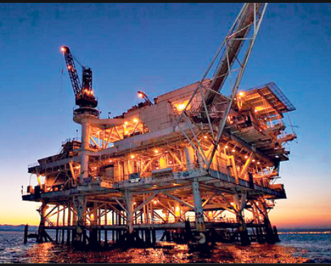
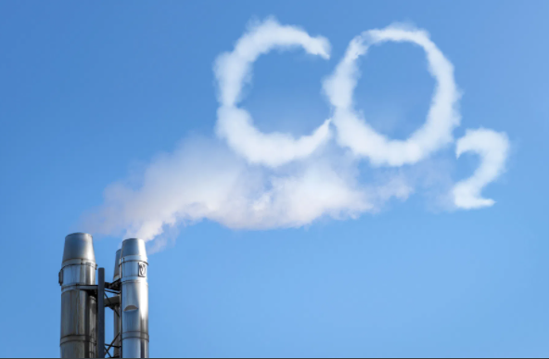
Our research - Intro
Main known effects that causes global warming:
CO2 Fossil
Oil industry
Natural gas

Slide 4
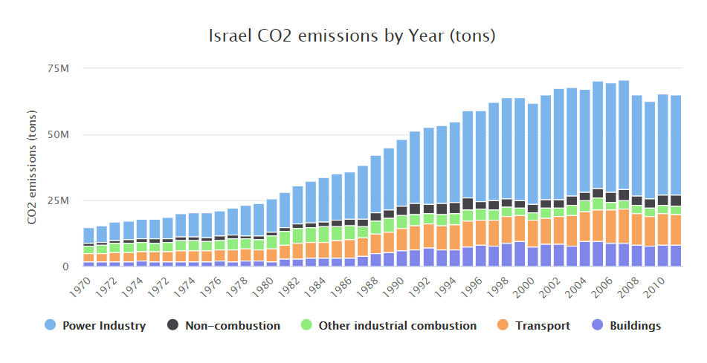
Data sources - crawling
One of the things that affects on global warming – CO2
For example

Slide 5
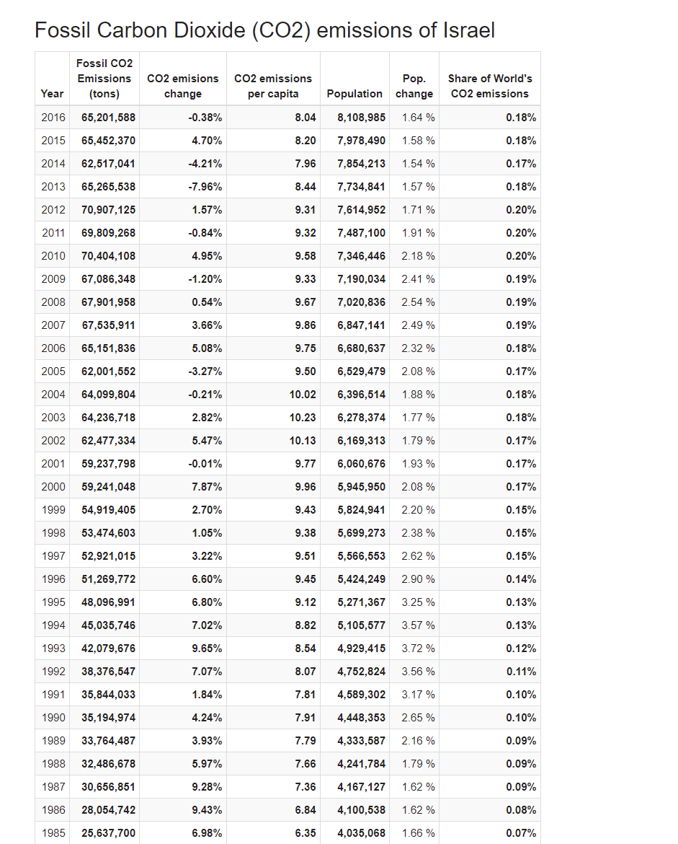
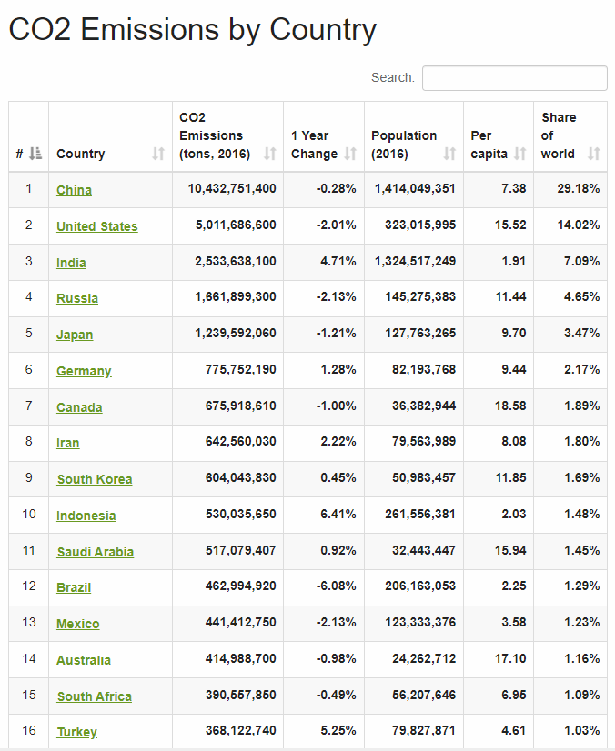
Crawling
We wanted to see how the CO2 affects on global warming.
We gathered information about CO2 Fossil around the world by going through each country and it Fossil, summarizing all the data into one average global CO2 fossil.

Slide 6

Data cleaning process
Matching each data into same years
Fixing broken CSV
Removing unnecessary data
Change type column
Merging data into one data frame

Slide 7
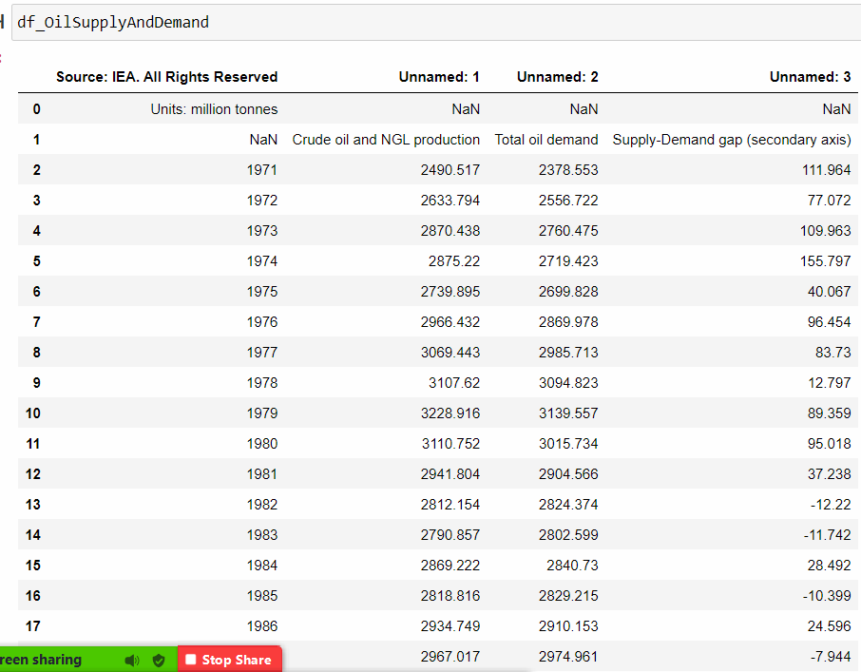
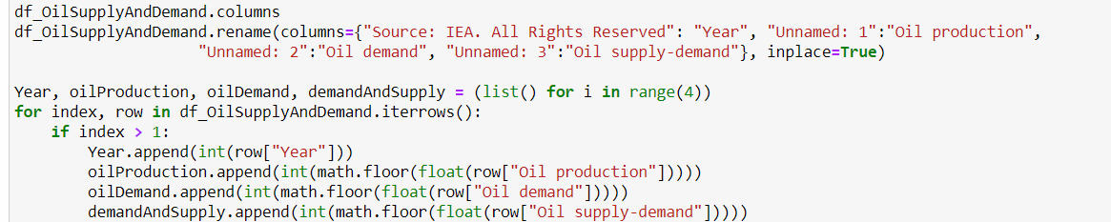
Data cleaning
Data obtained came broken with columns inside the CSV file
We had to observe and fix it in order to use it
The columns were found at index 1, while the entire data itself starts from index 2

Slide 8
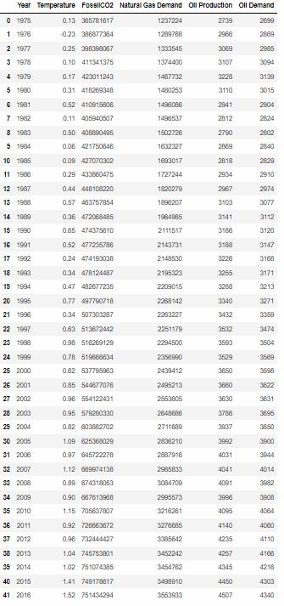

Data cleaning - Merging
The information came from various sources. Most of the data about Global Warming is completed, but in addition, the data itself starts not so long ago, only 4 decades behind, we used most of what we could get.

Slide 9

EDA - visualization
Subplot
Scattering
Correlations

Slide 10
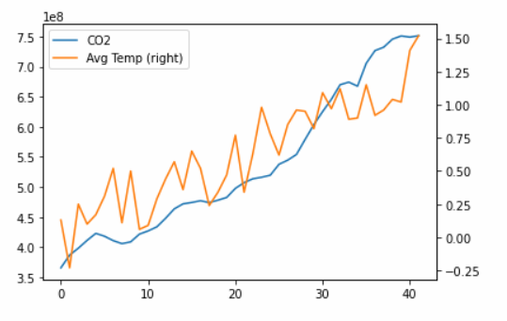
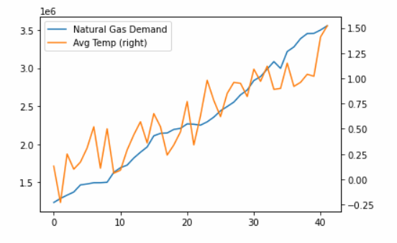
EDA - subplot
Temperature v CO2 Fossil
Temperature v Natural Gas Demand

Slide 11
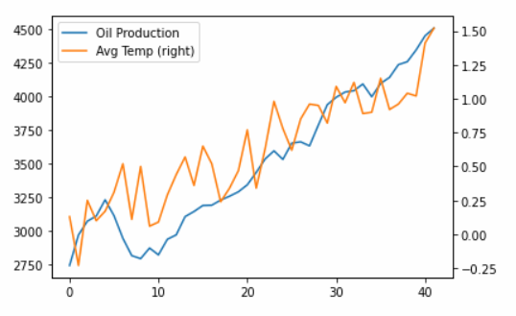
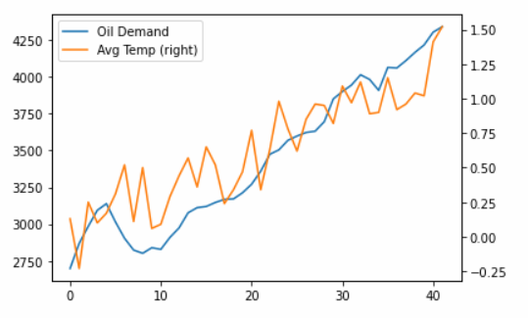
EDA - subplot
Temperature v Oil Production
Temperature v Oil Demand

Slide 12
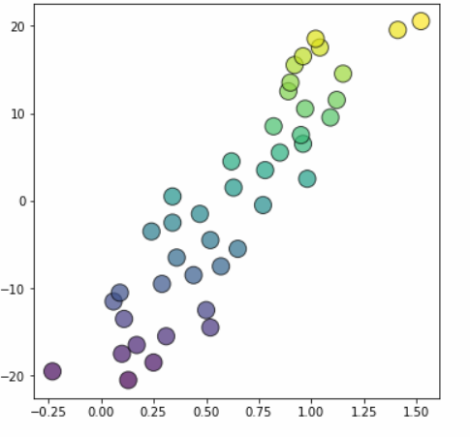
EDA - scattering
What does the graph contain?
X= Causes of Global Warming as scaled and after PCA
Y= Temperature
Colors= Years, as the color gets brighter, years are more advanced
Conclusions
We can see there’s coleration between the causes to temperature which results the global warming problem, as the temperature rises, the causes also “rises”
According to the x-axis, and y-axis, the causes growth simultaneously

Slide 13

Machine learning
Using `sklearn` library and linear regression,
we were able to tweak the model that predicts
if the causes does makes “Global Warming”

Slide 14
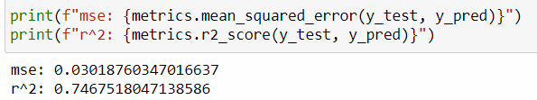
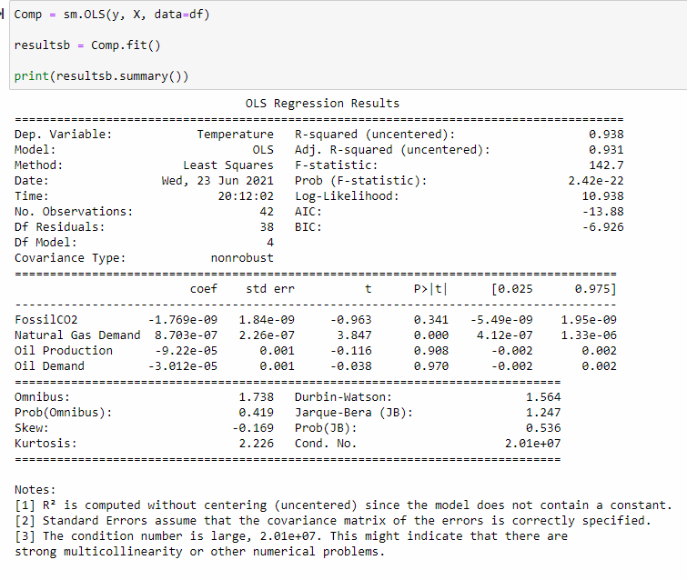
Machine learning - linear regression
The columns studied in the machine are: CO2 fossil, Natural Gas Demand, Oil Production, Oil Demand
There is an accuracy of almost 74%.
But when the OLS regression results were checked, we realized that there was an error and that the condition was too high, so we had to pinpoint the model.
Most of the data is limited by time, thus we tweeked the prediction as much as possible with current data

Slide 15
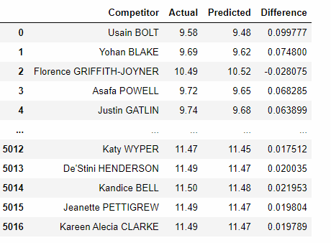
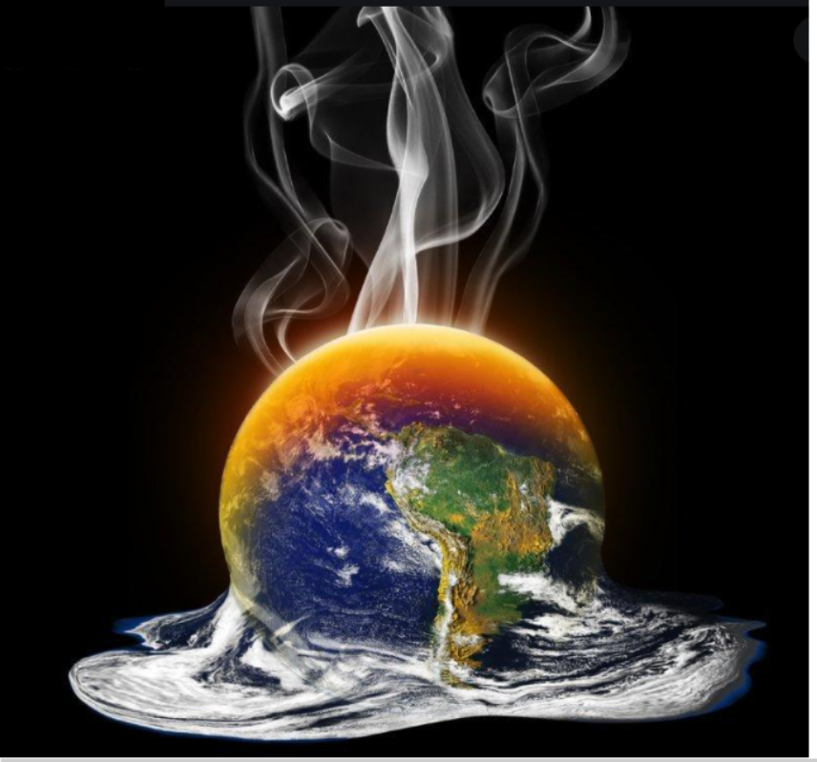
Machine learning - model’s result
In conclusion, we find that the causes does meet the Global Warming main problem, with enough data we can accomplish a good precision of what will come.
The more years, data and info we will gather, we can understand more about it effects.

