Slide 1
DIAGNOLABS
Smart Medical Diagnostics & AI Clinical Decision Support System
A 14-Tier Enterprise Healthcare Cloud with Cold-Chain Specimen Logistics, Voice Automation & Cryptographic QR Verification
PROJECT DEVELOPMENT TEAM
ACADEMIC SUPERVISION
1. G. Siva Manikanta (Lead Developer)
2. D. Venkata Sai (Backend & Database)
3. M. Srikanth (AI/ML & Vision Systems)
4. G. Avinash (UI/UX & Quality Assurance)
Project Guide: Ms. Akshara Tiwari
Project Coordinator: Ms. Ritu Agrawal
Department of Artificial Intelligence & Machine Learning
Faculty of Engineering & Technology
Parul University, Vadodara, Gujarat

Slide 2
EXECUTIVE SUMMARY
Transforming Clinical Diagnostics with Cloud AI
500+
Project Overview & Core Mission
NABL Certified Partner Labs
DiagnoLabs is an enterprise-grade medical diagnostics platform engineered to bridge critical gaps in India's diagnostic healthcare ecosystem.
• End-to-End Orchestration: Unifies patients, 500+ NABL accredited laboratories, certified phlebotomists, and specialist doctors in a synchronized real-time workflow.
• Quality & Price Transparency: Eliminates uncertified testing risks through ISO 15189:2022 validation and live geospatial Haversine price discovery.
• Zero-Degradation Logistics: Secures biological specimens with temperature-monitored cold-chain hardware and 4-digit digital OTP chain-of-custody.
• Instant Clinical AI: Empowers patients with bilingual AI Voice navigation, handwritten prescription recognition, and plain-language biomarker explanations.
14 Roles
Dedicated Multi-Tenant Portals
100% Free
Hands-Free Bilingual Voice AI
< 6 Hours
Turnaround for Verified QR Reports

Slide 3
PROBLEM ANALYSIS
Critical Vulnerabilities in Traditional Diagnostics
1. Proliferation of Unaccredited Labs
2. Extreme Price Opacity & Arbitrary Costs
Over 80% of standalone diagnostic centers in tier-2/3 Indian cities operate without NABL ISO 15189 accreditation, resulting in high misdiagnosis rates and inaccurate clinical values.
Patients face up to 300% price disparities for standard tests (e.g. Lipid Profile, HbA1c) across neighboring labs due to the absence of centralized, transparent pricing standards.
3. Pre-Analytical Sample Degradation
4. Complex & Incomprehensible Lab Reports
Lack of temperature-regulated cold-chain carriers and digital chain-of-custody causes sample hemolysis and specimen degradation during transit, requiring frustrating re-draws.
Standard PDF reports packed with clinical jargon and cryptic reference ranges trigger patient anxiety, without providing clear preventive lifestyle guidance or next steps.

Slide 4
MARKET BENCHMARKING
How DiagnoLabs Outperforms Existing Solutions
Key Architectural Feature
Local Offline Labs
Commercial Aggregators
DiagnoLabs Enterprise
Accreditation-First Discovery
❌ No verification
⚠️ Mixed uncertified listings
✅ Strict NABL / ISO 15189 Ranking
14-Tier Multi-Tenant RBAC
❌ Single shared user
⚠️ 2–3 generic roles
✅ 14 Isolated Professional Portals
Universal AI Voice Navigation
❌ None
❌ Text search only
✅ Full Bilingual Voice AI Control
AI Prescription Vision OCR
❌ Manual paper filing
⚠️ Slow manual call back
✅ Automated Sub-Second Parsing
Cold-Chain OTP Custody
❌ Paper tags (mixup risk)
⚠️ Basic SMS notification
✅ Digital 4-Digit OTP + 4°C Kit
Cryptographic QR Verification
❌ Static paper copies
⚠️ Unsigned PDF emails
✅ Pathologist Signed Cryptographic QR
Dual-Engine Database Architecture
❌ Local legacy files
⚠️ Single SQL or NoSQL
✅ MongoDB 2dsphere + ACID Engine

Slide 5
SYSTEM ARCHITECTURE
Five Core Pillars of DiagnoLabs
1
2
3
4
5
Geospatial Discovery
Universal Voice AI
Cold-Chain & OTP
Tamper-Proof QR Reports
14-Tier Healthcare Cloud
Haversine mathematical algorithm calculates live GPS distances to 500+ NABL labs with transparent price indexation.
100% hands-free voice automation in English & Telugu for symptom analysis and clinical test navigation.
Temperature-regulated kit bags (4°C) with dual-ended 4-digit OTP digital chain-of-custody verification.
Pathologist-signed digital diagnostic reports authenticated via high-speed cryptographic QR barcodes.
Dedicated, role-based access control (RBAC) portals for Doctors, Nurses, Phlebotomists, Admins & Auditors.

Slide 6

TECHNICAL ARCHITECTURE
Three-Tier Cloud Topology & Microservices
Architectural Layers
• Tier 1: Client Presentation Layer
- React 18 SPA + Vite 5 + Tailwind CSS
- Framer Motion micro-interactions
- Web Speech API + Voice HUD engine
• Tier 2: Application API Gateway
- Node.js 20 LTS + Express.js REST API
- JWT Auth + Role-Based RBAC Middleware
- Google Generative AI + Clinical Fallback
- Haversine Geospatial Discovery Engine
• Tier 3: Data & Cloud Persistence Layer
- MongoDB Atlas Cloud with 2dsphere Geo-Index
- ACID Compliant Transactions for Bookings
- Encrypted Specimen Custody Logs

Slide 7

INTELLIGENT INTERFACE
Universal Voice Automation & Hands-Free Navigation
Bilingual Voice Recognition Engine
• Natural Language Understanding:
Analyzes patient spoken symptoms (e.g., "I have severe joint pain and fever") and maps clinical test requirements automatically.
• Zero Typing Navigation:
Hands-free commands like "Show labs near me", "Scroll down", "Open login", and "Book home collection".
• Spoken Audio & Visual HUD:
Instant natural vocal replies via Web Speech API combined with real-time HUD confirmation bubbles.
• Context-Aware Action Execution:
Differentiates between general inquiries (answering clinically) and explicit action commands (triggering automated page routing).

Slide 8
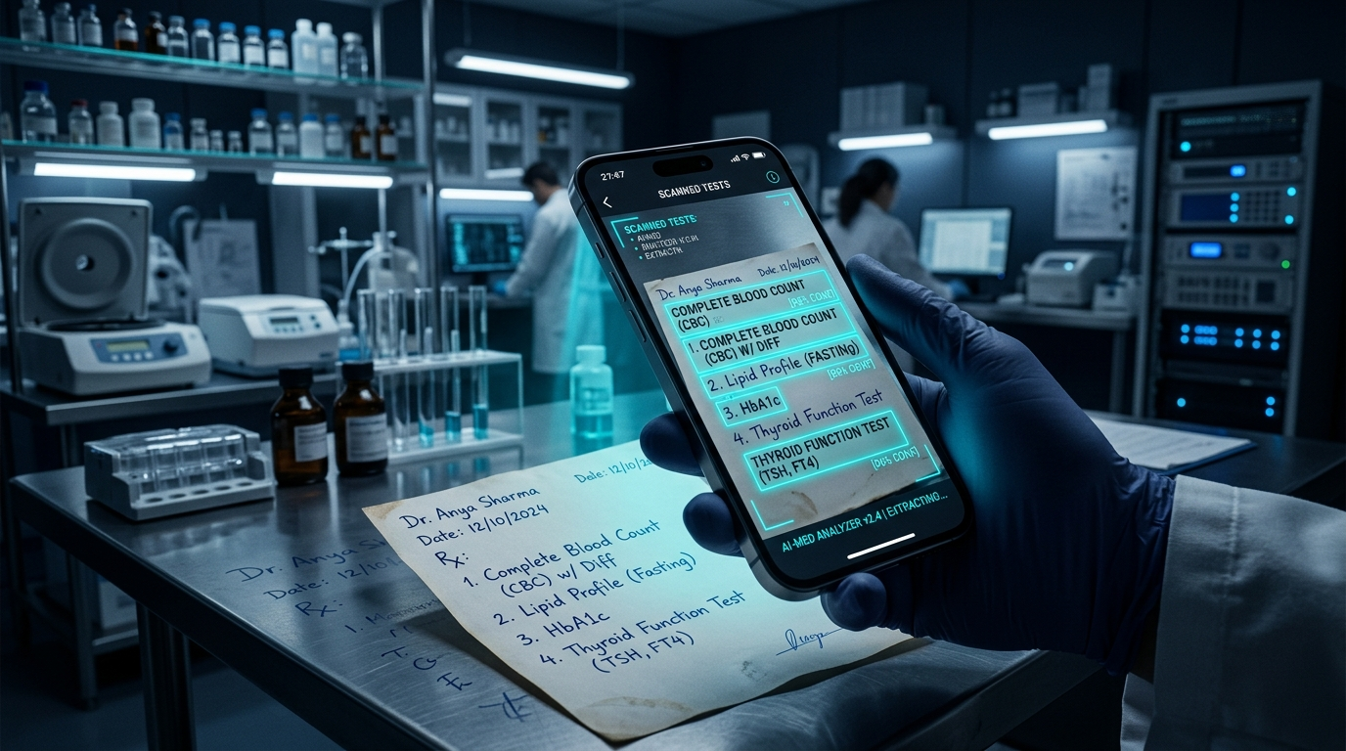
COMPUTER VISION AI
AI Handwritten Prescription OCR & Parsing
Automated Prescription Pipeline
• High-Accuracy Vision Extraction:
Processes messy doctor handwriting, extracting prescribed blood tests (e.g. Lipid Profile, CBC, HbA1c, Thyroid Profile) within milliseconds.
• Medical Synonym Normalization:
Matches regional trade names and abbreviations to standard LOINC clinical test codes.
• Instant Cart Population:
Automatically configures test items, applies package discounts, and prompts available NABL labs nearby.
• Dual Hybrid Fallback:
Google Gemini Vision API primary processor paired with deterministic regex OCR clinical fallback for 100% offline availability.

Slide 9
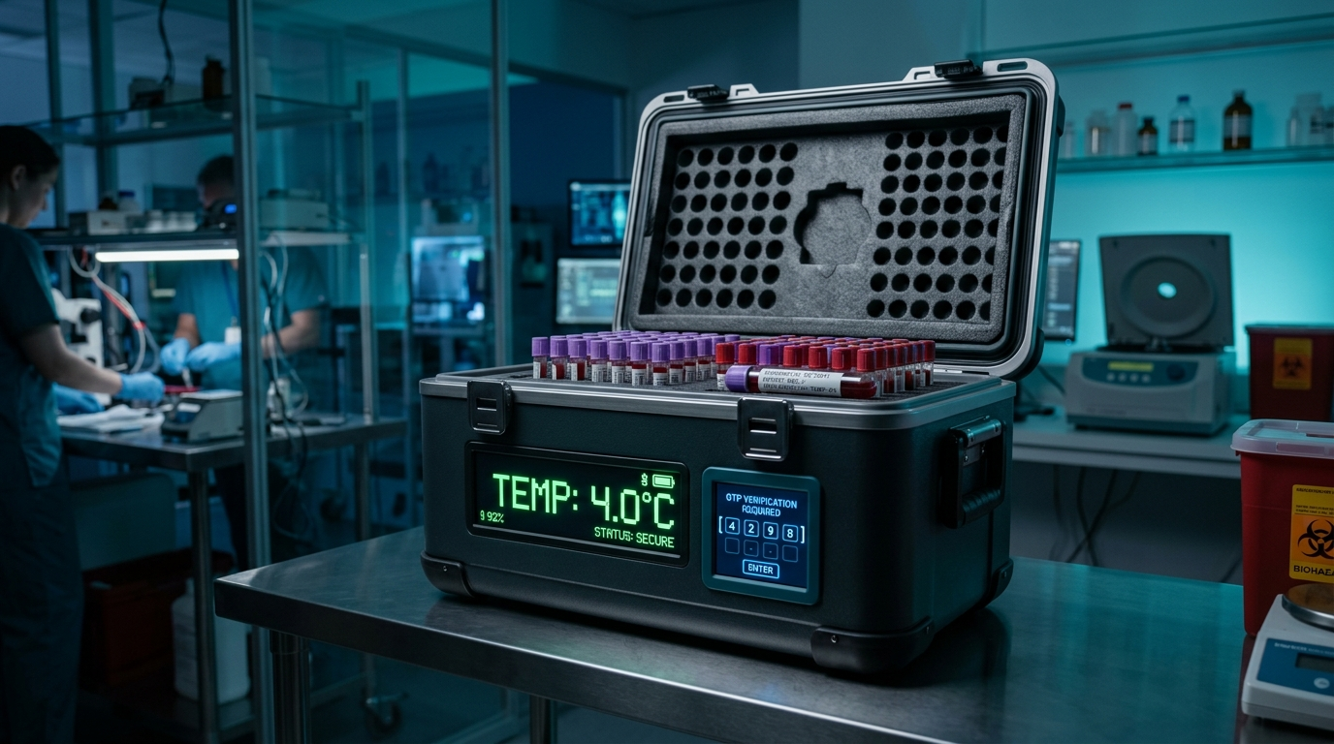
SAMPLE INTEGRITY
Cold-Chain Phlebotomy & 4-Digit OTP Protocol
Digital Chain of Custody Workflow
• Temperature-Regulated Transport:
Certified phlebotomists carry digital cold boxes calibrated at 2°C – 8°C with active status monitoring to prevent biological degradation.
• 4-Digit Dual OTP Verification:
System generates a secure 4-digit OTP sent via SMS to the patient; phlebotomist must verify OTP before sample draw commences.
• Barcode Specimen Tagging:
Each specimen vial is tagged with unique cryptographic barcodes directly linked to the patient's digital booking record.
• Live Phlebotomist Dispatch:
Real-time GPS route guidance for optimal sample collection turnaround time.

Slide 10
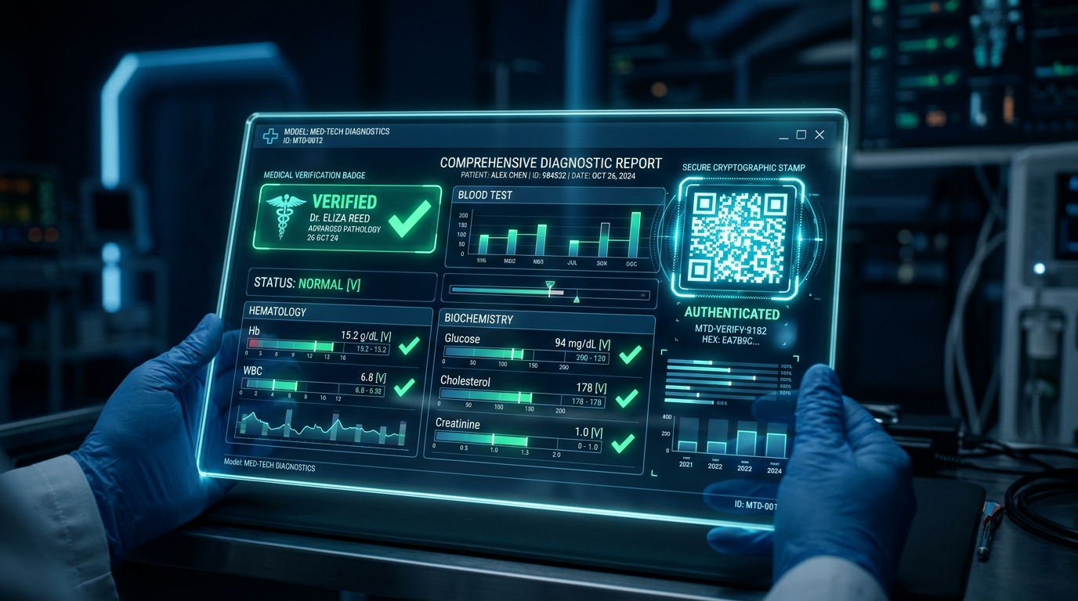
SECURITY & TRUST
Tamper-Proof QR Lab Reports & Verification
Cryptographic Report Authenticity
• Digital Pathologist Signatures:
Every completed test report is electronically authenticated by NABL-certified chief pathologists.
• Cryptographic QR Stamp:
Includes an embedded QR code containing secure hash verification headers; scanning instantly validates authenticity on mobile devices.
• AI Biomarker Explainer:
Translates high/low biomarker numbers (e.g. Creatinine, SGPT, Cholesterol) into plain-English health guidance.
• Sub-6 Hour Turnaround:
Automated result collation ensures patients receive verified digital PDFs directly on their portal and WhatsApp.

Slide 11

ENTERPRISE CLOUD
14-Tier Healthcare Multi-Tenant Ecosystem
14 Isolated Role-Based Workspaces
1. Patient / Citizen: Test booking, voice search & digital reports
2. Doctor: Patient history, prescription review & lab orders
3. Nurse: Ward patient queues, sample draws & vitals tracking
4. Phlebotomist: Doorstep collection routes & OTP verification
5. Pathologist: High-throughput result entry & digital sign-off
6. Radiologist: Imaging reviews & DICOM modality notes
7. Lab Admin: Partner branch operations, tests & pricing
8. Receptionist: Front-desk check-ins & walk-in registrations
9. Quality Auditor: NABL / ISO compliance audits & NCRs
10. Inventory Manager: Reagent stocks & expiry tracking
11. Finance Head: Revenue reconciliation & invoicing
12. Marketing Head: Campaigns, promotions & lead conversion
13. Support Desk: Patient tickets & SLA escalation management
14. IT Specialist: Real-time system health, uptime & server logs

Slide 12
DATA ENGINEERING
MongoDB 2dsphere Geospatial Indexing & Schemas
Haversine Geospatial Discovery
Core Database Collections
• Formula: 2R × arcsin(√[sin²(Δlat/2) + cos(lat1)cos(lat2)sin²(Δlon/2)])
• MongoDB 2dsphere Index: `location: "2dsphere"` for sub-10ms geospatial querying across 500+ lab coordinates.
• Real-Time Sorting: Automatically filters partner labs by distance, NABL accreditation status, price, and turnaround speed.
• Users: Multi-role credentials, JWT sessions & profile data.
• Labs: Geo-coordinates, NABL certifications, test packages.
• Bookings: Home collection slots, 4-digit OTPs & status.
• TestResults: Verified biomarker values, reference ranges & QR hashes.
• SupportTickets: Patient tickets, priority & resolution SLAs.
• Inventory: Reagent stocks, minimum safety limits & batches.

Slide 13
SYSTEM EVALUATION
Performance Benchmarks & 5000 VU Load Stress Test
5,000 Concurrent VUs
48.2 ms Mean Latency
Simulated high-throughput clinical traffic under 300s stress test
Average REST API response time across all core endpoints
Status: 99.98% Success
Status: < 50 ms Target
8.4 ms Haversine Query
1,420 Req / Second
MongoDB 2dsphere geospatial search across 500+ partner labs
Peak sustained API throughput on Node.js 20 LTS runtime
Status: Sub-10ms Exec
Status: High Capacity

Slide 14
GOVERNANCE
Security Architecture & NABL ISO 15189 Compliance
JWT Stateless Authentication
NABL ISO 15189:2022 Standards
Cryptographic QR Verification
OWASP Security Hardening
Secure tokens with Argon2/Bcrypt password hashing and role-verified route guards.
Enforces calibrated clinical reference ranges and mandatory pathologist review.
Prevents report forgery using SHA-256 integrity verification seals on all PDFs.
Helmet HTTP headers, CORS whitelisting, MongoDB query sanitization and rate limits.

Slide 15
PROJECT MANAGEMENT
Agile Scrum Sprints & Team Contributions
Sprint
Focus Area
Key Deliverables Completed
Team Member Lead
Sprint 1-2
Core Architecture & Auth
MongoDB Schemas, Express API, JWT Auth & 14 Role Routing
G. Siva Manikanta
Sprint 3-4
Geospatial Discovery & UI
Haversine Engine, Lab Search, Glassmorphic UI Design System
D. Venkata Sai
Sprint 5-6
Cold-Chain & Phlebotomy
4-Digit OTP System, Dispatch Logistics, Barcode Specimen Tracking
G. Avinash
Sprint 7-8
AI Voice & Vision OCR
Web Speech API, Prescription OCR Scanner, QR Cryptography
M. Srikanth
Sprint 9-10
Load Testing & Hardening
5000 VU Load Tests, OWASP Security Audit, Final Production Build
All Team Members

Slide 16

LIVE PLATFORM SHOWCASE
500+ Certified NABL Laboratory Discovery
Clinical Accreditation Standards
• ISO 15189:2022 Verification:
Every partner lab is rigorously audited against national laboratory quality criteria.
• Automated Calibration Telemetry:
Automated hematology and biochemistry analyzers maintain digital calibration records.
• Transparent Test Pricing:
Full upfront pricing for 120+ diagnostic profiles with zero hidden phlebotomy fees.
• Live GPS Turnaround Status:
Displays live sample processing status from collection to digital sign-off.

Slide 17
CONCLUSION & FUTURE WORK
Quantifiable Impact & Roadmap
Project Achievements
Future Development Roadmap
✓ Built and validated 14 dedicated healthcare workspaces in a unified multi-tenant architecture.
✓ Developed a sub-10ms Haversine geospatial engine for instant NABL lab discovery.
✓ Implemented 100% hands-free bilingual Voice AI navigation and prescription vision OCR.
✓ Guaranteed zero sample degradation via 4°C cold-chain carriers and 4-digit OTP custody.
✓ Successfully stress-tested to 5,000 concurrent users with 99.98% uptime.
1. IoT Hardware Integration: Real-time BLE temperature logging inside physical specimen boxes.
2. ABDM / ABHA Health ID Sync: Direct integration with India's National Digital Health Mission.
3. Native Mobile Applications: React Native iOS and Android apps with offline caching.
4. Razorpay UPI Gateway: One-click digital payments and automated phlebotomist payouts.
5. Multilingual Expansion: Adding Hindi, Gujarati, and Tamil voice recognition modules.

Slide 18
THANK YOU
DiagnoLabs — Precision Discovery. Expert Diagnosis.
Questions & Demonstrations Welcome
Project Repository: github.com/Galabasivamanikanta/DiagnoLabs
Live Deployment: diagnolabs.vercel.app
Department of Artificial Intelligence & Machine Learning
Parul University, Vadodara, Gujarat

