Slide 1
Brain Tumor Detector

Slide 2
Course Details & Team Members
Deep Learning
CSE-460
Md. Abdus Shohid Shakil
Mahfuz Ibne Syful
Id: 210303020005
Id: 210303020016
Semeter: 8th
Semeter: 8th
Session: Fall-21
Session: Fall-21

Slide 3
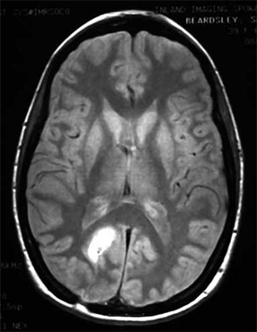
Problem Statement
Brain Tumor = Serious health issue.
Manual detection = time-consuming & error-prone.
MRI = Primary diagnostic tool.
Deep Learning can automate & support doctors.

Slide 4
Objectives
Automate MRI image classification.
Detect if tumor is present.
Predict tumor type: Pituitary, Glioma, Meningioma.
Use Transfer Learning (VGG16).

Slide 5
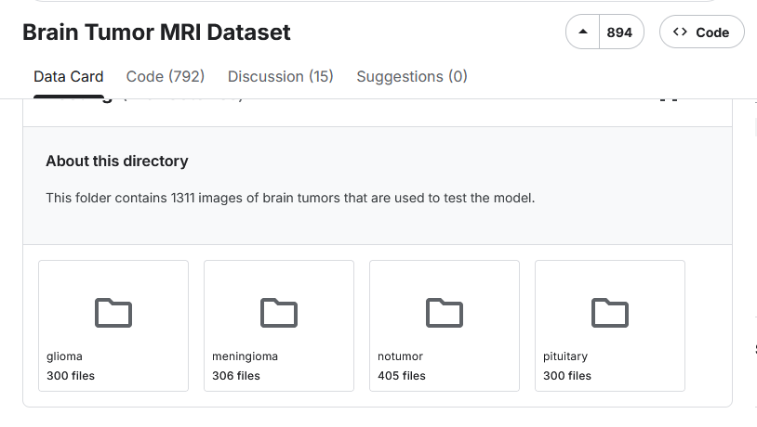
Dataset Details
Source: https://www.kaggle.com/datasets/masoudnickparvar/brain-tumor-mri-dataset

Slide 6
Model Architecture
Pre-trained VGG16 (Transfer Learning)
Input Image
VGG16
Flatten
Dense
Output

Slide 7
Training Setup
Optimizer: Adam
Loss: Sparse Categorical Crossentropy
Batch Size: 20
Epochs: 5
Data Generator: Augmented images during training

Slide 8
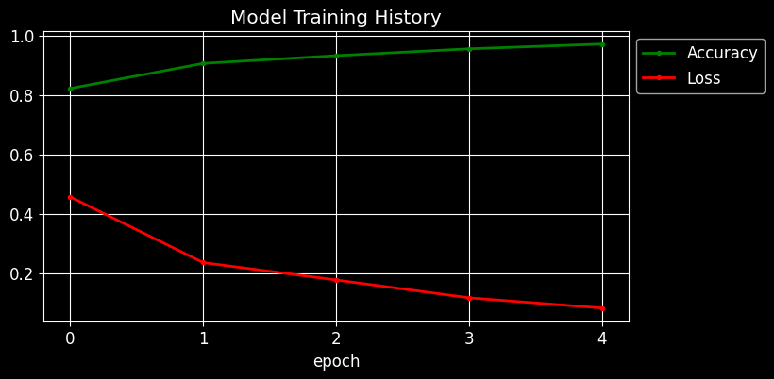
Training Results
Accuracy: ~97% on Train

Slide 9
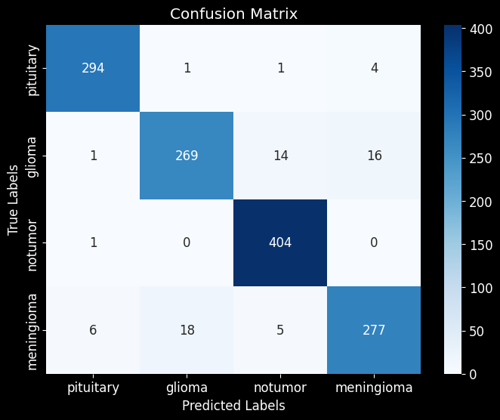
Test Results
Accuracy: ~95% on test

Slide 10
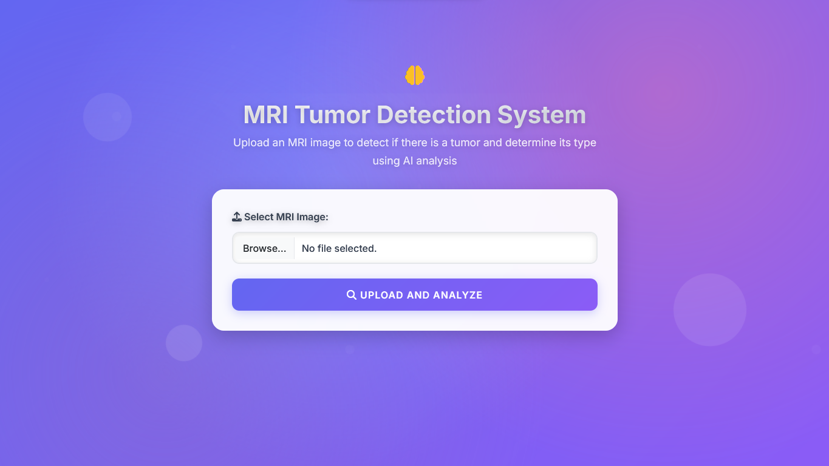
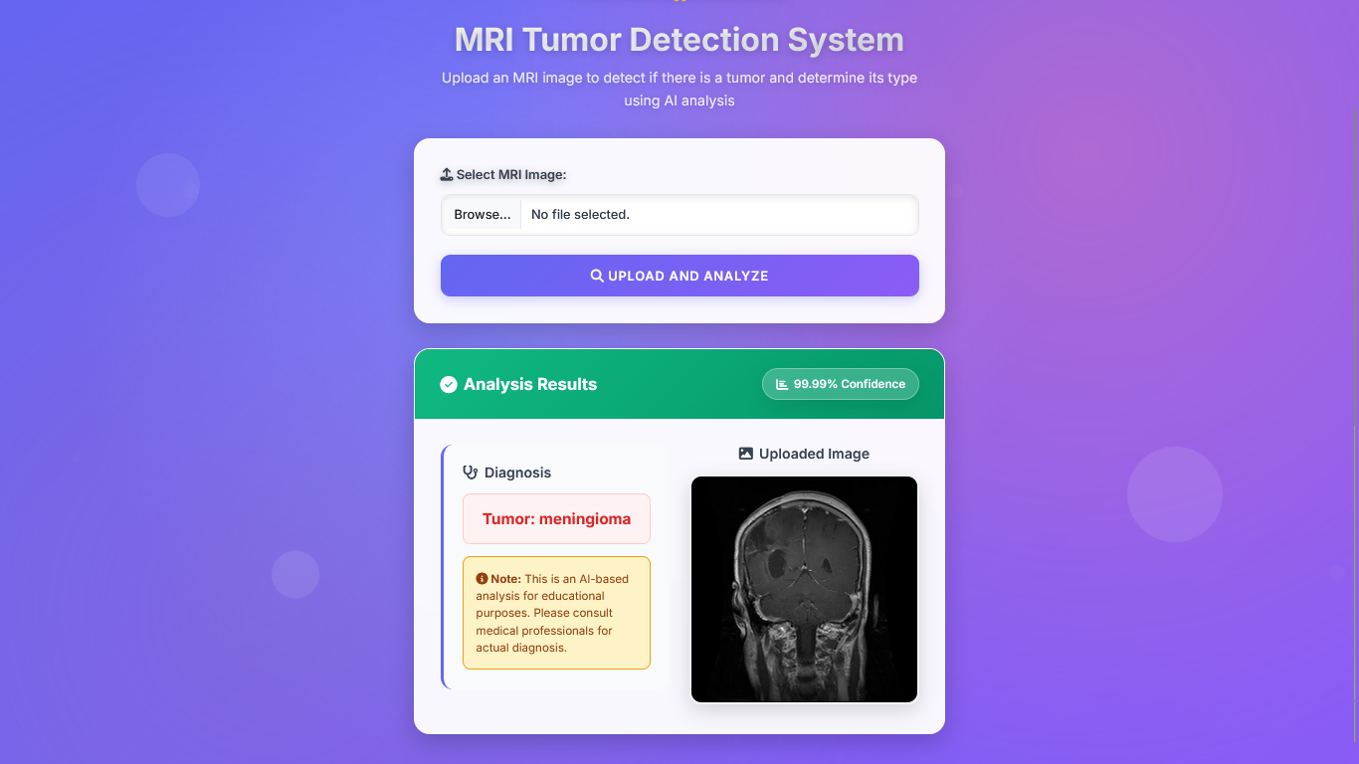
Preview

Slide 11
Conclusion
Achieved ~95% test accuracy.
Model supports early detection.
Used model in a web app.

Slide 12
Thank You

