Slide 1
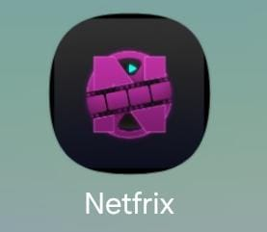

Slide 2
Team Member
Galal Magdy (Team Leader)
Ahmed Ashour
Ahmed Sokrat
Seif Emad
Faisal Mahmoud

Slide 3
Project Idea
An Android mobile application for browsing and exploring detailed movie information, similar to a movie database interface. The app allows users to explore, search, and view comprehensive movie details with a simple and user-friendly interface without streaming capabilities.

Slide 4
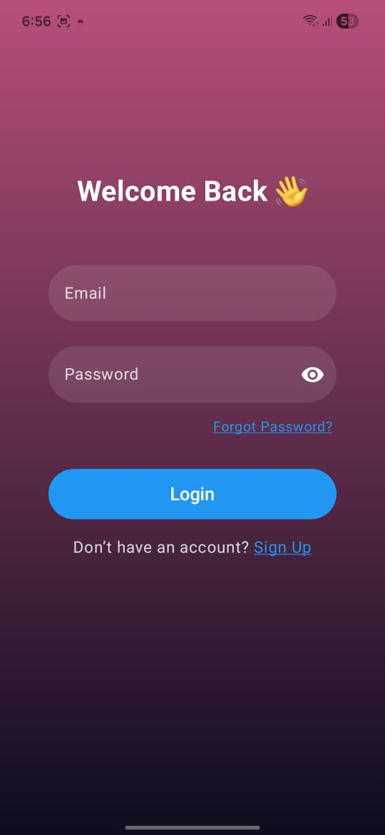
Login Screen UI
Purpose: Secure user authentication interface.
Inputs: Validates Email and Password credentials.
Features: Includes password visibility toggle and "Forgot Password" recovery flow.
Navigation: Direct link to the Sign-Up screen for new users.

Slide 5
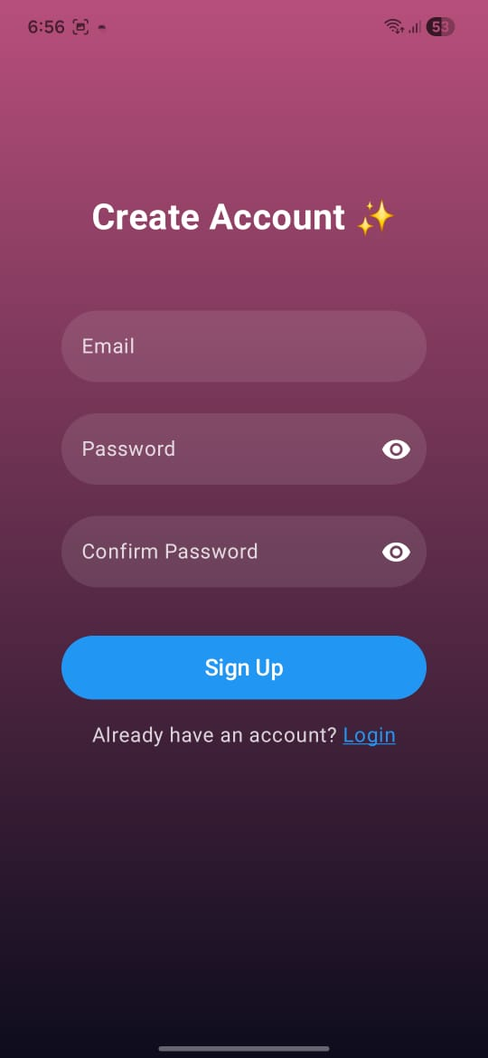
Sign-Up Screen UI
Purpose: Facilitates new user registration and account creation.
Inputs: Fields for Email, Password, and Password Confirmation.
Features: Includes "Confirm Password" validation with visibility toggles.
Navigation: Quick link to the Login screen for existing accounts.

Slide 6
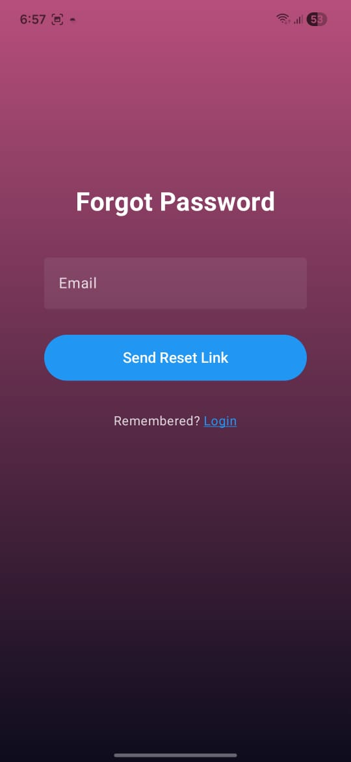
Forgot Password Screen UI
Purpose: Enables users to recover account access securely.
Inputs: Single field for entering the registered Email address.
Action: Triggers a password reset link sent to the user's email.
Navigation: "Remembered? Login" link to return to the sign-in page.

Slide 7
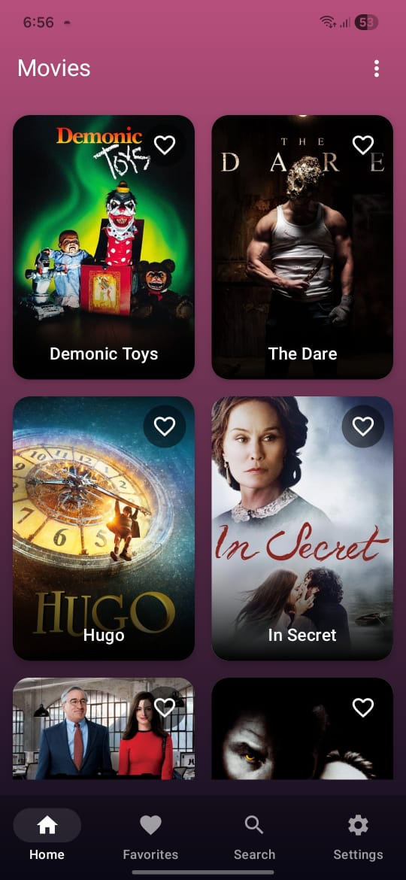
Home Screen UI
Purpose: Serves as the main dashboard for browsing the movie catalog.
Top Bar: Includes an options menu (⋮) allowing users to securely Logout.
Layout: Displays a visual grid of movie posters with quick "Favorite" toggle.
Navigation: Persistent bottom bar for access to Favorites, Search, and Settings.

Slide 8
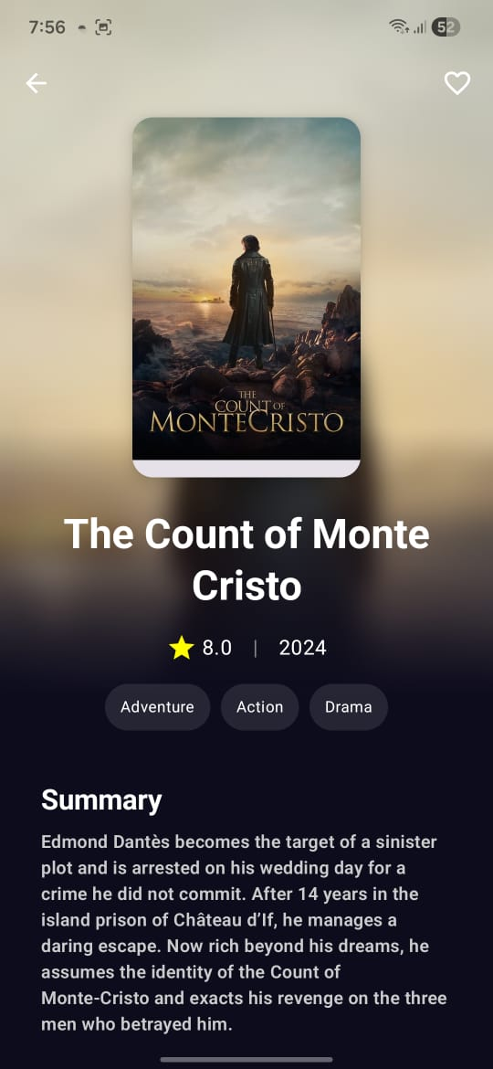
Movie Details Screen UI
Purpose: Displays comprehensive information about a specific movie.
Content: Features the movie poster, title, rating, release year, and genre tags.
Info: Presents a detailed "Summary" section describing the plot and storyline.
Actions: Includes a "Favorite" toggle (heart icon) and a back button for navigation.

Slide 9
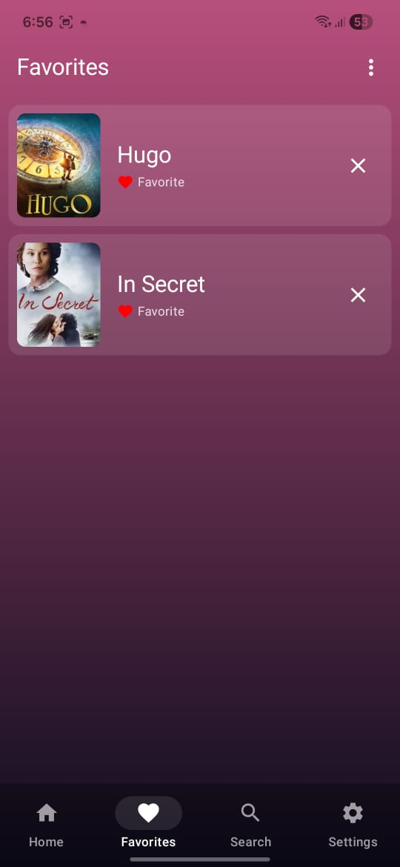
Favorites Screen UI
Purpose: Centralized hub for users to access and manage their saved movies.
Layout: Vertical list view displaying movie thumbnails, titles, and status.
Interactions: Allows users to easily remove items from the list using the "X" button.
Navigation: Directly accessible via the persistent bottom navigation bar.

Slide 10
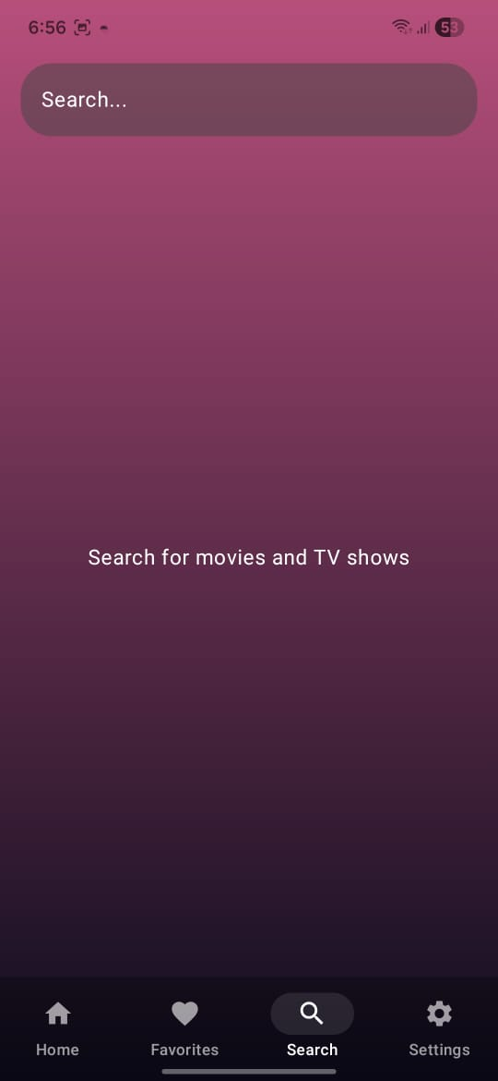
Search Screen UI
Purpose: Enables users to discover specific movies and TV shows from the catalog.
Input: Features a prominent top search bar for entering keywords or titles.
State: Displays a clear placeholder message to guide user interaction when empty.
Navigation: Accessible instantly via the "Search" tab in the bottom navigation bar.

Slide 11
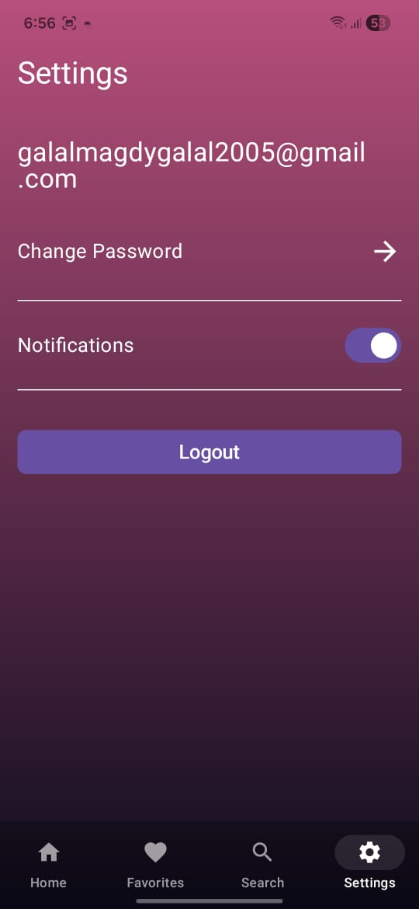
Settings Screen UI
Purpose: Central hub for managing account preferences and session.
Profile: Displays the currently logged-in user's email address for verification.
Security: "Change Password" option triggers a secure reset link sent directly to the user's email.
Preferences: Includes a toggle switch to easily enable or disable app notifications.
Session: Prominent "Logout" button allows users to safely sign out of the application.

Slide 12
Thank You

